Slide 1
MobileViT-Based Traffic Analysis
for Digital Twin Optimization
Interim Presentation #2 — First Runs
Andreas Demosthenous & Marios Olymbios
EPL 445 – Digital Video Processing | University of Cyprus | April 23, 2026
EPL 445 – Digital Video Processing | University of Cyprus, Spring 2026 | Slide 1/8

Slide 2
Agenda
1. Project Recap & Goals
2. Dataset & Training Setup
3. Performance Metrics (Test Set)
4. Training Curves & Visualizations
5. Video Inference Pipeline
6. Next Steps — Final Presentation (25 May 2026)
EPL 445 – Digital Video Processing | University of Cyprus, Spring 2026 | Slide 2/8

Slide 3
Project Recap & Interim 2 Goals
Topic: Mobile Video Processing & Analysis (EPL 445, Topic #1)
Scientific Goal:
Intelligent auto-interpretation of traffic video to support city Digital Twin systems via vehicle detection and density estimation.
Interim 2 Objective:
FIRST RUNS — demonstrate a working, end-to-end pipeline using lightweight models on video frames; verify all metrics on a held-out test set.
Why MobileViT?:
Light-weight Vision Transformer (ICLR 2022). Balances accuracy and efficiency — designed for mobile/edge deployment.
Methodological Rigour:
We identified and corrected a sequence-level data-leakage issue, retrained on clean splits — results below are honest.
EPL 445 – Digital Video Processing | University of Cyprus, Spring 2026 | Slide 3/8

Slide 4
Dataset & Training Setup
Dataset: UA-DETRAC
Training Strategy
Source: Wen et al., 2020 — urban surveillance
Staged Fine-Tuning (15 epochs)
4 classes: car | bus | truck | background
Epochs 1–3: Backbone frozen
100 video sequences total
Only classifier head trains (lr = 3e-4)
Sequence-level split (no leakage)
Epochs 4–15: Full model unfrozen
Train — 69 sequences, 6,827 patches
End-to-end fine-tuning (lr = 3e-5)
Val — 15 sequences, 928 patches
Test — 16 sequences, 2,614 patches
Optimizer: AdamW | Scheduler: CosineAnnealingLR
Crops < 64 px filtered to avoid upscale artefacts
Loss: Class-weighted Cross-Entropy
Image size: 256 × 256 input
Hardware: AMD Radeon 780M (ROCm 7.2) | bs=4
Augmentation: random flip, rotation, colour jitter
Best checkpoint chosen by val macro-F1
Best val macro-F1: 94.04%
EPL 445 – Digital Video Processing | University of Cyprus, Spring 2026 | Slide 4/8

Slide 5
Performance Metrics — Test Set (n = 2,614)
Metrics on held-out, sequence-level test set as required by Interim #2 brief
Accuracy
Macro F1-Score
Macro Precision
Macro Recall
Macro AUC
96.44%
95.90%
95.69%
96.15%
99.59%
Per-Class Results (Test Set)
Class
Precision
Recall / Sensitivity
Specificity
F1-Score
Support
Car
96.04%
92.92%
99.20%
94.45%
438
Bus
99.16%
97.45%
99.39%
98.30%
1,136
Truck
93.69%
96.26%
97.71%
94.96%
695
Background
93.86%
97.97%
99.03%
95.87%
345
EPL 445 – Digital Video Processing | University of Cyprus, Spring 2026 | Slide 5/8

Slide 6
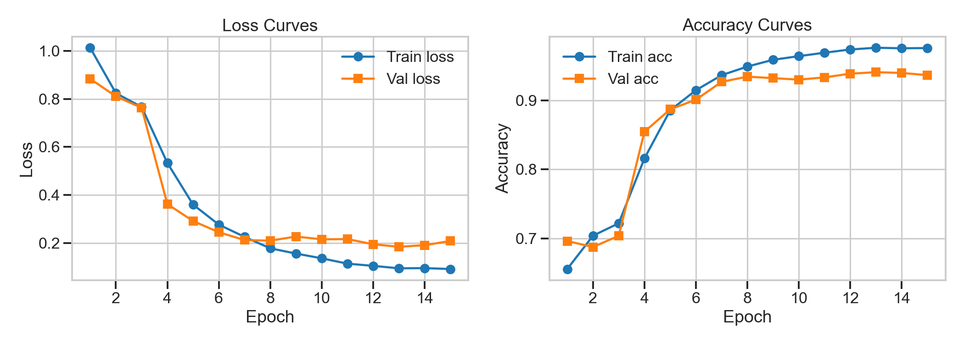
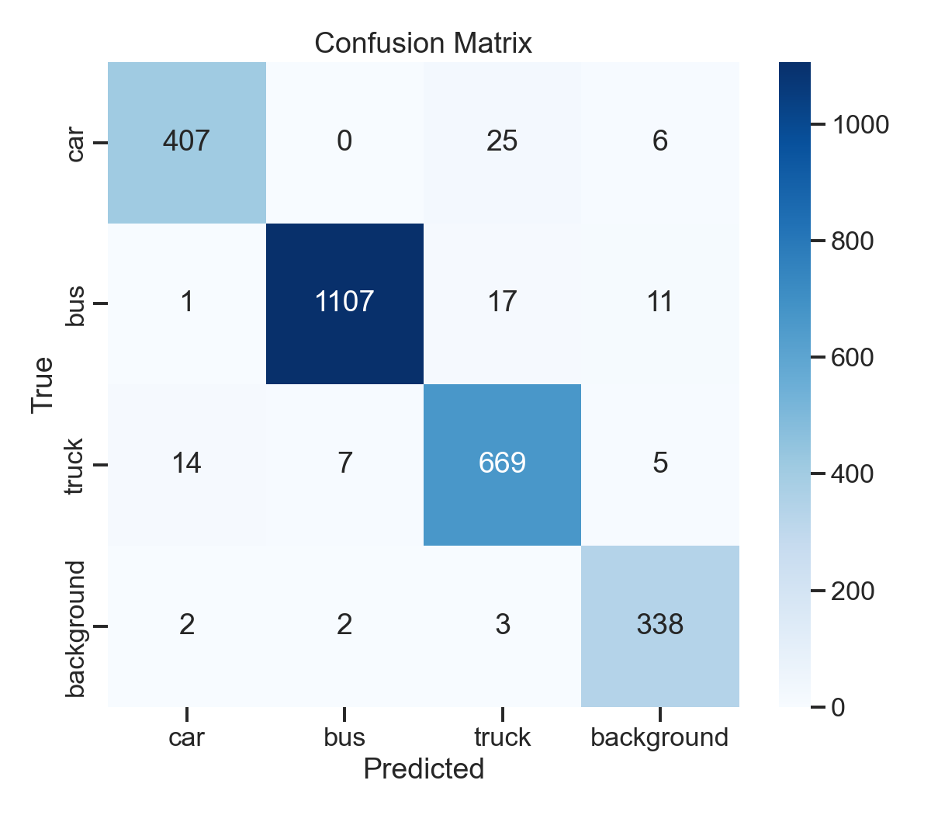
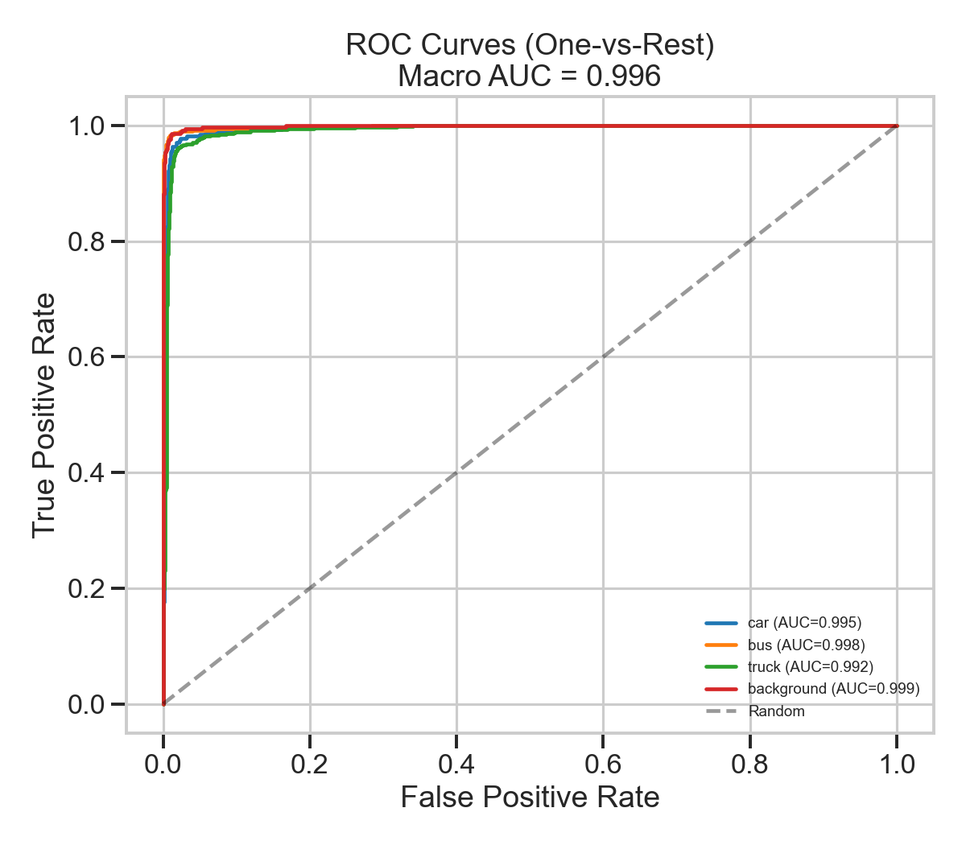
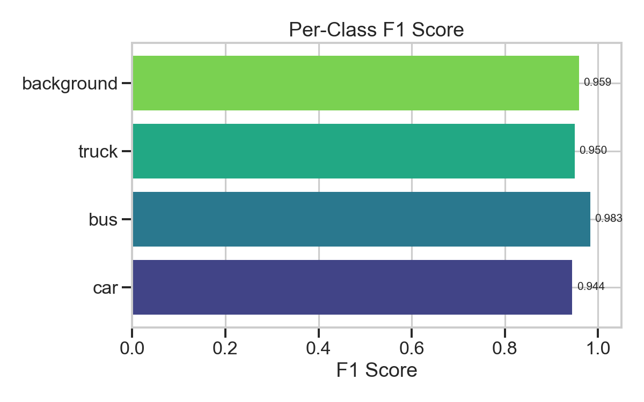
Training Curves & Performance Visualizations
Training Curves
Confusion Matrix
ROC Curves
Per-Class F1 Score
EPL 445 – Digital Video Processing | University of Cyprus, Spring 2026 | Slide 6/8

Slide 7
Video Inference Pipeline
Challenge: MobileViT is a patch classifier (trained on cropped objects). Applied directly to full-resolution frames it has poor localisation.
1. Frame Extraction
Video decoded frame-by-frame using OpenCV (with frame_skip).
2. Multi-Scale Sliding Window
Windows of 3 sizes (120, 180, 256 px) stride across each frame; each patch resized to 256×256 for MobileViT.
3. Non-Maximum Suppression
Per-class NMS at IoU 0.3, retaining the highest-confidence detection.
4. Aggregation & Output
Per-frame class counts → CSV. Aggregated totals → JSON. Annotated bounding boxes → MP4.
Working video demo with per-frame density estimates | Phase 3: replace sliding window with YOLOv8-nano
EPL 445 – Digital Video Processing | University of Cyprus, Spring 2026 | Slide 7/8

Slide 8
Next Steps — Final Presentation (25 May 2026)
Detection Upgrade:
Replace sliding-window with YOLOv8-nano for box proposals; pass each crop to MobileViT classifier. Expected >10× speed-up.
Tracking Engine:
SORT / ByteTrack to assign persistent IDs across frames; eliminates double-counting for time-series occupancy.
Web Dashboard:
FastAPI / Streamlit: upload video, view live counts, ROI lane counting, density heat-maps.
Real-Time Support:
RTSP stream ingestion for live camera integration; target latency <200 ms/frame on GPU.
EPL 445 – Digital Video Processing | University of Cyprus, Spring 2026 | Slide 8/8

