Slide 1

Apache Airflow
Airflow is a platform created by the community to programmatically author, schedule and monitor workflows.

Slide 2
What is a Airflow
A sequence of tasks
Started on a schedule or triggered by an event
Frequently used to handle big data processing pipelines

Slide 3
A typical workflows
Download data from source
Send data somewhere else to process
Monitor when the process is completed
Get the result and generate the report
Send the report out by Email

Slide 4
Running Airflow in Docker
May help CMAD to improve current situation
This is the fastest way to start Airflow 1.10.
https://airflow.apache.org/docs/apache-airflow/stable/start/docker.html
Note: SQLite is used in Airflow tests. Do not use it in production. We recommend using the latest stable version of SQLite for local development.
https://airflow.apache.org/docs/apache-airflow/stable/installation.html

Slide 5
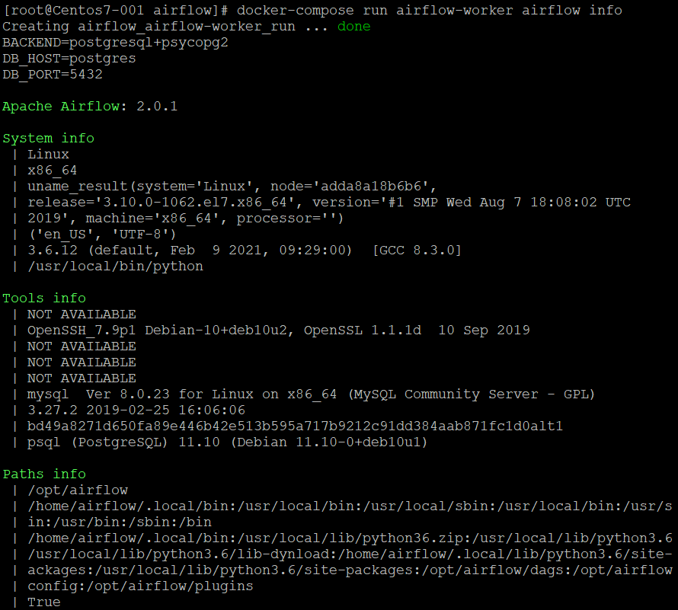
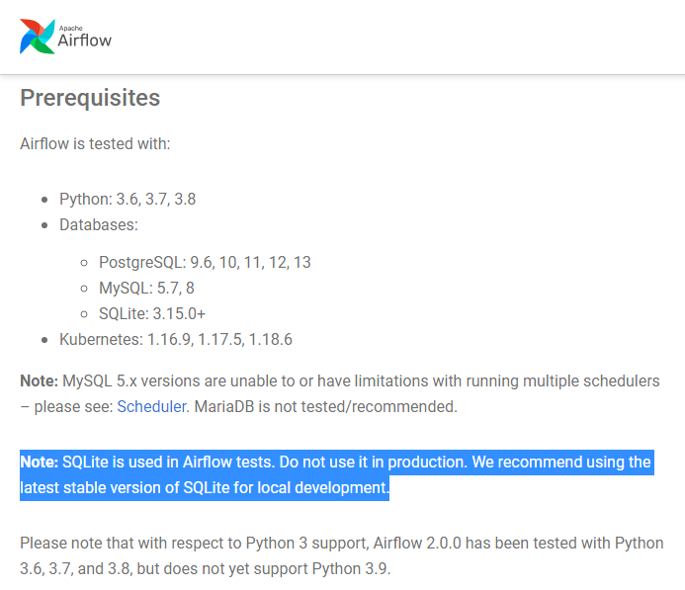

Slide 6
Important concepts
DAG: Workflows are called DAGs (Directed Acyclic Graph): No cycles, one direction.
Operator: DAGs do not perform any actual computation. Instead, Operators determine what actually gets done.
Task: Once an operator is instantiated, it is referred to as a ‘task’. An operator describes a single task in a workflow.

Slide 7
Some useful Operator
Sensors: a certain type of operator that will keep running until a certain criteria is met
HDFSSensor: Wait for a file or folder tp land in HDFS.
NameHivePartitionSensor: Check whether the most recent partition of a Hive table is available for downstream processing.
Operators: triggers a certain action
BashOperator: execute a bash command
PythonOperator: calls an arbitrary Python function
Transfers: moves date from one location to another.
MySqlToHiveTransfer: Moves date from MySQL to Hive
S3ToRedshiftTransfer: Load files from S3 to Redshift

Slide 8
Setup a good DAG
A DAG file, which is basically just a Python script, is a configuration file specifying the Dag’s structure as code
There are only 5 steps you need to remember to get a DAG or workflow
Step 1: Importing modules
Step 2: Default arguments
Step 3: Instantiate a DAG
Step 4: Tasks
Step 5: Setting up dependencies

Slide 9
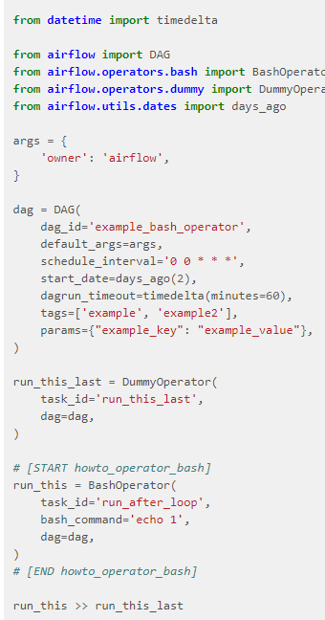
Step 1: Importing modules
Step 2: Default arguments
Step 3: Instantiate a DAG
Weird things happen:
It’s running at the wrong time!
Step 4: Tasks
Step 5: Setting up dependencies

Slide 10
Demo

