Slide 1
Calendar App
By: Andrew Sverdrup, Kolten Leffler, Nick DiPinto, and Robert Velarde

Slide 2
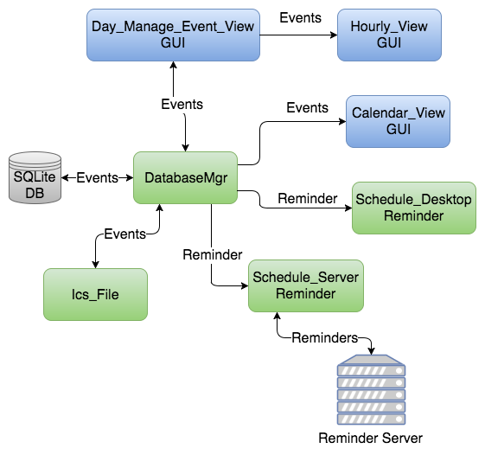
Design Overview

Slide 3
Prototype

Slide 4
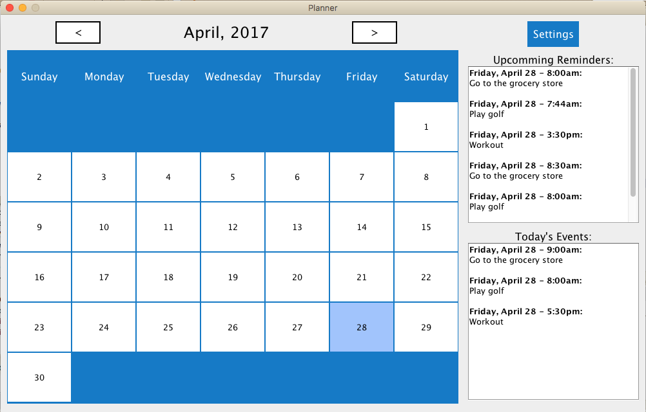

Slide 5
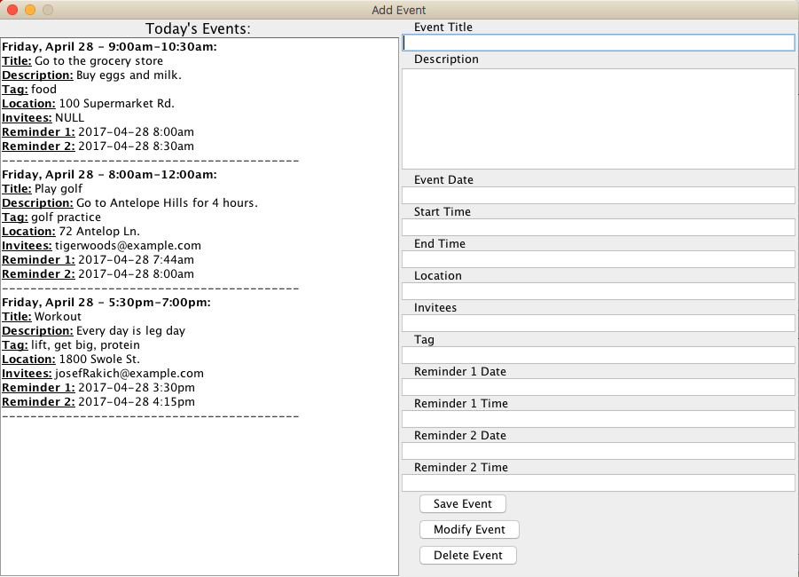

Slide 6
Requirements Overview
The application shall display dates in a monthly format.
The application shall display event information for an event upon user request.
Event information shall consist of an event title, start time (time and date), end time (time and date), and any additional notes about the event
The application shall add, remove, or edit an event upon user request.
The application shall send reminders to users concerning upcoming events using the following mediums:
email
SMS text message
OS notification

Slide 7
Acceptance Test Plan
Calendar View
This test will be performed by starting the calendar application and visually inspecting it to ensure the calendar is displayed correctly according to the requirements.

Slide 8
Acceptance Test Plan cont.
Events View
View Events - This test will be performed by writing a test script that simulates user selection of a date, and compares the event info that is retrieved from the database to the expected event info
Add Event - This test will be performed by writing a test script that simulates user selection of a date, and user input into the date form, and the user clicking the ‘save event` button , and then verify that the event is in the database and is displayed in the windows where it should be displayed
Delete Event - - This test will be performed by writing a test script that simulates user selection of a date, and the user selecting an event and clicking the ‘delete event` button, and then verify that the event is no longer in the database and that is is no longer displayed in any windows

Slide 9
System test plans
Events
This test will be performed by writing a test script to add an event various events to the database and verifying that the event can be located within the database.
This test will be performed by writing a test script to remove various events from the database and verifying that they have been removed.
ICS File
This test will be performed by writing a test script to import events from an ics file to the database and verifying that the events can be located within the database.
This test will be performed by writing a test script to export various events from the database to an ics file and verifying that the events have been correctly added to the ics file by visual inspection.

Slide 10
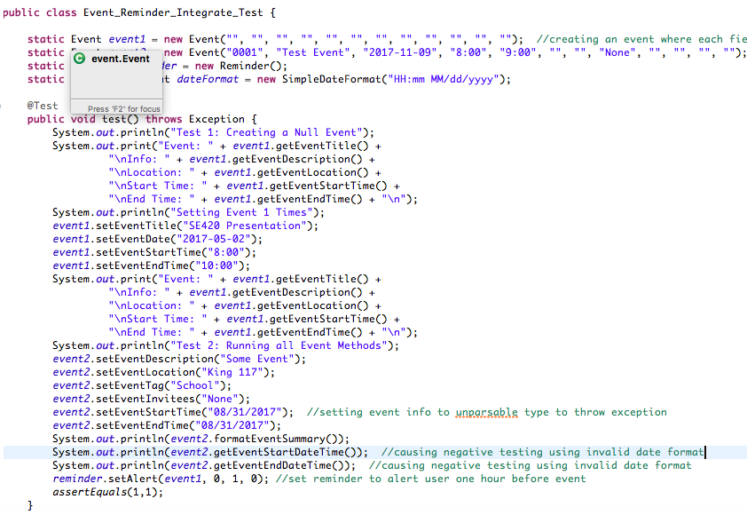
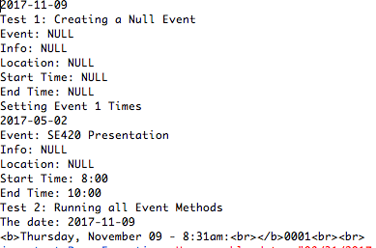
Integration and test plans
Examine behavior of integrated modules
Perform fault injection
Increase code coverage not covered during unit tests

Slide 11
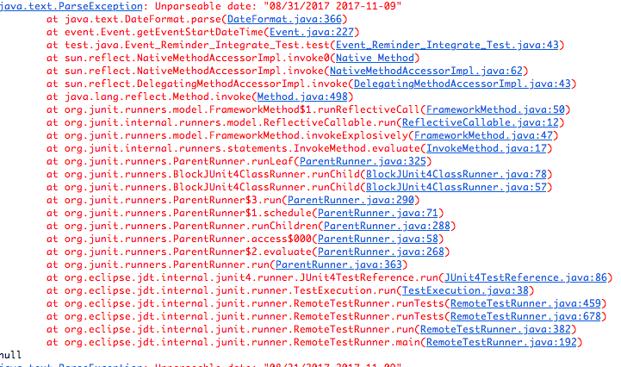
Stress, performance, soak, and negative test summary

Slide 12
Unit test drivers
19 Unit tests
All passing
Tests for
Add/Edit/Delete events
Time class
Retrieve Reminders
SQL Injection

Slide 13
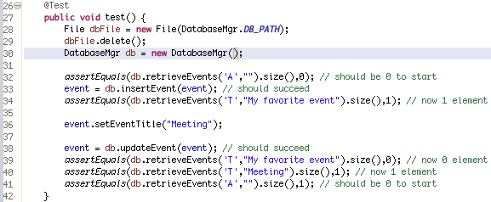
Edit event junit test

Slide 14
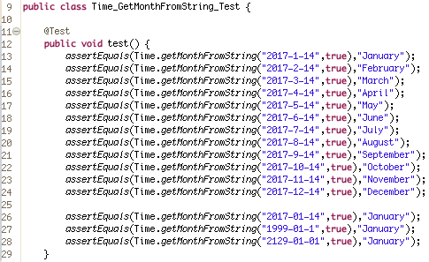
Junit test

Slide 15
SEI CMM PROCESS
CMM Level 3
GitHub used for CMVC and issue tracking
Metrics
Code coverage - codecov.io
Build History – Travis-CI
Bug open/close rates - GitHub
Error handling – Java Exceptions
Notes:
We’re not acutally at CMM level 3, we don’’t have our process well documented. But we felt that we achieved some of the goals of CMM level 3

Slide 16
Process/Workflow
1) Make changes
2) Run all unit tests locally
3) [tests passed] Commit locally
4) Push changes to GitHub repo
5) Automated: Commit triggers a Travis-CI build, which includes code compilation and running all unit tests.
If compilation error – Build fails and no unit tests are run
If failed unit tests – Build fails, but all tests still run and number of tests that passed/failed is shown
6) Automated: After successful build and all unit tests pass, code coverage report is generated and sent to codecov.io
Notes:
Ubuntu 12.04

Slide 17
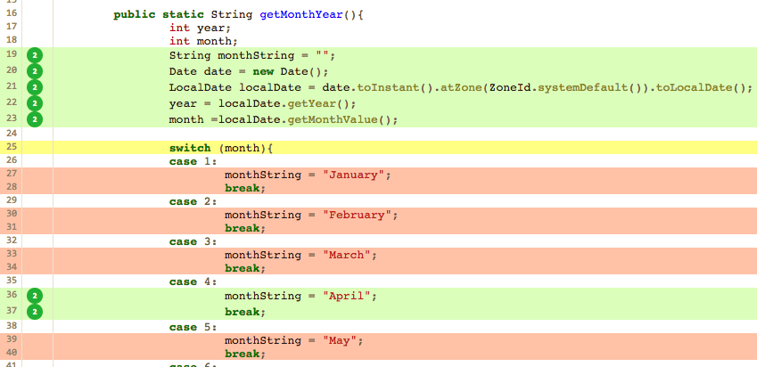
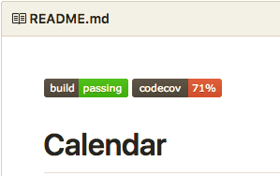
Code coverage – codecov.io

Slide 18
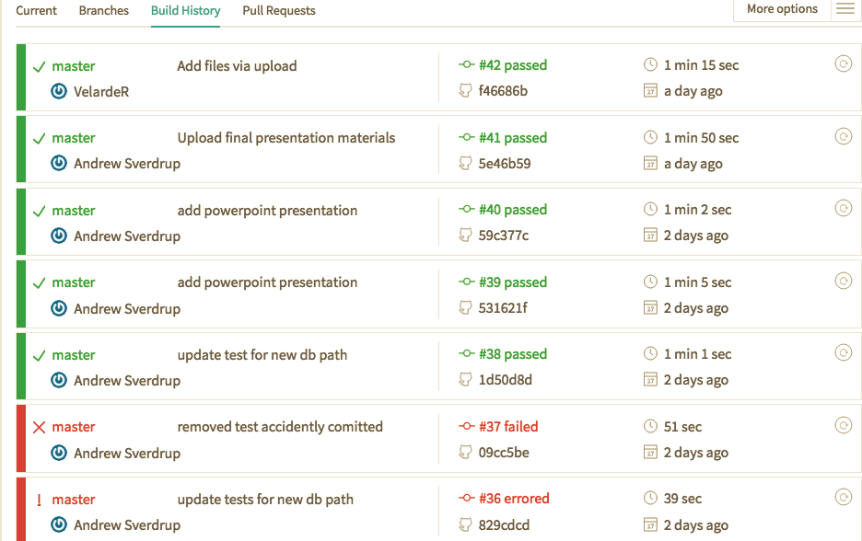
Regression test plans and automation – Travis-ci
Notes:
Run units tests on every commit. And additionally once per month automated

Slide 19
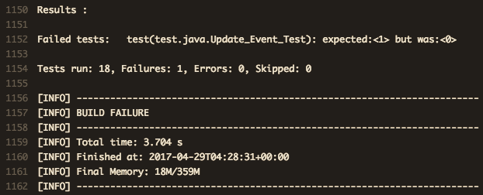
Travis-ci build log

Slide 20
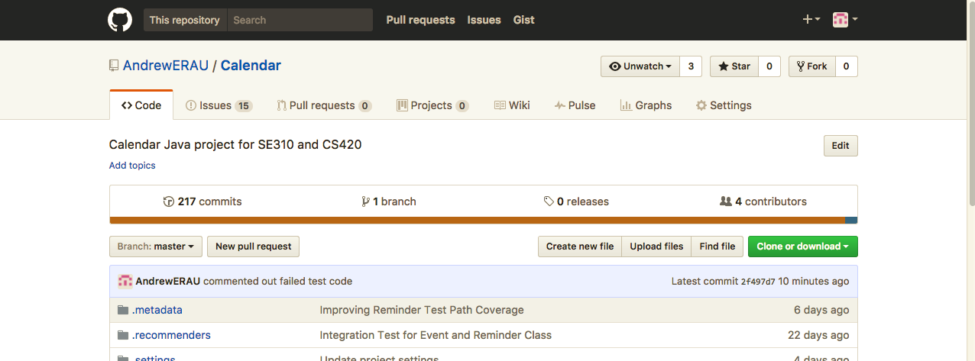
Use of CMVC and clear identification of versions of code and configuration tested
GitHub Repository URL: https://github.com/AndrewERAU/Calendar

Slide 21
Summary of final code readiness for shipping (quality assessment and release notes)
Calendar_View – Functional except for:
Viewing months other than the current month
Clicking the settings button
Day_Manage_Event_View – Functional except for:
Error handling and feedback to user not fully implemented
Cant modify or delete an event
Looks bad/messy
Send Desktop Reminders –
Code written for Mac, but not yet integrated because of complexity
Code not written for Windows or Linux reminders
Send Email and SMS Reminders From Server
Code written but not yet integrated due to complexity
ICS File support not fully implemented and tested

Slide 22
Issues overview
48 Total Issues
33 Issues closed
15 Issues remain open
Delay – 3 (#3, #44, #12)
Enhancements – 12 (#4, #6, #7, #11, #20, #22, #13, #16, #45 ,#46 , #47, #48)
Current issue list - https://github.com/AndrewERAU/Calendar/issues

Slide 23
Issues Status
ISSUE #3 – Error Handling for user input of event not fully implemented
ISSUE #4 – Enhancement: Use date pickers and make other customizations for ease of use for event input form
ISSUE #6, 7, 11, 20, 22 – ICS file import/export support not fully implemented
ISSUE #12 – Remove print statements from all modules
ISSUE #13 – Write more unit tests for event and reminder times
ISSUE #16 –Enhancement: Day_Mangage_Event_View screen needs UI improvements
ISSUE #44 – Cannot view a month other than the current month
ISSUE #45 – Integrate email and SMS reminders
ISSUE #46 – Integrate Mac desktop reminders
ISSUE #47 – Add support for Windows and Linux desktop reminders
ISSUE #48 – Function in time class should accept a date as a parameter
Notes:
3, 44, 12

Slide 24
Questions?

Slide 25
Backup Slides

Slide 26
More acceptance test plans
The application shall send reminders
Desktop Reminders: To test this, we will write a test driver that calls the desktop reminder function and provides the appropriate inputs. The script will then read the contents of the user’s crontab file to verify that the crontab has been successfully installed.
The jar file that sends the desktop reminders will be tested manually to ensure that running it causes a reminder to be displayed
Email and SMS Reminders: To test this, we will write test drivers that call the the email and SMS reminder functions to schedule a reminder. We will then manually check for the reminder at the specified email address or phone number

Slide 27
More Acceptance test plans
ICS File Export
To test the application’s functionality to export an .ics file, we will use a simple black box test. We will start by creating various events and add them to the calendar. The application will then be used to export the calendar to an .ics file. Once the .ics file has been created, we will pass it to a program that verifies iCS files are in the proper format to ensure it was exported correctly.

Slide 28
More Acceptance test plans
ICS File Import
To test the application’s functionality to import events from ICS files, we will use a black box test. We will start by generating a .ics file in the standard format. From there, we will use our application to import the .ics file. The events in the application will then be compared to the original to ensure that all of the data is intact.

Slide 29
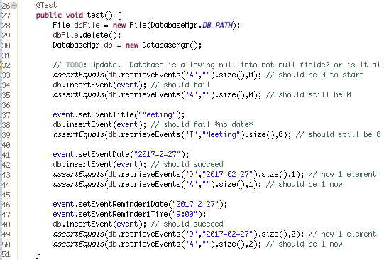
Add Event Junit test

Slide 30
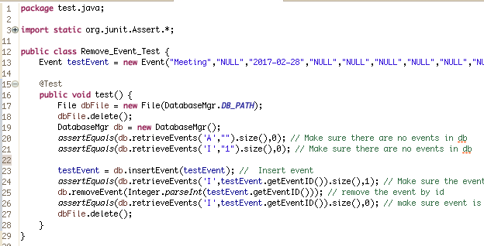
Remove Event Junit test

