Slide 1


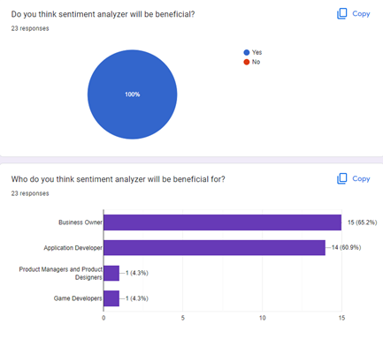
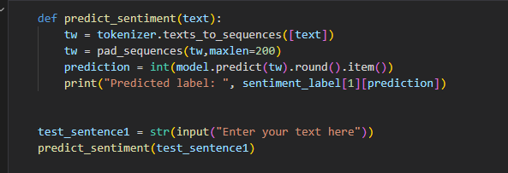
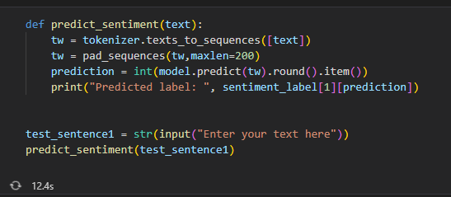
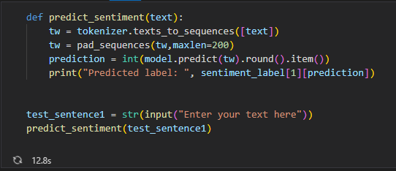
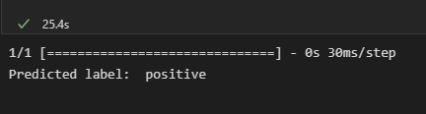

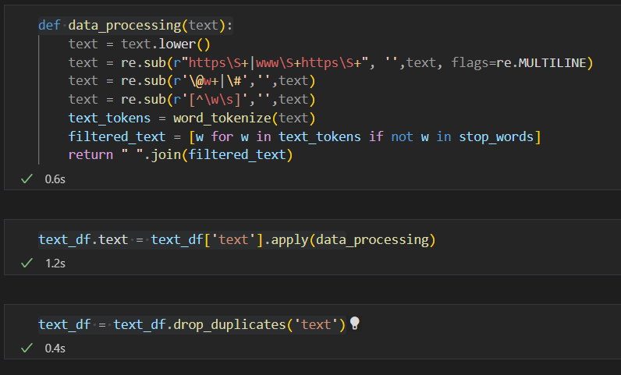
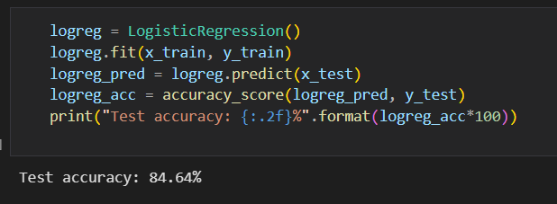
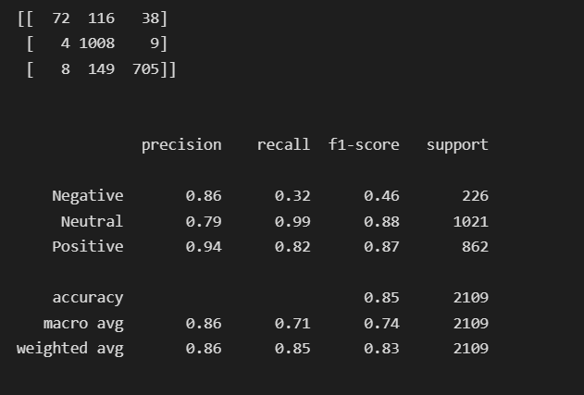
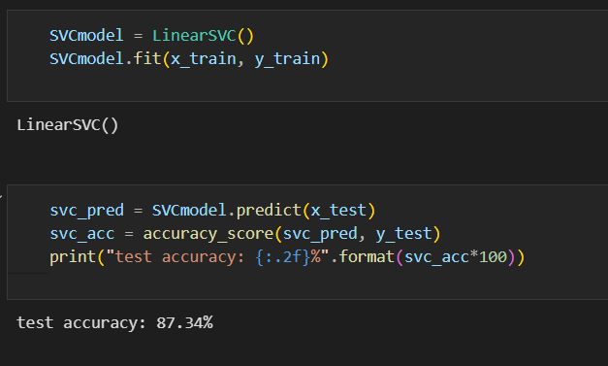
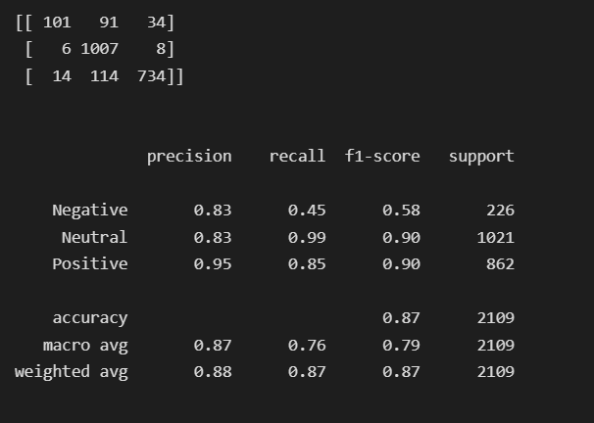



ECEN425-P2
Sentimental Analysis using Machine Learning
Andrew Effat – 19105700
Salma Khaled – 19100068
Machine Intelligence – Dr. Ghada Khoriba
Abstract
Methodology
Sentiment analysis is growing more and more popular among businesses that seek to determine the emotions of their clients because of technological breakthroughs in areas like deep learning. Businesses now classify words into positive, negative, and neutral categories using natural language processing, statistical analysis, and text analysis to determine the sentiment. The top businesses recognize how crucial it is to comprehend the feelings of their clients, including what they are saying, what they mean, and how they are saying it. When people mention your brand in comments, reviews, tweets, or other social media platforms, you may utilize sentiment analysis to determine how people feel about it. We have created a comprehensive guide to help you understand "what is sentiment analysis?" its tools, and its various categories and use cases since sentiment analysis is the field of utilizing software to interpret emotions.
STEP1: What is Sentiment Analysis?
We have mentioned about the benefits of sentiment analysis, but it was not mentioned what is actually sentiment analysis.
Analysis of the customer's positive or negative attitude in text is known as sentiment analysis. Businesses can monitor online chats to use contextual analysis of identifying information to better understand the social attitude of their customers.
STEP2: Types of Sentiment Analysis
a. Fire-grained:
Positive
Neutral
Negative
Very Negative
b. Emotion Detection
c. Aspect Based
d. Multi-lingual
Introduction
Sentiment analysis has developed into a potent tool for tracking and comprehending online dialogues as consumers share their opinions and thoughts about the brand more freely than ever before. You may discover what makes a customer happy or unhappy by automatically analyzing feedback and reviews from surveys or social media conversations. Additionally, you may utilize this information to customize your goods and services to match the needs of your clients and strengthen your brand. The effectiveness of sentiment analysis algorithms has risen because of recent developments in machine learning and deep learning. Innovative machine learning and advanced artificial intelligence techniques can be used to conduct research and produce analysis. For instance, sentiment analysis can assist you in automatically analyzing more than 5000 reviews of your business to determine whether your customers are pleased with your pricing strategies and level of customer support, or not. As a result, you may assert that there are countless applications for emotion.
STEP3: Importance of Sentiment Analysis
The most important benefit of sentiment analysis is that it makes it possible for you to comprehend how your clients feel about your brand. By automatically assessing the thoughts and sentiments of your customers through social media chats, reviews, polls, and more, you can enhance your goods and services and make better decisions. According to our survey, 23 people responded, and they all agree that sentiment analyzer is beneficial, and also, they suggested for whom is the analyser beneficial for.
Results/Discussion
The user enters any text of his own, the function first tokenizes the text to break it down to tokens, padding these tokens to have the same length. Finally we predict the sentiment of the input text , and the put is then displayed.
Method 1:
a. Positive Text: b. Negative Text:
STEP4: Implementation Steps
1) Data Preprocessing
2) Text Classifier
3) Model Training
4) Model Execution
a. Logistic Regression Mode:
Method 2:
References
[1] “Introduction to Sentiment Analysis: Concept, Working, and Application,” Maruti Techlabs, Oct. 08, 2021. https://marutitech.com/introduction-to-sentiment-analysis/
[2] “Sentiment Analysis using Python [with source code],” TechVidvan, Jun. 14, 2021. https://techvidvan.com/tutorials/python-sentiment-analysis/
b. Linear SVC Mode:
Conclusion
Members
Due to the development of technology, the era of gaining insightful data from surveys and social media has come to an end. As a result, it is now important for your company to be aware of how your clients are feeling. To maximize the potential of data and gain the most insightful understanding, businesses are utilizing sophisticated classifiers like sentiment analysis and contextual semantic search. Utilizing technologies for natural language processing, you may create business strategies, meet, or exceed customer expectations, generate leads, create marketing campaigns, and uncover new growth opportunities.

