Slide 1
Spiral arms at low frequencies
Andrew Fletcher
Newcastle University

Slide 2
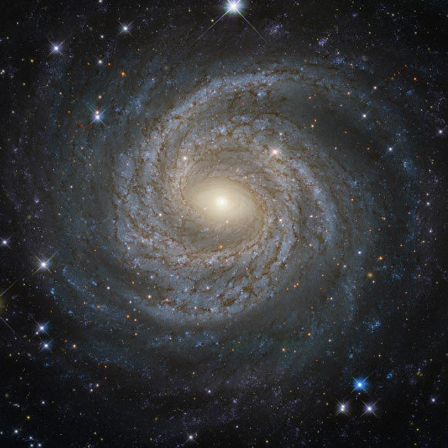
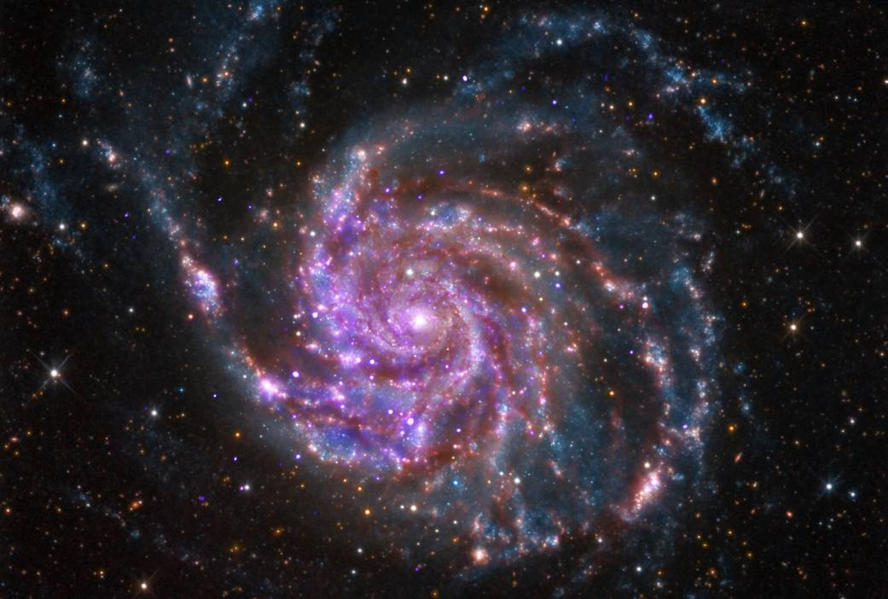
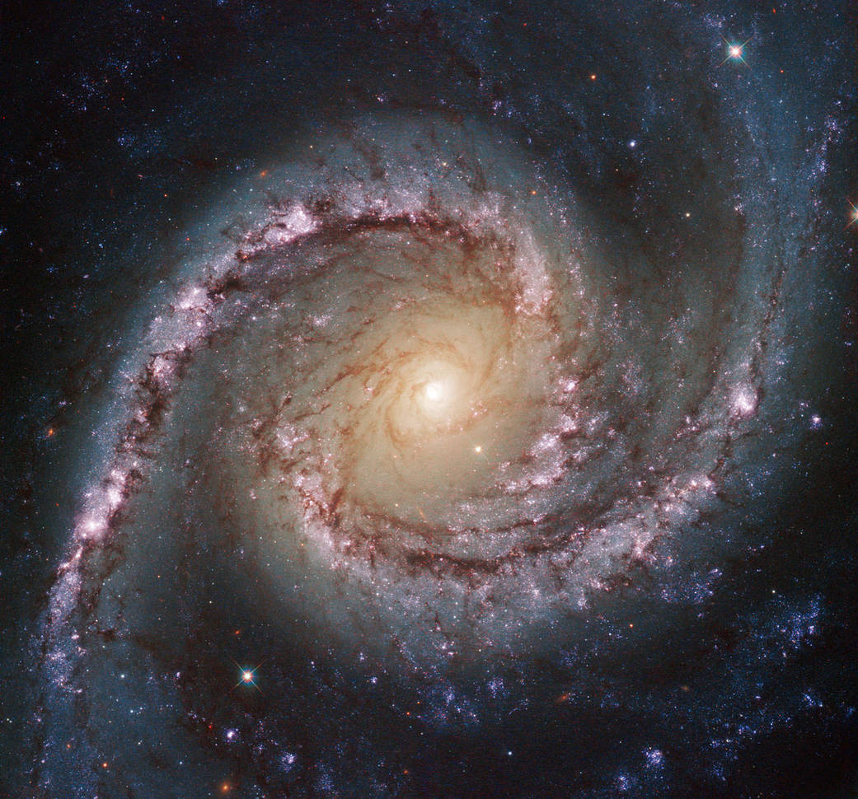
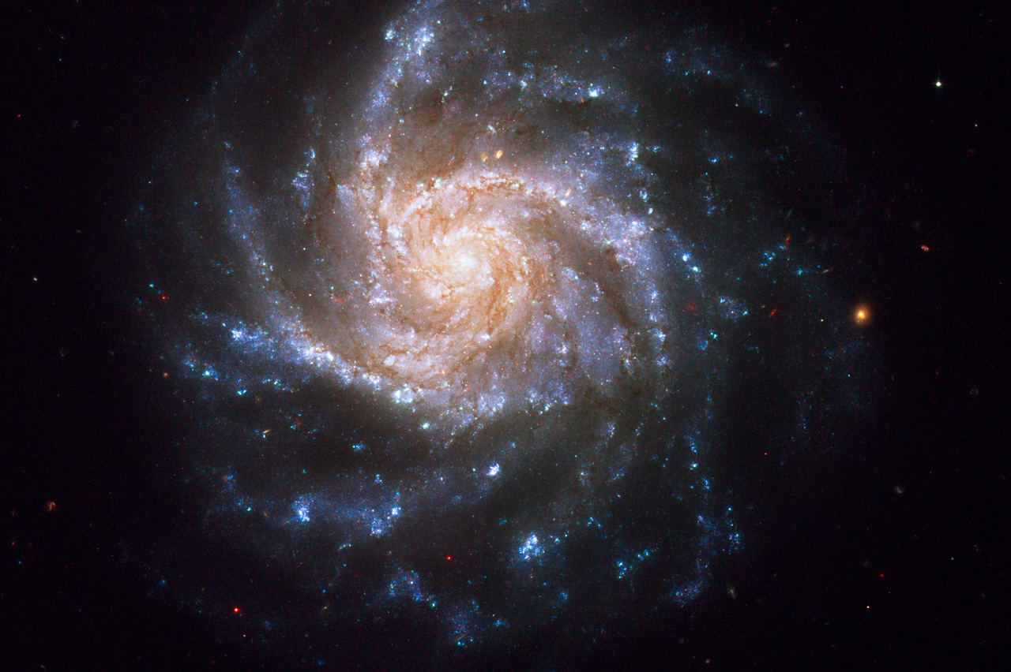
Massive galaxies: 2/3 spiral,
1/3 elliptical

Slide 3
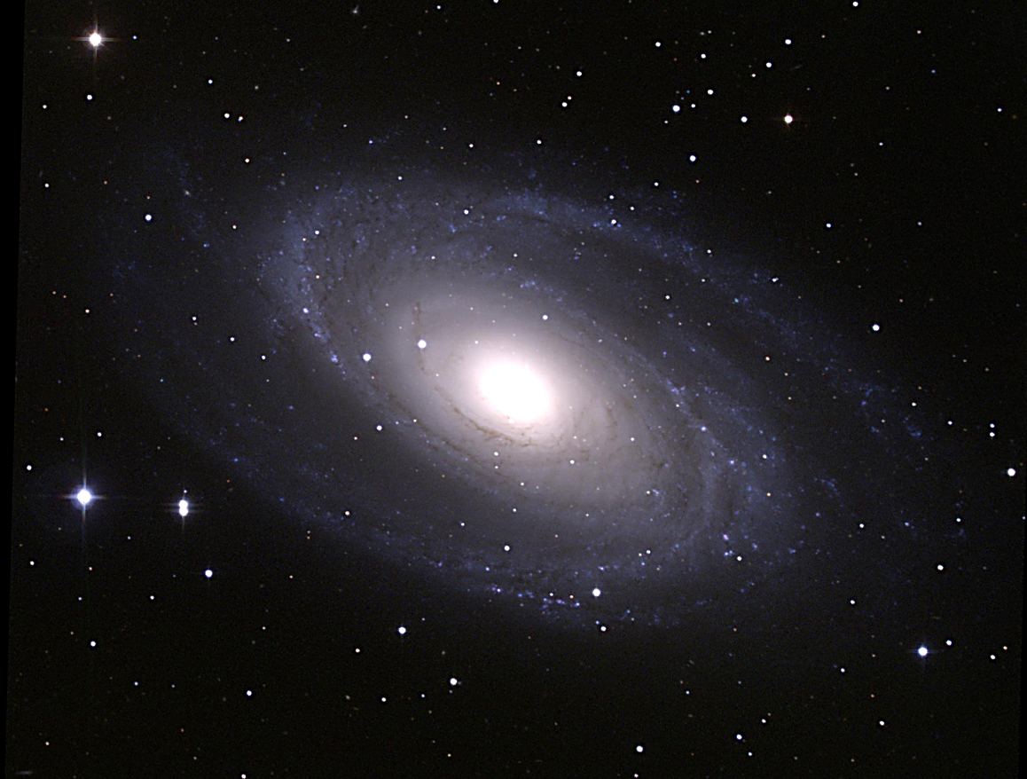
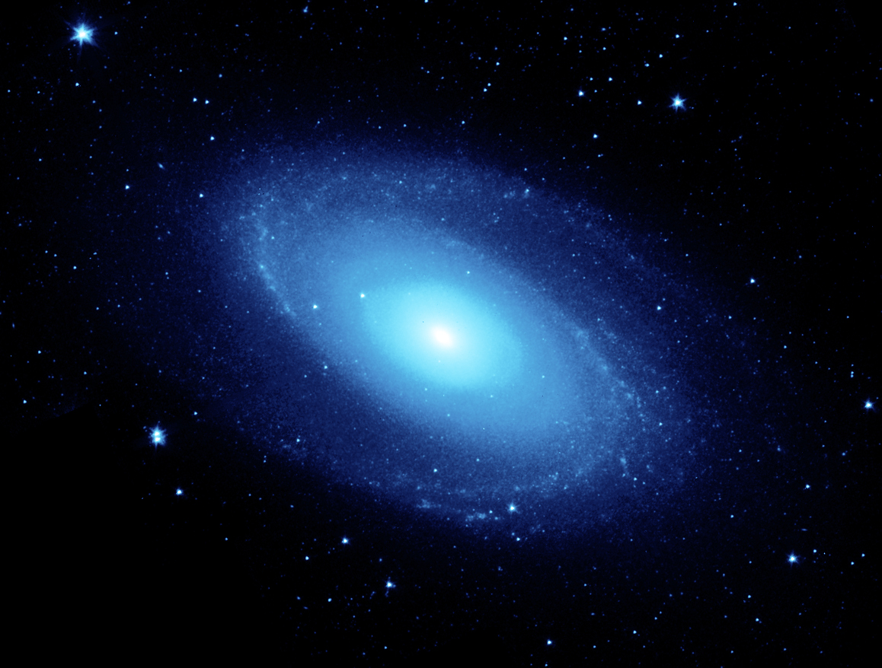
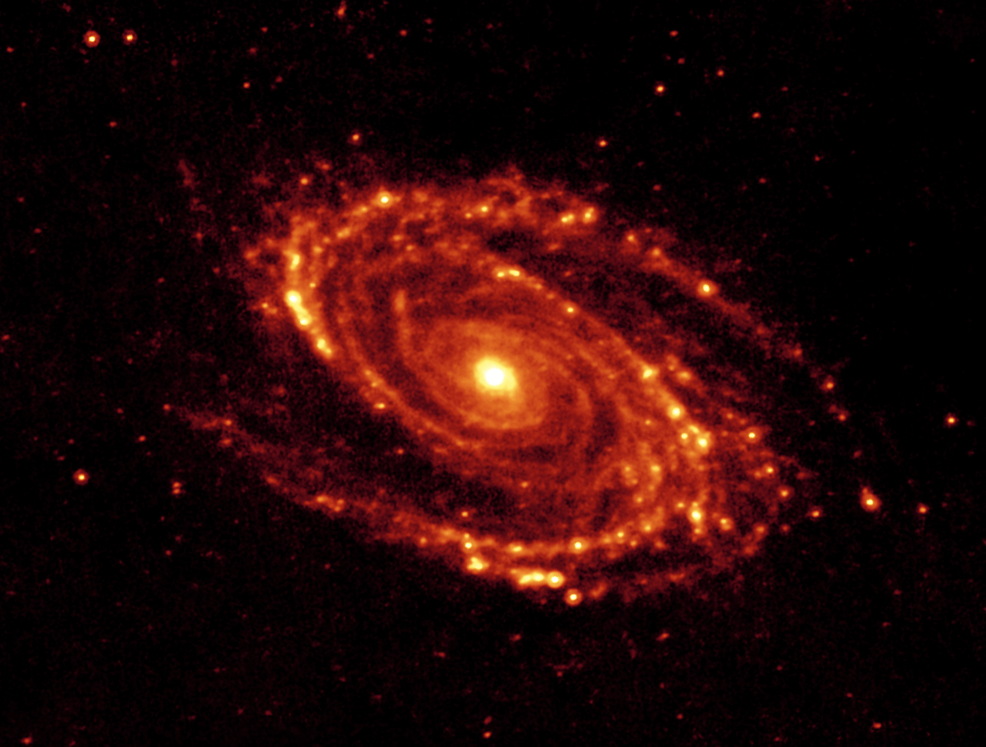
M81
visible
3.6 μm, stars
24 μm, dust

Slide 4
Outline
How are they formed?
What are the predicted arm properties?
How to identify the formation mechanism?
What about (low-frequency) radio observations?

Slide 5
How are spiral arms formed?
There is no consensus! [Dobbs & Baba, PASA, 2014]
Possibilities include:
density wave theory, [Lin & Shu, 1964, + many variants]
transient “dynamic” spirals, [N-body simulations]
bar-driven, [N-body simulations + stellar orbit theory]
tidal interactions. [N-body simulations]

Slide 6
Spiral arm behaviour?
Density wave:
  quasi-stationary arms (rotate rigidly, Ω_{p} = constant ),
  Ω_{p} is pattern (angular) speed
Dynamic:
  short-lived segments form and break up
  material arms (rotate with disc, Ω_{p} = Ω(r), co-rotation everywhere)
Bar-driven:
  arms rotate: with bar or independently or some other way.
Tidal arms:
  quasi-stationary or material or kinematic (aligned elliptical orbits, Ω_{p} = Ω(r) – κ(r)/2, for 2-arms)

Slide 7
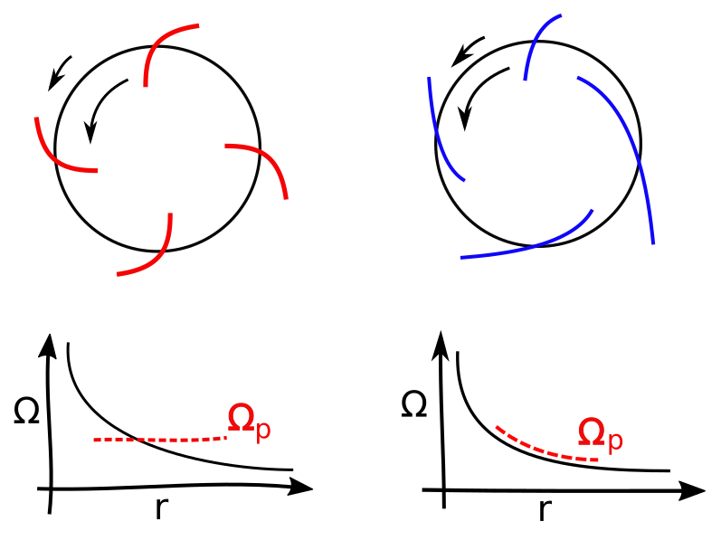
Pattern speeds
density wave
material arm
spiral rotates rigidly,
constant pattern (angular) speed
spiral rotates with disc, variable pattern (angular) speed

Slide 8
How to identify mechanism?
Do the arms move w.r.t. the disc?
  fixed Ω_{p} or Ω_{p}(r)
How to find pattern speed:
  spiral shock location, either side of co-rotation
  offsets of e.g. CO and Hα
  stellar age sequence w.r.t. spiral arm
  velocity field
  conservation of mass through arm (Tremaine-Weinberg method)
Correlations:
  pitch angle and shear
  bar strength and spiral strength / contrast

Slide 9
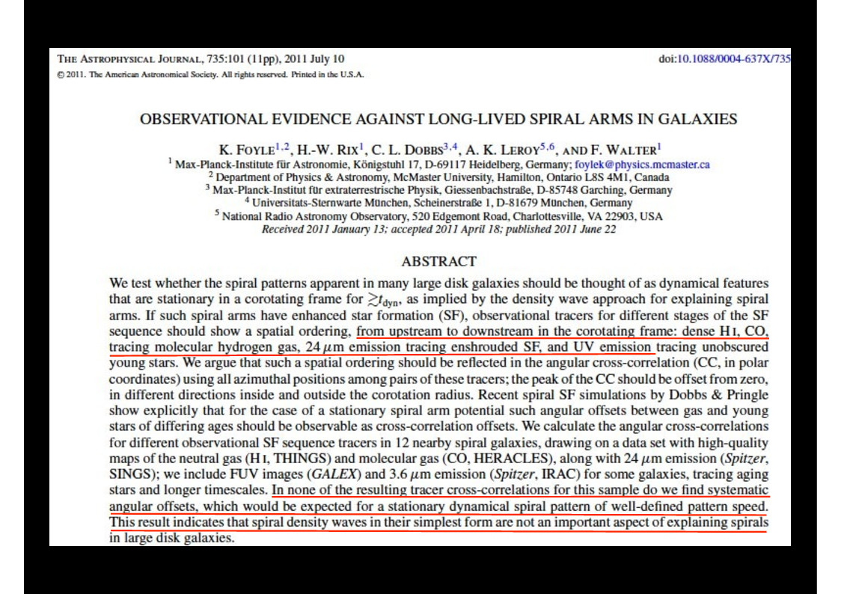

Slide 10
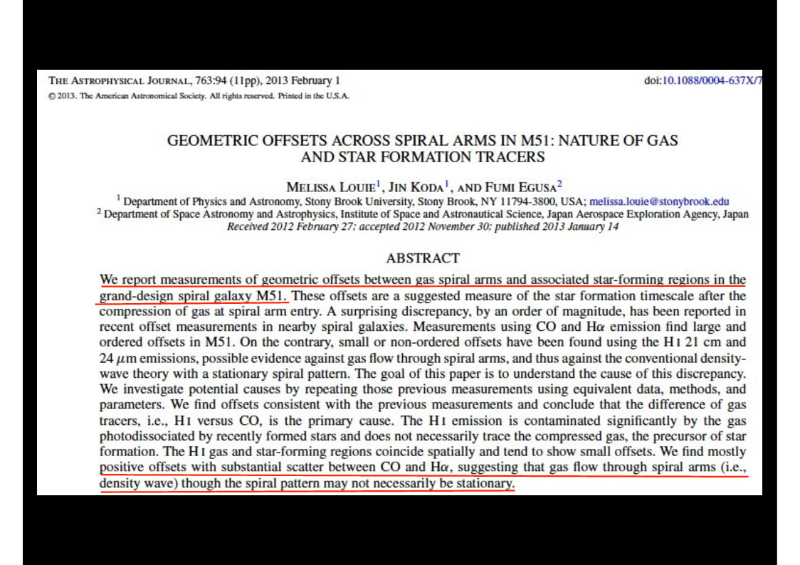

Slide 11
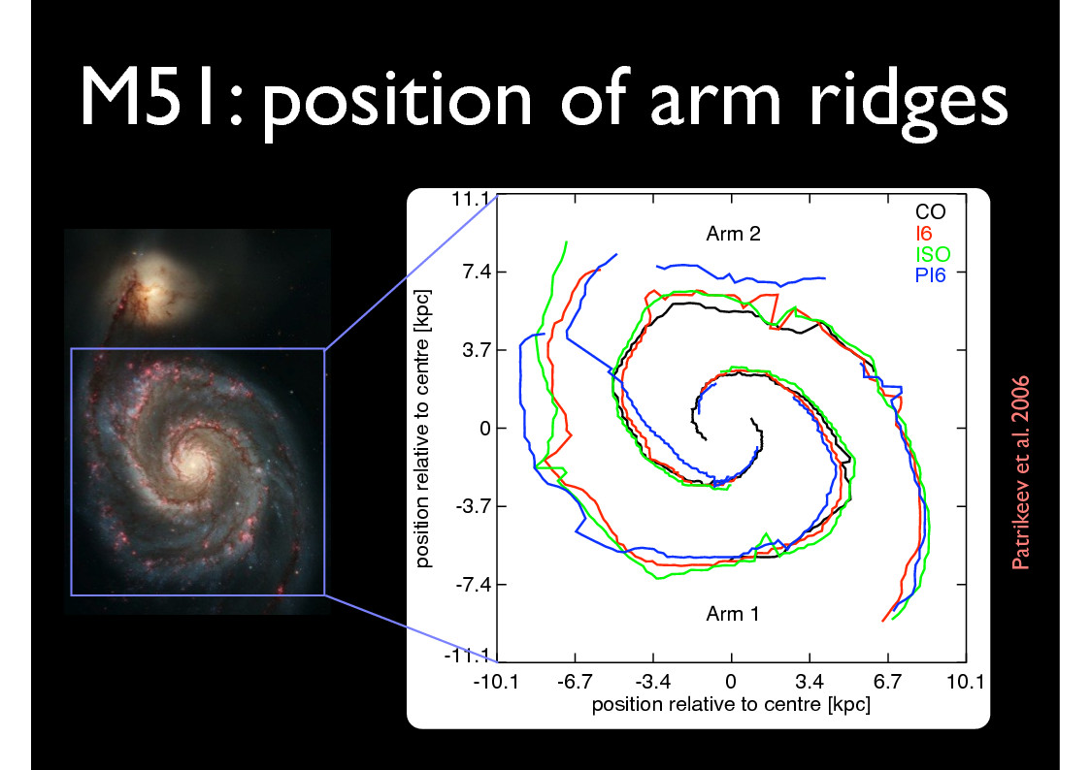

Slide 12
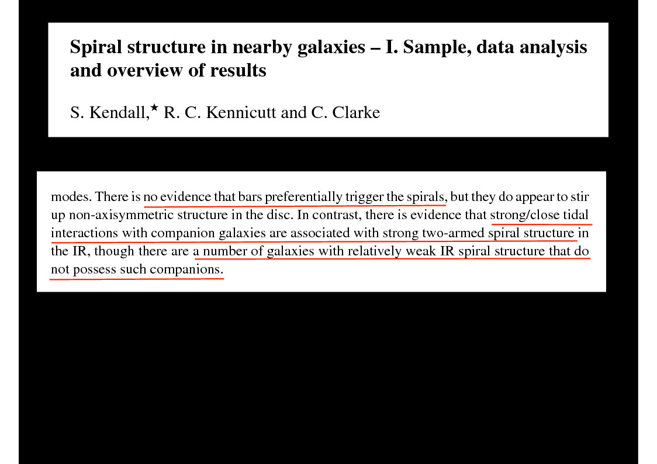

Slide 13
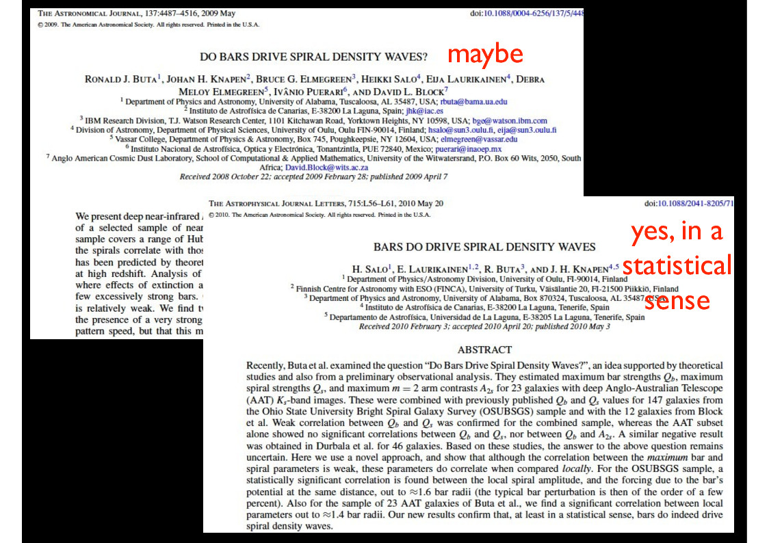

Slide 14
What about low-frequency radio?
massive stars: sources of cosmic ray electrons
massive stars: concentrated in spiral arms
pattern speed of spiral arm distinguishes different formation mechanisms
does the azimuthal profile of synchrotron emission look different if sources move?

Slide 15
Diffusion energy-loss equation
diffusion
energy loss
source
escape
solve around a ring in azimuth

Slide 16
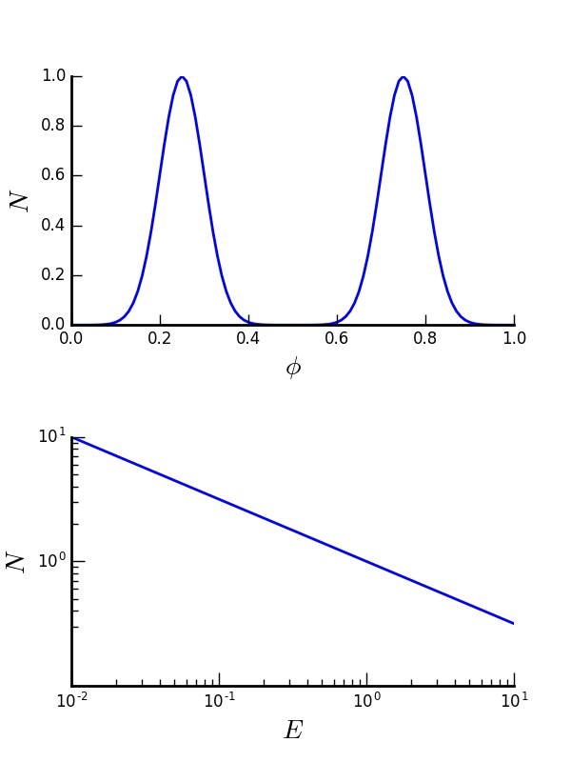
Cosmic ray sources
spatial distribution
energy

Slide 17
Cosmic ray sources
spatial distribution
energy

Slide 18
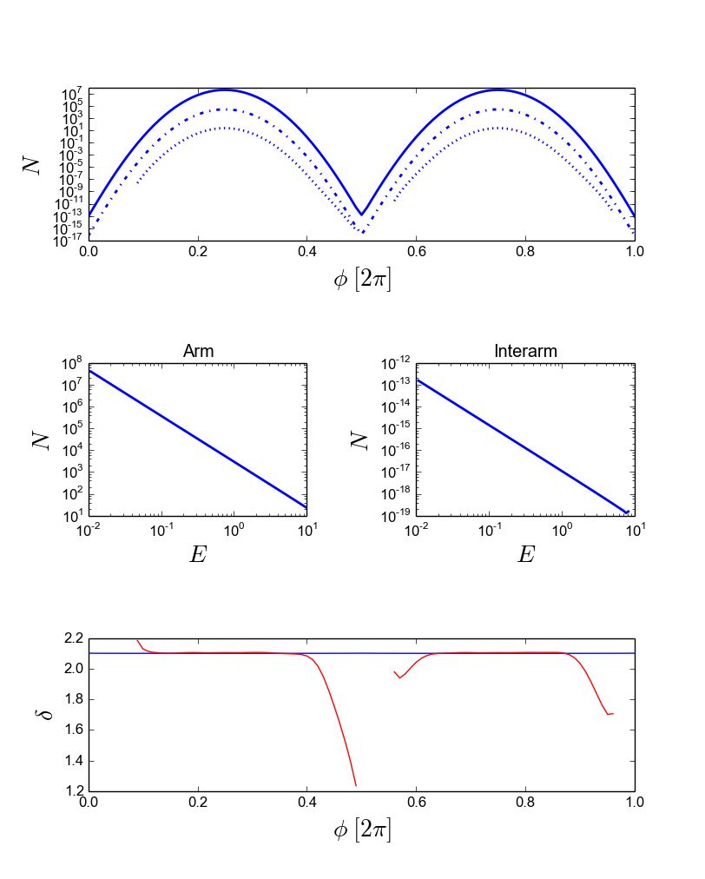
Sample result: no pattern speed
material arm
or
density wave at co-rotation radius

Slide 19
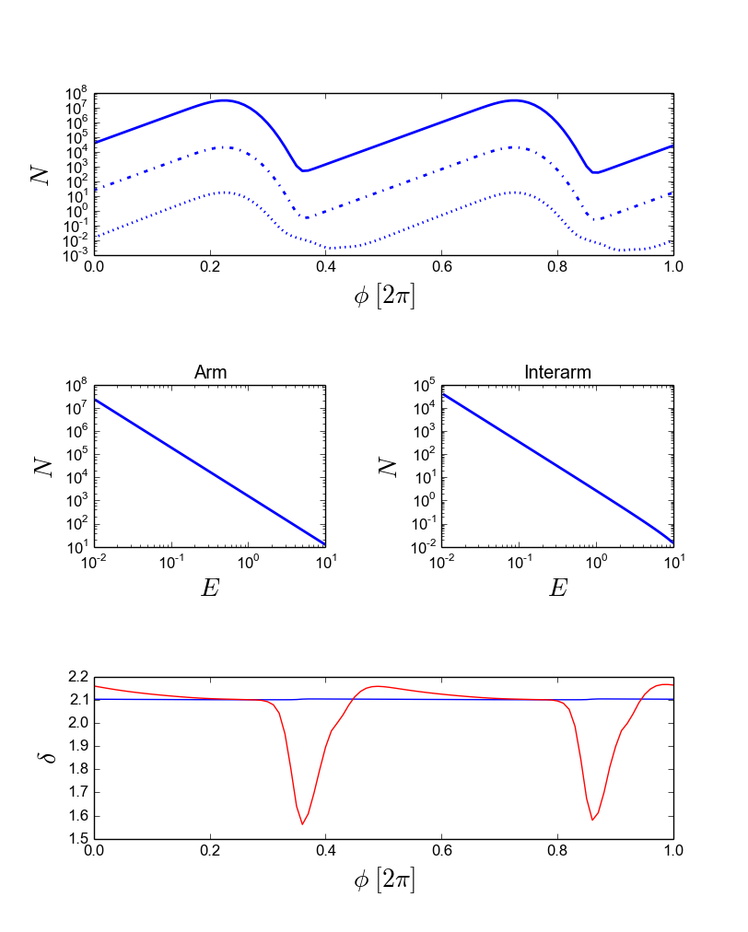
Sample result: one rotation of arms
arm moves w.r.t. disc
density wave one side of co-rotation radius

Slide 20
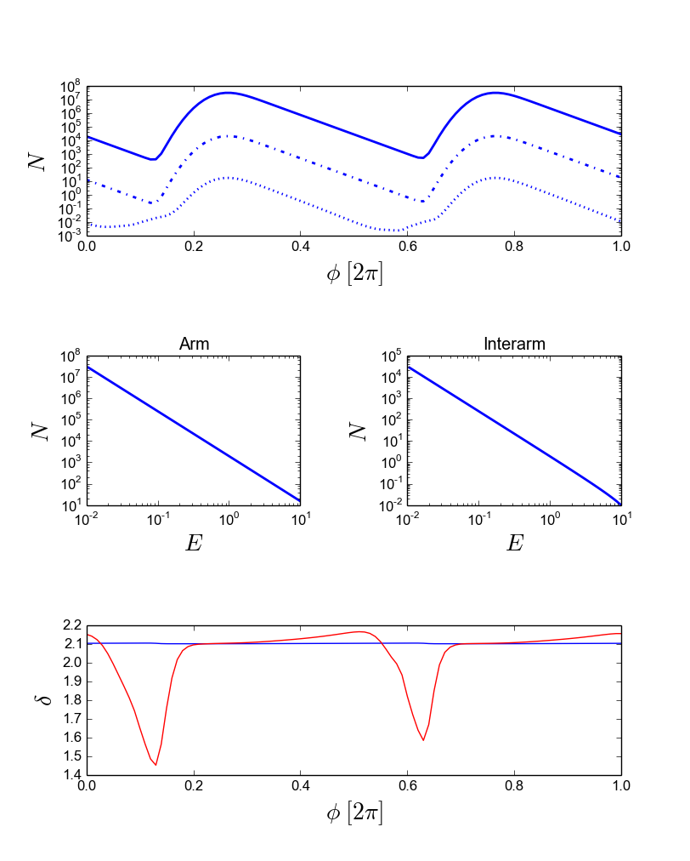
Sample result: one rotation of arms
arm moves w.r.t. disc
density wave other side of co-rotation radius

Slide 21
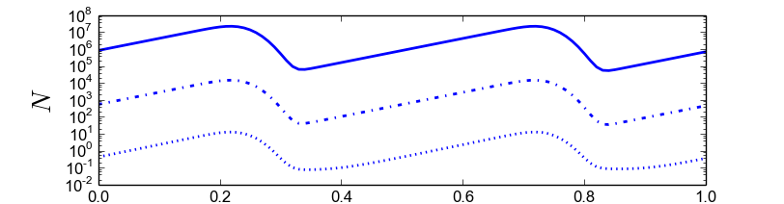
Sample results

Slide 22
Pattern speed of spiral arm
(e.g. due to density wave)
=>
motion of cosmic ray sources
=>
asymmetry of synchrotron intensity
No pattern speed of arm
(e.g. material arm)
=>
symmetry of synchrotron intensity

