Slide 1
Email Classification Using Natural Language Processing
Andrew Ferreira, Michael VanDusen
February 24, 2022

Slide 2
Project
The objective of this project is to help a person to classify an incoming email.
We will use different datasets with a similar data structure create the data pipeline, which can be applied to different purposes later.

Slide 3
Book Chapters
Ch. 22 – Natural Language Processing
Ch. 23 – Natural Language for Communication

Slide 4

Critical Path
Data cleaning - Due Date: Jan 31
The processing of transformation the YELP! dataset into the structure we need: review and classification
Exploratory Data Analysis | Due Date: Feb 4
Understand the data and it's distribution
Defining the model | Due Date: Feb 11
The bag-of-words model VS N-gram word model
Paper | Due Date: Feb 25
write the mid-term paper

Slide 5
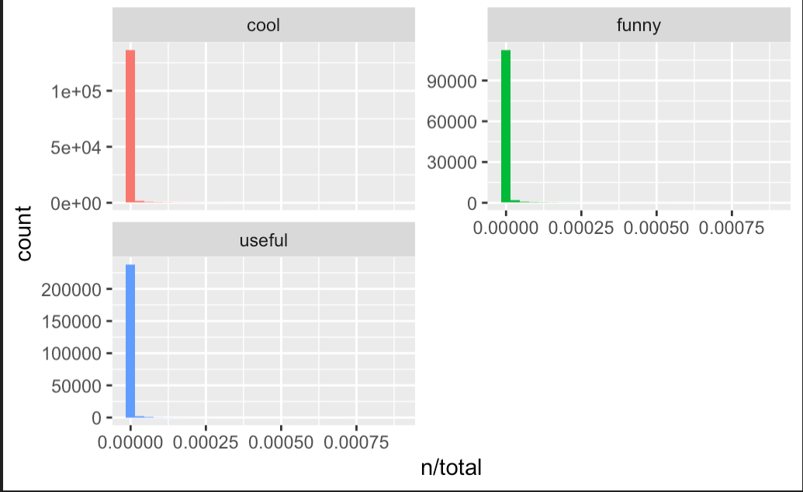
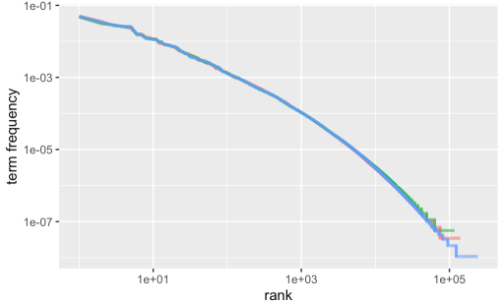
Bag-of-words
Conclusion: We should use n-gran

Slide 6
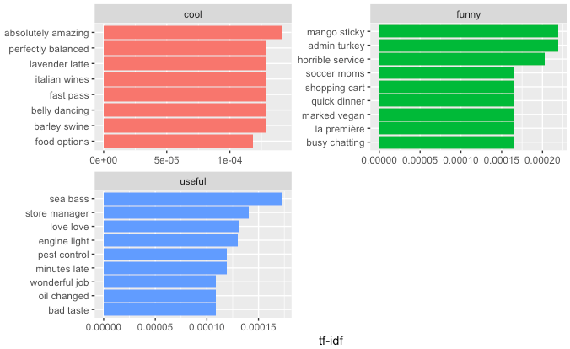
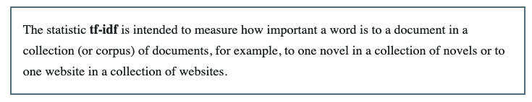
Bigram
We decided to use bigram because trigram is too expense to compute
We used “tf-idf” to find valuable bigrams

Slide 7
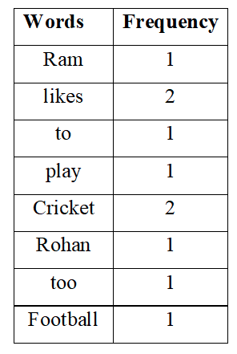
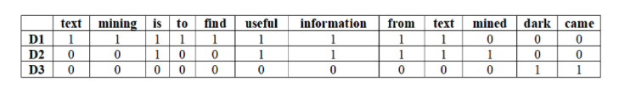
Modeling
Remember to use the correct function
Avoid terabytes
Document Term Matrix

Slide 8
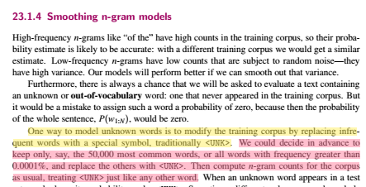
Smoothing n-gram
6GB of observations
1MM observations
200k observations for training
1MM bigrams
2135 bigrams
dataset_20p_bi_bigrams_top_1K <- dataset_20p_bi_tf_idf %>%
filter(
tf_idf >= quantile(dataset_20p_bi_tf_idf$tf_idf, 0.25, na.rm = TRUE)
& tf_idf <= quantile(dataset_20p_bi_tf_idf$tf_idf, 0.75, na.rm = TRUE)
) %>%
top_n(1000, n) %>%
select(bigram)

Slide 9
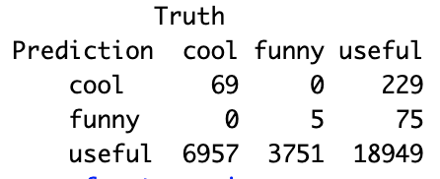

Trained model
accuracy multiclass 0.633

Slide 10
Trained model
Training script – Once a month
Get new data
Train the model
Save the model
Predicting script – Batch or streaming
Open the model
Get new data
Run the model
Send the classification

