Slide 1
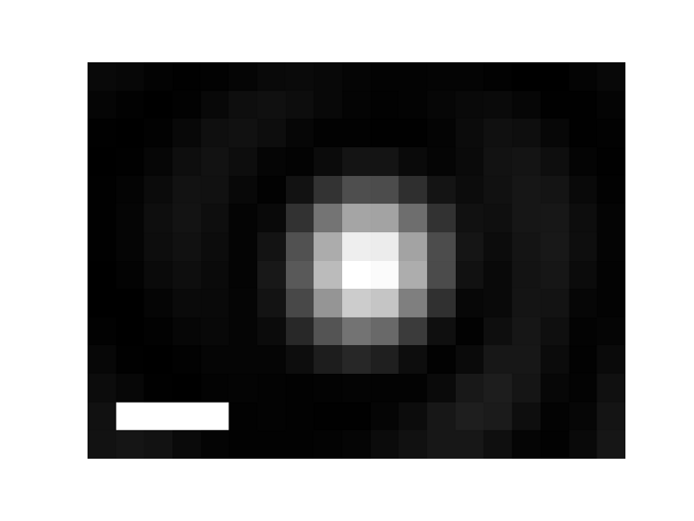

A
2.5 µs
1 µs
Dark-field image of nanodiamond doped with N-v centers
721 nm light only (excitation and fluorescence filtered out)
2.5 µs
1.25 µs
0 µs
1.25 µs
2.5 µs
No change
(reference image)
Change in dark-field image

