Slide 1
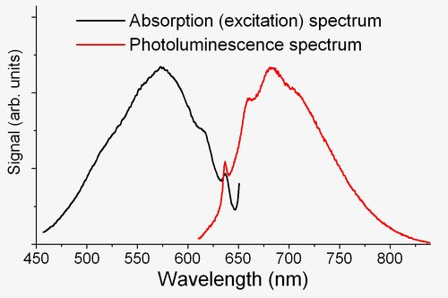
Nitrogen vacancy spectrum
Image light path
Excitation beam path
Excitation
Sample
Lens
Lens
Lens
Lens
Lens
Objective lens
SCMOS camera
Excitation
B
Excitation stop filter
Emission pass filter
Fluorescence

Slide 2
Nitrogen vacancy spectrum
Image light path
Excitation/stimulation beam path
Excitation
Stimulation
Transmitted beam path
τ
Sample
Lens
Lens
Lens
Lens
Lens
Objective lens
SCMOS camera
Stimulation
Excitation
B
Excitation stop filter
Emission pass filter
Fluorescence/depletion

Slide 3
Nitrogen vacancy spectrum
Image light path
Illumination and transmitted beam path
Stimulation
Sample
Lens
Lens
Lens
Lens
Lens
Objective lens
SCMOS camera
Stimulation
B
Excitation stop filter
Emission pass filter
Dark field beam block
Dark field

Slide 4
Nitrogen vacancy spectrum
Image light path
Excitation/stimulation beam path
Excitation
Stimulation
Transmitted beam path
τ
Sample
Lens
Lens
Lens
Lens
Lens
Objective lens
SCMOS camera
Stimulation
Excitation
B
Excitation stop filter
Emission pass filter
Dark field beam block
Dark field/STE

Slide 5
Nitrogen vacancy spectrum
Image light path
Illumination and transmitted beam path
Stimulation
Attenuated transmitted beam path
Sample
Lens
Lens
Lens
Lens
Lens
Objective lens
SCMOS camera
Stimulation
B
Excitation stop filter
Emission pass filter
Partial
dark field beam block
Rotating phase plate
Phase contrast

Slide 6
Nitrogen vacancy spectrum
Image light path
Excitation/stimulation beam path
Excitation
Stimulation
Transmitted beam path
Attenuated transmitted beam path
τ
Sample
Lens
Lens
Lens
Lens
Lens
Objective lens
SCMOS camera
Stimulation
Excitation
B
Excitation stop filter
Emission pass filter
Partial
dark field beam block
Rotating phase plate
Phase contrast/STE

Slide 7
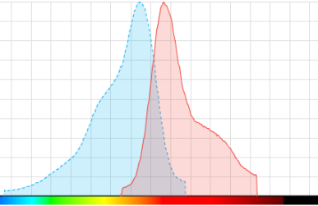
Fluorescent dye spectrum
1
Image light path
Excitation
Stimulation
Excitation/stimulation beam path
Intensity (a.u.)
Transmitted beam path
Attenuated transmitted beam path
0
500
600
700
800
Wavelength (nm)
τ
Sample
Lens
Lens
Lens
Lens
Lens
Objective lens
SCMOS camera
Stimulation
Excitation
B
Excitation stop filter
Emission pass filter
Partial
dark field beam block
Rotating phase plate
Phase contrast/STE

Slide 8
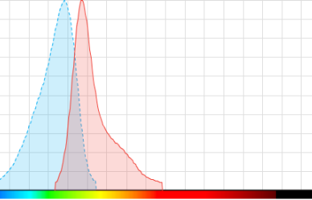
Fluorescent dye spectrum
1
Image light path
Excitation
Stimulation
Excitation/stimulation beam path
Intensity (a.u.)
Transmitted beam path
Attenuated transmitted beam path
0
500
600
700
800
Wavelength (nm)
τ
Sample
Lens
Lens
Lens
Lens
Lens
Objective lens
SCMOS camera
Stimulation
Excitation
B
Excitation stop filter
Emission pass filter
Partial
dark field beam block
Rotating phase plate
Phase contrast/STE

Slide 9
Fluorescent dye spectrum
1
Image light path
Stimulation
Illumination and transmitted beam path
Intensity (a.u.)
Attenuated transmitted beam path
0
500
600
700
800
Wavelength (nm)
Sample
Lens
Lens
Lens
Lens
Lens
Objective lens
SCMOS camera
Stimulation
B
Excitation stop filter
Emission pass filter
Partial
dark field beam block
Rotating phase plate
Phase contrast

Slide 10
Fluorescent dye spectrum
1
Image light path
Stimulation
Illumination and transmitted beam path
Intensity (a.u.)
Attenuated transmitted beam path
0
500
600
700
800
Wavelength (nm)
Sample
Lens
Lens
Lens
Lens
Lens
Objective lens
SCMOS camera
Stimulation
B
Excitation stop filter
Emission pass filter
Partial
dark field beam block
Rotating phase plate
Phase contrast

Slide 11
Fluorescent dye spectrum
1
Image light path
Excitation
Stimulation
Excitation/stimulation beam path
Intensity (a.u.)
Transmitted beam path
0
500
600
700
800
Wavelength (nm)
τ
Sample
Lens
Lens
Lens
Lens
Lens
Objective lens
SCMOS camera
Stimulation
Excitation
B
Excitation stop filter
Emission pass filter
Dark field beam block
Dark field/STE

Slide 12
Fluorescent dye spectrum
1
Image light path
Excitation
Stimulation
Excitation/stimulation beam path
Intensity (a.u.)
Transmitted beam path
0
500
600
700
800
Wavelength (nm)
τ
Sample
Lens
Lens
Lens
Lens
Lens
Objective lens
SCMOS camera
Stimulation
Excitation
B
Excitation stop filter
Emission pass filter
Dark field beam block
Dark field/STE

Slide 13
Fluorescent dye spectrum
1
Image light path
Stimulation
Illumination and transmitted beam path
Intensity (a.u.)
0
500
600
700
800
Wavelength (nm)
Sample
Lens
Lens
Lens
Lens
Lens
Objective lens
SCMOS camera
Stimulation
B
Excitation stop filter
Emission pass filter
Dark field beam block
Dark field

Slide 14
Fluorescent dye spectrum
1
Image light path
Stimulation
Illumination and transmitted beam path
Intensity (a.u.)
0
500
600
700
800
Wavelength (nm)
Sample
Lens
Lens
Lens
Lens
Lens
Objective lens
SCMOS camera
Stimulation
B
Excitation stop filter
Emission pass filter
Dark field beam block
Dark field

Slide 15
Fluorescent dye spectrum
1
Image light path
Excitation
Stimulation
Excitation/stimulation beam path
Intensity (a.u.)
Transmitted beam path
0
500
600
700
800
Wavelength (nm)
τ
Sample
Lens
Lens
Lens
Lens
Lens
Objective lens
SCMOS camera
Stimulation
Excitation
B
Excitation stop filter
Emission pass filter
Fluorescence/depletion

Slide 16
Fluorescent dye spectrum
1
Image light path
Excitation
Stimulation
Excitation/stimulation beam path
Intensity (a.u.)
Transmitted beam path
0
500
600
700
800
Wavelength (nm)
τ
Sample
Lens
Lens
Lens
Lens
Lens
Objective lens
SCMOS camera
Stimulation
Excitation
B
Excitation stop filter
Emission pass filter
Fluorescence/depletion

Slide 17
Fluorescent dye spectrum
1
Image light path
Excitation
Excitation beam path
Intensity (a.u.)
0
500
600
700
800
Wavelength (nm)
Sample
Lens
Lens
Lens
Lens
Lens
Objective lens
SCMOS camera
Excitation
B
Excitation stop filter
Emission pass filter
Fluorescence

Slide 18
Fluorescent dye spectrum
1
Image light path
Excitation
Excitation beam path
Intensity (a.u.)
0
500
600
700
800
Wavelength (nm)
Sample
Lens
Lens
Lens
Lens
Lens
Objective lens
SCMOS camera
Excitation
B
Excitation stop filter
Emission pass filter
Fluorescence

