Slide 1
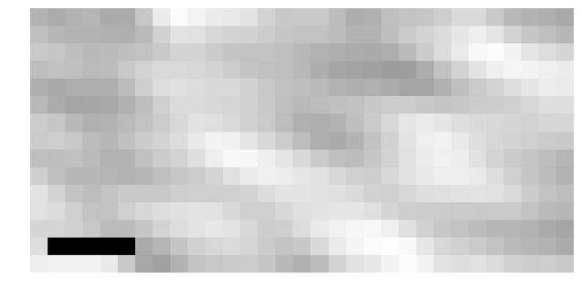

B
2.5 µs
1 µs
Phase contrast image of index-matched crimson fluorescent bead
721 nm light only (excitation and fluorescence filtered out)
0 µs
2.5 µs
Change in phase contrast image

