Slide 1
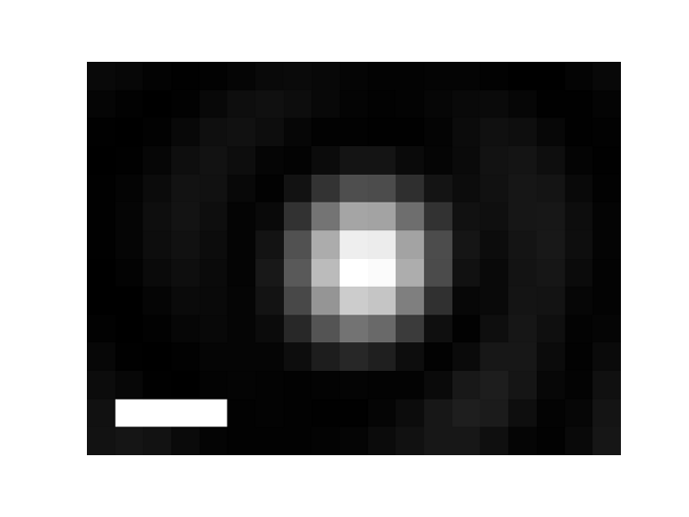

2.5 µs
1 µs
Dark-field image of nanodiamond doped with N-v centers
(prior to excitation)
1.25 µs
0 µs
1.25 µs
2.5 µs
Change in dark-field image at other excitation/stimulation pulse delays

