Slide 1
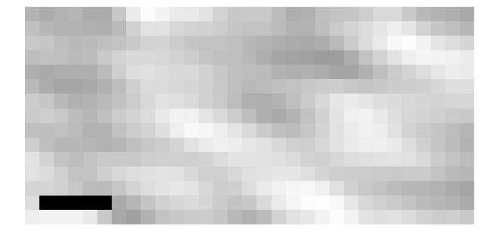

2.5 µs
1 µs
Phase contrast image of index-matched crimson fluorescent bead
(prior to excitation)
0 µs
2.5 µs
Change in phase contrast image during and after excitation

