Slide 1
Healthty

Slide 2
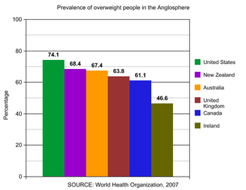
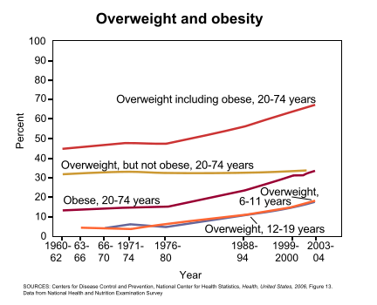
Our pain
Obesity
Spend Time and money on your own nutritionist

Slide 3
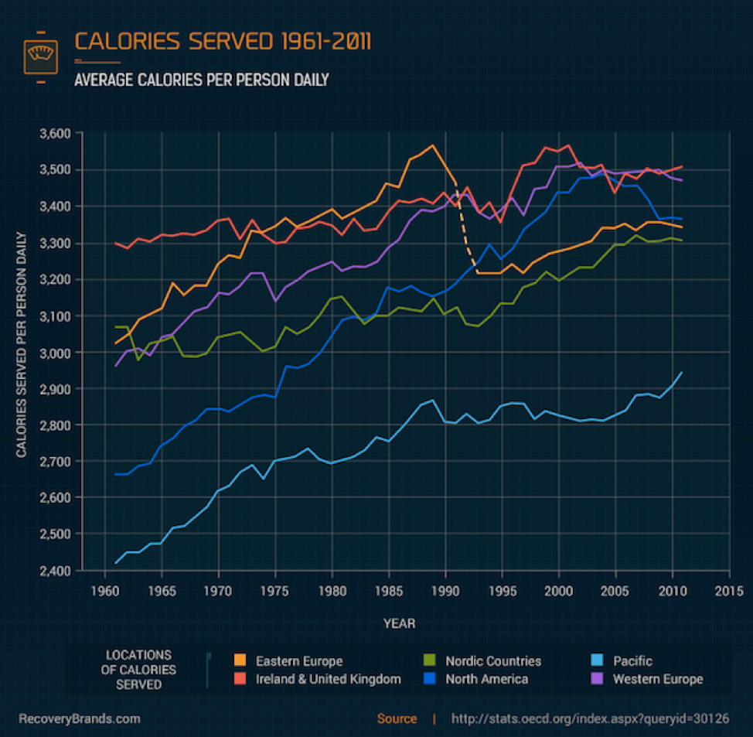

Slide 4
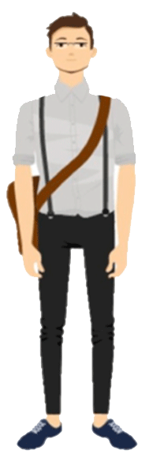
Our potential clients
Hi! My name is Bod.
Age: 25-45
Markets:
West Europe and USA
Salary > = average
Lazy character
Lifestyle: sedentary

Slide 5
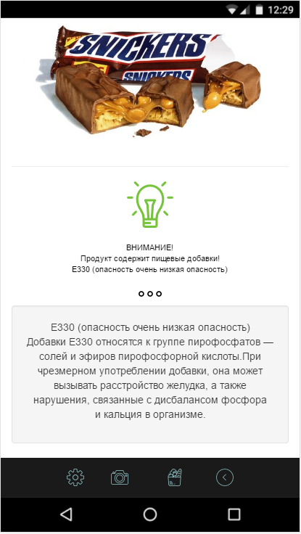
Opportunities
Get information product right now.
Get balanced ration
* In Future
Purchase product in our Application
Get the cheapest products depend on Salary

Slide 6
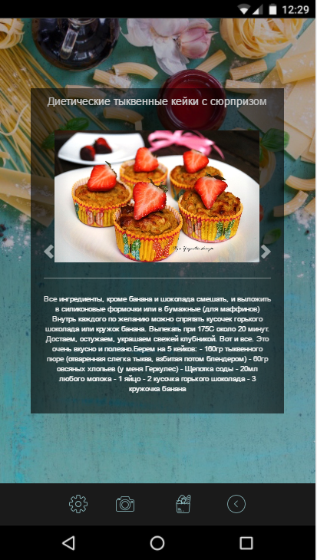
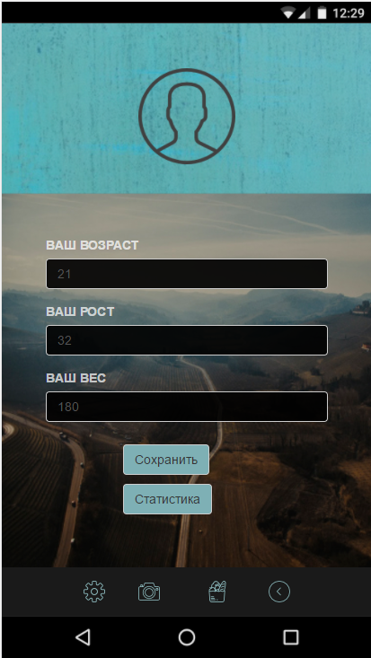
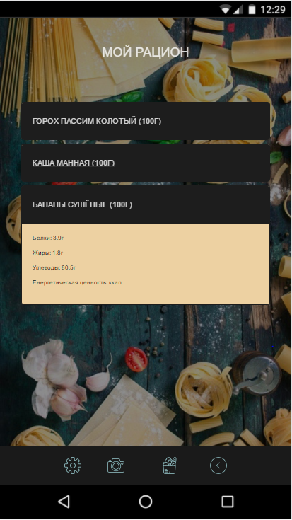

Slide 7
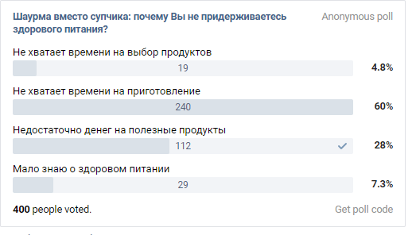
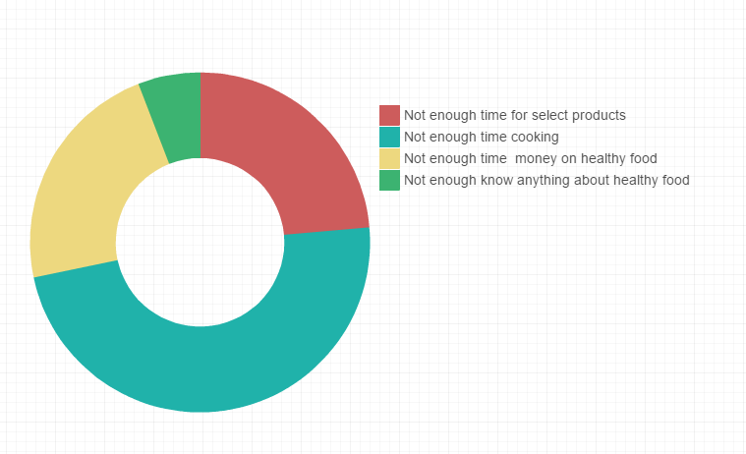
What problems we solve?

Slide 8
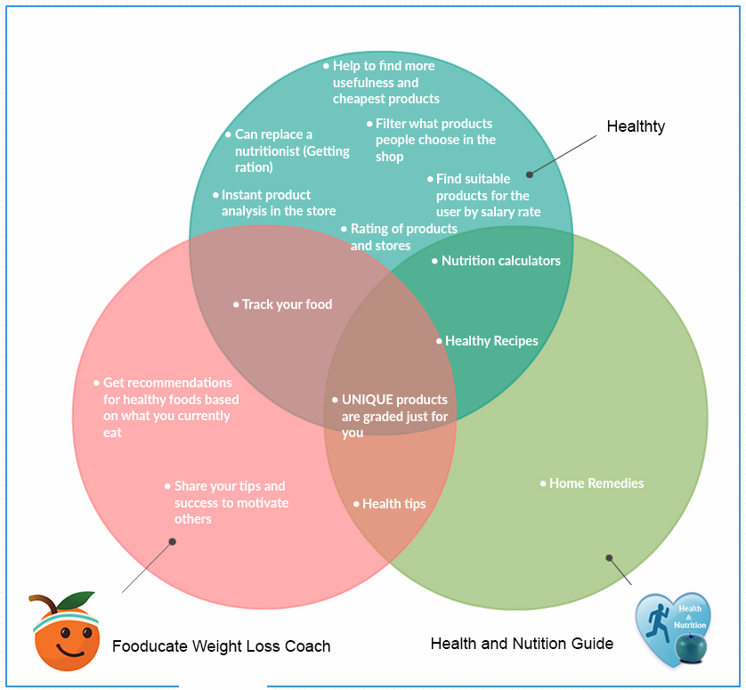
Our competitors

Slide 9

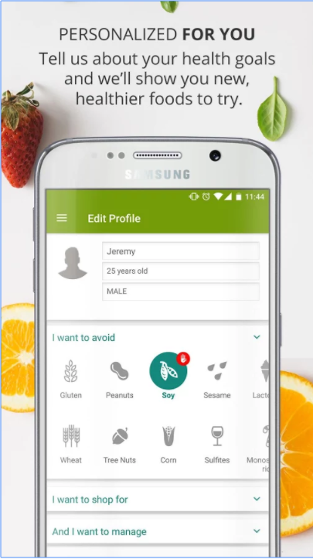
ShopWell

Slide 10

Monetization
Advertise of goods
Cooperation with markets
Additional features for subscribe

Slide 11

Thanks for your attention.
Take care about your health.
Healthty

