Slide 1

LUNG CANCER: Death and Demographics
Abear Awadallah
Brown Varghese
Mike Ingram
Gretel Uptegrove

Slide 2
Motivation
Lung cancer is one of the six leading causes of death- (according to WHO-World Health Organization)
Hypothesis – There is a correlation between a person’s demographics and their chances of dying of lung cancer
Questions – What demographics are associated/ correlated with lung cancer mortality?
Notes:
Lung cancer is one of the six leading causes of death according to the World Health Organization (WHO). We are investigating mortality data on lung cancer in the United States, focusing on disparities within demographics to determine viable relationships and/or correlations between these variables.

Slide 3
Questions & Data
Questions- Which demographics influence lung cancer mortality:
Race
Poverty Rate
Gender
Age
Geography
Sources:
CDC
FRED

Slide 4


Data Cleanup & Exploration
https://wonder.cdc.gov/
Cancer Statistics
Mortality Data
https://fred.stlouisfed.org/
Poverty Data

Slide 5
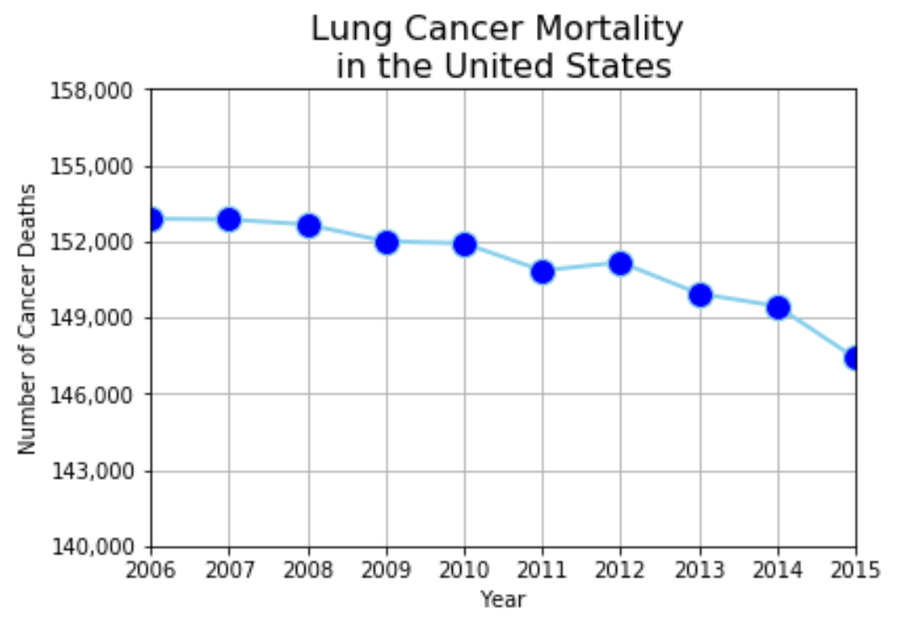
Data Analysis - Cancer Death over 2006-2015
Lung cancer death for All Ages, All Races, Both Sexes
There is a steady decrease in rates over time
- 2006 152,888
- 2015 147,395
Notes:
Before formulating our research questions, we wanted to see what stories the data would tell us. We know that cancer impacts people of all ages, race and sex. Despite of that, it does not affect everyone equally.
Our data is gathered as the number of deaths in the United States which is separated by gender, age, race and socioeconomic conditions. We wanted to see how each of these factors correlate with the death counts.
This graph is the visual representation of the overall change in the number of cancer-related deaths in the United States from the past 10 years.
Overall the trend of this graph is that each year, the number of deaths gradually decrease.

Slide 6
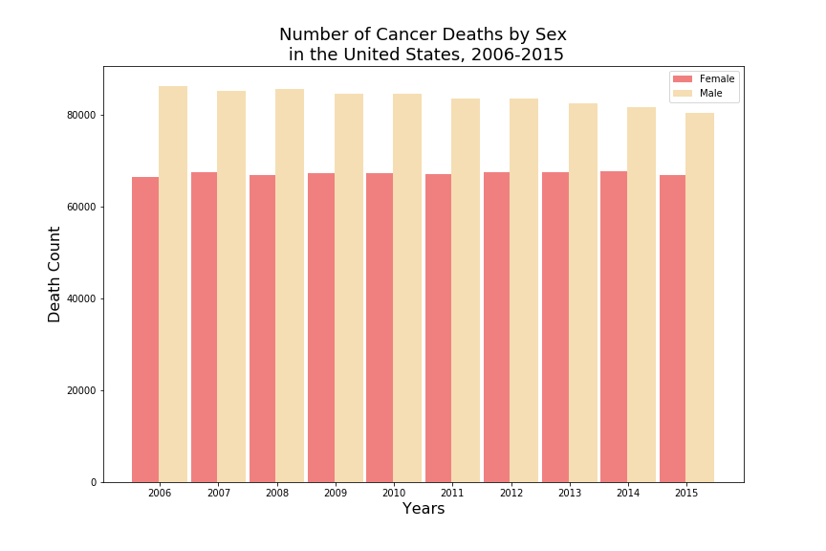
Data Analysis - Cancer Death by Sex
Number of Lung Cancer Deaths by Sex, All Races
Male deaths is greater than Female
Deaths go down for both, but seems like greater decrease in men
Year | Female | Male
2006 | 97,903 | 191,956
2015 | 86,551 | 146,777
Notes:
As apart of our evaluation we looked at the incidences of death based on gender.
As of the past ten years, the men have an overall higher death rate that decreased greatly overtime in comparison to women.

Slide 7
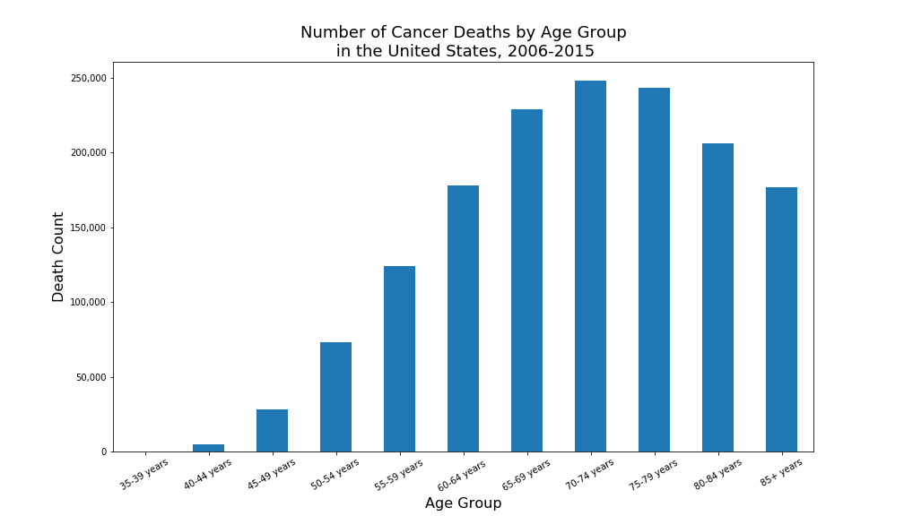
Data Analysis- Cancer Death by Age
Number of Lung Cancer Deaths by Age Group, All Races, Both Sexes
Increasing age is an important risk factor.
Most deaths occurred when people are in their 70’s
Lesser cases of death reported for 35 below age group
Notes:
Another factor that was taken into consideration is the age groups of the deaths.
Old age and cancer-related deaths are strongly correlated. It is evident in this bar chart that the elderly of 70-74 years have the highest death count.

Slide 8
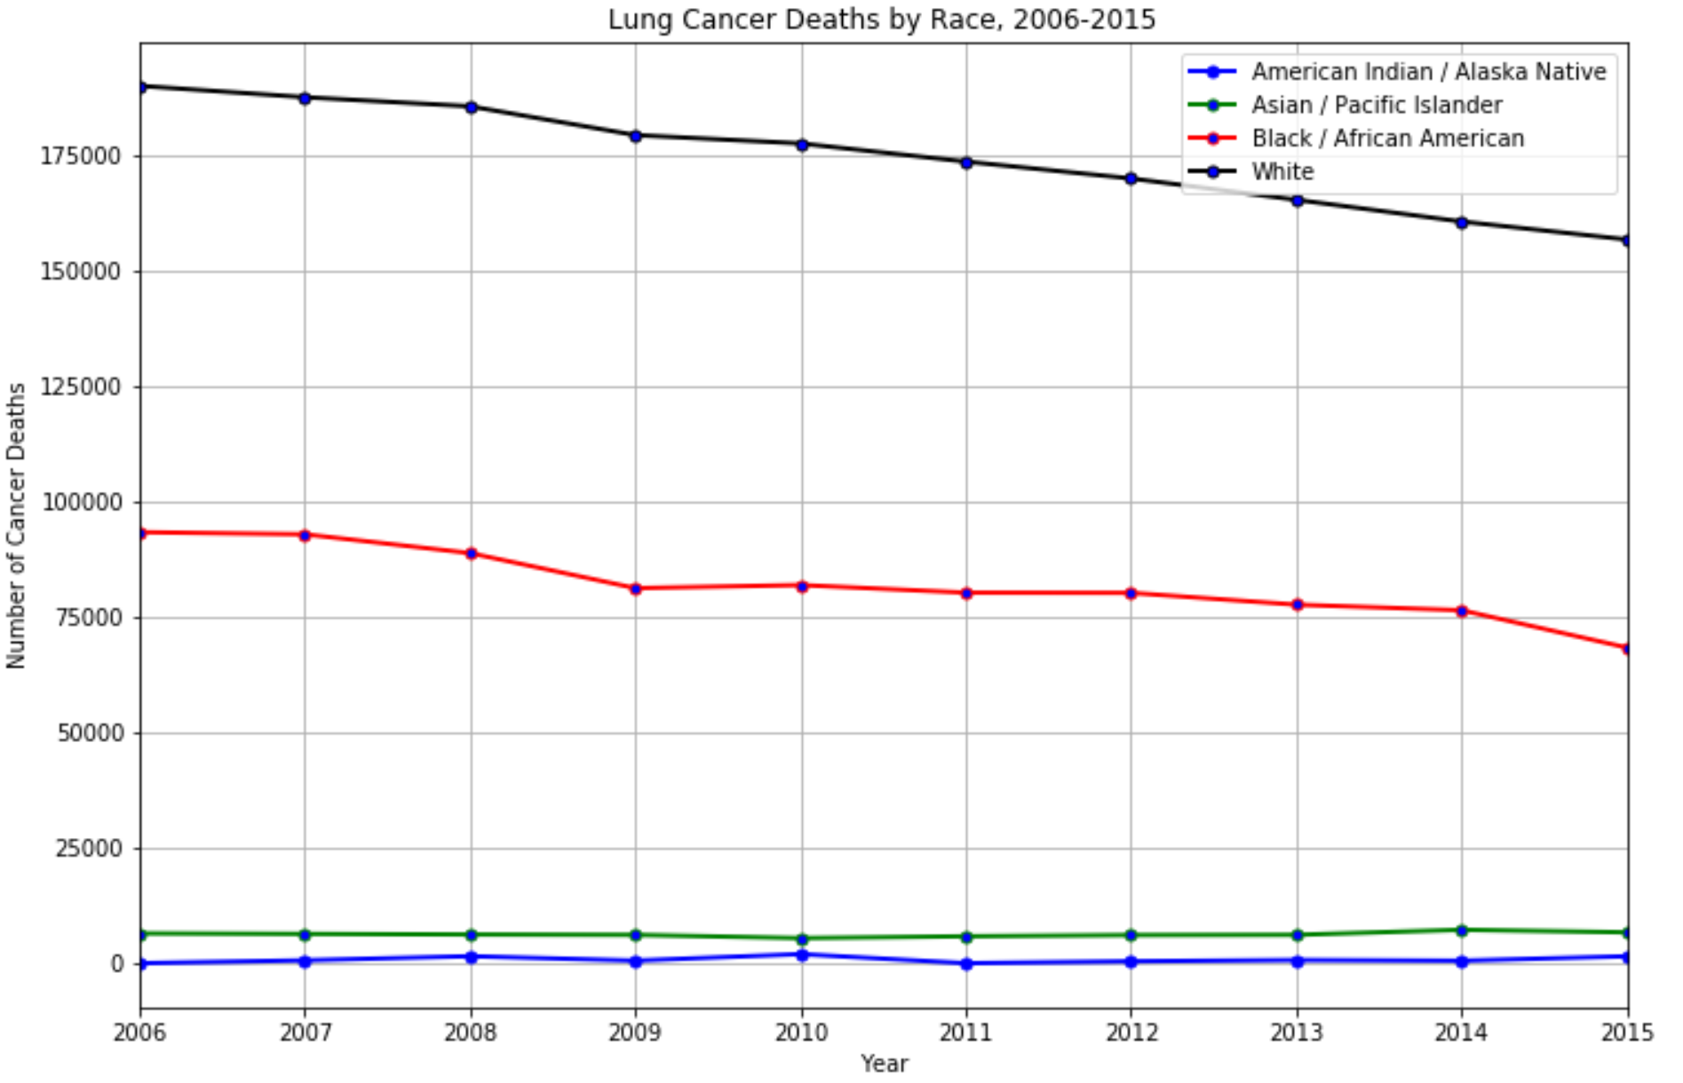
Data Analysis - Cancer Death by Race
Number of Lung Cancer Deaths by Race over 10 years period
Total Number of deaths without taking population distribution into account
White population is larger; more cancer related death reported
Notes:
The next factor that was taken into consideration was race and ethnicity.
This is a line graph of the total number of deaths against the years for each race. Note how we did not take population distribution into account. That is why it seems as though the white population has the highest death rate. This is due to their larger population in the United States, leading to more cancer related deaths being reported.
The overall trend seen in all of these races is that the incidents of death has come down in the past ten years.
For our studies, we focused on ethnicities.

Slide 9
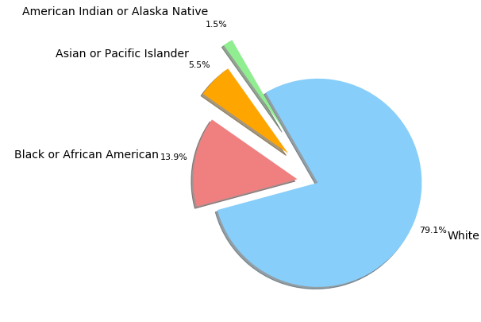
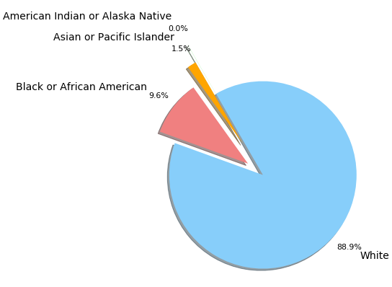
Data Analysis - Cancer Death by Race
Total Population 2015
Lung Cancer Mortality 2015
Notes:
We decided to take a closer look at race and made it one of our central questions.
We took only 1 year, 2015, and looked at the distribution of race in cancer deaths and compared that to the total population distribution.
If there was no correlation between race and lung cancer mortality, these charts would look exactly the same, but you can see that the wedge for White is oversized, and all the others are undersized, showing it has a higher prevalence in the White population
We decided to test our hypothesis that there is a correlation between race and lung cancer mortality

Slide 10
Data Analysis – Chi-Square Test
Race and Lung Cancer Mortality - 2015
Null Hypothesis(H0):There is no relationship between race and lung cancer mortality within 2015
Alternative Hypothesis(H1):There is a relationship between race and lung cancer mortality within 2015
P-value = 0.001
Results: Chi-Square (10042.59) and Critical Value (16.27)
Significant Relationship between Race and Lung Cancer Mortality
Notes:
Why? whether there is any difference between the observed (experimental) value and the expected (theoretical) value.
We decided to conduct a Chi-Square test on race and lung cancer mortality for 2015 using a p-value of 0.001. After conducting the test, we decided to reject the null hypothesis since the chi-square (10042.59) value exceeds the critical value (16.27) and accept the alternative hypothesis which states that there is a realtionship between race and lung cancer mortality within 2015.

Slide 11
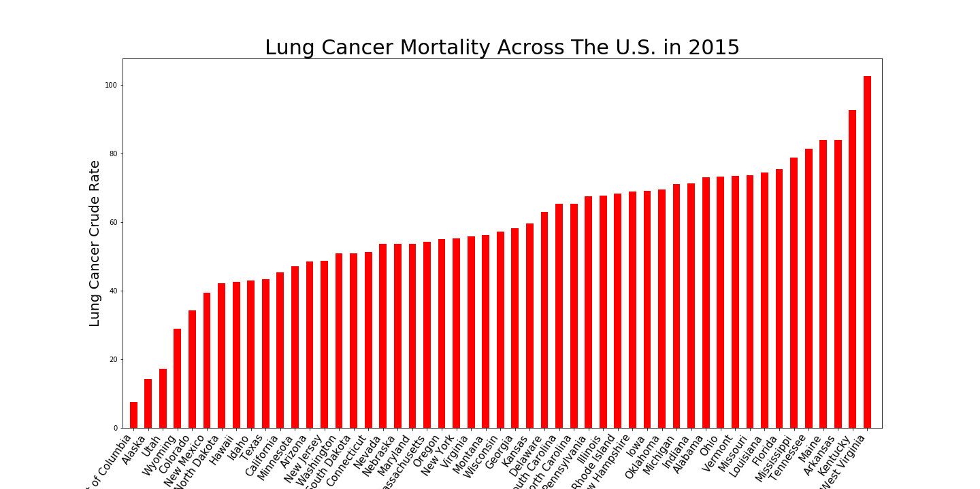
Data Analysis – Introduction to Crude Rate
Notes:
Crude Rates are expressed as the number of cases reported each calendar year per 100,000 population.
Crude Rate = (Death Count / Population) * 100,000
You use crude rate over death count to take into account different population sizes (e.g., California has a much higher population than Wyoming)
You multiply by 100,000 to get numbers that are easily visualized and comparable
(e.g., crude rates of 7 and 32 are easier to compare than simple percentages like .007% and .032%)

Slide 12
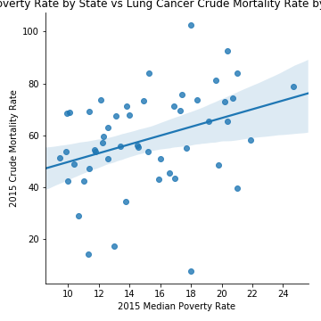
Poverty Rate & Crude Death Rate by State- Regression Analysis
R-Squared value of 0.122, showing a weak correlation
Note the large light blue shaded area denoting the large standard deviation

Slide 13
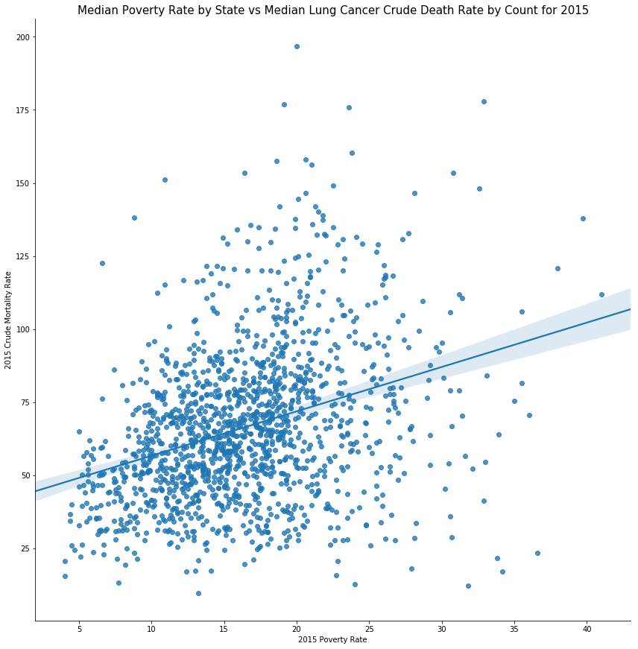
Poverty Rate & Crude Death Rate by County- Regression Analysis
R-Squared value of 0.110, showing slightly weaker correlation than the state level data

Slide 14
Conclusions
Race: There is a statistically significant relationship between race and lung cancer mortality in 2015.
Poverty: There is a statistically weak correlation between poverty levels and death rate from lung cancer.

Slide 15
Additional Observations
The death rate due to lung cancer has decreased from 2006-2015
Death from lung cancer occurs more often in men than women
People die in their 70’s more than any other age demographic
Wva Greatest; DC lowest

Slide 16

Post-Mortem
Difficulties:
Compiling Data
Finding best visualizations
Which statistical tool to use
Github
Further questions
Points of intervention to reduce mortality
Other factors such as education, access to healthcare, etc.

