Slide 1

APP TITLE
Lumen Player
APP ID
com.andrew1h1.lumenplayer
APP VER.
1.0.0
UX Scenario Document
APP DEVELOPER
Andrew Hany
SUBMISSION DATE
Application walkthrough for LG Content Store QA review
2026-07-08
Based on LG UX Scenario Document File Version 4.4 · Platform: webOS (web app type)

Slide 2
Table of Contents
1
Basic Information
5
Main Page Description
App identity, category, platform and content policy
Home (My List & History) and top navigation
2
Flow Chart
6
Sub Page Description
End-to-end navigation from launch to playback
Browse shelves, A–Z grid, Accounts and the player
3
Page Description — Guideline
7
Paid Content
How the numbered call-outs map to descriptions
In-app purchase / payment methods — Not applicable
4
Detailed Login Information
8
In-App Ad
Sign-in, register, test accounts and profile selection
Advertising placements — Not applicable
Lumen Player · UX Scenario Document
02

Slide 3
1
Basic Information
Application identity and content policy at a glance
App Title
Lumen Player
What the app does
App ID
com.andrew1h1.lumenplayer
Lumen Player is a media player for the playlist the user already owns. The user points it at their own playlist source; the app organises that media into Live, Movies and Series sections, remembers playback position, and keeps favourites and history in sync across the user's devices — with a 10-foot D-pad interface built for the remote. It ships with no content of its own: it hosts, bundles and supplies no channels, streams or media.
Version
1.0.0
Developer / Vendor
Andrew Hany
Category
Video · Media Player
App Type
webOS web application (HTML/JS)
Content policy
Permissions
internet, network.state
Login required
Yes — free account
Languages
English (UI)
Paid content
None
In-app purchase
None
DRM / Hardware
None required
In-app advertising
None
Bundled content
None
Base content rating is low; user-supplied media is outside the application's control.
Lumen Player · UX Scenario Document
03

Slide 4
2
Flow Chart
End-to-end navigation from app launch to playback
1
2
3
4
5
6
›
›
›
›
›
Launch
Sign In /
Register
Who's
Watching?
Home
Browse
Video
Player
App starts,
session restored
Account for
cross-device sync
Select or add
a profile
Home · Live ·
Movies · Series
Shelves &
A–Z grid
Full-screen
playback
↑ modal overlay
Accounts / Settings
Reachable from any Main Page tab (gear icon) — add or switch playlist, manage profiles.
Steps 5–6 are described generically because they display only the media the user has supplied; the application provides none of its own.
Lumen Player · UX Scenario Document
04

Slide 5
3
Page Description — Guideline
How to read the page walk-throughs that follow
Each page shows one real screen (or a wireframe of it). Numbered markers on the screen correspond to the numbered list beside it:
Lumen Player
1
2
1
App title / brand identifies the current screen.
3
2
Profile & settings switch profile, open Accounts/Settings.
3
Focused / featured item the element the D-pad highlight is on.
4
4
Selectable content tile OK opens detail or starts playback.
Note on screenshots: content areas show sample/placeholder media only — no broadcaster logos, channel names or programme guides — because all media is user-supplied.
Lumen Player · UX Scenario Document
05

Slide 6
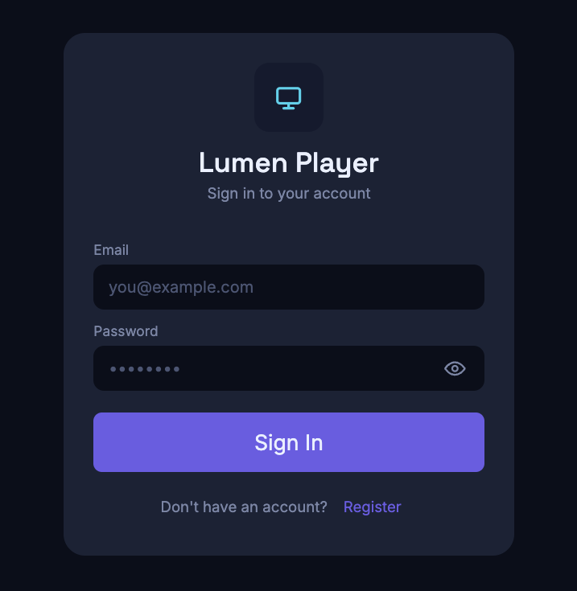
4
Detailed Login Information
Start page — Sign in to an existing account
1
Email input field for the account email address.
2
Password input field for the account password.
3
Show / hide toggles password visibility.
1
4
Sign In authenticates and continues to profile selection.
2
3
Register switches to the create-account screen.
5
4
5
The account is a free Lumen Player account used only to sync favourites, history and profiles across the user's devices. It is not a content subscription.
Lumen Player · UX Scenario Document
06

Slide 7
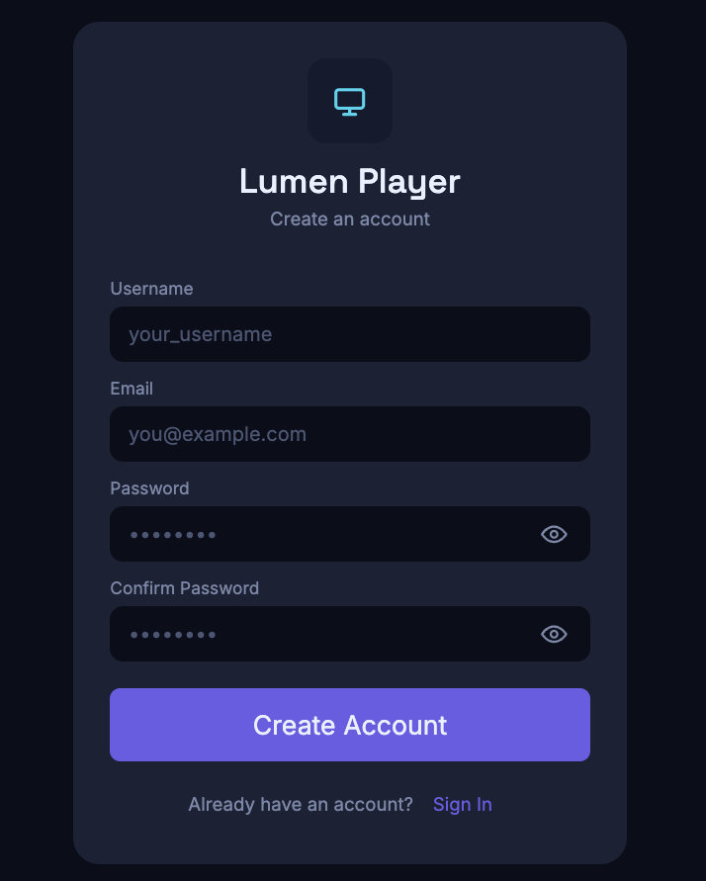
4
Detailed Login Information
Start page — Create a new account (Register)
1
Username display name for the account.
2
Email account email address.
3
Password account password (each field has a show/hide toggle).
1
4
Confirm Password re-enter to confirm.
2
3
5
Create Account creates the account and continues.
4
Sign In returns to the sign-in screen.
6
5
6
Lumen Player · UX Scenario Document
07

Slide 8
4
Test Accounts for QA
Mandatory — credentials the review team can use to test the app
Test Account (ID / PW)
Sample Playlist (to load media)
Email / ID
test@test.com
In Settings › Accounts the reviewer adds a playlist source. Use the sample source below to load sample media for testing:
Password
test.123
Test Account
One profile is pre-created; more can be added on the profile screen.
Reviewer notes (LG QA)
• Either the test account (ID/PW) or an access/activation flow is required to test the app; the account above is provided.
• A single account may be signed in on multiple devices at once — no per-device limit — so one test account is sufficient for QA.
• Lumen Player ships with no media. To exercise playback, add the sample playlist under Settings › Accounts.
• The application hosts and supplies no content; all media shown during testing originates from the sample playlist the reviewer loads.
Lumen Player · UX Scenario Document
08

Slide 9
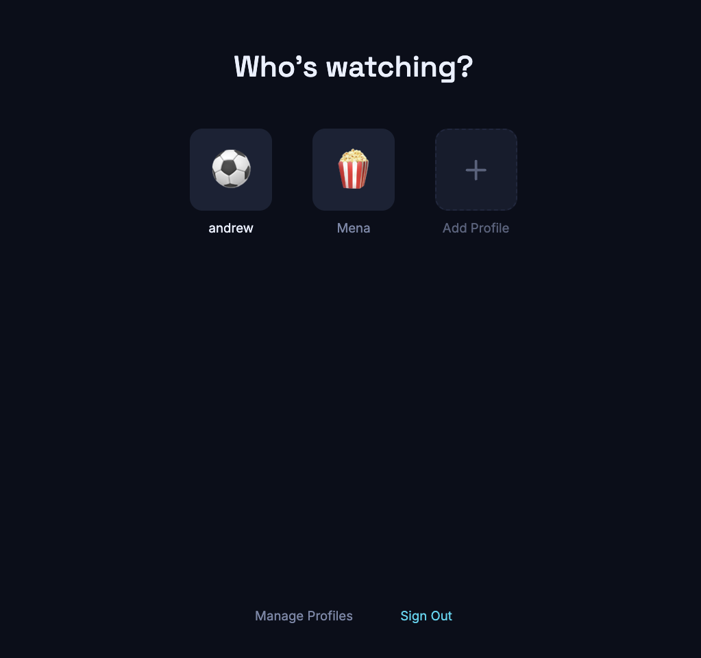
4
Profile Selection
“Who’s watching?” — choose or add a profile after sign-in
1
Profile tile select a profile to enter the app.
1
2
2
Add Profile create a new viewing profile.
3
Manage Profiles rename / remove profiles.
4
Sign Out returns to the sign-in screen.
Profiles keep each viewer's favourites, history and resume points separate. They are local personalisation only — not separate accounts or logins.
3
4
Lumen Player · UX Scenario Document
09

Slide 10
5
Main Page Description
Home — My List & History (favourites and resume)
1
Top navigation Home, Live, Movies, Series — D-pad left/right.
Lumen
1
Home
Live
Movies
Series
(•)
☀
2
My List & History
2
Account / menu opens Accounts (playlist, profiles, settings).
Favourites
Favourites items the viewer saved; OK opens / plays.
3
3
Watch History recently played, with a resume progress bar.
4
Watch History
4
Wireframe — tiles are placeholders; the live app shows only the artwork of media in the user's own playlist.
Lumen Player · UX Scenario Document
10

Slide 11
6
Sub Page Description
Browse — Movies & Series shelves
1
Section tab Movies (Series is identical).
Lumen
1
Home
Live
Movies
Series
(•)
☀
Movies
2
All Movies opens the full A–Z grid (next page).
▦ All Movies ›
2
Poster (focused) OK opens the detail view, then playback.
3
Movies · 527
4
More shelves rows grouped by the playlist's own categories.
3
Movies · Series · 80
Live uses the same browsable layout as a grid of content categories (General, Music, Sports, News …).
4
Lumen Player · UX Scenario Document
11

Slide 12
6
Sub Page Description — All Movies / Series
Full A–Z catalogue with search
1
Back returns to the Movies / Series shelves.
Lumen
Home
Live
Movies
Series
(•)
☀
‹
All Movies
651
2
Search type-to-filter the catalogue by title.
1
⌕ Search movies…
2
A–Z filter jump to titles starting with a letter.
3
3
ALL A B C D E F G H I J K L M N O P Q R S T U V W X Y Z
4
Poster (focused) OK opens the detail view, then playback.
4
Series uses the identical layout (Search series…, count, A–Z). Titles under the tiles come only from the user's playlist.
Lumen Player · UX Scenario Document
12

Slide 13
6
Sub Page Description — Accounts
How the reviewer adds a playlist (Settings › Accounts)
1
Add account paste an M3U or Xtream playlist URL.
Accounts
Playlist entry the active source; “✓ Active” is in use now.
2
+ Add account
1
3
Edit / Delete update or remove a saved playlist.
2
Sample Playlist
‹ your M3U / Xtream URL ›
✓ Active
3
Edit
Delete
4
TV Layout toggle how Movies & Series browse (shelves / grid).
4
TV Layout
How Movies & Series browse
▤ Shelves
Reviewers enter the sample playlist from the Test Accounts page here. Lumen Player stores and supplies no playlists of its own.
Lumen Player · UX Scenario Document
13

Slide 14
6
Sub Page Description — Video Player
Full-screen playback and on-screen controls
1
Play / Pause & seek transport controls; OK toggles play/pause.
Now playing
3
Sample media title
2
Progress bar shows position; left/right seek.
4
▶
Title & metadata current item; Back returns to the grid.
3
4
Playback surface auto-recovers from network hiccups.
⏮
⏯
⏭
1
Controls auto-hide during playback and reappear on any remote key. The player recovers automatically from transient network drops.
2
12:34
Lumen Player · UX Scenario Document
14

Slide 15
7
Paid Content
In-app purchase and payment methods
✓
Not applicable
Lumen Player contains no paid content and offers no in-app purchases, subscriptions, or payment flows. There are no credit-card, voucher-code, or SMS payment methods to test.
Lumen Player · UX Scenario Document
13

Slide 16
8
In-App Ad
Advertising placements (banner / video)
✓
Not applicable
Lumen Player displays no advertising of any kind — no banner ads and no video ads. There are no ad placements, locations, or ad-network integrations to describe.
Lumen Player · UX Scenario Document
14

Slide 17

Thank you for reviewing Lumen Player
A generic media player for the playlists you already own — it bundles, hosts and supplies no content.
com.andrew1h1.lumenplayer · v1.0.0 · Andrew Hany

