Slide 1
















TGC Annual Meeting
San Antonio, TX
Saturday October 16th 2021

Slide 2
Agenda
Approve 2020 Minutes
Roll Call
TGC Background
Current Objectives/Goals
Constitution/Rules Discussion
2022 Meet Schedule
2022 TGC Shirts
Elections

Slide 3
Roll Call
Roll Call
Have you moved gyms this year?
Are you unable to workout due to covid?
Do you know if you will be allowed to compete?
Survey Results
A quick note on social media

Slide 4
TGC History
1979: TGCCC Founded, though clubs and competition existed beforehand
Teams began attending NAIGC nationals in early 90’s
2006(?): Constitution written
2012: Began collecting income
2016: Board expanded
2018: Registration and Scoring System
2019: Constitution cleanup
2022 (goal): attain 501c3 status
Notes:
Andrew

Slide 5
Current Objectives
Education
-Alliance with Judging Organizations
-Clinics/ Judging Courses
2. Outreach
-New Clubs
-Visibility to JO Clubs/High School Programs
-Marketing/Brand Development

Slide 6
Current Objectives
3. Facilitating Competition
-Streamline Meet Registrations
-Streamline Competition Structure and Rules
-Virtual Meet?
-Dual Meets?
4. Operations
-Non-Profit Status
Notes:
mention new alum listserv

Slide 7
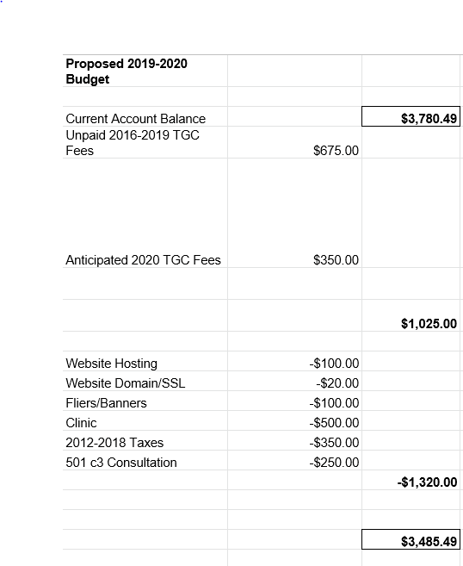
Proposed 2019-2020 Budget

Slide 8
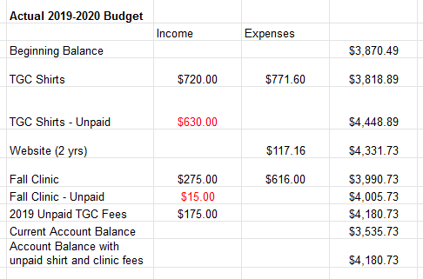
Actual 2019-2020

Slide 9
Actual 2019-2020
However, this just reflects unpaid fees from this past year. We have a few more outstanding fees, only one of which was paid this past year.

Slide 10
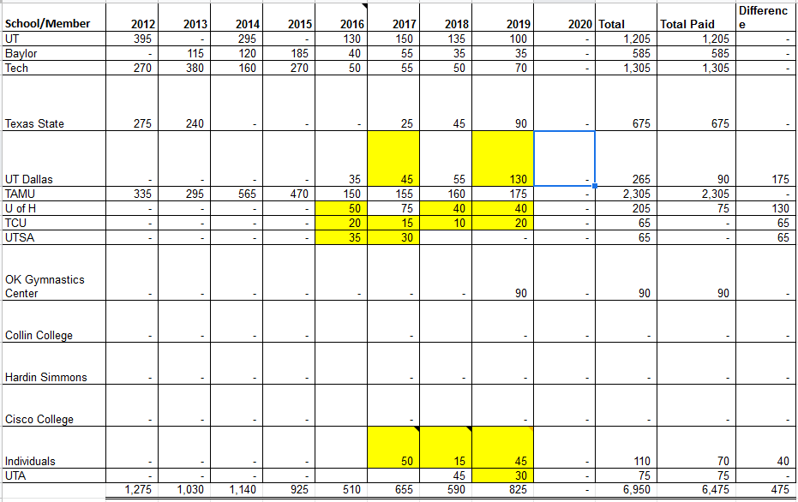
TGC Fees 2012-2020

Slide 11
Proposed 2020-2021 Budget
Domain name and website: -$73.14
Tax reimbursement: -$500
TGC Shirts:
Dri Fit: +$15/-$10 each
Regular: +10/-$8 each
Multiply ea profit by #sold, minus shipping

Slide 12
Actual 2020-2021 Budget
Domain name and website: -$72.40
Tax reimbursement: -$500
TGC Shirts:
$525.01 Expensed for shirts
$187.03 Expensed for shipping
$554.00 income
Overdue 2020 fees
$445
Net: -$285.44

Slide 13
Proposed 2021-2022 Budget
Domain name and website: -$72.40
Tax reimbursement: -$500
TGC Shirts:
Small profit
Fall Clinic: +$520
TGC fees: +$600
Printing fliers and ads: -$100
Nonprofit advisor: -$300

Slide 14
Questions?
Any questions about the presentation so far?
10min break / intermission
Next up:
2022 Meet Schedule
Shirt Designs
TGC Board Elections

Slide 15
Scheduling Constraints
Spring Break
Mar 7-11: Baylor, TCU
Mar 14-18: UT Austin, ACC, TxSt, UH, TAMU, SMU, UTD, UTA, Blinn, UNT, Tech
Other big meets to avoid:
Metroplex
Simone Biles Challenge
NAIGC Nationals April 14th-17th
Covid
Notes:
For TGC Hosts:
Everyone said both open & collegiate to their respective offered levels
Everyone said modified capital cup (warm up each event before competing it)

Slide 16
April 2022
April 14-17: NAIGC Nationals
April 2nd?
Notes:
Women for sure level 8 and 9
slight chance might change to some combo of two out of three of: level 6, level 7 and developmental

Slide 17
March 2022
26th: A&M
26th is NCAA Men’s championship
Unknown dates: Tech, Powerhouse
5th: Houston

Slide 18
February 2022
19th: UT Austin
Avoid Feb 19th as it is Metroplex
Unknown date: Tech, Houston, Powerhouse

Slide 19
January 2022
Unknown date: Tech, Houston, Powerhouse
HNI (SCL?) Jan 21/22?
Avoid Biles invite, Jan 27-30

Slide 20
2022 Shirts
We need a design
Dri fit or cotton?

Slide 21
Misc Nationals Updates
First fee increases in several years to keep up with inflation
Rules differences:
Men’s NCAA vs Modified NCAA
Men have developmental
Women have developmental and lv7
T&T
Mixed Teams
Decathlon/Men on Wag VT
Notes:
These are 2019-2020 updates that have not been published by NAIGC yet.

Slide 22
Anything else?
Before we open the floor to elections

Slide 23
Elections
1. President
2. Vice President
3. Secretary/Treasurer
4. Directors (2)
5. Executive Director
Notes:
Describe Positions, (college students spiel),Take Nominees for Each Position, Vote For Each

Slide 24
Reminders for club reps
You should have a copy of this page printed to take home.
Make sure your officers are subscribed to TGC email list
Make sure your officers are subscribed to NAIGC announcement list
you can remind gymnasts too as rules and nationals logistics are announced via that list
Optionally your officers can be in the NAIGC discussion google group
If you have competing alumni/adults make sure they are subscribed to the alumni email list.
Poll your team if anyone is interested in making a shirt design
Remind your team and the world to follow TGC social media!!!
Also follow each other on social media. tgcgymnastics.com/teams

