Slide 1
















TGC Annual Meeting
Austin, TX
Friday September 2nd 2017

Slide 2
Agenda
Roll Call
Meet Scheduling
Clinic
TGC History
Current Goals
Budget Report
Rules Discussion

Slide 3
Collegiate Gymnastics
What is collegiate gymnastics?
Current Systems:
NCAA
Side note: January 2015 Decision (potential loss of programs)
TGC
NAIGC
Other states
Adult Gymnastics

Slide 4
Partner Roll Call
High School Coaches - THSGCA:
Mark Sherman (THSGCA president, Highland Park HS)
Scott McDonald (Ozen)
CJ and/or Brandon Cook (Abilene)
Men’s Judges - TGJA
Mark Sherman (TGJA President)
James Sergeant
Women’s Judges – TX NAWGJ
Carol Buck (Women’s Judges State Director)
USAG Gym Owners
Adrian Eissler (Austin Gymnastics Club)

Slide 5
Old Club Roll Call
Briefly describe your club: Number of members Workout Schedule / Location Dues Anything new? | UT Dallas (Elijah) UT Austin (Jade, Zach) A&M (Katie, Madison) Texas State (Shelby & Bailey) TCU (Lonestar coaches) Rice Baylor Texas Tech (Jackie) OU (Ryan & Gio) UTSA (Doug) Houston (Raquel) Tulane (Greg - coach) Adults (Sydney R)

Slide 6
New/Upcoming Club Roll Call
Briefly describe your club: Number of members? Workout Schedule / Location? How can we help you? | UNT & TWU Lamar University Scott McDonald UT El Paso Brian Bishop Abilene Area Schools Brandon Cooke, Justin Powers SMU Austin CC Devon Hallford Other Richland, SFA, Tarrant CC, Collin, UT Arlington

Slide 7
2017 Meet Schedule
Preliminary Discussion Items:
Anyone to men’s USAG? last weekend of March
Fall Meets?
Smaller regional meets?
Adult Division
Level 8/9 Divisions?
Spring Breaks
March 6th to 10th: Baylor
March 13th to 17th: All TX Public Schools, TCU, Rice, OU, SMU

Slide 8
2017 Meet Schedule
Jan 27th – 29th: Metroplex, Fort Worth (Men Only)
Feb 5th: Jazz Invite, New Orleans
Feb 11th: UT Dallas
Feb 11th: OU
Feb 18th: Texas Tech
Feb 18th or 25th: Baylor, Waco (Women Only)
Feb 24th – 27^{th:} ASU (UTEP?), Phoenix
Feb 24th – 26^{th:} HNI, Galveston
March 25th(?): TGC Championships (A&M?)
NAIGC Nationals April 6th to 8th, 2016 - Columbus Ohio
Lamar University / Ozen HS (Beaumont, TX)
Texas State
Mark Sherman/ Highland Park HS (DFW)
Adrian Eissler / Austin Gym Club (Austin)
Abilene HS / Abilene?

Slide 9
TGC History
Founded in 1979
Currently have detailed records dating back to 2007

Slide 10
TGC History
606 Unique Gymnasts
and 34 Schools Since 2007, 28 in Texas
A&M
A&M Corpus Christi
Abilene Christian University
McMurry
ACC
Angelo State
Baylor
Collin Community College
Del Mar
Eastfield College
Hardin Simmons University
Lone Star
Odessa College
Oklahoma
Rice University
Richland Community College
South Plains College
St. Mary's University Tarrant County College
Tech
Texas Christian University
Texas State University
Tulane
UC Davis
University of Houston
University of Kansas
University of Mary Hardin Baylor
University of North Texas
UT Austin
UT Arlington
UTD
UTMB
UTSA

Slide 11
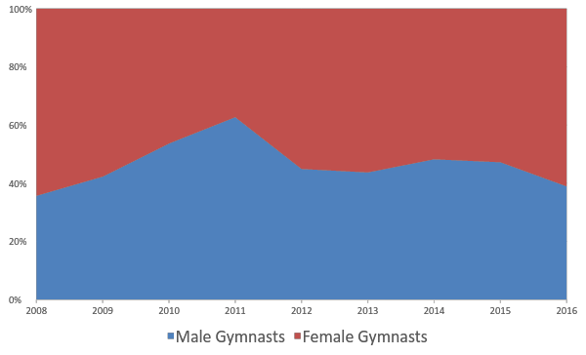
Unique Gymnasts per Year

Slide 12
Recent Milestones
Drafted constitution in 2006
Opened Bank Account 2011
Moved this meeting to 3hr slot in 2015
Informational table across the hall in 2016
Campaign to create new clubs, 2016
Build on Olympic interest and 2018 nationals
How many large universities don’t have teams?
2019 goal (map)

Slide 13
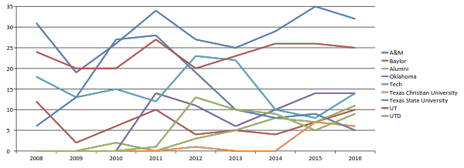
TGC History
 | 2008 | 2009 | 2010 | 2011 | 2012 | 2013 | 2014 | 2015 | 2016 | 2013-2016 Avg
A&M | 31 | 19 | 26 | 34 | 27 | 25 | 29 | 35 | 32 | 29.7
Baylor | 12 | 2 | 6 | 10 | 4 | 5 | 4 | 7 | 10 | 5.3
Alumni | 0 | 0 | 2 | 0 | 3 | 5 | 8 | 7 | 11 | 6.7
Oklahoma | 0 | 0 | 0 | 14 | 11 | 6 | 10 | 14 | 14 | 10.0
Tech | 18 | 13 | 15 | 12 | 23 | 22 | 10 | 8 | 14 | 13.3
Texas Christian University | 0 | 0 | 0 | 0 | 1 | 0 | 0 | 7 | 6 | 2.3
Texas State University | 6 | 13 | 27 | 28 | 19 | 10 | 8 | 9 | 5 | 9.0
UT | 24 | 20 | 20 | 27 | 20 | 23 | 26 | 26 | 25 | 25.0
UTD | 0 | 0 | 0 | 1 | 13 | 10 | 9 | 5 | 9 | 8.0

Slide 14
Current Goals
Develop educational camp
Develop organizational partnerships
Host more dual session meets
Team TX @ TWU?
Create alumni outreach program
Apply for nonprofit status
Open endowment fund
Intra-Texas growth strategy

Slide 15
Current Goals - Educational Camp
NAIGC
Part 1: Judging Courses
Educate TGC members so that they can build stronger routines
Develop judges (shortage)
Part 2: Workout
Provide coaching to build better teams
Promote TGC inter-team sportsmanship

Slide 16
Current Goals
Develop Educational camp
Host more Dual-Session meets
Apply for nonprofit status
Open endowment fund(s)
Create outreach program(s)
e.g. alumni, industry
Team TX @ TWU?
Intra-Texas growth strategy

Slide 17
Current Goals – Growth Strategy
Fliers for Advertising
We have a table at gat for the weekend to hand out info
JO Meets - have people attend and hand out info
A&M won bid for level 4/5 state
Work with Judges to spread info
High School
Timing: Build on Olympic interest and Ft Worth nationals

Slide 18
New NAWGJ Request System
Carol Buck

Slide 19
Questions?
Any questions about our history or current goals?
10min break / intermission
Next up: organizational business
Finances
Competition Rules
Organization Rules & Constitution
TGC board elections

Slide 20
2016 Budget
Current Account Balance 2035.99
Unpaid Fees +1395.00
3430.99
-(2016 Website Expenses) (105.00)
-(2016 Fliers/Promotion) (100.00)
$3225.99

Slide 21
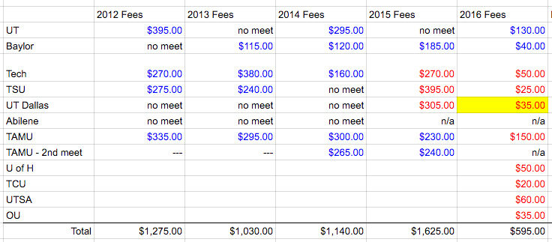
TGC Income 2012-2016

Slide 22
Current Goals-Financial
Income
Nonprofit Status/Endowment
Other Fundraising Ideas?
Spending Ideas/Goals
Subsidize Judges for Conference Championships, Annual Judging Clinic/Workout
Other ideas?
Saving
$3000 balance

Slide 23
Rules Discussion

Slide 24
New Quadrennium
New Rules Discussion

Slide 25
Any Men’s Rules Discussion?
TGC follows NCAA rules, team limit exception for non-championship meets
Disparity with NAIGC may affect future Qualifications and Rankings
Dismounts
Additional skills
New NAIGC developmental rules
New quadrennium changes
Most notably: 4 EGs; required double flip on floor

Slide 26
Any Women’s Rules Discussion?
Currently level 9 as modified by NAIGC, with team limit exception for non championship meets
Add level 8 division?
New quadrennium changes don’t take effect until next year

Slide 27
Open TGC Rules Discussion
Suggestions
Constitution

Slide 28
Anything else?
Before we open the floor to elections

Slide 29
Elections
Keep same roles?
Number of positions?
Advisory committee?

