Slide 1
















TGC Annual Meeting
Austin, TX
Friday September 1st 2017

Slide 2
Agenda
Approve 2016 Minutes
Roll Call
TGC History
Current Objectives/Goals
2018 Meet Schedule
Constitution/Rules Discussion
Elections
Notes:
Handouts: Constitution, Minutes, Packet

Slide 3
Attending Clubs
-UT Dallas (Elijah, Bassam) -UT Austin (Jade, Jacqueline) -UTEP (Mitch) -Houston (Haley) -A&M (Morgan, Emily) -Abilene (Justin) -Baylor (Amber) -Texas Tech (Meaghan, Saul) -UTSA (Matt) -OU (Tyson, Gio) -Alum/Adults | -UT Arlington (McKenna) -TCU (Megan / Donna) -Tulane -UNT -UMHB -Texas State -AGC
Notes:
Direct attendees to see packets with survey results for valuable information about other TGC clubs, can be a good resource especially for new officers and new clubs

Slide 4
TGC History
1979: TGCCC Founded, though clubs and competition existed beforehand
Teams began attending NAIGC nationals in early 90’s
2006: Constitution written
2012: Began collecting income
2015: Outreach initiative
2016: Board expanded

Slide 5
Current Objectives
Education
-Alliance with Judging Organizations
-Clinics/ Judging Courses
2. Outreach
-New Clubs
-Visibility to JO Clubs/High School Programs
-Marketing/Brand Development

Slide 6
Current Objectives
3. Facilitating Competition
-Streamlining Meet Registration
-Dual or Regional Meets
-Centenary / Metroplex
4. Operations
-Non-Profit Status
-Constitutional Revisions
Notes:
Objectives:
Facilitating Competition
-Streamlining Meet Registration
-Centenary / Metroplex
-Dual or Regional Meets
Outreach
-New Clubs
-Visibility to JO Clubs/High School Programs
-Marketing/Brand Development
Education
-Alliance with Judging Organizations
-Clinics/ Judging Courses
Operations
-Non-Profit Status
-Constitutional Revisions

Slide 7
Educational Camp
Part 1: Judging Course and/or Clinic
Educate TGC members so that they can build stronger routines
Develop judges (shortage)
Part 2: Workout
Provide coaching to build better teams
Promote TGC inter-team sportsmanship
Notes:
Education
Is this important to y’all? What would make your club members want to come?

Slide 8
Growth/Outreach Strategy
We have a table at GAT for the weekend to hand out info
JO Meets (TAAF, USAG, Xcel) - have people attend and hand out info
Work with Judges to spread info
Outreach to High Schools
Timing: Build on Ft Worth nationals
Same school student collection
Notes:
Outreach

Slide 9
2018 Meet Schedule
Preliminary Discussion Items:
Anyone to men’s USAG? last weekend of March
Fall Meets?
Level 8/9 Sessions at More Meets this Year
Multi-Session Meets in General
Scheduling Process
Meet Registration
Notes:
Facilitate Competitions
Can bring up the trend in TGC Comraderie at this point (ask the question what are your club members looking for out of these competitions)

Slide 10
January
Su | M 1 | T 2 | W 3 | Th 4 | F 5 | S 6
7 | 8 | 9 | 10 | 11 | 12 | 13
14 | 15 | 16 | 17 | 18 | 19 | 20
21 | 22 | 23 | 24 | 25 | 26 | 27
28 | 29 | 30 | 31
First Day of Class (Most Schools)
Notes:
27 Jan: UT Austin/AGC
27 Jan: A&M
2 Feb: HNI (Houston)
3 Feb: Jazz Invite (New Orleans)
10 Feb: UT Dallas
17 Feb: Bart Connor (Oklahoma)
24 Feb: UTEP @ ASU
Late Feb: Baylor
End March: Conf Championships @ Tx Tech
12 Apr: Nationals, in Ft Worth

Slide 11
February
Su | M | T | W | Th 1 | F 2 | S 3
4 | 5 | 6 | 7 | 8 | 9 | 10
11 | 12 | 13 | 14 | 15 | 16 | 17
18 | 19 | 20 | 21 | 22 | 23 | 24
25 | 26 | 27 | 28
HNI
Jazz Invite

Slide 12
March
Su | M | T | W | Th 1 | F 2 | S 3
4 | 5 | 6 | 7 | 8 | 9 | 10
11 | 12 | 13 | 14 | 15 | 16 | 17
18 | 19 | 20 | 21 | 22 | 23 | 24
25 | 26 | 27 | 28 | 29 | 30 | 31
|----------------------------Spring Break for Baylor----------------------------|
|-------------------Spring Break for Most Texas Schools-------------------|
TGC Championships

Slide 13
April
Su 1 | M 2 | T 3 | W 4 | Th 5 | F 6 | S 7
8 | 9 | 10 | 11 | 12 | 13 | 14
15 | 16 | 17 | 18 | 19 | 20 | 21
22 | 23 | 24 | 25 | 26 | 27 | 28
29 | 30
Easter
Nationals @ Fort Worth, TX

Slide 14
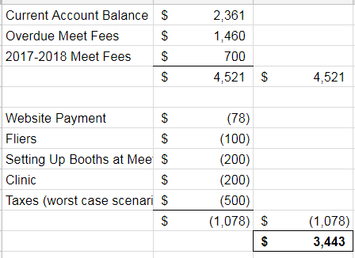
2017-2018 Budget
Notes:
For Board Reference: https://docs.google.com/a/tamu.edu/spreadsheets/d/1THmI4T2ratGvfFcQ9xNEEhr35Nnlgr6bHhgYNpuuo2c/edit?usp=sharing

Slide 15
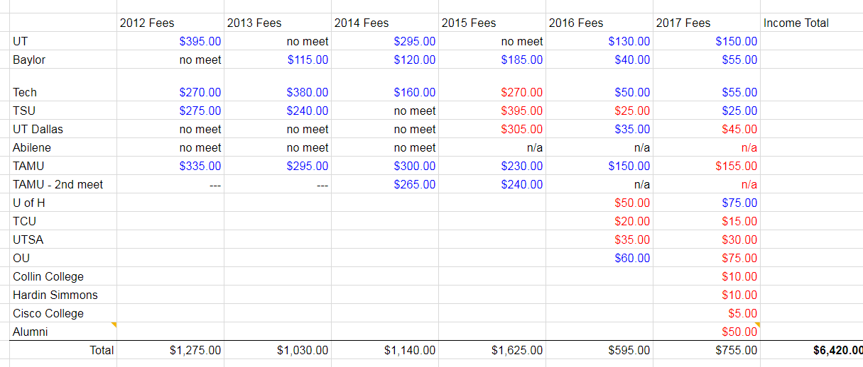
TGC Income 2012-2017
Notes:
Talk individually at the end (especially to 2015 teams)
Paying each other

Slide 16
Questions?
Any questions about the presentation so far?
10min break / intermission
Next up:
Constitution/Rules Discussion
TGC board elections

Slide 17
TGC Rules Discussion
Identify Problems
Suggestions
Constitutional Proposals/Vote
Notes:
Potential Talking Points:
Level 8 and Level 9
Team (Level 9 Shortage)
Constitutional Changes: (Rules Committee Meetings)
One School One Team
Enforcement Mechanism (Incentives/Punishment)

Slide 18
Anything else?
Before we open the floor to elections

Slide 19
Elections
1. President
2. Vice President
3. Secretary/Treasurer
4. Directors (2)
5. Executive Director
Notes:
Describe Positions, (college students spiel),Take Nominees for Each Position, Vote For Each

