Slide 1
















TGC Annual Meeting
Austin, TX
Friday August 31st 2018

Slide 2
Agenda
Approve 2017 Minutes
Roll Call
TGC Background
Current Objectives/Goals
2019 Meet Schedule
Constitution/Rules Discussion
Vote on 2018/2019 Shirt Designs
Elections
Notes:
Handouts: Constitution, Minutes, Packet

Slide 3
Attending Clubs
-UT Dallas (Caleb) -UT Austin (Jade, Sal) -UTEP () -A&M (Madison, Isabel) -Abilene (Andrew) -Baylor (Amber) -Texas Tech (Wendy, Zachary) -UTSA (Ryan) -OU (Randy, Corbin) -Alum/Adults (Sydney) | -Houston (Lauren) -UT Arlington (Lydia) -TCU (Andrew) -Tulane (Andrew) -Texas State ()
Notes:
Direct attendees to see packets with survey results for valuable information about other TGC clubs, can be a good resource especially for new officers and new clubs

Slide 4
TGC History
1979: TGCCC Founded, though clubs and competition existed beforehand
Teams began attending NAIGC nationals in early 90’s
2006(?): Constitution written
2012: Began collecting income
2015: Outreach initiative
2016: Board expanded

Slide 5
Current Objectives
Education
-Alliance with Judging Organizations
-Clinics/ Judging Courses
2. Outreach
-New Clubs
-Visibility to JO Clubs/High School Programs
-Marketing/Brand Development

Slide 6
Current Objectives
3. Facilitating Competition
-Streamline Meet Registrations
-Streamline Competition Structure and Rules
-Dual or Regional Meets
-Centenary / Metroplex
4. Operations
-Non-Profit Status
-Constitutional Revisions
Notes:
Objectives:
Facilitating Competition
-Streamlining Meet Registration
-Centenary / Metroplex
-Dual or Regional Meets
Outreach
-New Clubs
-Visibility to JO Clubs/High School Programs
-Marketing/Brand Development
Education
-Alliance with Judging Organizations
-Clinics/ Judging Courses
Operations
-Non-Profit Status
-Constitutional Revisions

Slide 7
TGC Fall Clinic
October 13-14 or 20-21
Part 1: Clinic (Saturday around noon)
Educate TGC members so that they can build stronger routines
Part 2: TGC Social (Saturday evening)
Part 3: Workout (Sunday mid-morning
Provide coaching to build better teams
Promote TGC inter-team sportsmanship
Notes:
Reflects requests from last year’s meeting (weekend event, in mid fall semester so new members can participate, good workout facility/coaching matters in terms of the workout)

Slide 8
Growth/Outreach Strategy
We have a table at GAT for the weekend to hand out info
JO Meets (TAAF, USAG, Xcel) - have people attend and hand out info
Work with Judges to spread info
Outreach to High Schools
Timing: Build on Ft Worth nationals
Same school student collection
Notes:
Outreach
Katie’s specific goal - outreach to high school has been effective, but as far as outreach to JO USAG, TAAF on the women’s side, we need to get more exposure to continue to add experienced gymnasts to the conference

Slide 9
2018 Meet Schedule
Preliminary Discussion Items:
Anyone to men’s USAG?
Thoughts on Competition Season last year - what you liked, what you want to change
Multi-Session Meets
Competitor Restrictions
Meet Registration
Notes:
Facilitate Competitions-
No AGC this year (factor that into budgeting for judges)
Can bring up the trend in TGC Comraderie at this point (ask the question what are your club members looking for out of these competitions)
Meet Registration - what worked, what didn’t
Meet Bidding process- need a shared calendar system more suited towards our needs next year

Slide 10
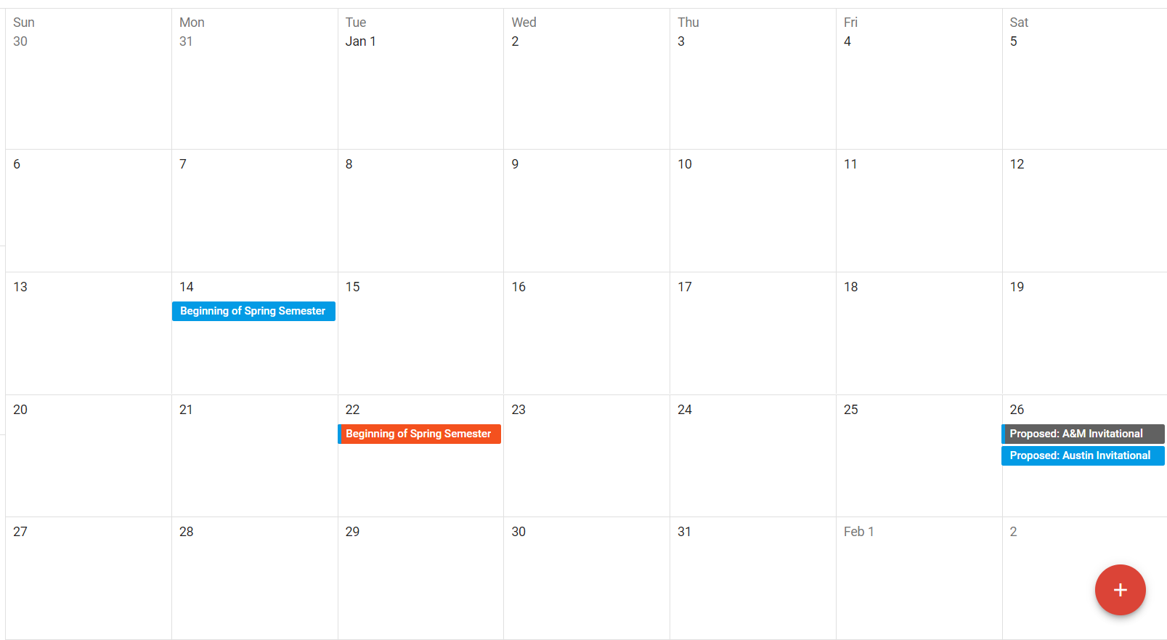
January

Slide 11
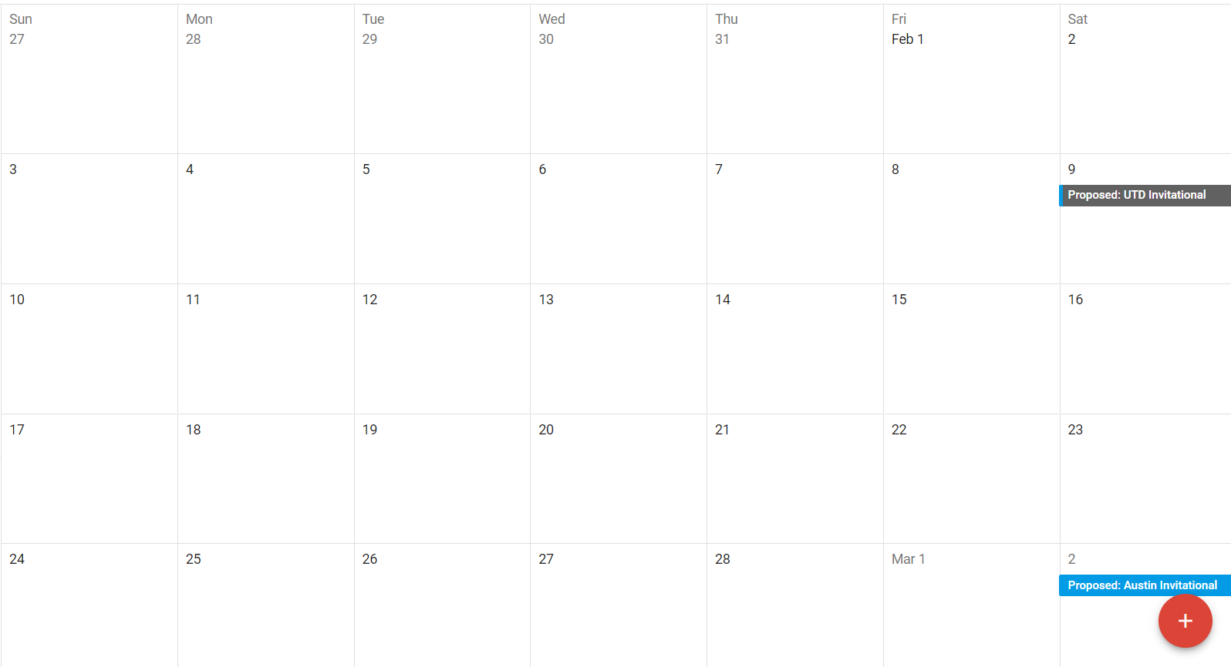
February

Slide 12
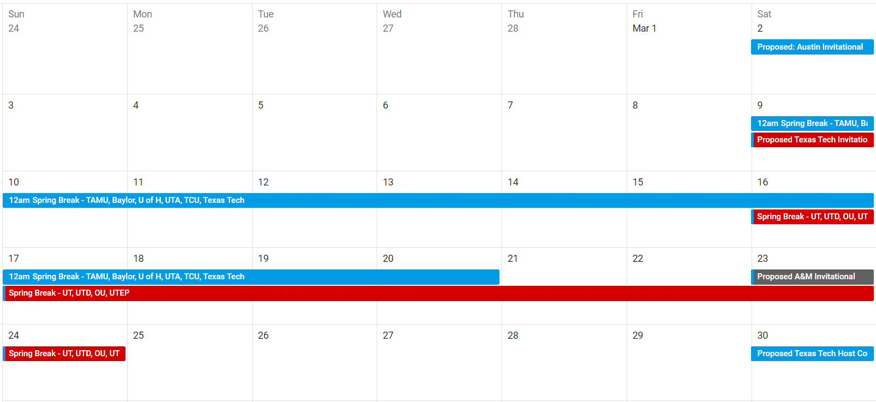
March

Slide 13
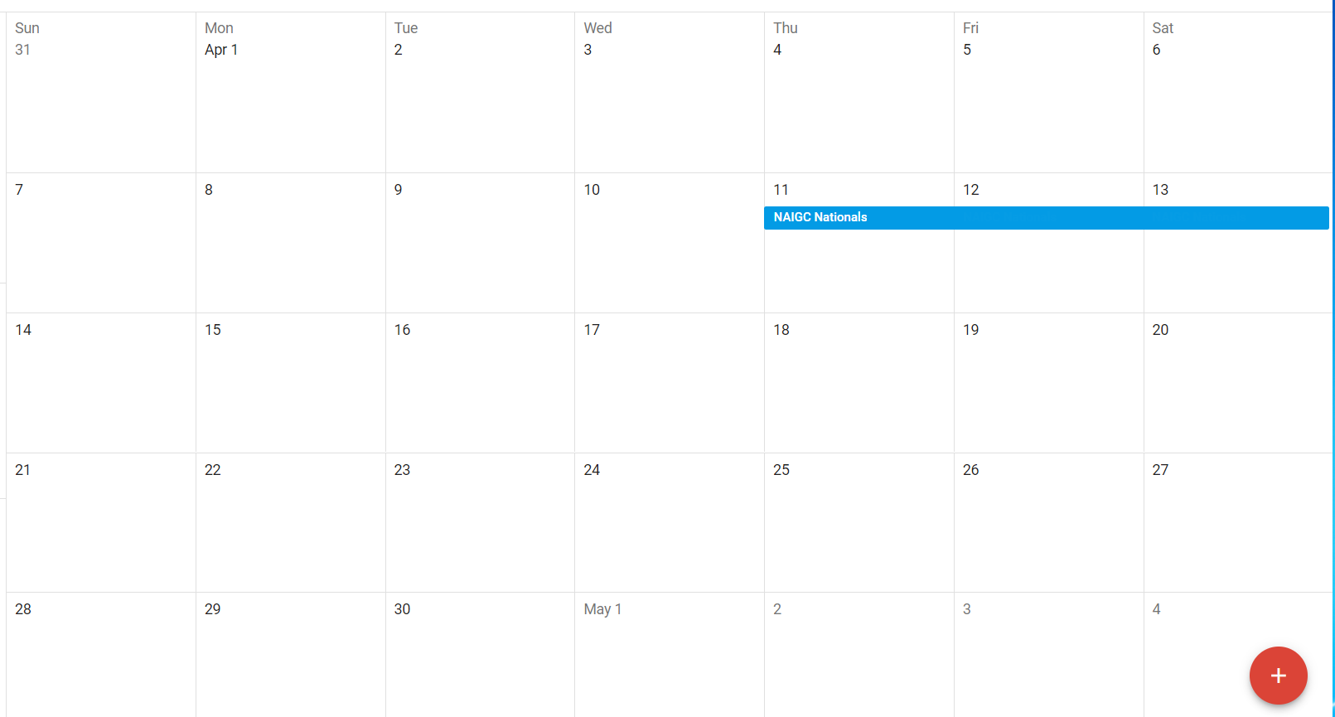
April
Notes:
Add screen shots of hosting school survey results

Slide 14
Potential Meet Host Survey Results
Club | M | W - L8 | W - L9 | Competitor Restrictions | Alumni Awarded | Notes
Texas A&M | ✓ | ✓ | ✓ | No | Yes
UT Dallas | ✓ | ✓ | ✓ | 8 competitors per level per event? | Yes
Baylor | X | ✓ | ✓ | No | Yes
UT Austin | ✓ | ✓ | ✓ | Maximum 10-12 athletes per event | Yes | Want to discuss potential athlete max at GAT
UTSA | ✓ | ✓ | ✓ |  | Yes
Texas Tech | ✓ | ✓ | ✓ | N/A | Yes | Want to host State
Notes:
Should have asked whether they can host more than one session.

Slide 15
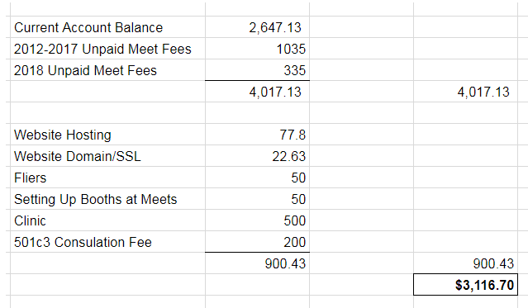
2017-2018 Budget
Notes:
For Board Reference: https://docs.google.com/a/tamu.edu/spreadsheets/d/1THmI4T2ratGvfFcQ9xNEEhr35Nnlgr6bHhgYNpuuo2c/edit?usp=sharing

Slide 16
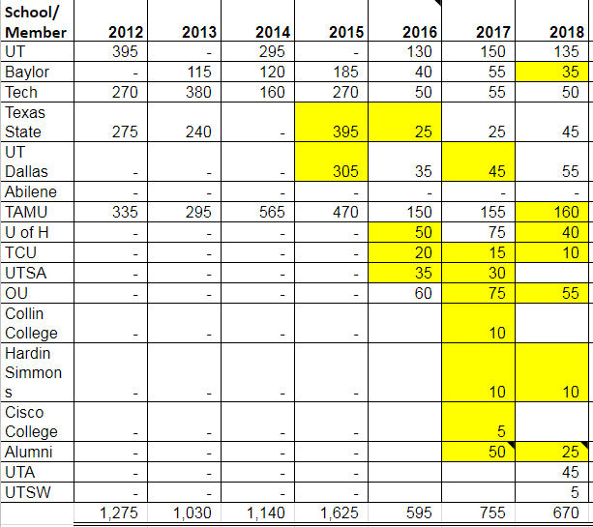
TGC Income 2012-2017
Notes:
Meet Fees Workbook, who can view, who has used it
Treasurers update as payments come in, new officers should check and reach out to check on any overdue payments (especially Texas Tech 2015)
Pay other schools first, but with the exception of Texas State and UTD (2015 balance- can discuss individually), we want to be current on TGC Fees as well

Slide 17
Questions?
Any questions about the presentation so far?
10min break / intermission
Next up:
Constitution/Rules Discussion
TGC board elections

Slide 18
TGC Rules Discussion
Current Rules/Current State of Constitution
Open discussion
New Proposals
Operational Rules
Notes:
See Handout:
Current Rules
Definition Proposals
Other Topics of Discussion

Slide 19
NAIGC Rules Discussion
Current Rules
Open Discussion
Regional Coordinator Position Opening
Potential Town Hall with NAIGC President Tim Michaels
Notes:
See Handout:
Current Rules

Slide 20
2018-2019 Shirt Designs

Slide 21
Anything else?
Before we open the floor to elections

Slide 22
Elections
1. President
2. Vice President
3. Secretary/Treasurer
4. Directors (2)
5. Executive Director
Notes:
Describe Positions, (college students spiel),Take Nominees for Each Position, Vote For Each

