Slide 1
















TGC Annual Meeting
Austin, TX
Friday August 30th 2019

Slide 2
Agenda
Approve 2019 Minutes
Roll Call
TGC Background
Current Objectives/Goals
Constitution/Rules Discussion
2020 Meet Schedule
Vote on 2020 Shirt Designs
Elections
Notes:
Handouts: Constitution, Minutes (copies for everyone), survey results (like 5 copies to share, it’s on the website)

Slide 3
Attending Clubs
-UT Dallas (Melanie) -UT Austin (Nikki, Chris) -A&M (Madison, Joseph) -OU (Corbin) -Texas State (Aja,Brianna,Alicia) -UT Arlington (Lyndsay, Liam, Gabby) -Katy Kips (Danelle) -Alum/Adults (Lauren) -Misc San Antonio Schools (Ryan Maskell) -Hardin Simmons (Justin) | Not expected -Baylor -TCU -UNT -Houston -Tulane -Texas Tech Individual competitors -Tarleton ( 1 w from Trinity HS, maybe 1m) -Eastfield (1 m from Rockwall gym academy) -A&M Prairie View (1W from Kentucky) -ACC (1M from Crenshaw’s)
Notes:
2019-2020 notes:
Direct attendees to see packets with survey results for valuable information about other TGC clubs, can be a good resource especially for new officers and new clubs
Baylor not present per on campus recruiting event; freshman president
Houston has 2 away meet limit, no out of state
ULL may come to TAMU meet
Tarleton girl for sure, maybe one guy from Trinity HS; working out at Texas Twisters (mostly cheer, no mens equipment, only gym in 30 miles)
Girl from prairie view competed for U Kentucky club team

Slide 4
TGC History
1979: TGCCC Founded, though clubs and competition existed beforehand
Teams began attending NAIGC nationals in early 90’s
2006(?): Constitution written
2012: Began collecting income
2015: Outreach initiative
2016: Board expanded
Notes:
Andrew

Slide 5
Current Objectives
Education
-Alliance with Judging Organizations
-Clinics/ Judging Courses
2. Outreach
-New Clubs
-Visibility to JO Clubs/High School Programs
-Marketing/Brand Development

Slide 6
Current Objectives
3. Facilitating Competition
-Streamline Meet Registrations
-Streamline Competition Structure and Rules
-Dual or Regional Meets?
4. Operations
-Non-Profit Status
-Constitutional Revisions
Notes:
mention new alum listserv

Slide 7
TGC Fall Clinic
October 5-6 or November 2-3; Cost $15-$20 per person
Part 1: Clinic (Saturday around noon)
Educate TGC members so that they can build stronger routines
Meet Hosting Seminar
Part 2: TGC Social (Saturday evening)
Part 3: Workout (Sunday mid-morning
Provide coaching to build better teams
Promote TGC inter-team sportsmanship
Notes:
Last year’s numbers: 37 people at the open workout
Could maybe go through feedback from last year -
Home Games (fall clinic)
Oct 5: Tech
Nov 2: TAMU

Slide 8
TGC Summer Retreat
Triple Springs Gymnastics Camp, located midway between Waco and Temple.
Date might need to be near their kids camps b/c they rent the men’s equipment, so late July / early Aug 2020.
Have cabin capacity for 400
Dining hall / they can provide food in cost
Pool, Lake, etc
They would like a relationship with the TGC as well to help hire coaches in the future.
Cost TBD
Notes:
Andrew to explain, gauge interest

Slide 9
Growth/Outreach Strategy
We have a table at GAT for the weekend to hand out info
JO Meets (TAAF, USAG, Xcel) - have people attend and hand out info
Work with Judges and Coaches to spread info
Outreach to High Schools
Organize the efforts of students attending the same school who are interested in starting a club

Slide 10
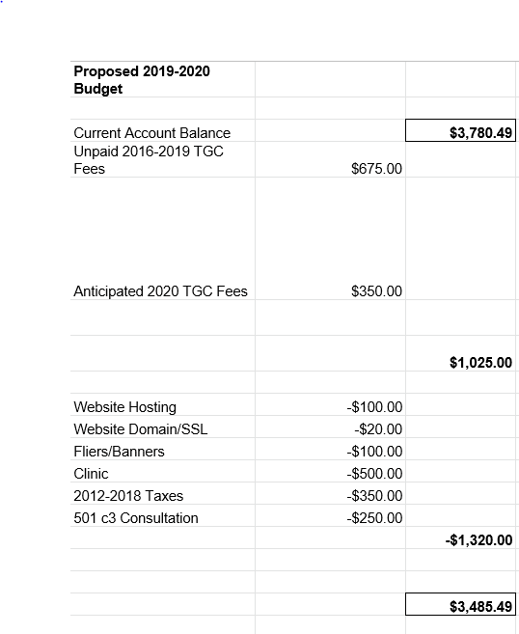
2019-2020 Budget

Slide 11
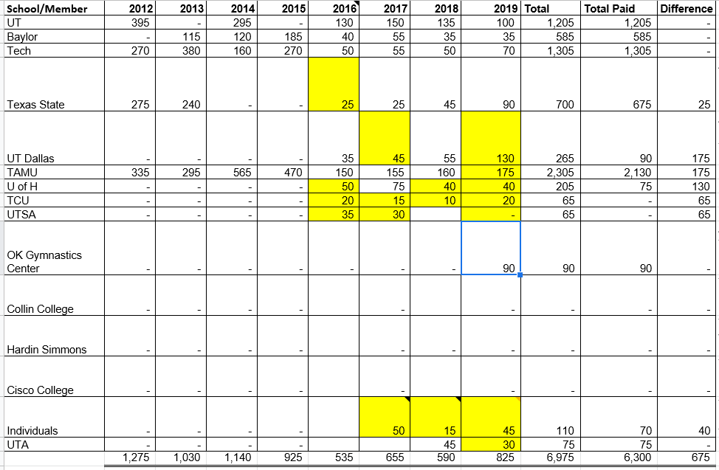
TGC Income 2012-2019
Notes:
Can also go over Meet Fees Workbook, who can view, who has used it
Treasurers update as payments come in, new officers should check and reach out to check on any overdue payments (especially Texas Tech 2015)

Slide 12
TGC Rules Discussion
Discussion of Proposed Constitution
2) Vote on ratification
3) Discuss and vote on any proposed amendments
Notes:
Maybe look at purpose and objectives
Definitions and Privileges (similar to what was passed last year with addition of definition of annual meeting, privilege to vote expanded upon, privilege to use TGC Resources added)
Article 5 - note club responsibilities
Article 6 - note the meet bidding process (appendix a), responsibilities of meet host (appendix b), responsibilities of meet attendees
Article 7 - a) Talk through what our goals were when drafting this part (team competition, protect higher levels, have people compete the level they are and still be able to contribute to a team score)
b) Open/Collegiate division, Levels that meet hosts can choose from, registration limitations
c) Awards - 3 count per team in all, all levels place, but restrictions on who can place
Article 8 - Amendments by Majority vote

Slide 13
Questions?
Any questions about the presentation so far?
10min break / intermission
Next up:
2020 Meet Schedule
Shirt Designs
TGC Board Elections

Slide 14
2020 Meet Schedule
Preliminary Discussion Items:
Anyone to men’s USAG?
Thoughts on Competition Season last year - what you liked, what you want to change
Multi-Session Meets
Competitor Restrictions
Meet Registration

Slide 15
Scheduling Constraints
Spring Break
Mar 9-13: TAMU, TCU, UNT, UTA, Tech, Baylor, UH
Mar 16-21: UT, TxSt, OU, UTD
Other big meets to avoid:
HNI Feb 7-9th
Metroplex Jan 24th
NAIGC Nationals April 16th
Notes:
For TGC Hosts:
Everyone said both open & collegiate to their respective offered levels
Everyone said modified capital cup (warm up each event before competing it)

Slide 16
April 2020
April 4th: Open
April 11th: Open
April 16th-18th, NAIGC Nationals, Providence RI
Women: Developmental, L7, 8 ,9
Men: Developmental, 9, NCAA
Notes:
Women for sure level 8 and 9
slight chance might change to some combo of two out of three of: level 6, level 7 and developmental

Slide 17
March 2020
Mar 7th: Open
Mar 7th - 15th: Spring break (TAMU, TCU, UNT, UTA, Tech, Baylor, UH)
Mar 14th: Open
Mar 14th - 22nd: Spring break (UT, TxSt, OU, UTD)
Mar 21st: Open
Mar 28th: Proposed Conference Championships (A&M or Powerhouse)

Slide 18
February 2020 (Dates)
Feb 1st: Open
Feb 8th: UTD (possibly Feb 7th)
Feb 15th: U of H (women only)
Feb 22nd: UT Arlington (possibly women only)
Feb 29th: UT Austin (Preferred date)

Slide 19
February 2020 (Meet Details)
UT Austin: Feb 8th, Feb 15th, Feb 22nd, Feb 29th (Preferred)
15 per event limit; 2 sessions
Women’s L8,L9, Men’s NCAA
U Houston: Feb 22^{nd,} Feb 15th, Feb 1st;
1 session; afternoon; Women’s L6, L8, L9; teams at 10 per level limit
Men included if another gym found
A&M: Feb 8th
2 sessions; Men’s NCAA, Women’s L6, L8 and L9 or w/e else
UT Arlington: Feb 22nd
Feb 22nd @ Texas Tough Invite; possible increased fees
TBA Date: Trevino’s, Women only
UT Dallas: Feb 7th/8th or Jan 25th
Feb 7th/8th in conjunction with Friendship Invitational; 12 per event
Jan 25th at Texas Champion Gymnastics, vault/hb/rings over mats in a pit

Slide 20
January 2020
Jan 18th: Open
Jan 25th: (Metroplex Challenge); UT Dallas

Slide 21
2020 Shirt Designs
[the past 11 shirts are on display up front]
How did we like dri-fit?
Anything else / tank tops?
We need a design
Backup plan is the printing artist makes one again (Austin Cashell, Texas Tech gymnastics alum)

Slide 22
Quick Updates on Nationals Rules
No known women’s changes at this time.
Men’s level caps to prevent sandbagging
12.3 start value cap for developmental
13.2 start value cap for level 9
no deduction for higher skills but no extra D score. This encourages higher level gymnasts to enter at the higher level.
Men’s Minimum score
doing nothing can still warrant a zero score, but:
any good faith attempt at a routine but has little or zero difficulty basically gets a pity score somewhere between 2.0 and 3.0. Applies to all difficulty levels.
Notes:
These are 2019-2020 updates that have not been published by NAIGC yet.

Slide 23
Anything else?
Before we open the floor to elections

Slide 24
Elections
1. President
2. Vice President
3. Secretary/Treasurer
4. Directors (2)
5. Executive Director
Notes:
Describe Positions, (college students spiel),Take Nominees for Each Position, Vote For Each

Slide 25
Reminders for club reps
You should have a copy of this page printed to take home.
Make sure your officers are subscribed to TGC email list
Make sure your officers are subscribed to NAIGC announcement list
you can remind gymnasts too as rules and nationals logistics are announced via that list
Optionally your officers can be in the NAIGC discussion google group
If you have competing alumni/adults make sure they are subscribed to the alumni email list.
Poll your team if anyone is interested in making a shirt design
Poll your team for outreach volunteers
Remind your team and the world to follow TGC social media!!!
Also follow each other on social media. tgcgymnastics.com/teams

