Slide 1
















TGC Annual Meeting
Zoom
Saturday October 24th 2020

Slide 2
Agenda
Approve 2019 Minutes
Roll Call
TGC Background
Current Objectives/Goals
Constitution/Rules Discussion
2021 Meet Schedule
2020 TGC Shirts
2021 TGC Shirts
Elections

Slide 3
Roll Call
Roll Call
Have you moved gyms this year?
Are you unable to workout due to covid?
Do you know if you will be allowed to compete?
Survey Results
A quick note on social media

Slide 4
TGC History
1979: TGCCC Founded, though clubs and competition existed beforehand
Teams began attending NAIGC nationals in early 90’s
2006(?): Constitution written
2012: Began collecting income
2016: Board expanded
2018: Registration and Scoring System
2019: Constitution cleanup
Notes:
Andrew

Slide 5
Current Objectives
Education
-Alliance with Judging Organizations
-Clinics/ Judging Courses
2. Outreach
-New Clubs
-Visibility to JO Clubs/High School Programs
-Marketing/Brand Development

Slide 6
Current Objectives
3. Facilitating Competition
-Streamline Meet Registrations
-Streamline Competition Structure and Rules
-Virtual Meet?
-Dual Meets?
4. Operations
-Non-Profit Status
Notes:
mention new alum listserv

Slide 7
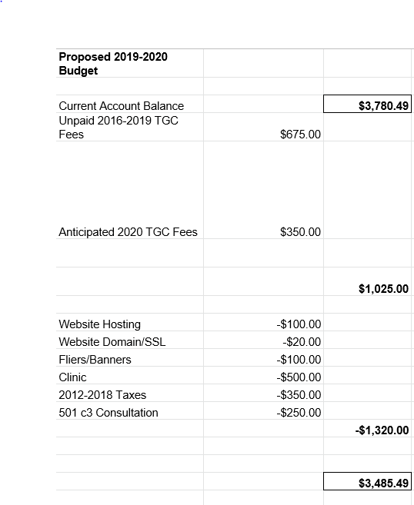
Proposed 2019-2020 Budget

Slide 8
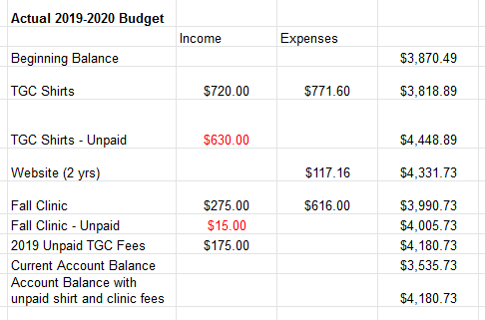
Actual 2019-2020

Slide 9
Actual 2019-2020
However, this just reflects unpaid fees from this past year. We have a few more outstanding fees, only one of which was paid this past year.

Slide 10
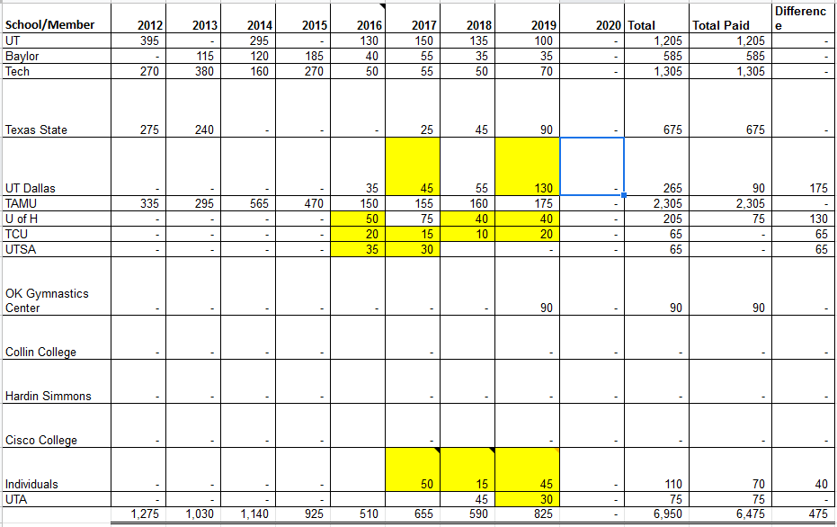
TGC Income 2012-2020

Slide 11
Proposed 2020-2021 Budget
Domain name and website: -$73.14
Tax reimbursement: -$500
TGC Shirts:
Dri Fit: +$15/-$10 each
Regular: +10/-$8 each
Multiply ea profit by #sold, minus shipping

Slide 12
Questions?
Any questions about the presentation so far?
10min break / intermission
Next up:
2020 Meet Schedule
Shirt Designs
TGC Board Elections

Slide 13
2020 Meet Schedule
Non-Covid Discussion Items:
Thoughts on Competition Season last year - what you liked, what you want to change

Slide 14
Scheduling Constraints
Spring Break
Mar 9-11 (Tu-Th): TCU
Mar 15-19 (M-F): UT, UT Arlington, UT Dallas, U Houston, Blinn, TxSt, TCC
Cancelled: SMU, A&M (just the 19th), UNT, OU, Baylor, Tech
Other big meets to avoid:
Metroplex Feb 12-14th
Simone Biles Challenge Jan 21st-24th
NAIGC Nationals April 14th-17th
Covid
Notes:
For TGC Hosts:
Everyone said both open & collegiate to their respective offered levels
Everyone said modified capital cup (warm up each event before competing it)

Slide 15
April 2020
April 14-17: NAIGC Nationals
Notes:
Women for sure level 8 and 9
slight chance might change to some combo of two out of three of: level 6, level 7 and developmental

Slide 16
March 2020
March 27th: A&M

Slide 17
February 2021 (Dates)
Feb 27th: UT
Feb 13th: A&M

Slide 18
January 2021
Jan 9th: OU (Men’s Teams only)

Slide 19
2020 Shirts
Outstanding schools
Baylor (Paid, not shipped)
UT Arlington
UT Dallas
Space City

Slide 20
2021 Shirts
We have used a TGC Family vendor for the past decade but need a new vendor
We also need a design

Slide 21
Quick Updates on Nationals Rules
No major men’s changes at this time.
Women will add Level 7
Notes:
These are 2019-2020 updates that have not been published by NAIGC yet.

Slide 22
NAIGC Regional Town Hall
Mid-November?
NAIGC Mission
NAIGC Board Election System
Notes:
These are 2019-2020 updates that have not been published by NAIGC yet.

Slide 23
Anything else?
Before we open the floor to elections

Slide 24
Elections
1. President
2. Vice President
3. Secretary/Treasurer
4. Directors (2)
5. Executive Director
Notes:
Describe Positions, (college students spiel),Take Nominees for Each Position, Vote For Each

Slide 25
Reminders for club reps
You should have a copy of this page printed to take home.
Make sure your officers are subscribed to TGC email list
Make sure your officers are subscribed to NAIGC announcement list
you can remind gymnasts too as rules and nationals logistics are announced via that list
Optionally your officers can be in the NAIGC discussion google group
If you have competing alumni/adults make sure they are subscribed to the alumni email list.
Poll your team if anyone is interested in making a shirt design or has a family owned company
Remind your team and the world to follow TGC social media!!!
Also follow each other on social media. tgcgymnastics.com/teams

