Slide 1
















TGC Annual Meeting
San Antonio
Saturday October 14th 2023

Slide 2
Agenda
Approve 2022 Minutes
Roll Call
TGC Background
Current Objectives/Goals
Last Meeting
Constitution/Rules Discussion
2024 Meet Schedule
2024 TGC Shirts
Elections

Slide 3
Roll Call
Roll Call
Have you moved gyms this year?
Are you unable to workout due to covid?
Do you know if you will be allowed to compete?
Survey Results
A quick note on social media

Slide 4
TGC History
1979: TGCCC Founded, though clubs and competition existed beforehand
Teams began attending NAIGC nationals in early 90’s
2006(?): Constitution written
2012: Began collecting income
2016: Board expanded
2018: Registration and Scoring System
2019: Constitution cleanup
2023 (goal): attain 501c3 status
Notes:
Andrew

Slide 5
Current Objectives
Education
-Alliance with Judging Organizations
-Clinics/ Judging Courses
2. Outreach
-New Clubs
-Visibility to JO Clubs/High School Programs
-Marketing/Brand Development

Slide 6
Current Objectives
3. Facilitating Competition
-Streamline Meet Registrations
-Streamline Competition Structure and Rules
-Virtual Meet?
-Dual Meets?
4. Operations
-Non-Profit Status
Notes:
mention new alum listserv

Slide 7
Proposed Constitutional Changes
MAG judges’ payment rates are changed to:
default rate, plus
if meet is > 4hr, +$20/every half hour
Limit to 6 up/event and no multiple teams
Registration is due 3 weeks prior to meet
Meet host must have a meeting with the TGC Board 2 weeks prior to the meet date
All sessions will have 4 womens judges and 3 mens judges unless approved by the TGC Board
Rotations must be approved by the TGC Board
Increase all individual meet fees by $5/person
Change “meet” to “event” in regards to reg fees and deadlines
Define a quorum

Slide 8
Any New Rules?
Notes:
mention new alum listserv

Slide 9
Major Rule Reminders
Review Constitution with emphasis on:
Article 6.4:
i) Attendees must register two weeks prior to the competition to avoid being charged a late fee. After two weeks prior, a $5 per competitor late fee will be imposed. One week prior to the competition, registration is closed, and additional entries will only be allowed at the discretion of the Meet Host.
ii) For all TGC meets except Conference Championships, there will be an entry fee of $10.00 per individual competitor and an additional $10.00 per team. Participants’ rosters are due two weeks prior to the competition, and entry fees will be charged based on this roster.
iii) For the Conference Championships, $15.00 per individual competitor will be charged by the host school. An additional $20.00 per team will be charged for those Clubs entering the team competition. All entry fees will be paid to the Meet Host unless otherwise directed by the Meet Director. The TGC will charge an additional $5 per gymnast based on the rosters submitted two weeks prior to the competition.
iv) If after the registration deadline, an individual open athlete or member(s) of a Club are no longer able to compete, it is the responsibility of the individual open athlete or Club to contact the Meet Host.
Article 6.3:
The Meet Host must contact teams four weeks prior to the competition concerning meet organization (including specific competitor limitations that will be imposed). Any exceptions or modifications to these rules may be permitted with the agreement of all teams concerned. If the Meet Host fails to contact teams at least four weeks prior to the competition, late fees will be waived for that competition.
Notes:
mention new alum listserv

Slide 10
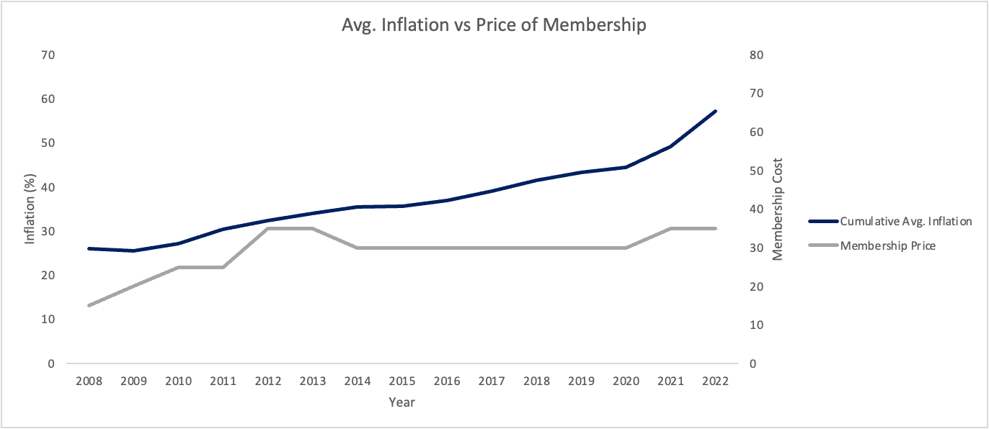
NAIGC Updates
Notes:
mention new alum listserv

Slide 11
NAIGC Updates
Cost changes
regular inflation
backlog of rescheduling cancelled events during covid has raised the demand for convention center space
Notes:
mention new alum listserv

Slide 12
NAIGC Updates
Award and category changes
3 awards per event
All discipline-student-gender-level combinations now separated (nonbinary combined with men)
Fee Increases:
8 per event limit gone, limit of one team per level with unlimited per event
Athlete Membership $35 -> $50 per person
Coach Membership $30 -> $40 per person
Club Membership $75 -> $100
~$10 change fee after registration closes?
Banquet ticket approximately double
Notes:
mention new alum listserv

Slide 13
NAIGC Updates
Fee Increases:
Competitor Registration has been simplified to a single tier, regardless of the number of disciplines.
New fee *estimate*
Early Individual Registration | $95
Standard Individual Registration | $110
Late Individual Registration | $130
Standard Additional Discipline Registration | $15
Late Additional Discipline Registration | $20
Standard Team Registration | $125
Regular Fee | Late Fee
$170 | $185
Notes:
mention new alum listserv

Slide 14
Example 2023 -> 2024 Calculations
Large Team, A&M
39 memberships: $1365 -> $1950
39 athletes: $3705 -> $6630
4 team fees: $500 -> $0
39 banquet Tickets: $1365 -> $2730
Total: $6935 -> $11310
Small Team, Baylor
11 memberships: $385 -> $550
11 athletes: $1250 -> $1870
1 team fees: $125 -> $0
11 banquet tickets: $410 -> $820
Total: $2170 -> $3240
Notes:
mention new alum listserv

Slide 15
Outstanding Last Season Payments
 | Shirts | TGC Fee | Clinic
baylor | $176.00 | $65 | --
scl | $96.00 | $30 | --
tcc | $48.00 | $20 | --
tcu | $192.00 | $60 | --
tech | $128.00 | -- | --
utd | $128.00 | $15 | --
ut | $496.00 | $135 | --
uh | $96.00 | $25 | --
tamu | $624.00 | $245 | --
ou | $256.00 | $80 | --
txst | $144.00 | $45 | --
unt | -- | $25 | --

Slide 16
Proposed 2022-2023 Budget
Domain name and website: -$72.40
Final Tax payment: -$400
TGC Shirts:
Small profit
Fall Clinic: ???
TGC fees: +$600
Printing fliers and ads: -$100
Nonprofit application: $-275

Slide 17
Actual 2022-2023 Budget
Domain name and website: -$63.88
Tax payment: -$500
TGC Shirts: -$2089.92 + $2464 = +374.08
Fall Clinic: ---
TGC fees: +$745

Slide 18
Proposed 2023-2024 Budget
Domain name and website: -$70
Tax payment: $0!
TGC Shirts: -$2000 + $2300
Fall Clinic: +$360 - $650
TGC fees: +$800
Nonprofit Application: -$300

Slide 19
Questions?
Any questions about the presentation so far?
10min break / intermission
Next up:
2024 Meet Schedule
Shirt Designs
TGC Board Elections

Slide 20
Scheduling Constraints
Spring Break
Mar 4-8: Baylor
Mar 11-16: UT, A&M, Houston, UTA, TCU, UTD, TxSt, Tech
Mar 18-22: OU
Other big meets to avoid:
Jan 20: HNI
Feb 9: Liukin
Feb 17: Metroplex
Notes:
For TGC Hosts:
Everyone said both open & collegiate to their respective offered levels
Everyone said modified capital cup (warm up each event before competing it)

Slide 21
March 2024
April 10-13: NAIGC Nationals
March 23rd: A&M
March 2nd: University of Houston

Slide 22
February 2024
Feb 3rd, UT Austin
Feb 10th, TBD: SCL (men & women) or Baylor (women only)
Feb 24th, Texas Tech

Slide 23
January 2024
Jan 27th: Rockwall HS
Registration due end of November

Slide 24
2024 Shirts
We need a design
Dri fit or cotton?

Slide 25
Anything else?
Before we open the floor to elections

Slide 26
Elections
1. President
2. Vice President
3. Secretary/Treasurer
4. Directors (2)
5. Executive Director
Notes:
Describe Positions, (college students spiel),Take Nominees for Each Position, Vote For Each

Slide 27
Reminders for club reps
You should have a copy of this page printed to take home.
Make sure your officers are subscribed to TGC email list and are in the officers groupme
Make sure your officers are subscribed to NAIGC announcement list
you can remind gymnasts too as rules and nationals logistics are announced via that list
Optionally your officers can be in the NAIGC discussion google group
If you have competing alumni/adults make sure they are subscribed to the alumni email list.
Poll your team if anyone is interested in making a shirt design
Remind your team and the world to follow TGC social media!!!
Also follow each other on social media. tgcgymnastics.com/teams

