Slide 1
FaIR overview
F.a.I.R. ~ Finite Amplitude Impulse-Response model
A simple, Python-based climate model which is idealized enough to run in a few seconds on your laptop but can also be used to explore interesting climate behaviour!
General idea is, specify some input emissions, and the model gives you GHG concentrations, radiative forcing and temperature change. ☺
We’re going to try and use this model to explore:
The different responses of climate to greenhouse gases and aerosols
…and the role of feedbacks and uncertainty in the future response.

Slide 2
FaIR schematic
Emissions
GHGs only…
Concentrations
(CO2, methane, aerosols, CFCs etc)
via the carbon/methane cycles
…ignore this for now ;)
Radiative Forcing
Global
temperature
change

Slide 3
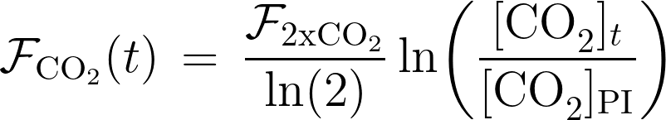
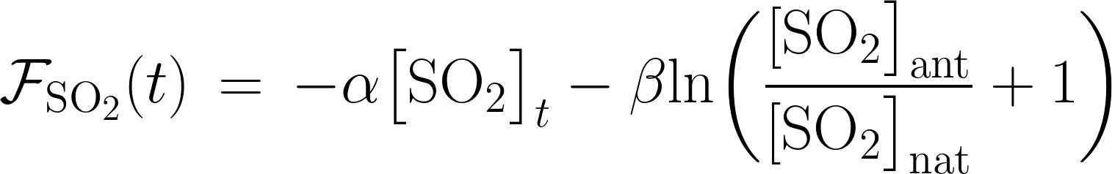
Radiative Forcing
Emissions
Concentrations
(CO2, methane, aerosols, CFCs etc)
For some well-mixed GHGs, it’s possible to relate their concentrations to radiative forcing using simple, semi-empirical relationships.
For aerosols, it’s much more complicated(*) and few closed analytical expressions exist.
*Question: Why could this be? What’s different about aerosols?
Radiative Forcing

Slide 4
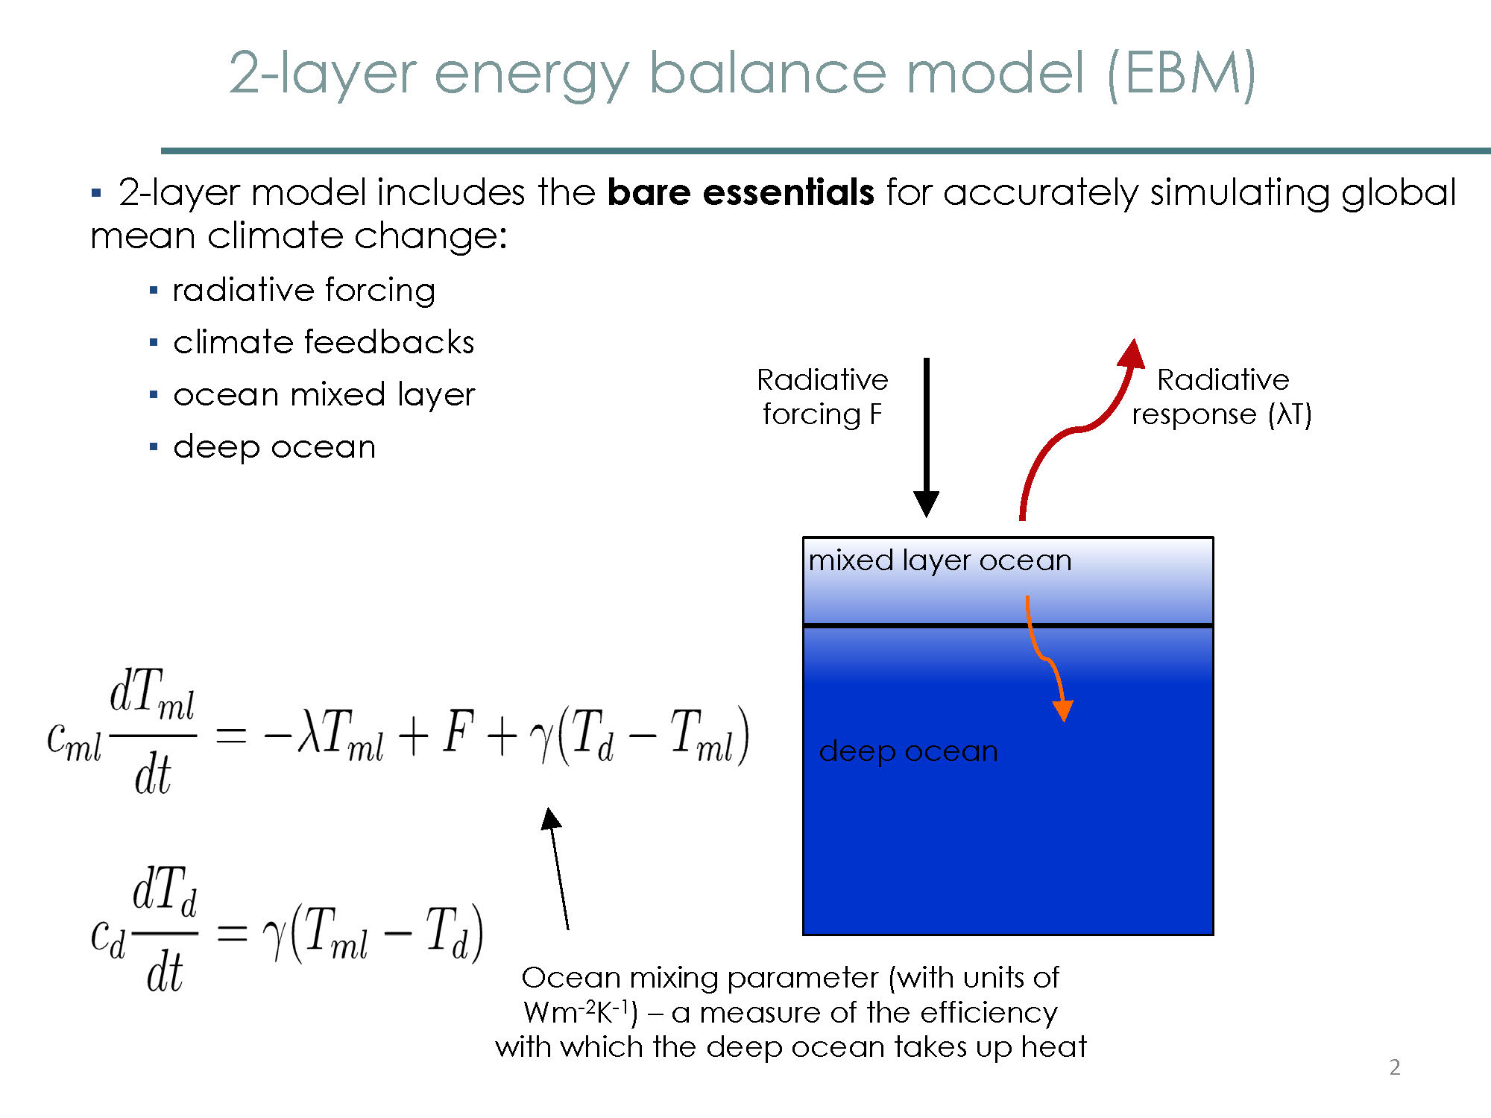
From Radiative Forcing --> Temperature
FaIR uses a two-layer “energy balance model” to represent the combined atmosphere-ocean system and its response to forcing.
Radiative response
Forcing, F
Surface layer responds to forcing through re-emission
Atmosphere/Upper ocean
External forcing warms the surface-layer
Temp: T_{upper}
Heat capacity: C_{upper}
Deep Ocean
Heat loss to deep ocean
Temp: T_{deep}
Heat capacity: C_{deep}
Deep ocean warms due to heating from above, acts
as a “heat sink”.

