Slide 1

Exploring the Nexus of Digital Behaviors, Information and Communication Technologies (ICT), and Economic Growth: An Empirical Analysis across Nations
Andrew j. Cade

Slide 2


Introduction
Research Question:
What impact, if any, would digital behaviors on the web itself correlate to the GDP growth of a given nation?
Motivation:
Media influencers have a big role in marketing.
Digital sphere as an information nexus
Trends, disparities, forecasting
Past questions concern access but not usage behavior
But internet culture feels substantial
Notes:
Motivation: In a rapidly digitizing world, the information age has illuminated much insight into social trends. However, many questions have been raised concerning digital divides, broadband access, variation of digital use across nations, and generational marketing strategies in recent years. Understanding these topics better might inform policy making for education, market behavior, and forecasting.

Slide 3
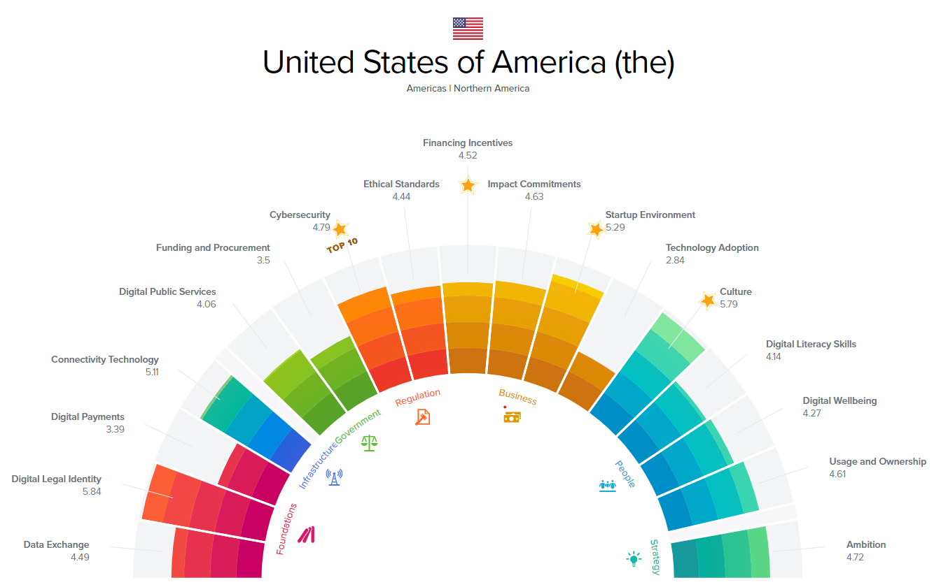
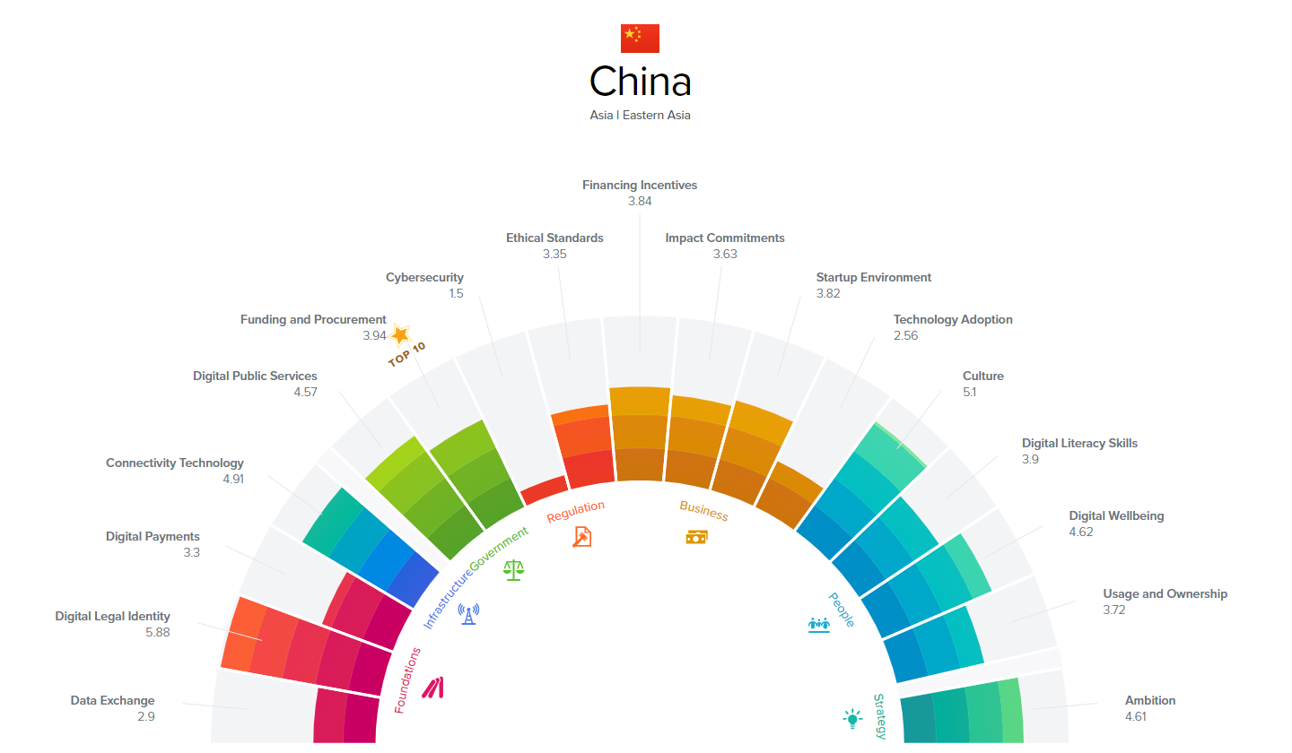
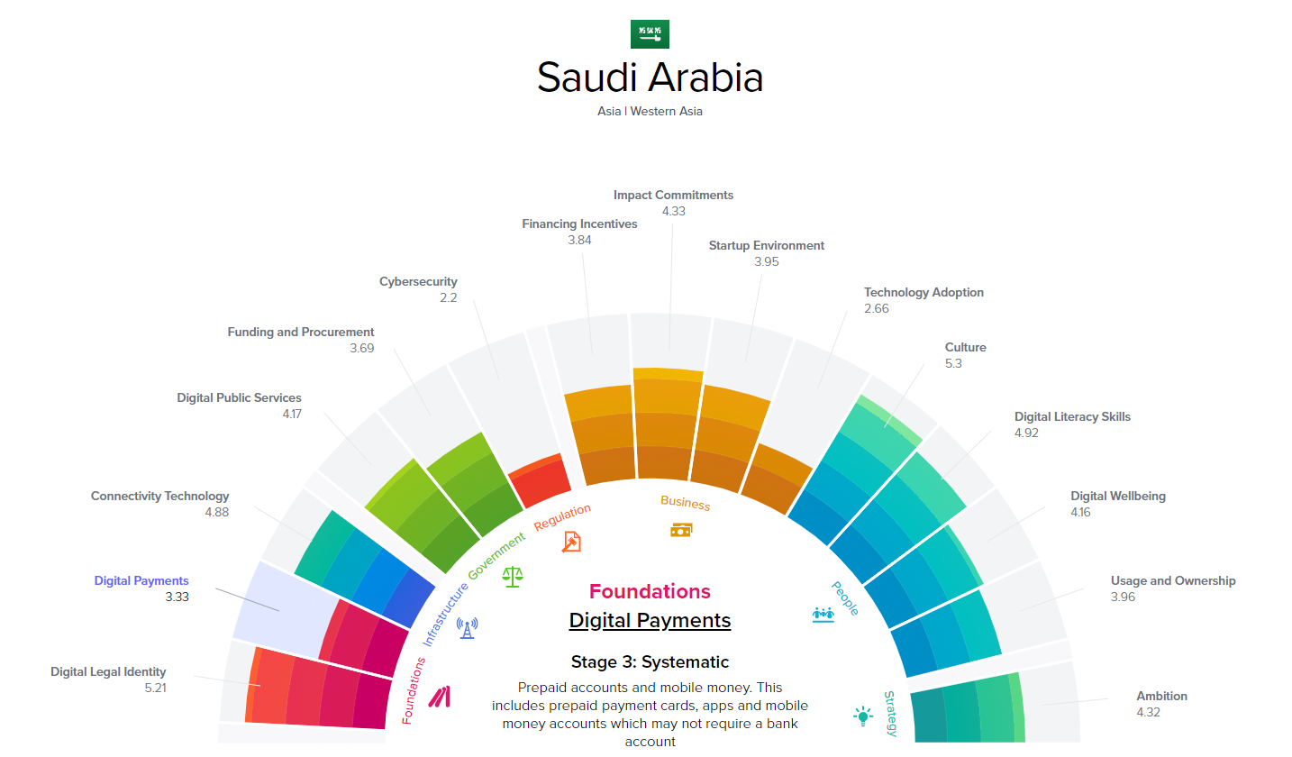
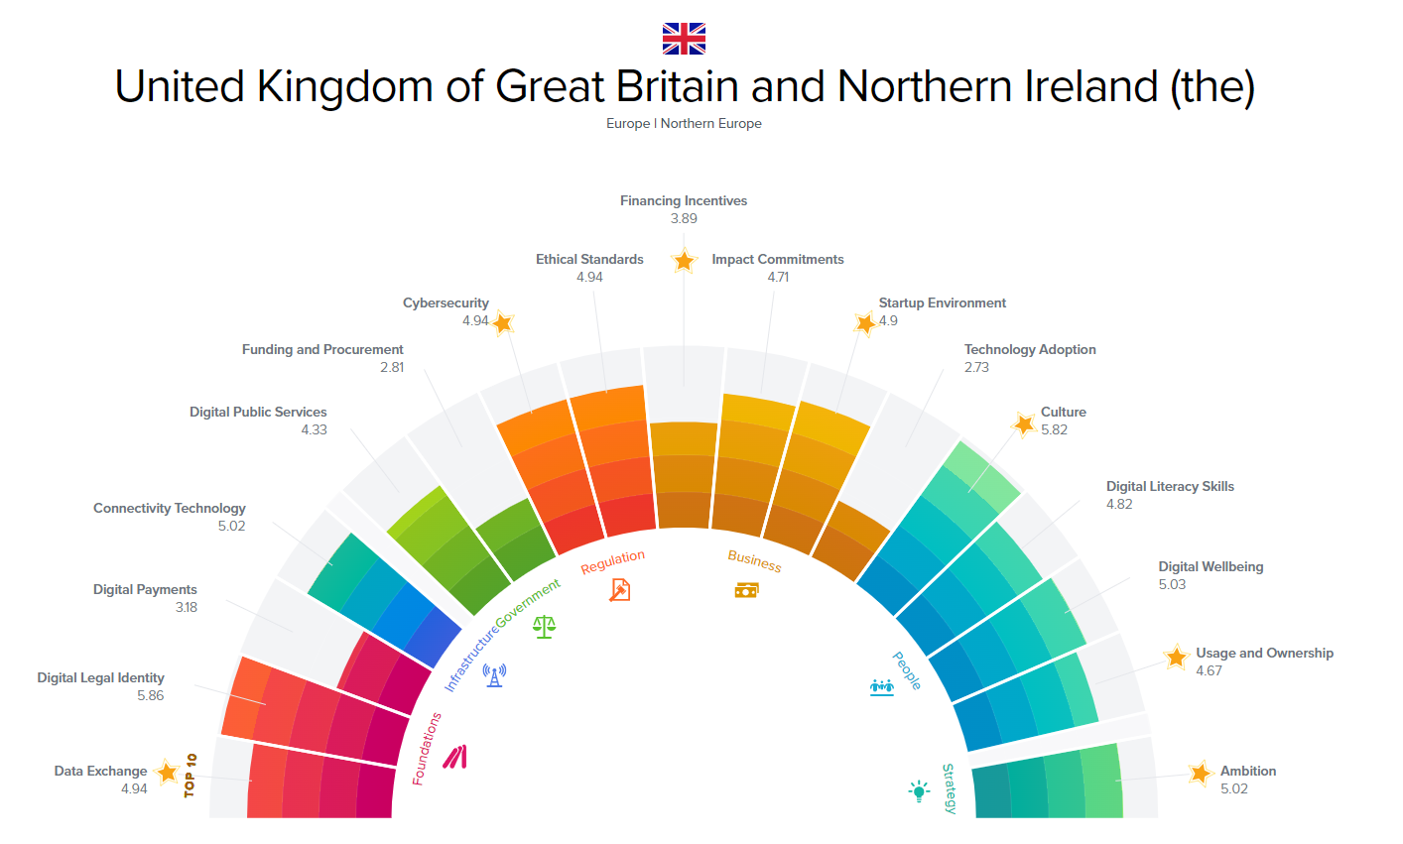
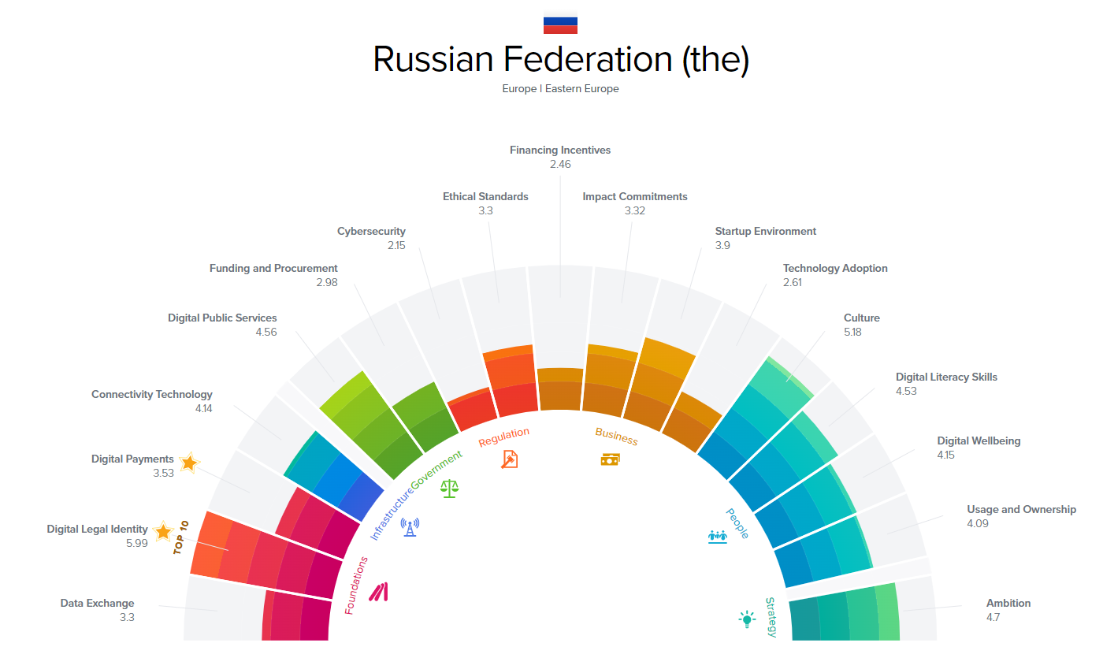
Background Information – UNDP’s Digital Development Compass
Notes:
Terms: ICT, MCI, HDI

Slide 4
Insights from the Literature
Seems to be a General focus on Infrastructure and Government.
Digital Sphere for production in GDP– a Cobb-Douglas Model
Ahmed, E. M., & Ridzuan, R. (2013).
Digital Technology is nonlinear and faces several empirical challenges.
Li, X., & Wu, Q. (2023).
A theoretical challenge of ‘Uncaptured GDP’ might exist
Watanabe, C., Naveed, K., Tou, Y., & Neittaanmäki, P. (2018).
Suggested causality between digital connectivity and consumption in COVID-19.
Olender-Skorek, M., Szałański, M., & Sylwestrzak, M. (2021).
Notes:
Key Takeaways:
ICT investment is best modelled as a Cobb-Douglas production function of GDP as a technological variable.
The quality of digital and information technologies in general are elusive to measure as their values are volatile in a given year. Its impact might be nonlinear, an expression of uncaptured GDP, and/or a “two-faced” mismatch of demand and supply.
For econometric analysis, the model must control for volatility using a variety of techniques ranging from GLS regressions, nonlinear models, or hedonistic pricing.

Slide 5
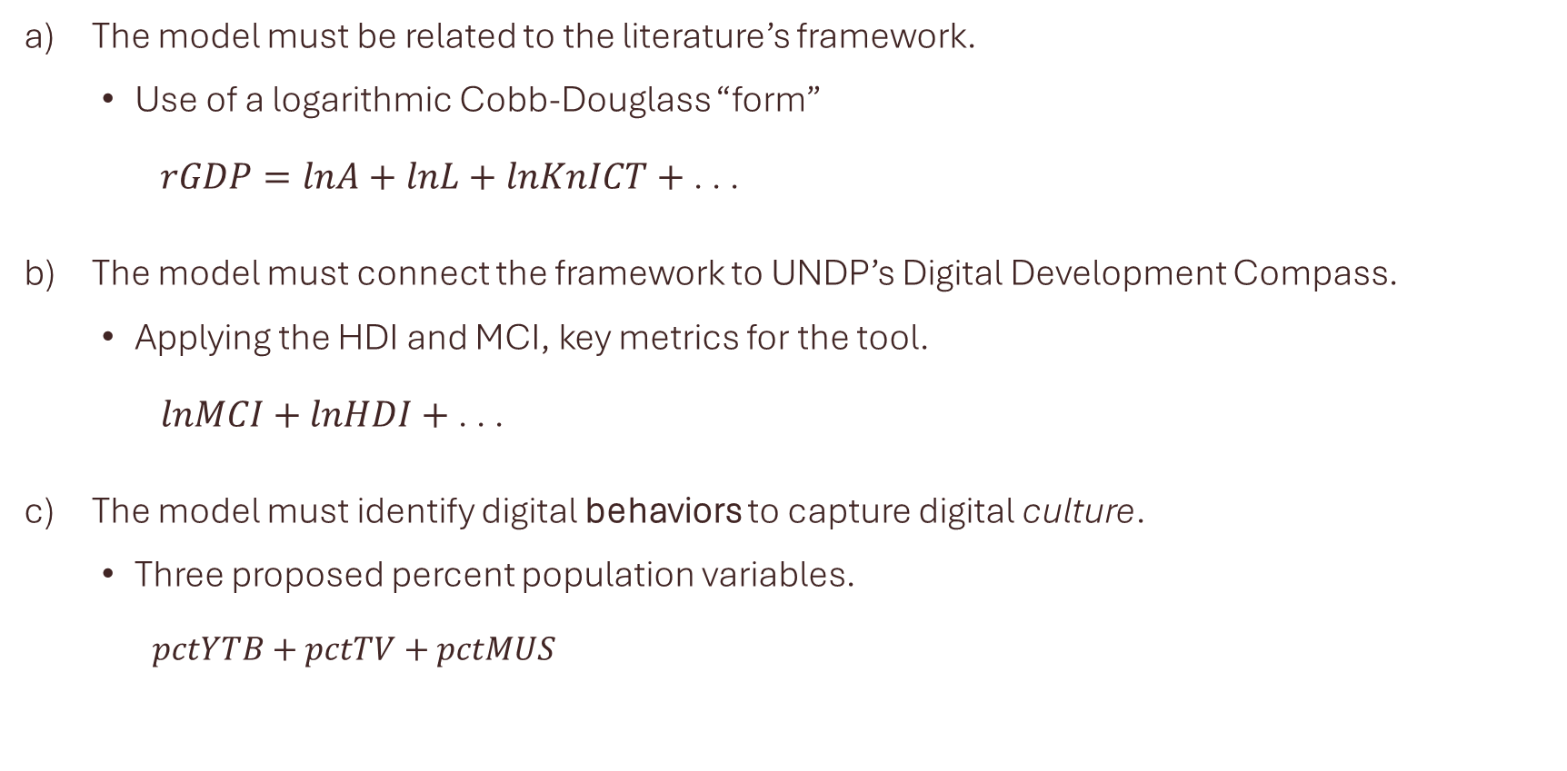
How to Model Digital Culture? What are the Variables?
The model must be related to the literature’s framework.
Use of a logarithmic Cobb-Douglass “form”
$rGDP=lnA+lnL+lnKnICT+$ . . .
The model must connect the framework to UNDP’s Digital Development Compass.
Applying the HDI and MCI, key metrics for the tool.
$lnMCI+lnHDI+$ . . .
The model must identify digital behaviors to capture digital culture.
Three proposed percent population variables.
$$pctYTB+pctTV+pctMUS$$

Slide 6
Data Summary, Sources, and Takeaways
$$rgdp= β1+β2lnA+ β3lnL+β4lnKnICT+β5lnMCI+β6lnHDI+β7pctYTB+β8pctTV+β9pctMUS+ε$$
 | Obs. | Mean | St. Dev | Min. | 25th | Med. | 75th | Max.
rGDP | 8663 | 3.326 | 5.38 | -36.8 | 1.4 | 3.4 | 5.7 | 74.4
lnA | 696 | 21.307 | 1.841 | 16.74 | 16.889 | 21.386 | 25.747 | 25.930
lnL | 5397 | 4.012 | 0.217 | 3.097 | 3.161 | 4.037 | 4.470 | 4.479
KnICT | 696 | 25.037 | 1.680 | 21.175 | 23.982 | 26.251 | 29.067 | 29.187
 | Obs. | Mean | St. Dev | Min. | 25th | Med. | 75th | Max.
ln_MCI | 1320 | 3.979 | 0.396 | 2.481 | 3.756 | 4.077 | 4.271 | 4.527
ln_HDI | 5332 | -0.434 | 0.278 | -1.532 | -0.603 | -0.364 | -0.039 | -0.039
 | Obs. | Mean | St. Dev | Min. | 25th | Med. | 75th | Max.
pctYTB | 333 | 0.275 | 0.134 | 0.001 | 0.179 | 0.266 | 0.361 | 0.732
pctTV | 111 | 0.373 | 0.186 | 0.103 | 0.229 | 0.347 | 0.467 | 0.831
pctMUS | 139 | 0.528 | 0.138 | 0.203 | 0.431 | 0.509 | 0.613 | 0.889
Notes:
Trends for Cobb Douglas, Infrastructure, and Behaviors
Dramatic Differences in Observations
Implications

Slide 7
Regression Results
rGDP | (1) | (2) | (3) | (4)
lnA | 0.04 |  |  | -0.76
 | (0.47) |  |  | (1.14)
lnL | 2.82* |  |  | 9.18
 | (1.51) |  |  | (7.29)
lnKnICT | -0.41 |  |  | 0.12
 | (0.50) |  |  | (1.27)
lnMCI |  | -0.15 |  | -34.65**
 |  | (1.19) |  | (13.04)
lnHDI |  | -0.64 |  | 50.96*
 |  | (1.99) |  | (25.08)
pctYTB |  |  | -5.41 | -7.07
 |  |  | (3.94) | (6.04)
pctTV |  |  | 17.78*** | 14.01*
 |  |  | (5.27) | (7.73)
pctMUS |  |  | -27.59*** | -22.97**
 |  |  | (6.90) | (10.83)
Obs. | 696 | 1320 | 55 | 44
R² | 0.042 | 0.001 | 0.299 | 0.541
Adj. R² | 0.038 | 0.000 | 0.259 | 0.436
The need for multiple regressions
The change in Adj. R²
Coefficient Estimates for Digital behavior variables
Statistical Significance
Notes:
Note: Robust standard error, clustered by country. Hausman and joint FE performed, not statistically significant. Significant details: OECD results are for 2016-2023 (w/ YouTube starting at 2008) for individuals ages 16-74 in the following countries:
(3) Austria, Belgium, Bulgaria, Croatia, Czechia, Denmark, Estonia, Finland, France, Germany, Greece, Hungary, Iceland, Ireland, Italy, Latvia, Lithuania, Luxembourg, Netherlands, Norway, Poland, Portugal, Romania, Slovak Republic, Slovenia, Spain, Sweden, Turkey, United Kingdom (4) Austria, Belgium, Czechia, Denmark, Estonia, Finland, France, Germany, Hungary, Iceland, Ireland, Italy, Latvia, Lithuania, Luxembourg, Netherlands, Norway, Poland, Portugal, Slovak Republic, Slovenia, Spain, Sweden, United Kingdom

Slide 8
Conclusions
“Broadstrokes” Approach due to nuance:
General correlation of TV and music consumption, even if not to scale.
Only Web-Streamed Television consumption has a positive correlation with GDP growth.
Difficulty in interpreting: Must be consistent for production and behavior.
Conclusions:
Using the perspective of production, it seems there might be a directional correlation with user behaviors on real GDP growth…
Areas of Improvement:
Yet, more data is needed to scale the findings of this study to the world stage, additionally, taking generational characteristics into account might detail the specific impact of generalized behavior and not just the activity itself.

Slide 9
References
Ahmed, E. M., & Ridzuan, R. (2013). The impact of ICT on East Asian economic growth: panel estimation approach. Journal of the knowledge economy, 4, 540-555.
Human development falling behind in ninety per cent of countries: UN report | UN News. (2022, September 8). News.un.org. https://news.un.org/en/story/2022/09/1126121
Li, X., & Wu, Q. (2023). The impact of digital economy on high-quality economic development: Research based on the consumption expansion. Plos one, 18(12), e0292925.
Nasab, E. H., & Aghaei, M. (2009). The effect of ICT on economic growth: Further evidence. International Bulletin of Business Administration, 5(2), 46-56.
Olender-Skorek, M., Szałański, M., & Sylwestrzak, M. (2021). Has the Internet Saved the Economy? Modeling Impact of ICT Sector and COVID-19 on GDP. Journal of Telecommunications and Information Technology.
Watanabe, C., Naveed, K., Tou, Y., & Neittaanmäki, P. (2018). Measuring GDP in the digital economy: Increasing dependence on uncaptured GDP. Technological Forecasting and Social Change, 137, 226-240.

