Slide 1
Assistive Technology
Market and Research
Prof. Dr.-Ing .Christian Bühler
President of AAATE
Association for the Advancement of Assistive Technology in Europe
Director of FTB

Slide 2
Brief History
A ssociation for the
A dvancement of
A ssistive
T echnology in
E urope:
Founded 1995 during ECART 3 in Lisbon, Portugal
Mission:
to stimulate the advancement of assistive technology for the benefit of people with disabilities including elderly people
Follow up of the HEART project
Sister organisation to ARATA, RESNA, RESJA

Slide 3
AAATE Focus
The AAATE is the
pan-European
interdisciplinary organisation
concerned with all aspects of assistive technology.
This includes the
use,
research,
development,
manufacture,
supply and provision.

Slide 4
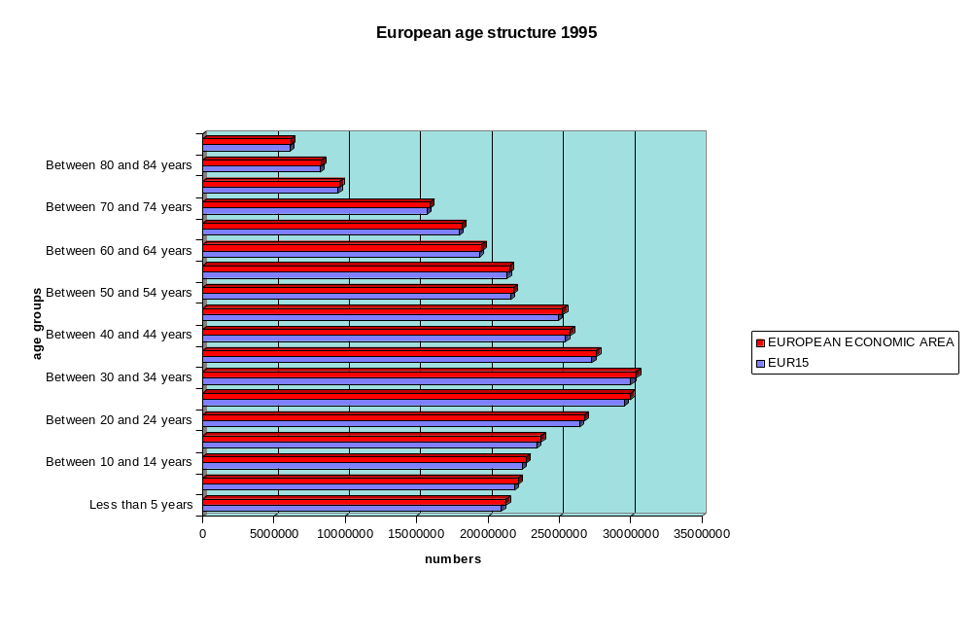
European demography

Slide 5
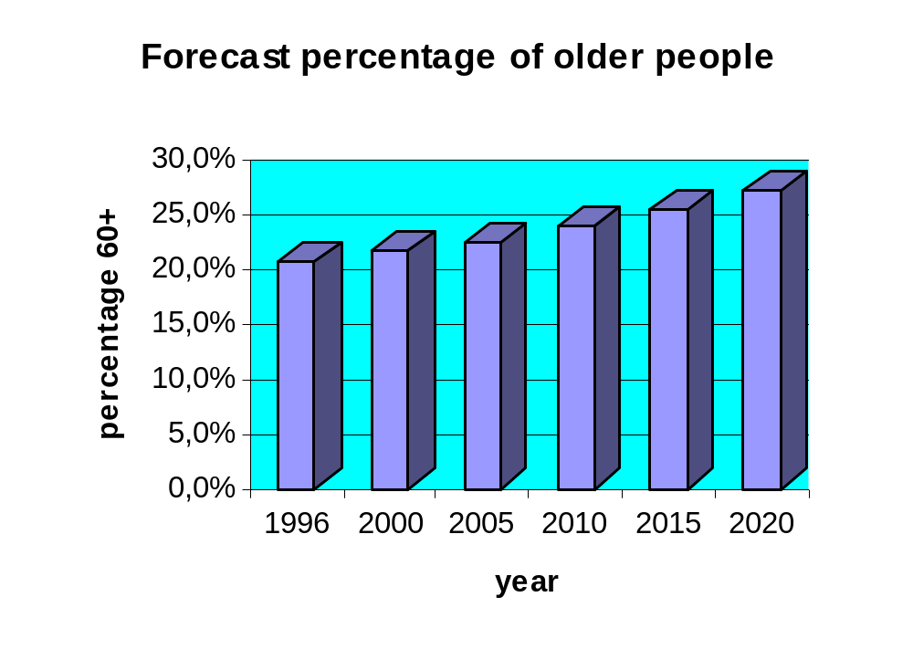
30% ~ 100 Million people
60+ in 2020

Slide 6
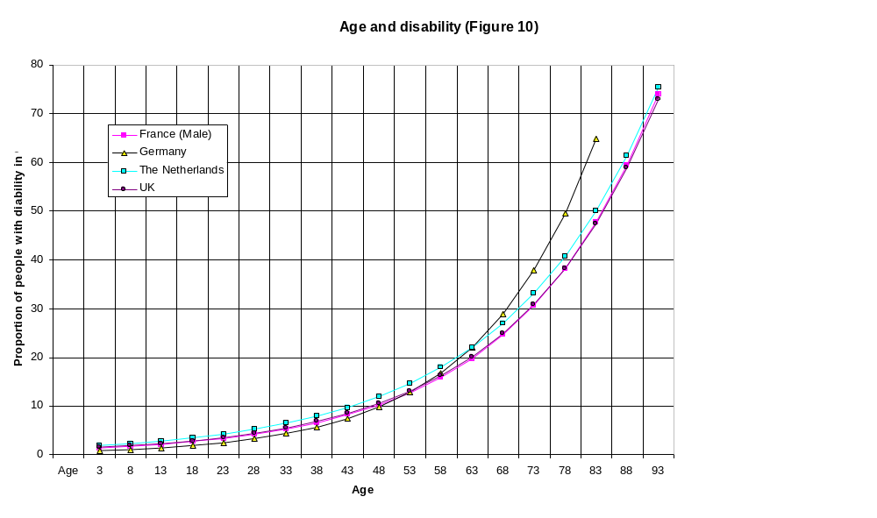
Correlation of age and disability
1:1,5
1:2
1:3,5
1:5
AGE

Slide 7
Trends in development of
European society
Decrease of children and young people 13% (1996-2020)
More people of higher age
  More than 100 million 60+
  More than 20 million 80+
ratio 60+/(20-59)--1,9
Increase of people with registered disability (11% today to ca. 17% - in 2020)
Increased individual mobility
More singles/ less family relations
Less persons per household
More outpatient care/ fewer carers
More private commercial services
More old
people wealthy and poor
Internationalisation
New assessment of resources
Knowledge society
Burden of maintaining social security

Slide 8
What can be compensated ?
Not a disease, not an impairment
A handicap (or sometimes also a disability)
Bridging the gap between
what a person wants and is able to do
and
what the environment demands

Slide 9
Definition of USA AT act 1998
AT is defined as
”technology designed
to be utilised in an assistive technology device or service”.
AT device means
”any item, piece of equipment, or product system, whether acquired commercially, modified, or customised, that is used to increase, maintain, or improve functional capabilities of
individuals with disabilities”.

Slide 10
Assistive Technology
is any product or technology based service that enable disabled or elderly people in their daily lives, education, work or leisure.
Hence, a broad view of AT encompassing technology
for therapy,
overcoming impairment,
enhancement of ability or
facilitating participation in society.
Products and technology based services and devices
targeted at meeting the specific needs of people with disabilities and elderly people and
their ability to use and benefit from mainstream technology products.

Slide 11
From RT to AT
Human rights
Medical model
Social model
Participation
ICD
Health care
Charity
ICIDH
Functional and problem orientation
Integration
ICIDH2
Ability and context
User empowerment
Participation
Rehabilitation Technology
Assistive Technology
Accessibility
Design for all

Slide 12
Balance for Success
End-user/
Customer Satisfaction
Quality
Service
Social System/
general Public
Industries/ Services
Cost

Slide 13
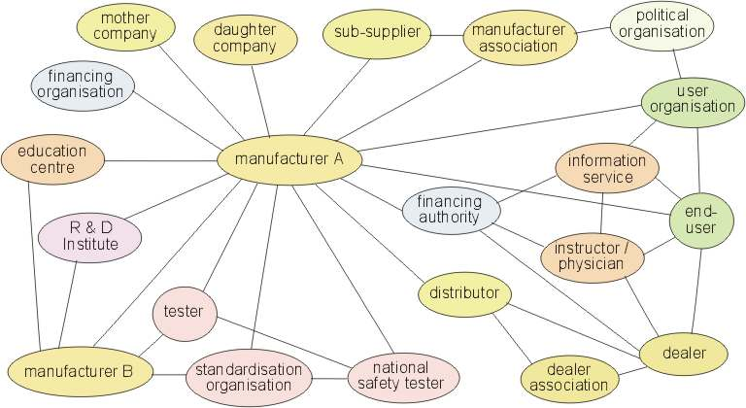
Market players and relations

Slide 14
Market characteristics
More than 20 000 AT products on the European market
Estimated market size > 30 Billion Euro
Common European market, but:
Fragmentation into small market segments
  National social systems with different regulations for the reimbursements of technical aids
  Fragmentation of industries and services due to focus on special impairments or disabilities
  traditional rehabilitation technologies, modern technologies
SME dominance/ almost no big players involved!
Notes:
30 000 000 citizens with disabilities receive about 1000 Euro average on technical aids in Europe--> Market size of 30 Billion Euro p.a.
15 countries about 100 larger impairment groups accoring ICIDH impairment level 2, 2 high/ low tech,
10 competitors
--> 1 500 000
or per product in average 1 500 000

Slide 15
AT research and development
Scopes
Dedicated solutions for very special needs
Design for all as complement
Fast return of investment required
European Programmes
FP 3/4 :TIDE / TAP
FP 5:
TIDE (TAP/) IST D&E - QoL, The ageing population - Generic research on disability
FP 6: ?????????????????????????????????????????

Slide 16
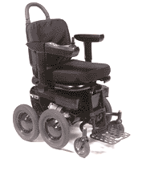
A traditional power chair ?
Picture IBOT 3000
Independence Technology

Slide 17
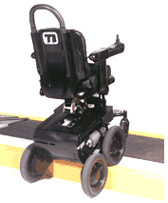
Passing steps
Picture IBOT 3000
Independence Technology

Slide 18
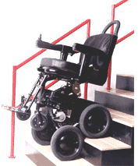
Climbing stairs
Picture IBOT 3000
Independence Technology

Slide 19
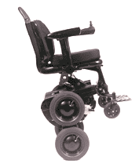
Balancing is the key
Picture IBOT 3000
Independence Technology

Slide 20
Balancing is the key
Picture IBOT 3000
Independence Technology

Slide 21
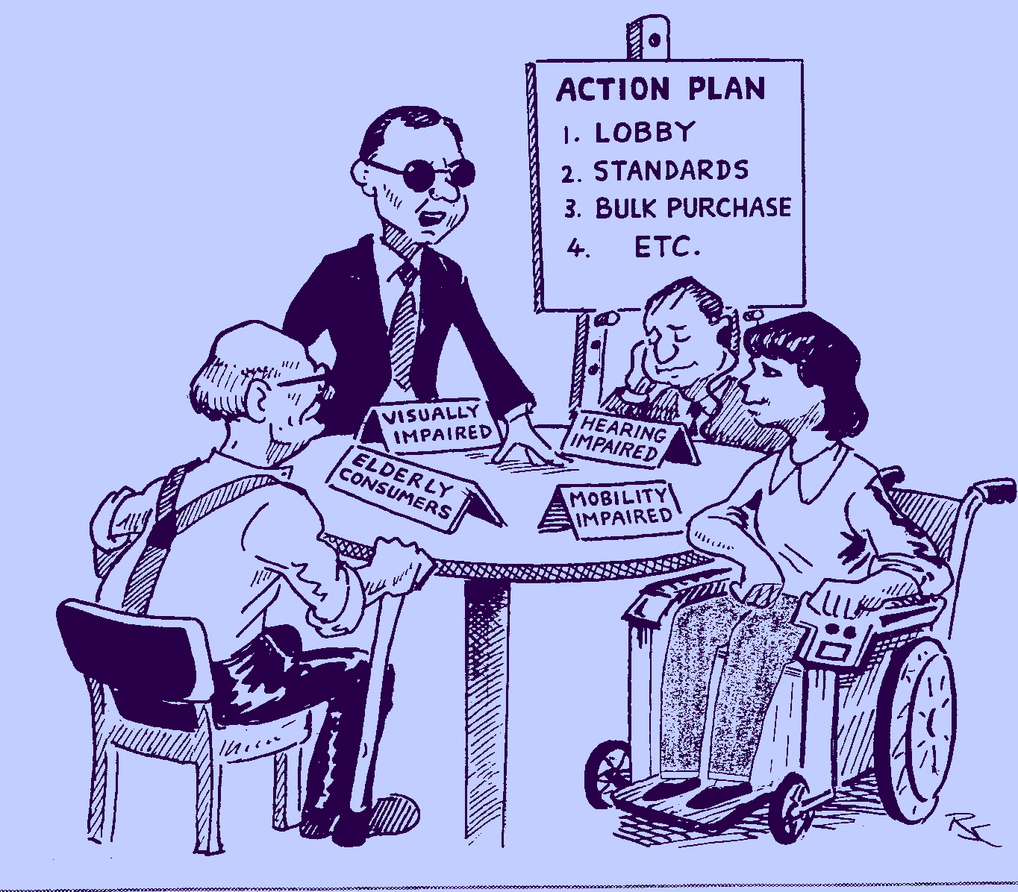
User Involvement / Participation
Picture: IOS Press

Slide 22
Technical Research Fields
Improve access to society and equal opportunities by
AT
AT supporting independence
AT for (self-)care and care management
AT for vocational integration
AT for social integration and participation
Design for all/ Universal design/ barrier free design
of built environment / and transportation
of mainstream consumer products
of public services
of information

Slide 23
Other Research Fields
Knowledge base on disability related perception and (human-machine) interaction
User participation in research, development, test and standardisation
Service delivery
Usability
Outcome measurement and socio-economics

Slide 24
Concluding Recommendations
Continue successful European actions like TIDE
  learn from evaluations of earlier phases
Balanced approach using AT, Access solutions and UD
Strategic cooperation between CEU and the Member States
  Design for all obligation
  Specific measures towards access and AT
Take into account the knowledge base of NGOs in Europe
Cooperation on global themes with USA and Japan

