Slide 1
Introduction to the
CGP-Library
Andrew James Turner

Slide 2
Overview
Cross Platform Library
Open Source (GNU LGPL)
Well Documented
Simple to use
Simple to modify / extend
Cartesian Genetic Programing
Recurrent Cartesian Genetic Programing
NeuroEvolution
Visualization tools

Slide 3
What it is NOT
It is NOT a stand-alone program
  It is a library, like math.h
  It is used BY other programs

Slide 4
Documentation
http://cgplibrary.co.uk/
Full API description
10+ tutorials/examples
Quick introduction to CGP

Slide 5
Installation
As a system-wide library
  Windows
    Copy CGP-Library.dll to C:\Windows\System32 or C:\Windows\SysWOW64
  Linux
    Copy libcgp.so to /usr/lib/
    Copy cgp.h to /usr/include/
Compile into executable / binary
  Place cgp.c and cgp.h in build path
  #define NO_DILL (windows only)

Slide 6
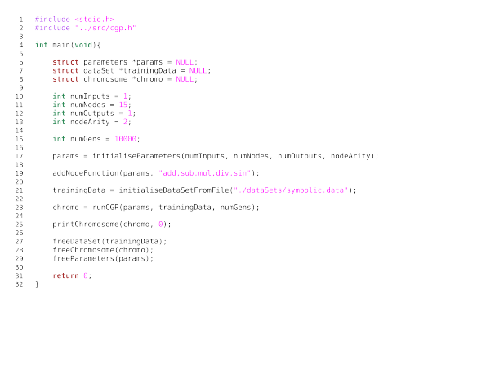
Basic Use

Slide 7
Defaults
Parameter | Value
Mu (μ) | 1
Lambda (λ) | 4
Evolutionary Strategy | (μ+λ)-ES
Mutation Type | Probabilistic
Mutation Rate | 0.05
Selection Scheme | Select Fittest
Reproduction Scheme | Mutate Random Parent
Fitness Function | Supervised Learning (ABS error)
Recurrent Connection Probability | 0.00
Connection Weight Range | 1.00 (i.e. +/- 1)
Update Frequency | 1

Slide 8
Changing Defaults
setMu(...)
setLambda(...)
setEvolutionaryStrategy(...)
setMutationType(...)
setMutationRate(...)
setRecurrentConnectionProbability(...)
setConnectionWeightRange(...)

Slide 9
Node Types
addNodeFunction(...)
add | AND
sub | NAND
mul | OR
div | NOR
abs | XOR
sqrt | XNOR
sq | NOT
cube | sig
pow | gauss
exp | step
sin | softsign
cos | tanh
tan | wire

Slide 10
Mutation Types
Probabilistic
  Mutates each chromosome gene with a given probability
Point
  Always mutates the same number of randomly selected genes
OnlyActive
  Conducts probabilistic mutation on active nodes only
Single
  Keeps mutating randomly selected genes until an active gene is mutated to a new allele

Slide 11
Custom Functions
setFitnessFunction(...)
setSelectionScheme(...)
SetReproductionScheme(...)
AddNodeFunctionCustom(...)
This is quite simple to do!
  Tutorials provided

Slide 12

DataSet
3 Bit Even Parity
Inputs, Outputs, Samples
Input_0, input_1, input_2, output_0

Slide 13
Visualization
printChromosome(...)
  Displays in terminal
(0): input
(1): sin 0 *
(2): mul 0 0
(3): mul 0 1 *
(4): add 1 3 *
(5): div 1 0
(6): div 2 5
(7): sin 1
(8): mul 4 1 *
outputs: 8

Slide 14
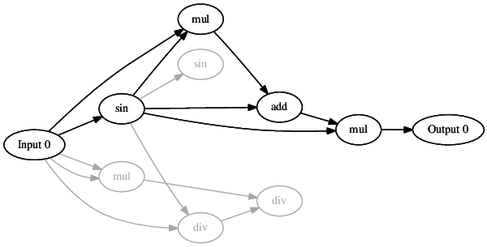
Visualization
saveChromosomeDot(...)
  Produces .dot file
  Used by Graphviz (www.graphviz.org)

Slide 15
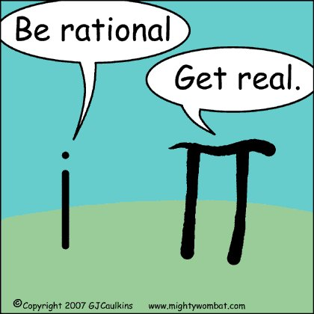
Visualization
saveChromosomeLatex(...)
  Produces .tex file
  Used by LaTaX

Slide 16
NeuroEvolution
Applications of Evolutionary Computation to Artificial Neural Networks
CGP-Library provides this
Cartesian Genetic Programming of Artificial Neural Networks (CGPANN)
Very simple to use!

Slide 17
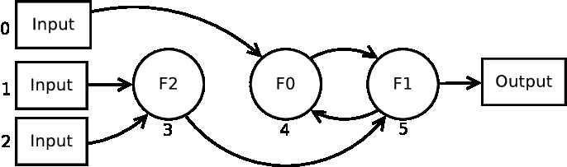
Recurrent Cartesian Genetic Programming
Allows for feed-back / recurrent connections
Enables CGP to have memory / states
CGP-Library provides this
Very simple to use!

Slide 18
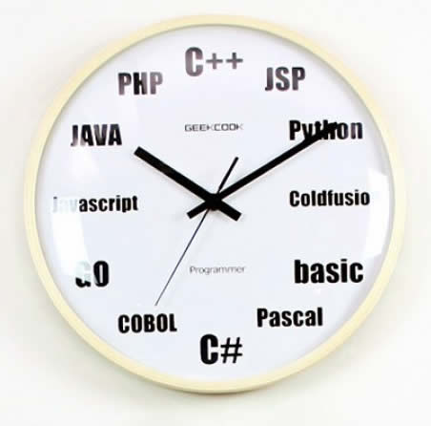
Language Bindings
C / C++
Python soon!
Possible other languages on request:
  Javascript, Perl, PHP, Tcl and Ruby, C#, Common Lisp (CLISP, Allegro CL, CFFI, UFFI), D, Go language, Java including Android, Lua, Modula-3, OCAML, Octave, R, Guile, MzScheme/Racket and Chicken

Slide 19
References
A. J. Turner and J. F. Miller. Introducing A Cross Platform Open Source Cartesian Genetic Programming Library. The Journal of Genetic Programming and Evolvable Machines, to appear
Miller, J.F.: Cartesian Genetic Programming. Springer (2011)
Turner, A.J., Miller, J.F.: Cartesian Genetic Programming encoded Artificial Neural Networks: A Comparison using Three Benchmarks. In: Proceedings of the Conference on Genetic and Evolutionary Computation (GECCO’13), pp.1005-1012 (2013)
Turner, A.J., Miller, J.F.: Recurrent Cartesian Genetic Programming. In:PPSN’14. pp.476-486 (2014)
Goldman, B.W., Punch, W.F.: Reducing Wasted Evaluations in Cartesian Genetic Programming. In: Proceedings of the 16th European Conference on Genetic Programming (EuroGP’13). vol.7831, pp.61-72. Springer Verlag (2013)

