Slide 1
Rebound in monocytes without increase in %BrdU+ monocytes after BLZ-945 in SIV+ART+ animals
Andrew Ding-Su

Slide 2
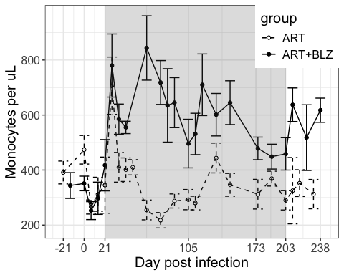
Monocyte numbers
test

Slide 3
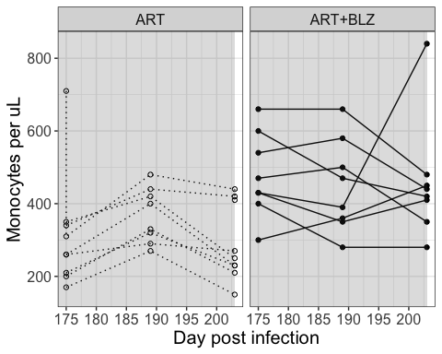
Total monocyte numbers remain the same during BLZ
test

Slide 4
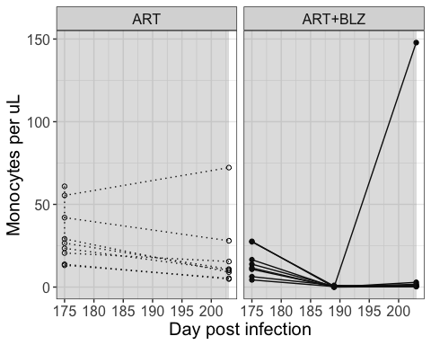
BLZ-945 eliminates CD16+ monocyte populations
test

Slide 5
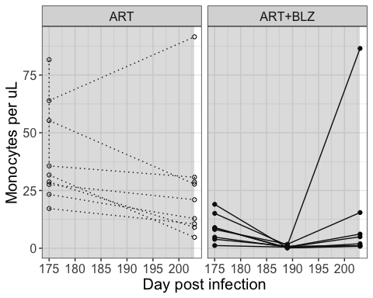
test

Slide 6
Slide with Bullets
Bullet 1
Bullet 2
Bullet 3

Slide 7
Slide with R Output
summary(cars)
## speed dist ## Min. : 4.0 Min. : 2.00 ## 1st Qu.:12.0 1st Qu.: 26.00 ## Median :15.0 Median : 36.00 ## Mean :15.4 Mean : 42.98 ## 3rd Qu.:19.0 3rd Qu.: 56.00 ## Max. :25.0 Max. :120.00

Slide 8
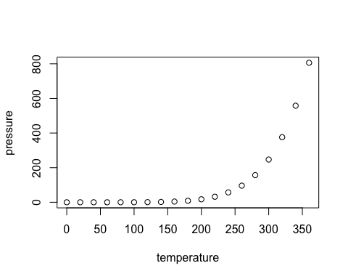
Slide with Plot
hello

