Slide 1
Welcome to ist 263
Intro to Front End Web Development

Slide 2
Agenda
Who am I?
Who are you?
About the Class
History of the Internet
How the Web Works

Slide 3
Who am I? Who are you?

Slide 4
Who am I?
Professor Ferger
Web Application Developer
I’ve been programming the front and backend of the web since 1999.

Slide 5

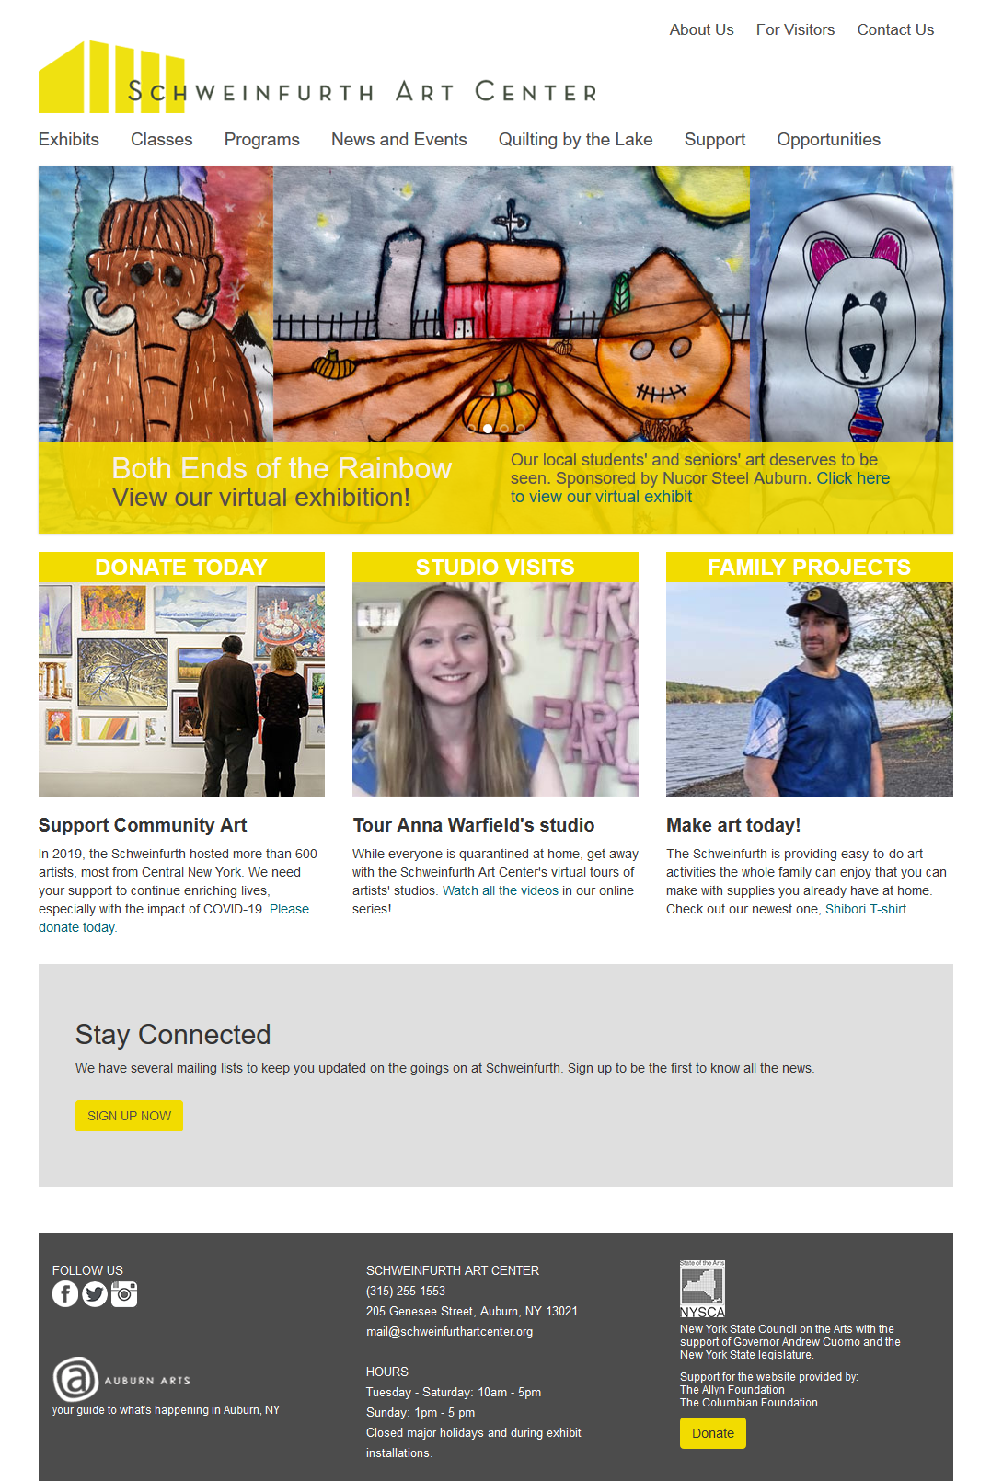

Slide 6
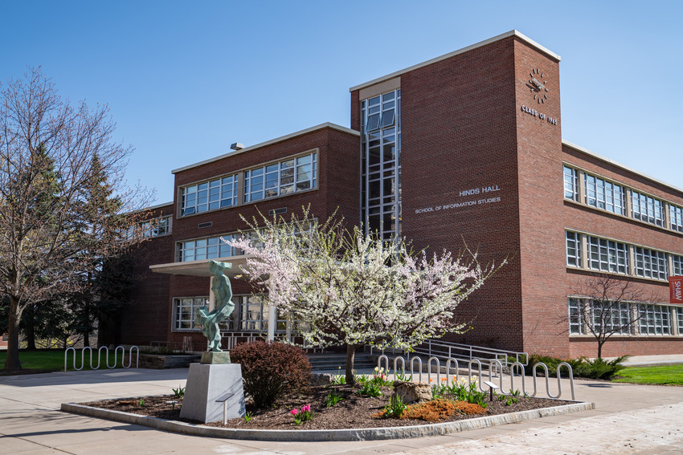
Where am I?
Office Hours:
Hinds 323b
Thurs 12:30-1:30pm

Slide 7
Who are you?
Preferred Name
Pronouns

Slide 8
Who are you?
What school?
iSchool or dual / architecture / arts and sciences / education / engineering and computer science / falk / law / whitman / maxwell / newhouse / vpa
What year are you?
Who has previous coding experience?

Slide 9
Who are you? Padlet at the end!

Slide 10
About the Class

Slide 11

What will you learn in this class?
HTML, CSS and JavaScript
Web development language and concepts
How to craft & design a functional website

Slide 12

Class Requirements
Bring your laptop to class every day.
Textbook: Learning Web Design: A Beginner's Guide to HTML, CSS, JavaScript, and Web Graphics

Slide 13
Blackboard
Tour of Blackboard

Slide 14
General Policies
No late work accepted – instead, I drop two labs for times when you aren’t feeling well, forgot, got overwhelmed with other work, etc.
No makeup exams or exams at alternate times.
No mobile phone use in class unless it’s needed for lesson.
All due dates are posted in the syllabus today. Plan accordingly.

Slide 15
Weekly Labs
Due Saturday at 11:59pm submitted to blackboard.syr.edu

Slide 16
Exams
3 Exams
Worth 100 points each

Slide 17
Projects
There is one project worth 120 points.
The project will be split into parts due throughout the semester.

Slide 18
Weekly Participation
5 points are allotted for participation. To earn these points, you must:
Attend class and come on time. Joining a couple minutes after start time is not on time.
Be engaged in class. Ask questions. Be able to answer questions I ask. Work on lab during lab time.
If you are joining the class virtually respond when I ask you a question.
Complete participation activities and turn them in at end of class.
Participation is all or nothing.

Slide 19
Absence
There will be a form linked in Blackboard announcements for you to let me know if you can’t make it to class.

Slide 20
Class Flow
Due | Item
Tuesday by start of class | read textbook
Saturday by 11:59pm | complete lab
Sunday 11:59pm (4 deliverables thru semester) | turn in project milestone
Please check the syllabus and mark the important dates on your calendar.

Slide 21
Grades
Assessment | Quantity | Points Each | Total Points | Part of Grade
Participation (best 12 count) | 14 | 5 | 60 | 10%
Labs (best 12 count) | 14 | 10 | 120 | 20%
Exams | 3 | 100 | 300 | 50%
Project | 1 | 120 | 120 | 20%

Slide 22
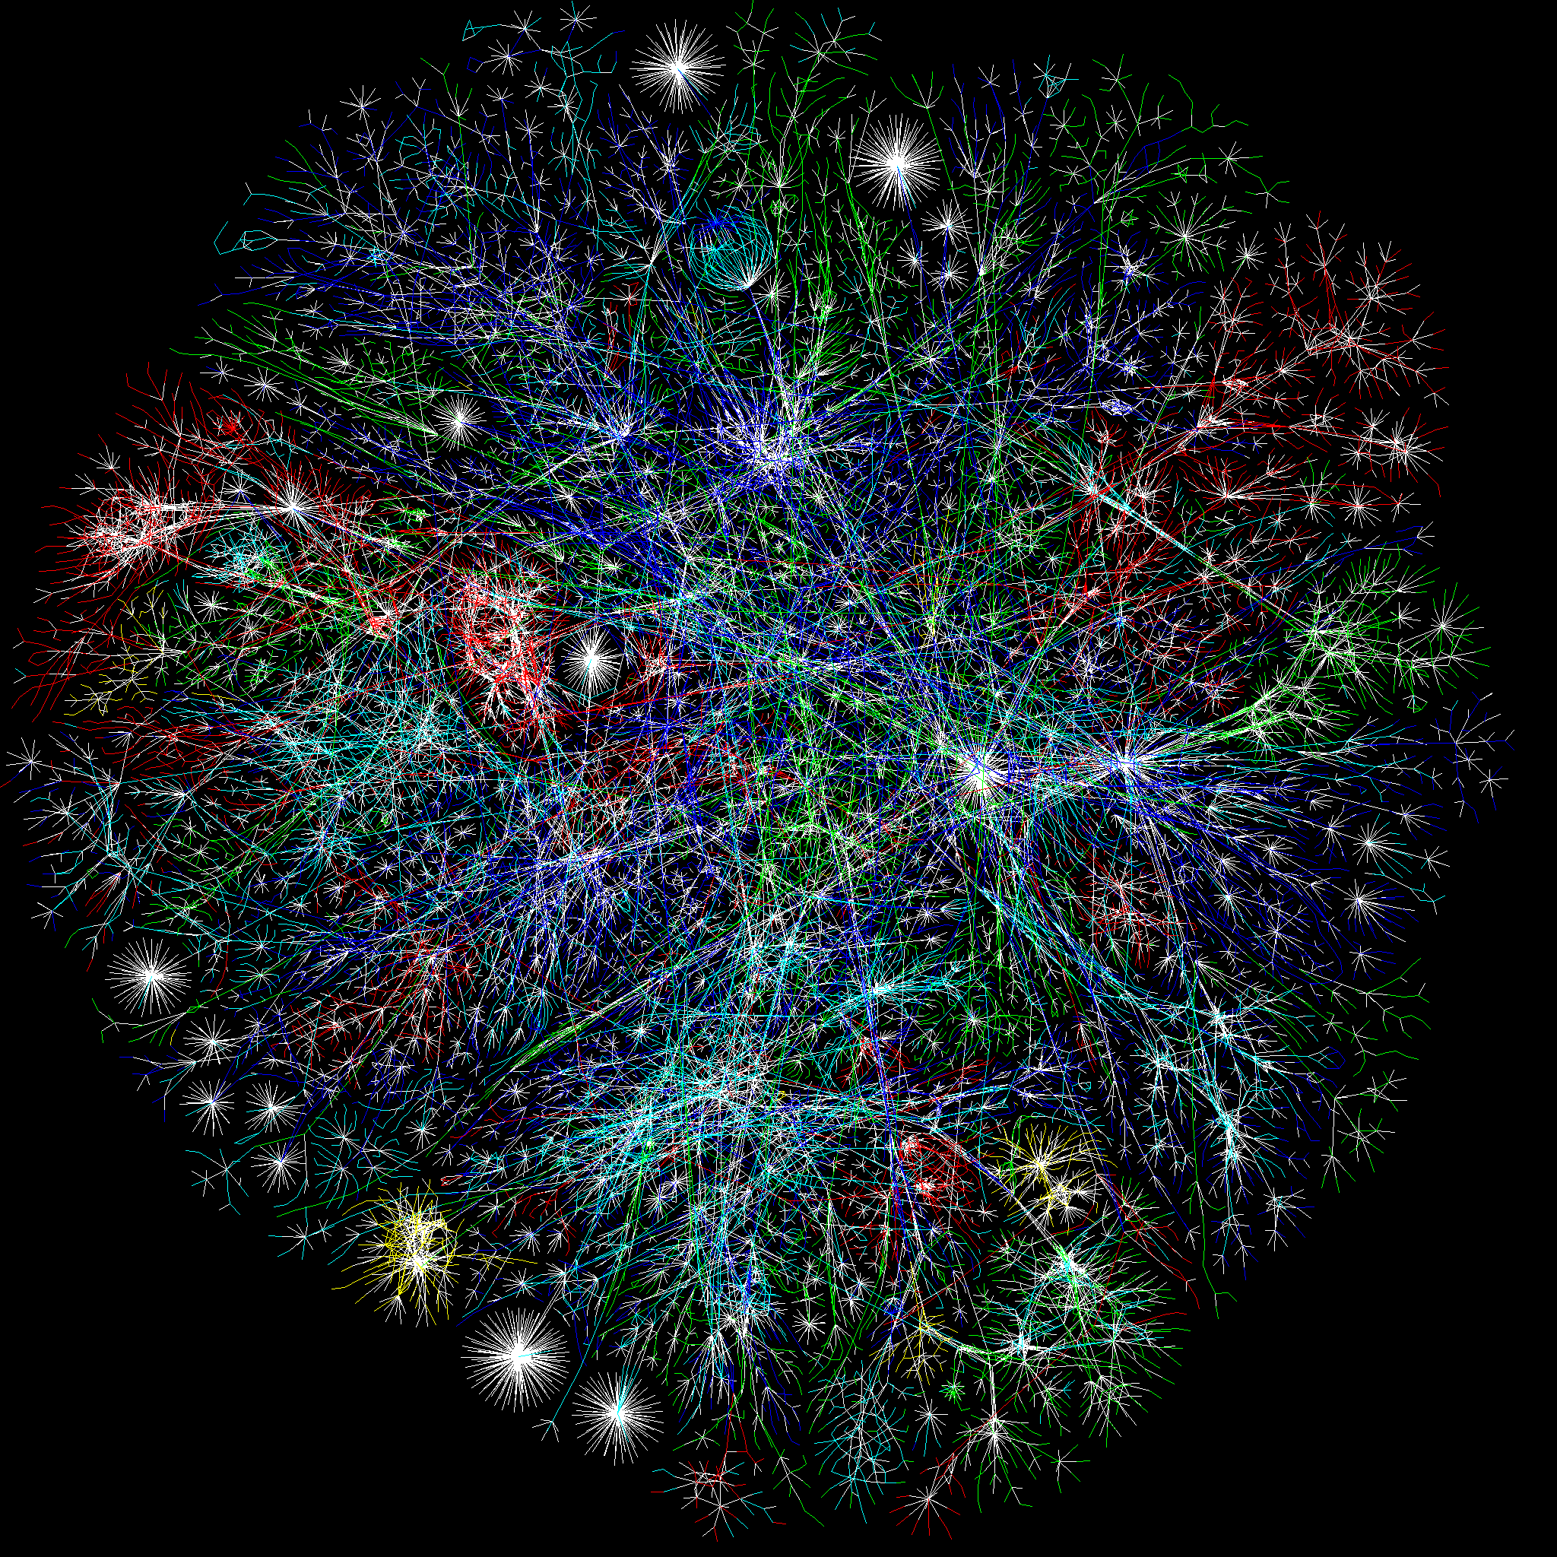
History of the Internet

Slide 23

What is the difference between the internet and the web?
This Photo by Unknown Author is licensed under CC BY-SA

Slide 24
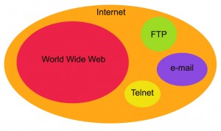
Difference Between Web and Internet

Slide 25
What decade was the internet conceived?
1940s
1950s
1960s
1970s
This Photo by Unknown Author is licensed under CC BY-SA

Slide 26
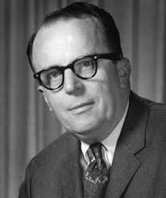
When was the idea of the internet conceived?
1962 Licklider of MIT
Proposed the idea of a network of computer that could talk to each other.
"

Slide 27
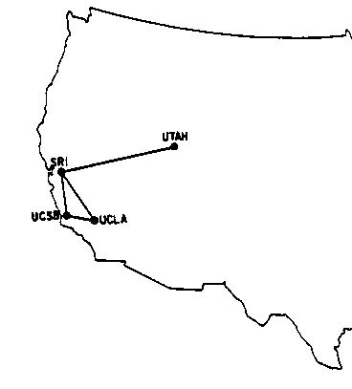
What was the first message sent on the ARPAnet?
1969 First Message Sent
First message was sent from UCLA to Stanford: “LOGIN”— it crashed the fledgling ARPA network anyway: The Stanford computer only received the note’s first two letters.
There were 4 computers on the network in 1969.
By early 1970’s several networks like ARPAnet had been developed.

Slide 28
What decade was email invented?
1960s
1970s 1980s
1990s
This Photo by Unknown Author is licensed under CC BY-SA

Slide 29
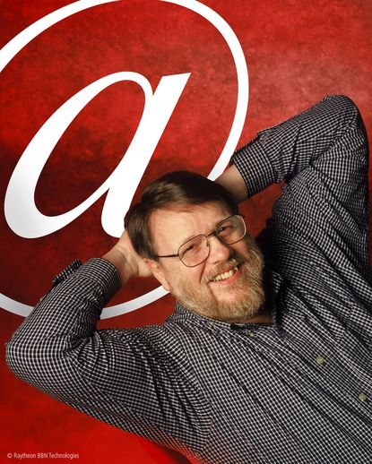
When was the idea of email conceived?
1971 Ray Tomlinson Develops Email
Came up with @ symbol to tell the difference between person and location in an email address.

Slide 30
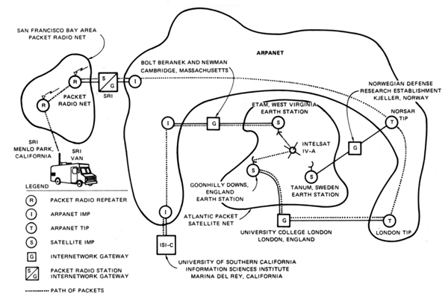
Modern technology that united all computers on early networks: TCP/IP
1971 Vincent Cerf Unifies Lots of Mini Networks Like ARPANet
Developed transmission control protocol to help computers talk to each other.
Diagram of the first internetworked connection

Slide 31
Who used the internet in the 1980’s
Throughout the 1980s, researchers and scientists used it to send files and data from one computer to another.

Slide 32
What decade was the web invented?
1960s
1970s 1980s
1990s
This Photo by Unknown Author is licensed under CC BY-SA

Slide 33
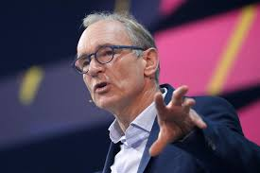
When was the World Wide Web Invented?
In 1991 Tim Berners-Lee (working at CERN) introduced the World Wide Web.
helped solve the difficulties scientists were having sharing information.
created HTML
created URLs
developed HTTP the protocol
director of the World Wide Web Consortium (W3C), which oversees the continued development of the Web.
In a list of 80 cultural moments that shaped the world, chosen by a panel of 25 eminent scientists, academics, writers and world leaders, the invention of the World Wide Web was ranked number one.

Slide 34
The first popular web browser was called:
Mosaic
allowed users to see words and pictures on the same page for the first time
to navigate using scrollbars and clickable links
1993
That same year, Congress decided that the Web could be used for commercial purposes.
Companies hurried to set up websites of their own, and e-commerce entrepreneurs began to use the Internet to sell goods directly to customers.

Slide 35
What was the first thing purchased on the internet?
Clothes
Books
Food
This Photo by Unknown Author is licensed under CC BY-SA

Slide 36
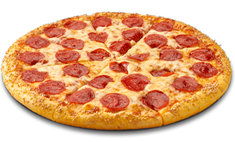
First thing purchased on the internet

Slide 37
How the Web Works

Slide 38
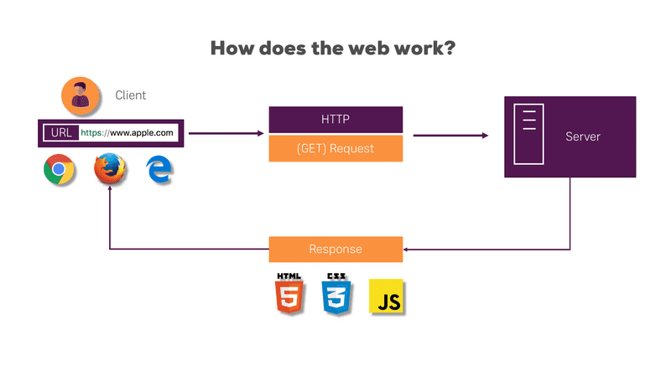

Slide 39
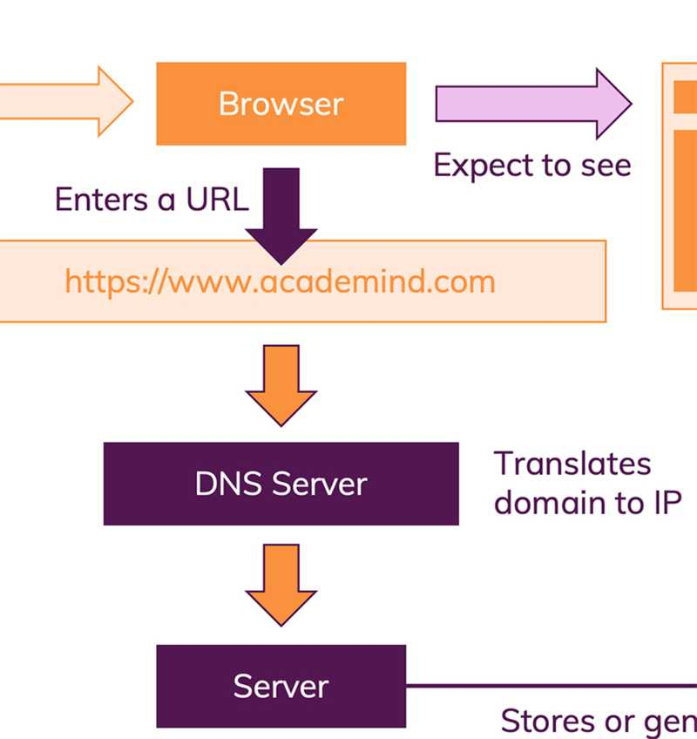

Slide 40
Vocabulary of a Web Address
URL | http://google.com
Protocol | https://maps.google.com http://maps.google.com
Host name / IP Address | google.com, 192.168.0.0
Port | https://maps.google.com:8080
Top-level-domain | .com, .net, .edu, .co, .uk, etc.
Sub-domain | http://its.syr.edu/visitors/visitors-future.html

Slide 41
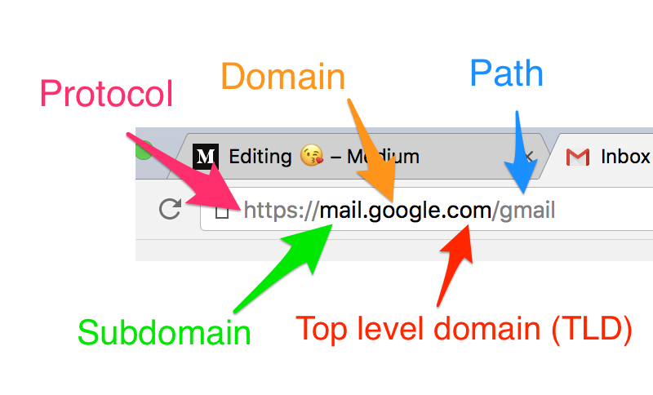

Slide 42
A Basic Web Page
Web pages are text
The extension at the end of the file tells the browser how to interpret the files.
.htm or .html means that you are sending the browser an HTML file
index.hml is a common name for a website’s home page

Slide 43
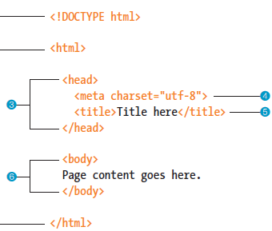
What does the text on the page look like?

Slide 44
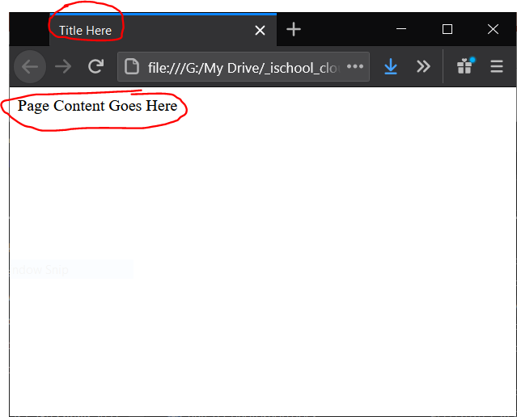
What will the user see in the browser?

Slide 45
Questions?

Slide 46
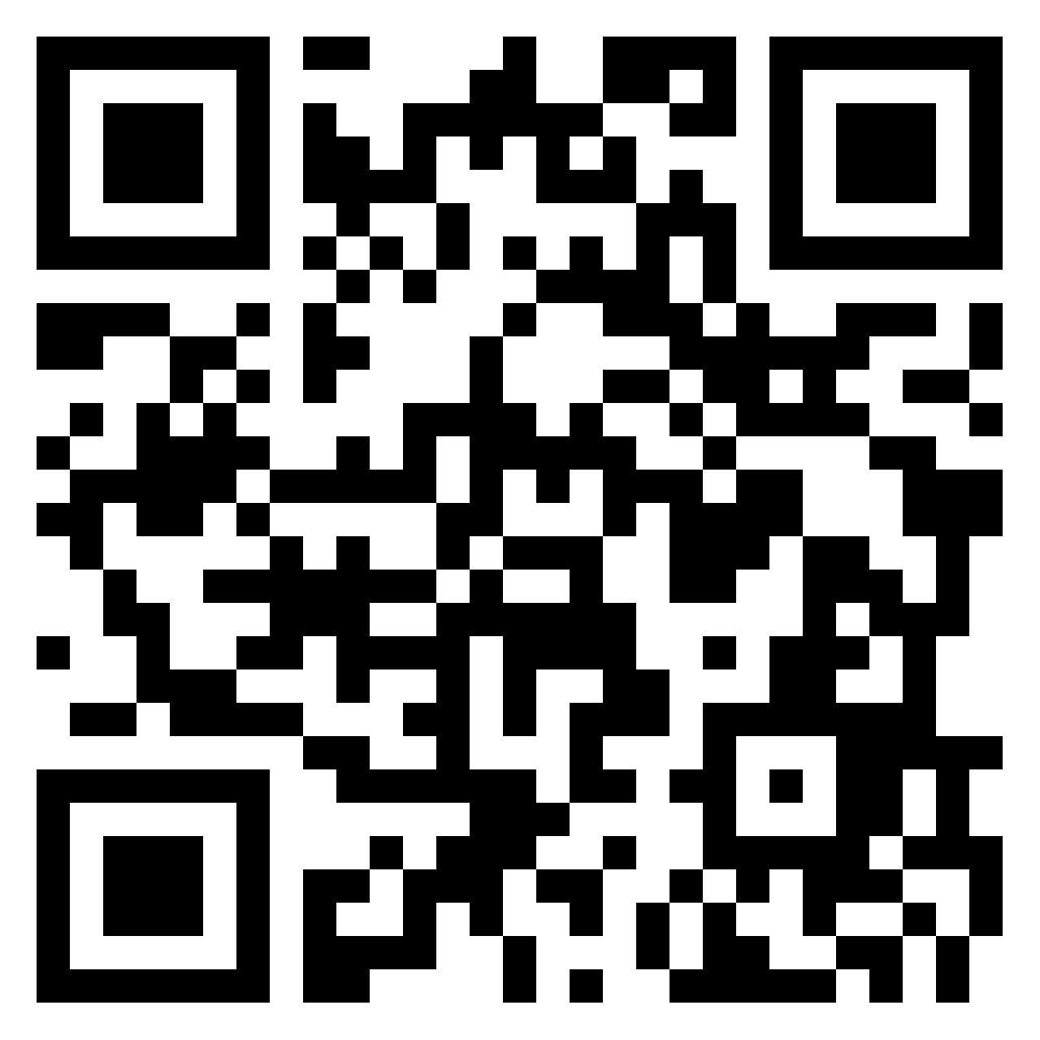
Who are you? Group Activity 2pm Class
Make a Post for Your Partner With:
Name
Photo
Hometown
Favorite food
Superpower
https://padlet.com/laferger/pl2oa507b33oytcy

Slide 47
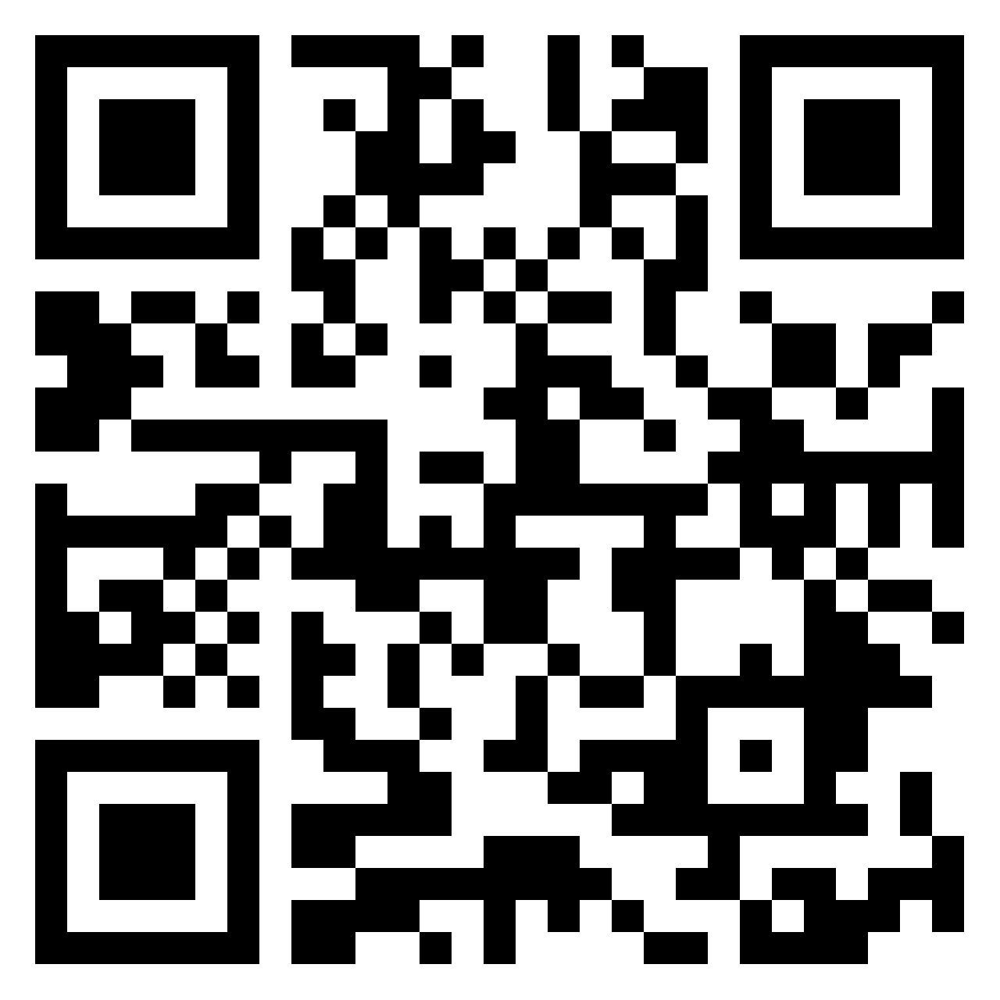
Who are you? Group Activity 3:30pm Class
Make a Post for Your Partner With:
Name
Photo
Hometown
Favorite food
Superpower
https://padlet.com/laferger/16hxutgk369uv30l

