Slide 1
Exploration of Success through the NHL
BY
Andrew Kehl

Slide 2


Slide 3
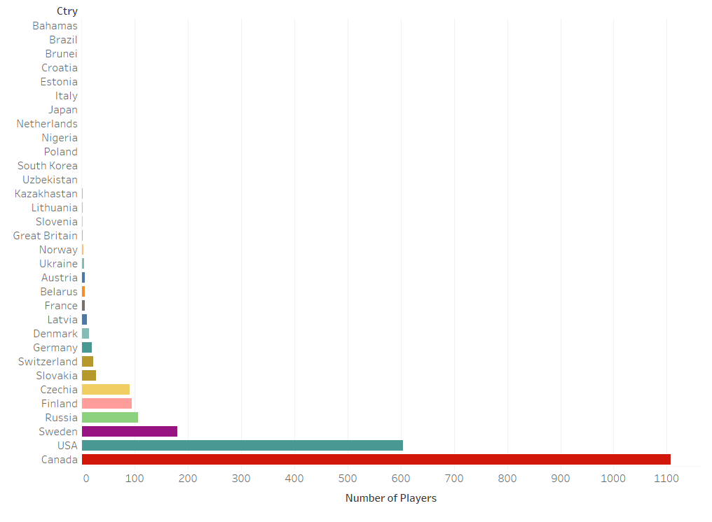
NHL Player Distribution by Country 2011-2021

Slide 4
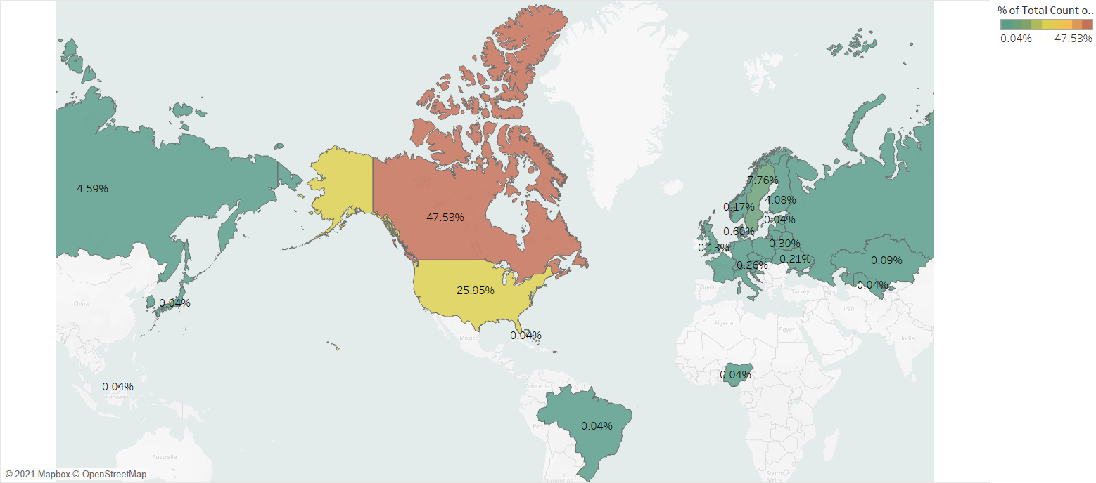
NHL Player Distribution by Country 2011-2021 Continued

Slide 5
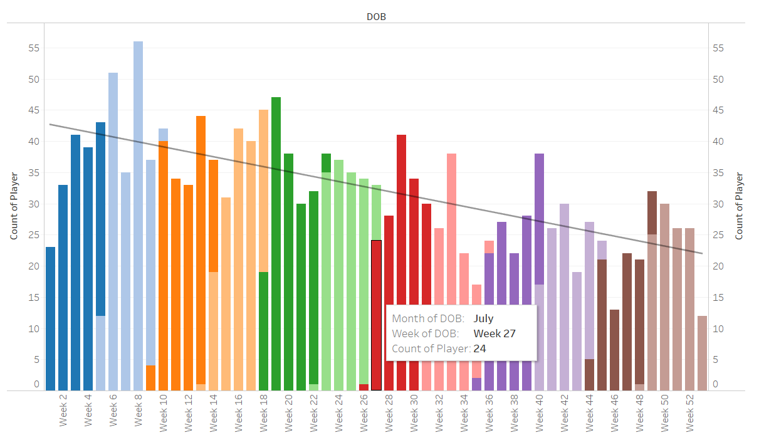
North American NHL Player Distribution by Birth Week 2011-2021

Slide 6
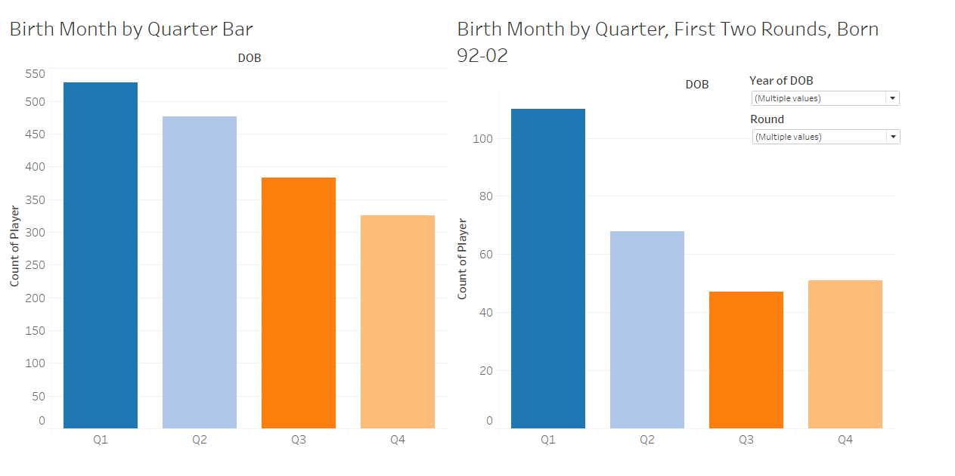

Slide 7
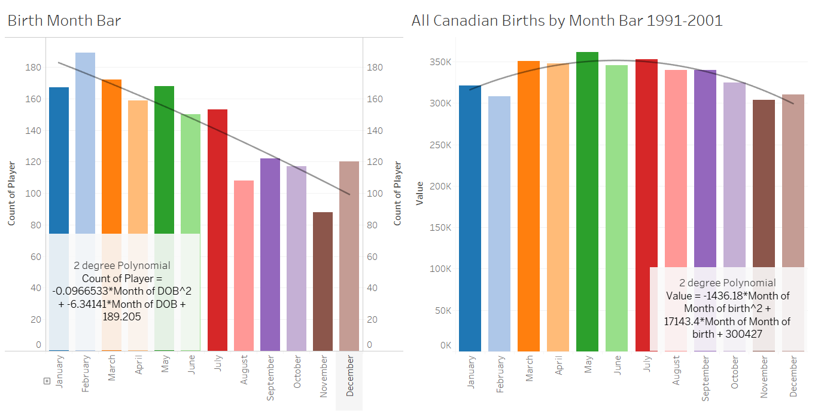
Canadian NHL Players Birth Months vs All Canadians 1991-2001

Slide 8
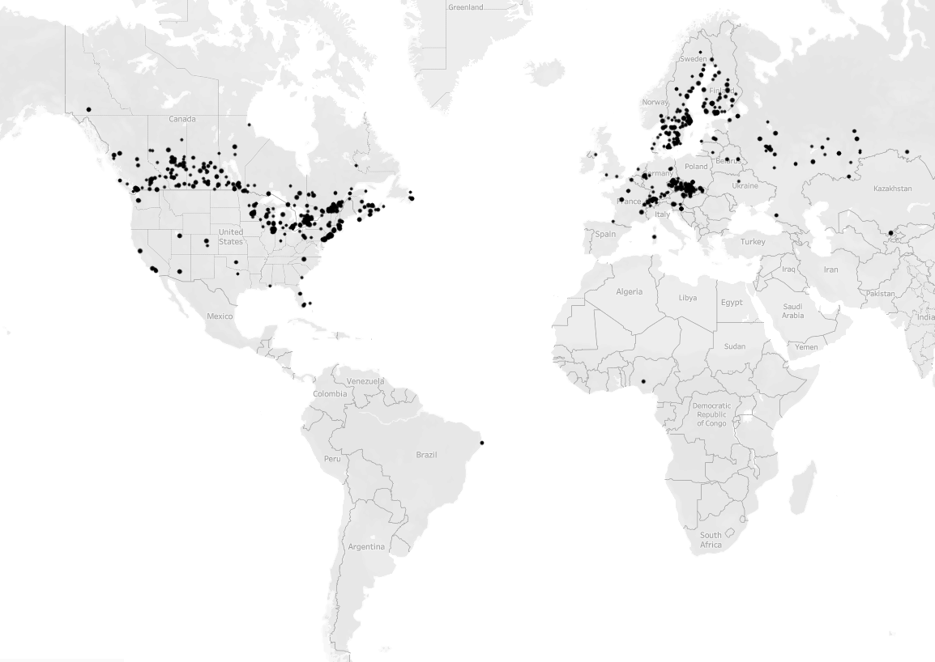
All NHL Players 2011-2021 Birth Places

Slide 9
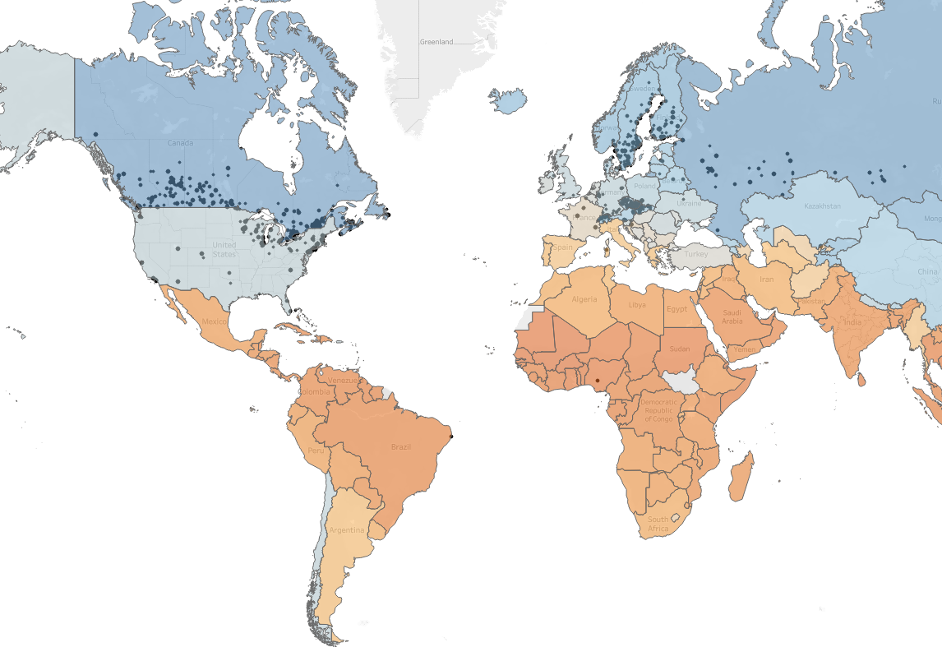
All NHL Players 2011-2021 Birth Places
Over Mean Winter Temp Map by Country

Slide 10
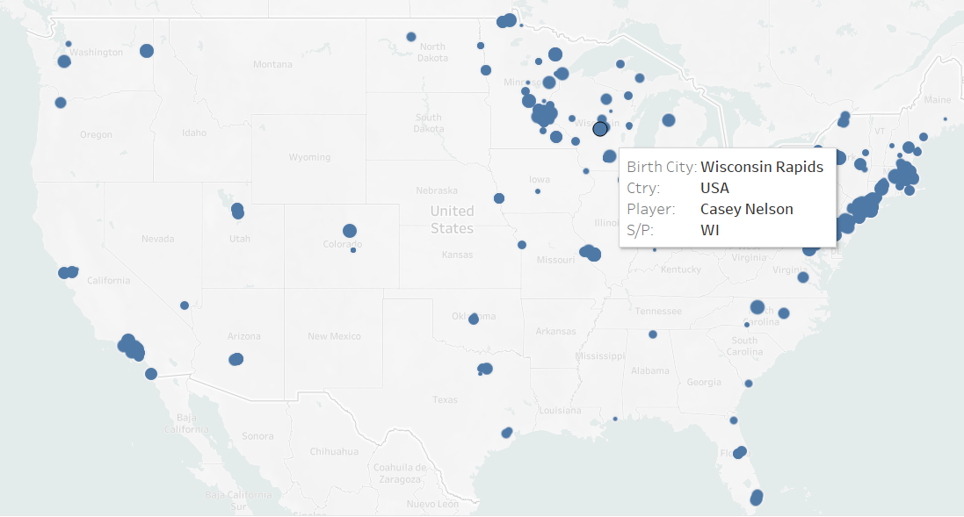
Birth Place of American NHL Players 2011-2021

Slide 11
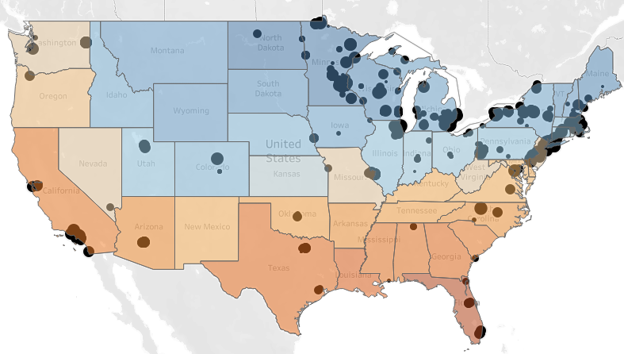

Birth Place of American NHL Players 2011-2021
Over Mean Winter Temp Map

Slide 12
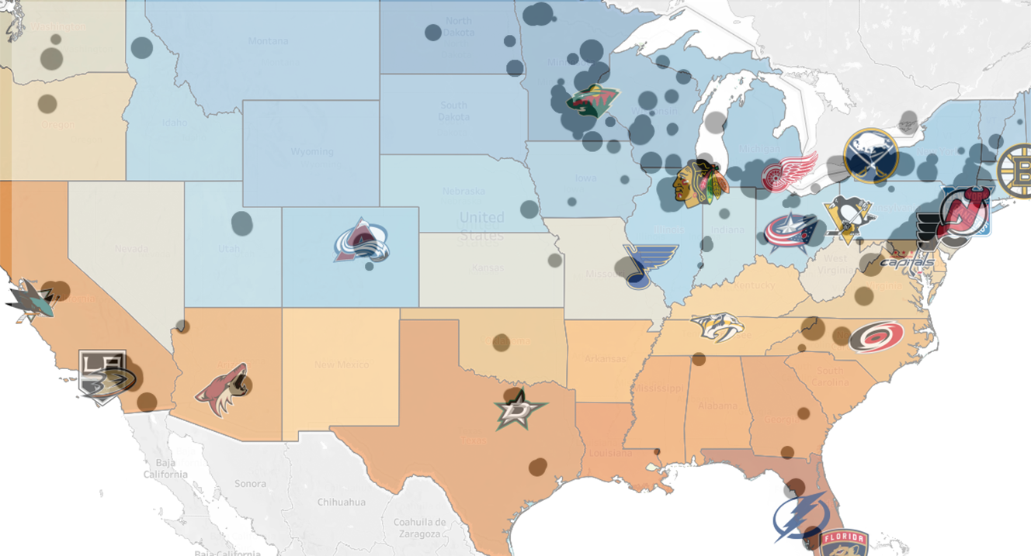
Birth Place of American NHL Players 2011-2021
W/ NHL Team Locations Marked

Slide 13
Thanks for your time.

