Slide 1
IMEX Formulations for Fluid Mechanics Applications
Brandon Murray
Binghamton University / RPI
Dr. Mark Carpenter, Mentor
NASA Langley – Computational AeroSciences Branch

Slide 2
Outline
Definitions
Background of research
Objectives
Methodology
Results
Future plans
Questions

Slide 3
Temporal integrators: Runge-Kutta
Three types of implicit temporal integrators:
Multistep schemes – Backward Differentiation (BDF)
  A-stability (L-stable) for 1st and 2nd order only
Multistage schemes- Runge-Kutta (RK)
  A-stability at any order, multiple stages increase cost
  downside: low stage order → order reduction for stiff problems
General linear methods- mixtures of multistage/multistage (MEBDF4)
  Extremely hard to design, not very mature

Slide 4
Stiffness
Definitions of Stiffness:
Necessitates implicit method for efficiency
Separation of temporal scales
  Not interested in high frequency scales
  Use implicit method to jump over high frequency scales
Separable stiffness:
  Form of stiffness where a splitting of the equations is easily identified to isolate the stiffness

Slide 5
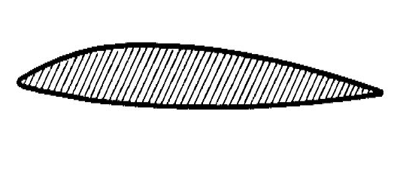
Background of Research
Implicit-Explicit RK (IMEX) schemes are optimal for applications with separable stiffness
Spacial dimensions may be separable
Individual convection, diffusion, reaction terms may be separable
Implicit
Explicit
http://www.bsaeronautics.com/wp-content/uploads/2015/05/1510.jpg

Slide 6
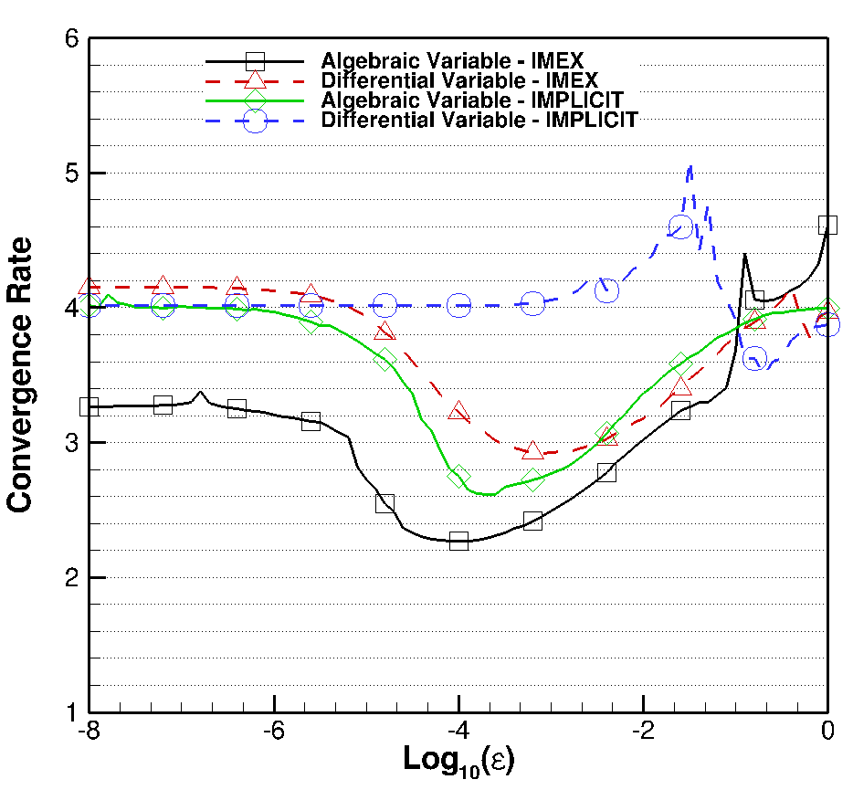
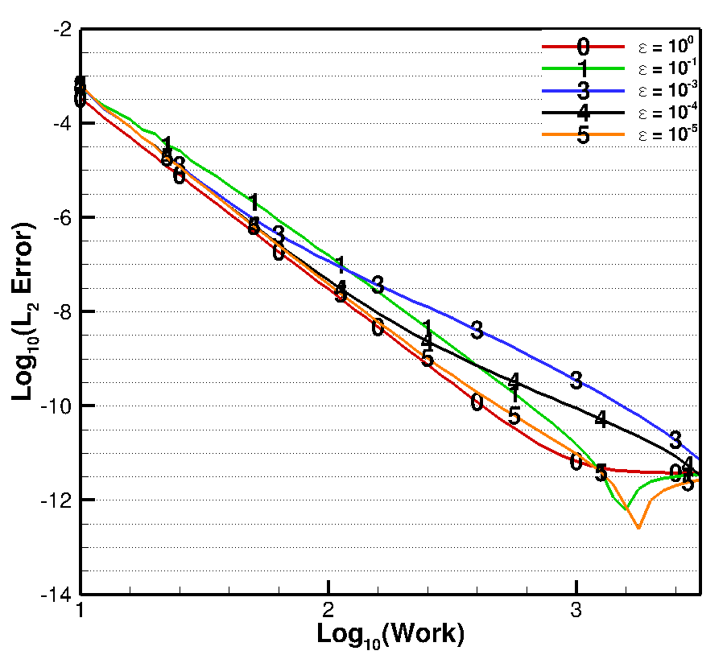
Order Reduction
Order reduction for Kaps Problem with ARK436[2]SA_4 RK scheme can be seen at ε≈10⁻⁴

Slide 7
Objectives
The objectives of this internship were to:
Build testing framework to test IMEX formulations
Investigate the efficacy of various IMEX RK schemes on multiple test problems
Compare convergence rates over varying stiffness of fully Implicit and IMEX formulations
Improve schemes from 2003 Applied Numerical Mathematics¹ paper
  Decrease order reduction
  Increase diagonal terms to improve convergence of iterative solver
1) Kennedy, Carpenter, “Additive Runge-Kutta schemes for convection-diffusion-reaction equations”. Applied Numerical Mathematics 44 (2003) 139-181.

Slide 8
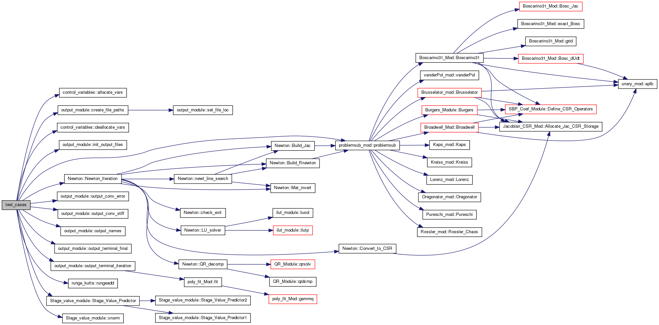
Test Suite

Slide 9
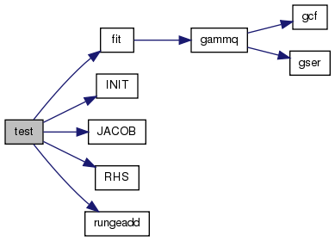
Test Suite

Slide 10
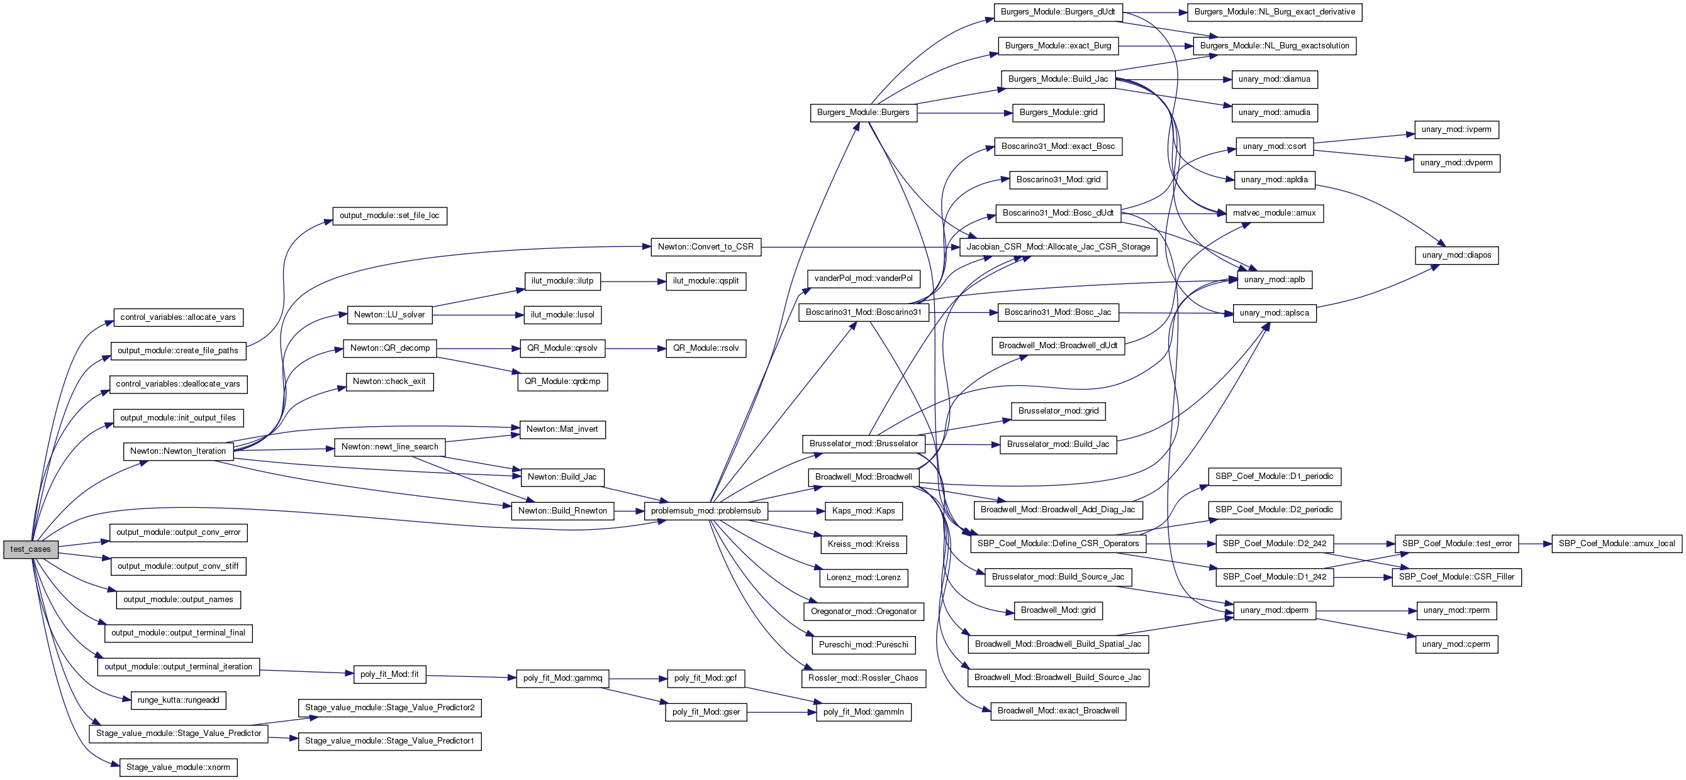
Test Suite

Slide 11
Test Problems
Van der Pol (Hairer II, pp. 403)
Pureschi and Russo
Kaps (Dekker 7.5.2 pp. 215: Index I)
Kreiss' (Dekker 7.5.1 pp. 214: Index II)
Lorenz Attractor
Rossler-Chaos (Wolf, Swift, Swinney, Vastano, Physica 16D, (1985), 285-317)
Oregonator
Brusselator
Burger's
Boscarino Eq. 31 (Boscarino, Russo, SIAM J. Sci. Comput., (2009), 1926-1945)
Broadwell Model (Boscarino, Russo, SIAM J. Sci. Comput., (2009), 1926-1945)

Slide 12
Methodology
Test problems were selected for their stiffness characteristics
Compare convergence rates with different stiffness values 10⁻⁸≤ ε ≤10⁰
Compare error of IMEX formulation against temporal cost with Implicit baseline

Slide 13
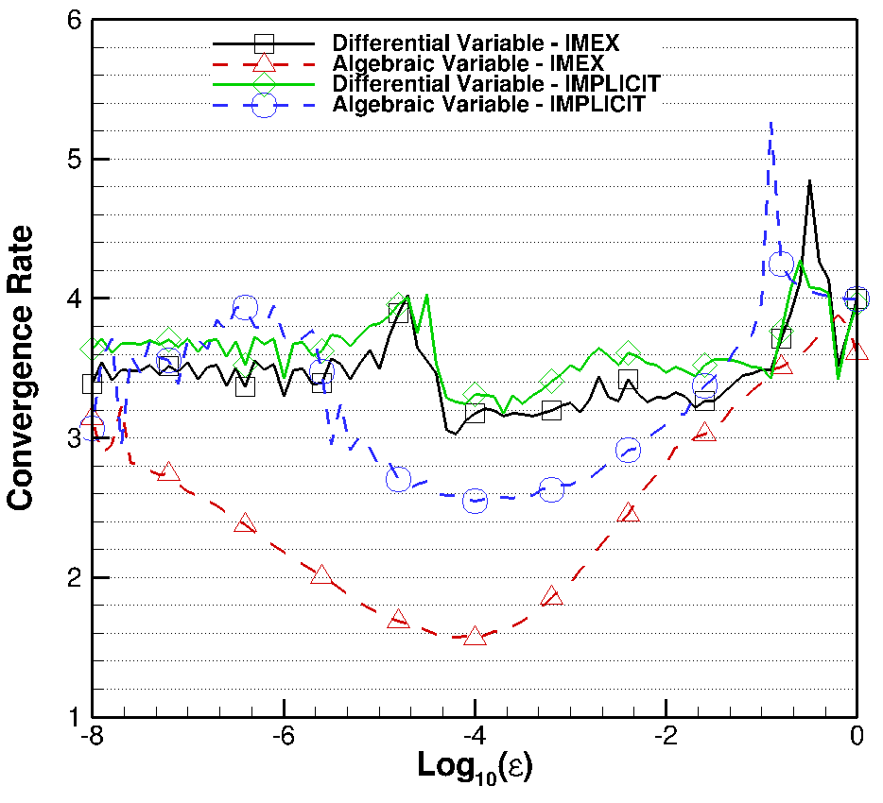
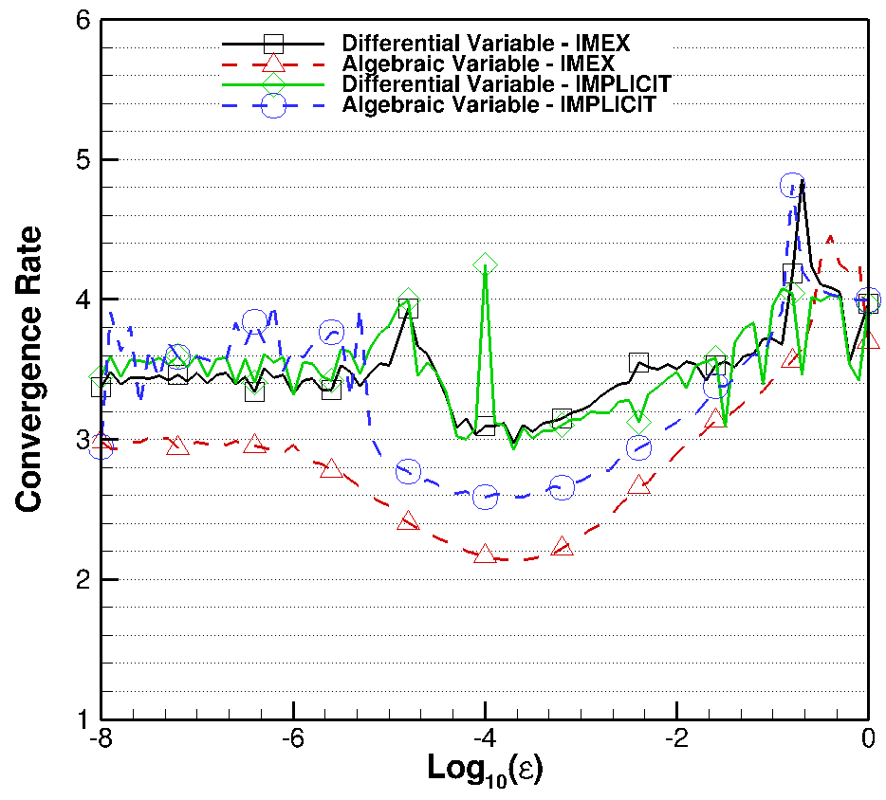
Order Reduction Improvement: Van der Pol
ARK436[2]SA_1
ARK436[2]SA_4

Slide 14
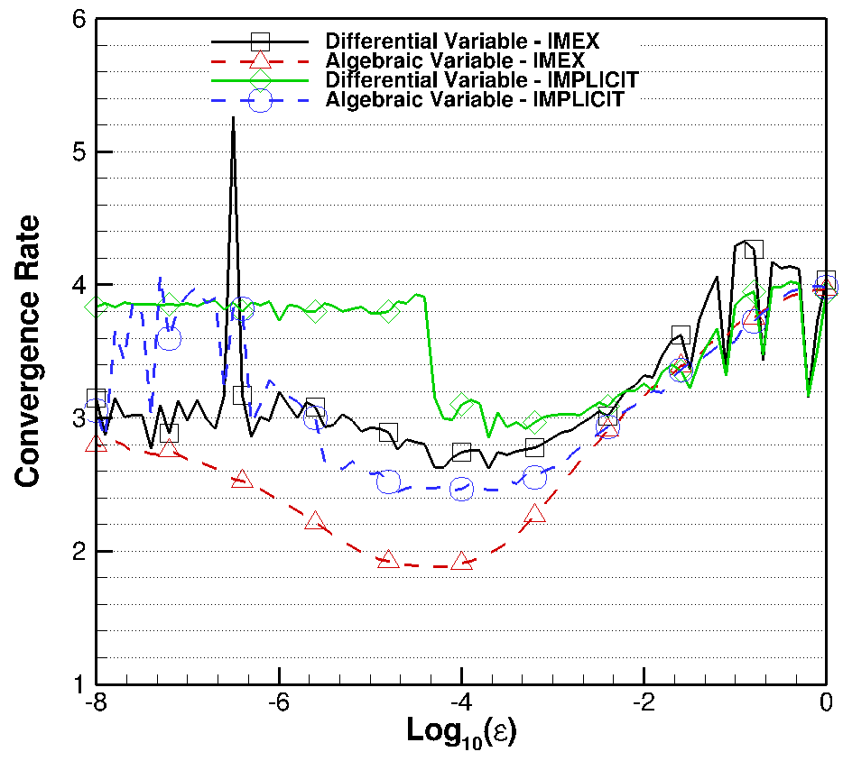
Order Reduction Improvement: Van der Pol
ARK436[2]SA_1
ARK437[2]SA_1 – C2E and C2I

Slide 15
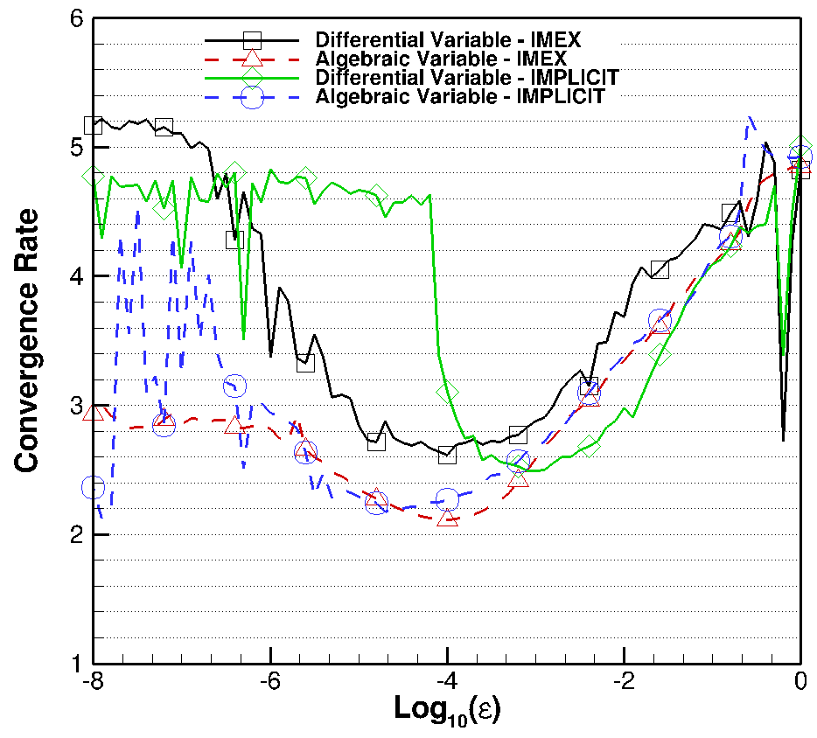
Order Reduction Improvement: Van der Pol
ARK436[2]SA_1
ARK538[2]SA_2

Slide 16
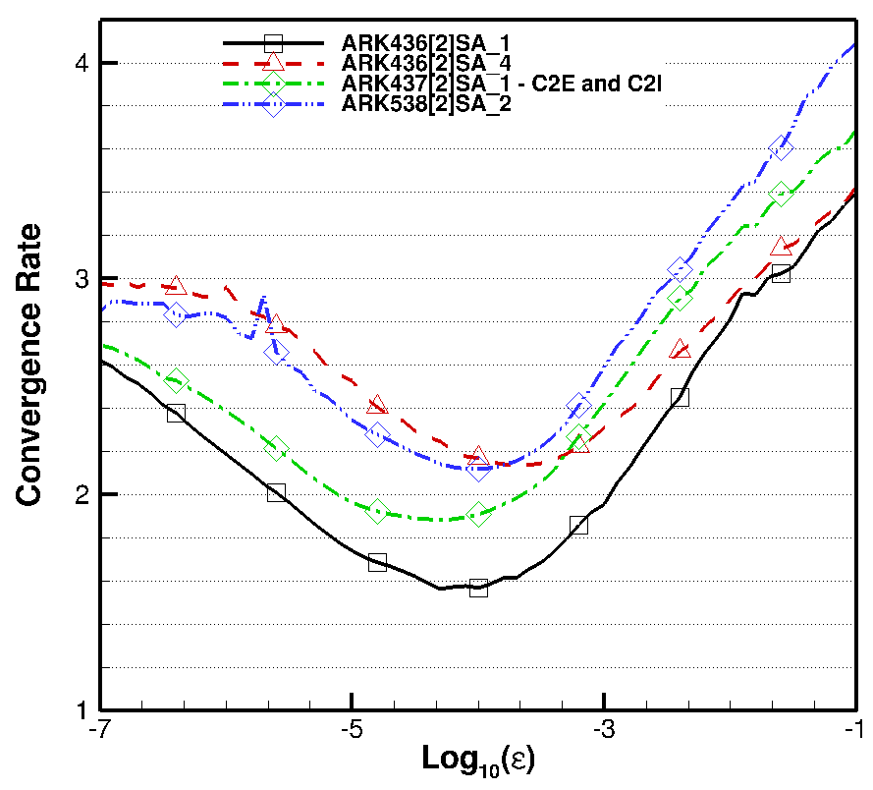
Order Reduction Improvement: Van der Pol
ARK436[2]SA_1 is baseline scheme
5th order ARK538[2]SA_2 and 4th order ARK436[2]SA_4 have similar order reduction
Multiple schemes on Van der Pol are improvements on baseline

Slide 17
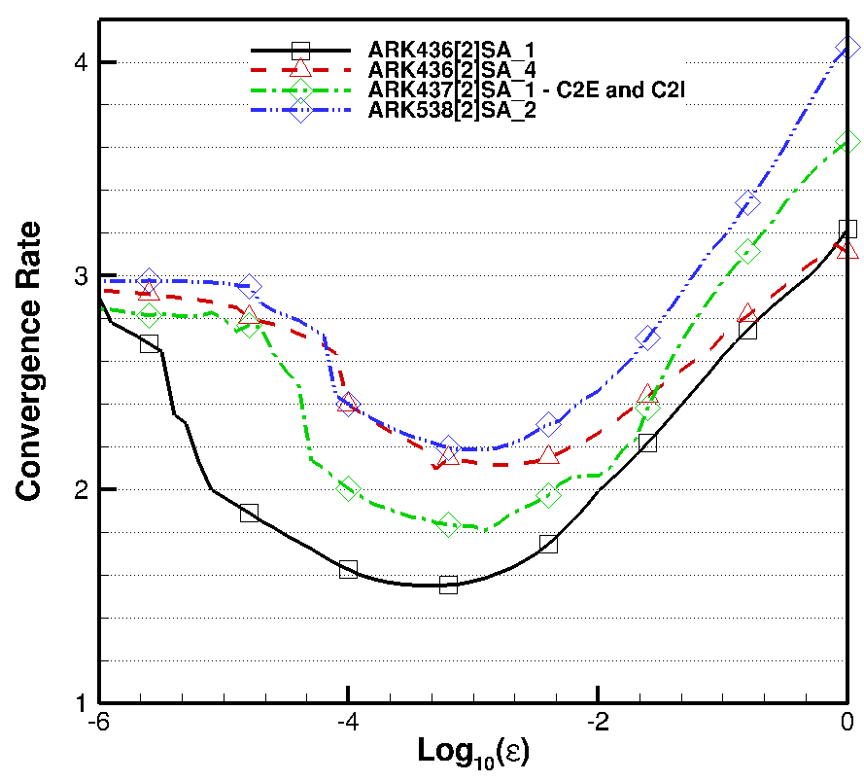
Order Reduction Improvement: Rossler-Chaos
ARK436[2]SA_1 is baseline scheme
5th order ARK538[2]SA_2 and 4th order ARK436[2]SA_4 have similar order reduction
Multiple schemes on Rossler-Chaos are improvements on baseline

Slide 18
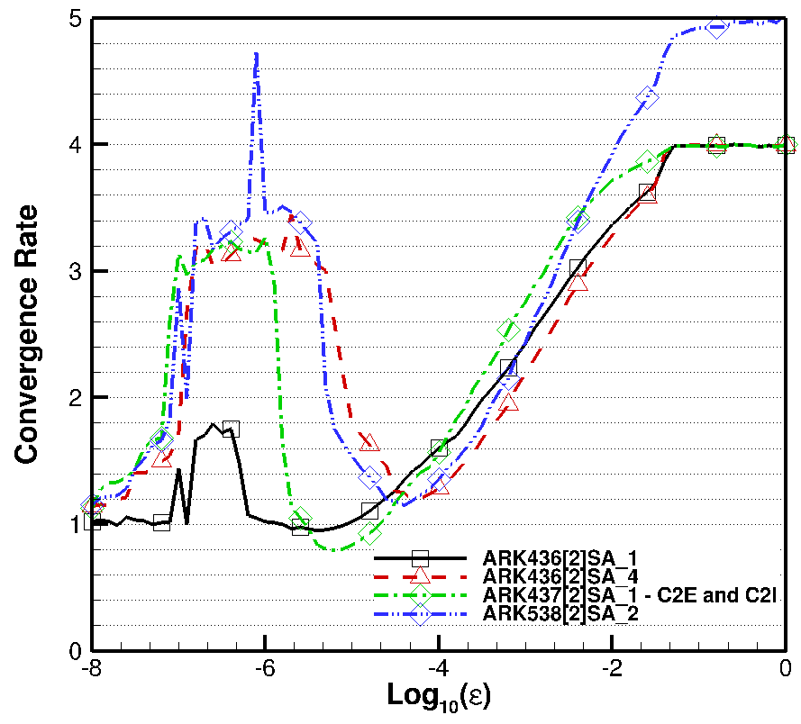
Order Reduction Improvement: Broadwell
ARK436[2]SA_1 is baseline scheme
Order reduction improvement is less clear than in other problems

Slide 19
error
text

Slide 20
Conclusions
Built test suite: ~95% idiot proof
Test suite produces reasonable solutions for each test problem
Order reduction in new schemes is better than the baseline
ARK436[2]SA_4 seems to be the best scheme investigated

Slide 21
Future Plans
NASA technical memorandum
  Long term: journal article
Implementation into FUN3D

Slide 22
Acknowledgments
NIFS
Dr. Mark Carpenter
Computational AeroSciences Branch

Slide 23
Questions?

