Slide 1


Cartopy
SciTools
Cartopy updates

Slide 2
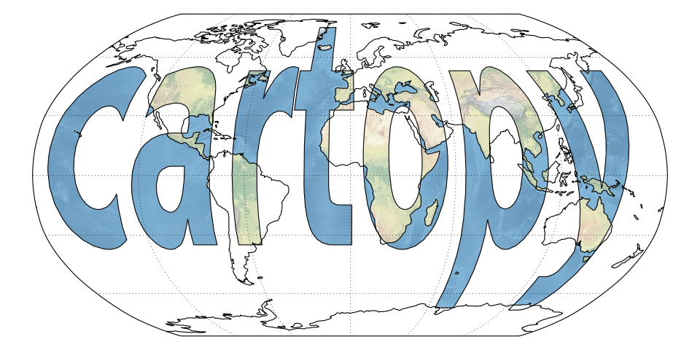
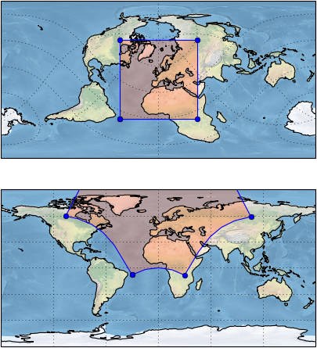
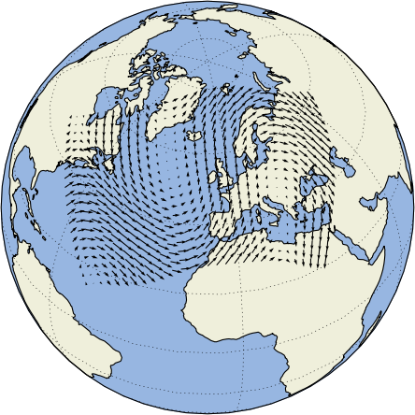
Object-oriented map projections
Image & Geometry
transform
Vector
transform
Matplotlib interface
SciTools
Cartopy updates

Slide 3
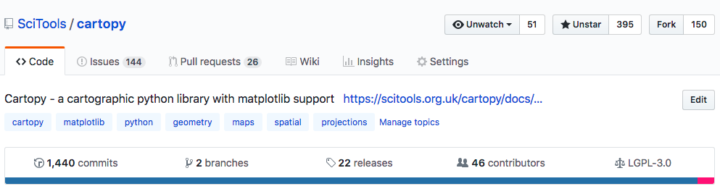
Repo status
github.com/SciTools/cartopy
SciTools
Cartopy updates
As of the 29th June 2018

Slide 4
Repo status
Slow-ish release cadence (avg. ~1 per year since 2015)
Interface has matured
Updates to track upstream version upgrades (e.g. matplotlib 2, proj v5)
Still lots of room for improvement before v1.0
Backlog of GitHub issues and pull requests
SciTools
Cartopy updates

Slide 5
Top feature requests*
Simple interface to convert between cartopy Projections and Proj
Improved performance
Better graticule implementation (and labelling for non-rectangular projections)
Clearer docs
More projections
SciTools
Cartopy updates
*As perceived by authors

Slide 6
Summary
Slow-ish release cadence
Direction of travel good, though more development welcome
Recent improvements to the stability of the geometry transformation algorithm very welcome
Marked uptake and questions on StackOverflow since Basemap announcement
Some significant feature / usability improvements remain
SciTools
Cartopy updates

Slide 7

Iris
SciTools
Iris updates

Slide 8

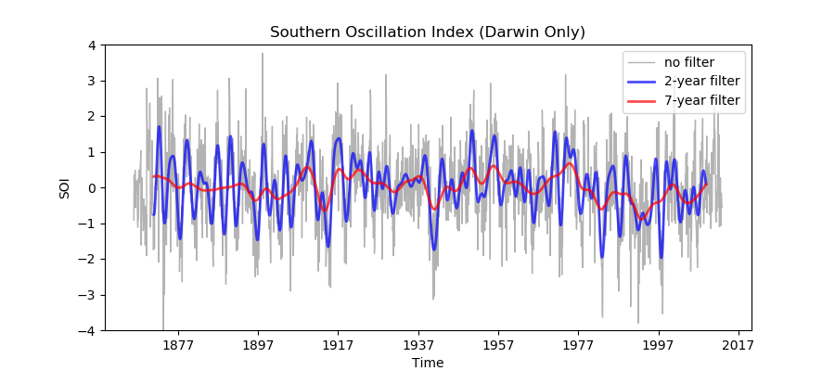
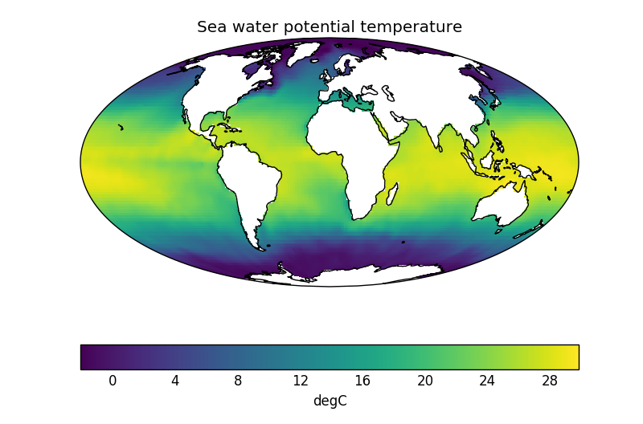
N-dimensional data + metadata
Data model based on CF conventions
Interpolation and regridding algorithms
Format Agnostic
(NetCDF, GRIB, PP/UM, custom)
v2
SciTools
Iris updates
Matplotlib
interface

Slide 9
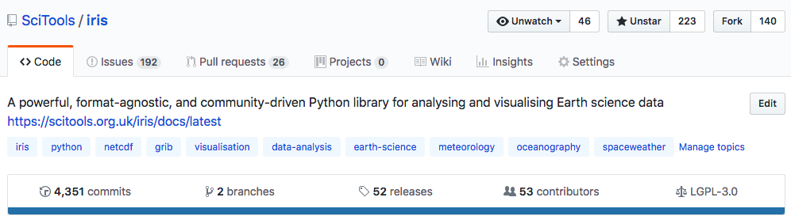
Repo status
github.com/SciTools/iris
SciTools
Iris updates
As of the 29th June 2018

Slide 10
Top feature requests*
CF-1.7 & 2D UGRID support
Dataset and data-less concepts
Further laziness & parallelisation with Dask
High performance load & concat (Pangeo: NetCDF with S3)
Improved indexing interface (value based & via
named coordinates)
SciTools
Iris updates
*As perceived by authors

Slide 11
Summary
Significant development continues to take place (v2!)
Resulted in wider community progress (e.g. cartopy, conda-forge, biggus => Dask, cf-units, matplotlib enhancements)
Steady uptake and large community of Earth Scientists
Pros & Cons of (CF-)conventions based data-model (e.g. Iris is more specialist vs. XArray => broader community & greater uptake)
SciTools
Iris updates
Notes:
Priorities:
UGRID major focus
Spherical regridding (unstructured)
Indexing interface

Slide 12
cf-units
SciTools
cf-units updates

Slide 13
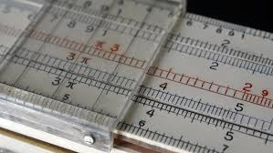
Units interface
Physical quantity unit conversions
Based on UDUNITS2
cf-units
v2
Cython implementation
SciTools
cf-units updates
Model calendar support
(360-day / 365-day)
via cftime
Notes:
YT: unyt hook
Recent cythonization
V2 released

