Slide 1
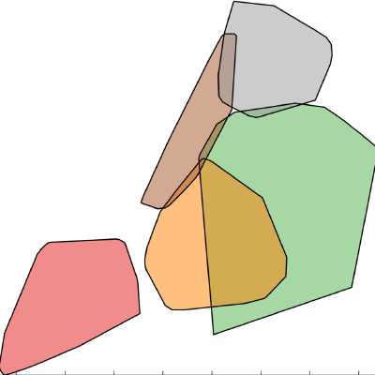
GeoPandas
Easy, fast and scalable geospatial analysis in Python

Slide 2
What is GeoPandas?
Extends the pandas DataFrame with support for geospatial data and operations
Focus on geospatial vector data (Points, LineStrings, Polygons)
Combines the power of whole ecosystem of (geo) tools (pandas, geos, shapely, gdal, fiona, pyproj, rtree, matplotlib, ...)
Similar to how PostGIS extends PostgreSQL
http://geopandas.readthedocs.io/en/latest/

Slide 3
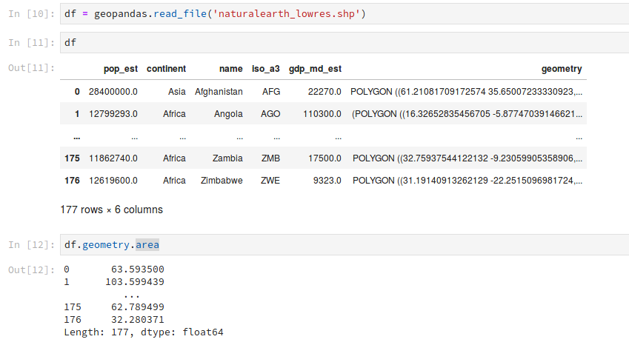
What is GeoPandas?
Many geospatial methods: distance, intersects, within, crosses, intersection, union, difference, buffer, explode, CRS conversion, ...

Slide 4
Upcoming 0.4.0 release (target date: Scipy sprints)
Much improved overlay function!
Read files from url
explode for GeoDataFrames
Plotting MultiPoints
... and many other enhancements and bug fixes

Slide 5
Fast?

Slide 6
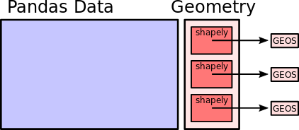
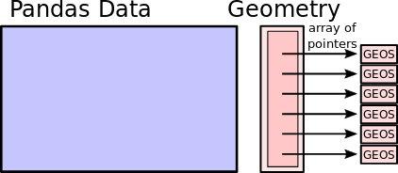
Fast?
In-development version that gives 5x to 100x speed-up
Currently, GeoPandas stores Geometry objects in object dtype array and iterates through them for operations
New version: remove python overhead by only storing pointers to C GEOS objects and iterating in C

Slide 7
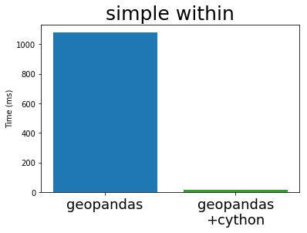
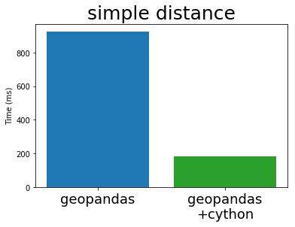
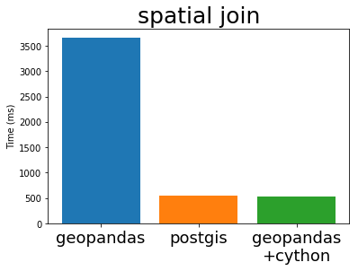
Fast?
In-development version that gives 5x to 100x speed-up
Needs some love to get it finished
https://jorisvandenbossche.github.io/blog/2017/09/19/geopandas-cython/

Slide 8
Scalable?
Experimental prototype with a geopandas collection for Dask providing parallel spatial operations
Example benchmark: parallel spatial join (http://matthewrocklin.com/blog/work/2017/09/21/accelerating-geopandas-1)
https://github.com/mrocklin/dask-geopandas

