Slide 1
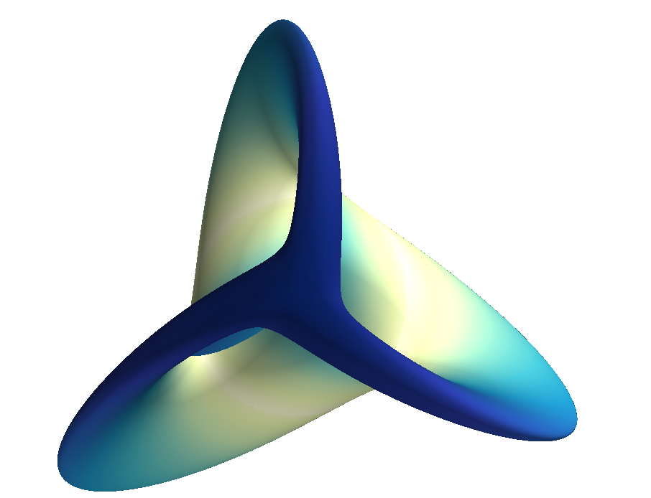
Mayavi: 3D Visualization
Prabhu Ramachandran

Slide 2
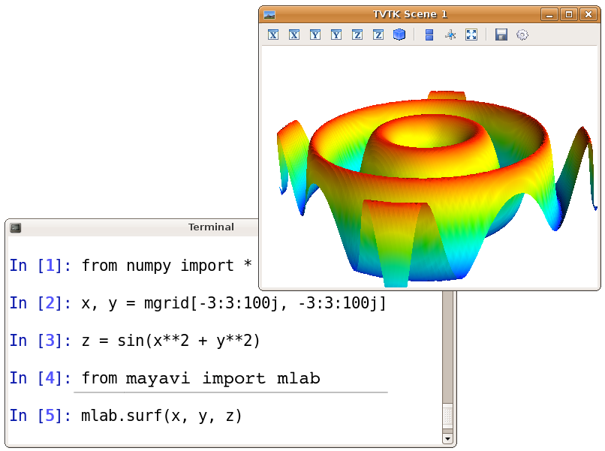

Slide 3
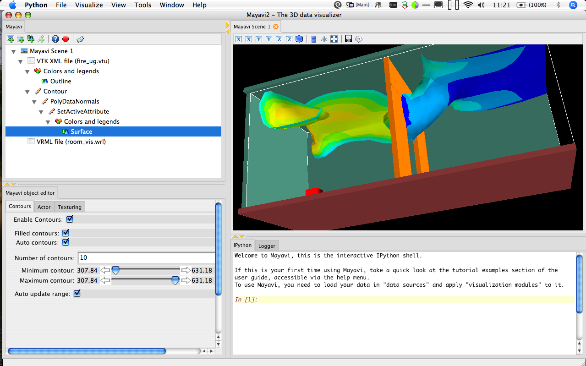

Slide 4
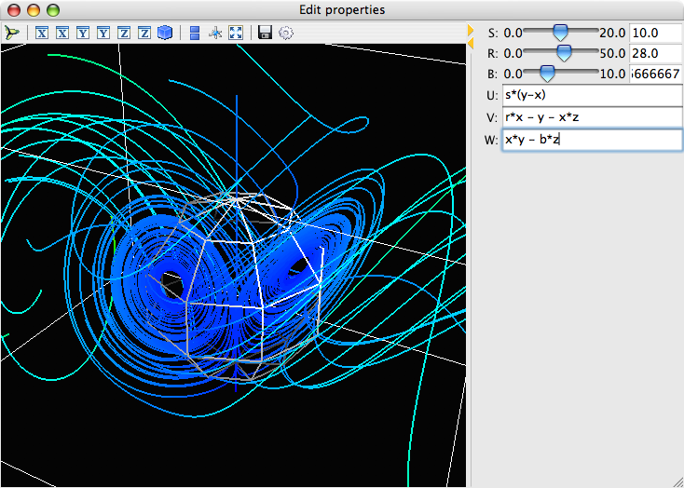

Slide 5
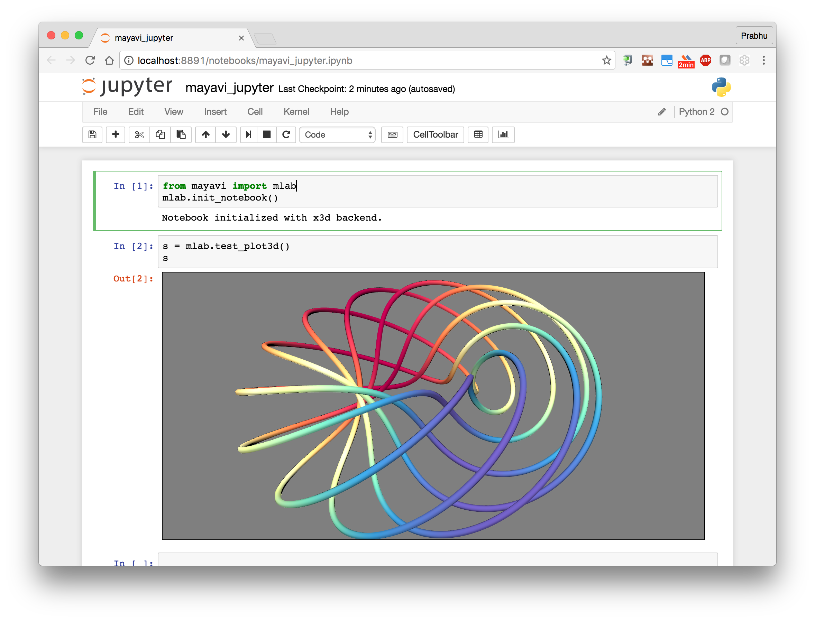

Slide 6
Features
Around for > 15 years
Highly scriptable
Seamless NumPy integration
Powerful command line options
Automatic script recording

Slide 7
Formerly, the hardest to install package on the planet!
Now pip installable!

Slide 8
Recent updates
VTK 8.1.0, 8.1.1 wheels now on PyPI!
Easier to install with pip
Python 3 support, stable now
PyQt5 support
Useful learning material
https://github.com/prabhuramachandran/mayavi-tutorial
https://github.com/prabhuramachandran/mayavi-workshop

Slide 9
Plans
Make installation a bit easier (done)
PySide2 support (done)
Fix issues with the Mayavi application
Miscellaneous improvements
More dataformats
Interop with new kids on the block

