Slide 1


Slide 2
Current development focus
Bug fixes, new features and enhancements
IO functionality (Parquet format support, styled excel output, JSON table schema, S3 support, ...)
DataFrame.aggregate
Intervals
…

Slide 3
Current development focus
Bug fixes, new features and enhancements
IO functionality (Parquet format support, styled excel output, JSON table schema, S3 support, ...)
DataFrame.aggregate
Intervals
…
Extending pandas data types and method

Slide 4
Current development focus
Bug fixes, new features and enhancements
Clean-up of the API (towards 1.0)
Deprecation of Panel
Deprecation of .ix
Sum of empty Series
Indexing with missing labels
...

Slide 5
Extending pandas data types
Ongoing work on an ExtensionArray interface: define your own array-like and tell pandas how to work with it.

Slide 6
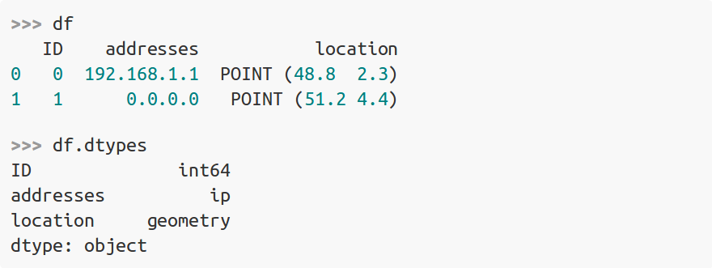
Extending pandas data types
Ongoing work on an ExtensionArray interface: define your own array-like and tell pandas how to work with it.
Examples with cyberpandas and GeoPandas:

Slide 7
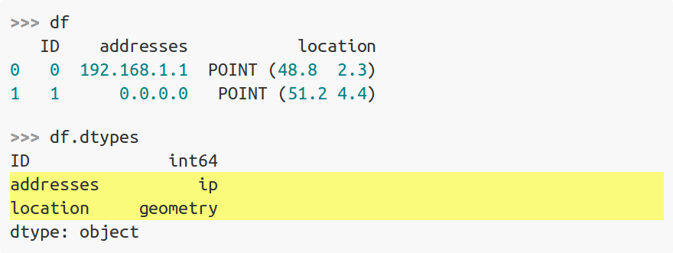
Extending pandas data types
Ongoing work on an ExtensionArray interface: define your own array-like and tell pandas how to work with it.
Examples with cyberpandas and GeoPandas:

Slide 8
Extending pandas data types
Already existing use cases:
Domain specific data types and functionality (e.g. cyberpandas, GeoPandas)
Arrow-backed data types: fletcher (by Uwe Korn) eg string data type
Integers with NA support (opt-in feature in next pandas release)

