Slide 1

scikit-image
Image processing in Python
http://scikit-image.org
https://github.com/scikit-image/scikit-image
Presentation template by SlidesCarnival

Slide 2
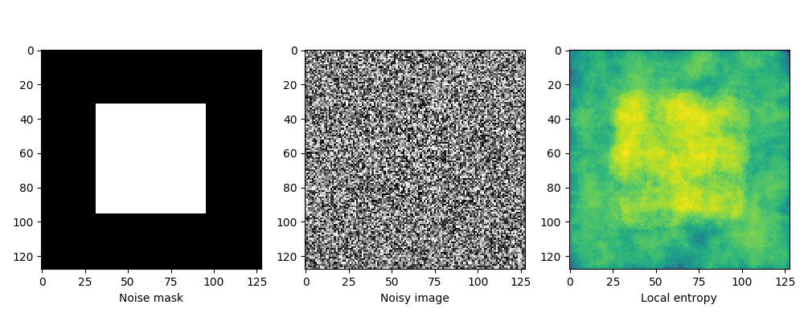
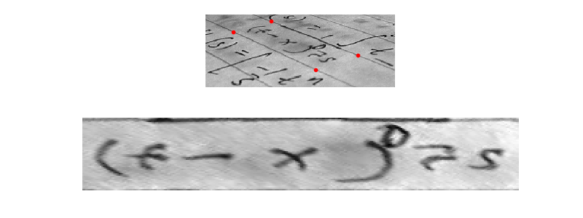
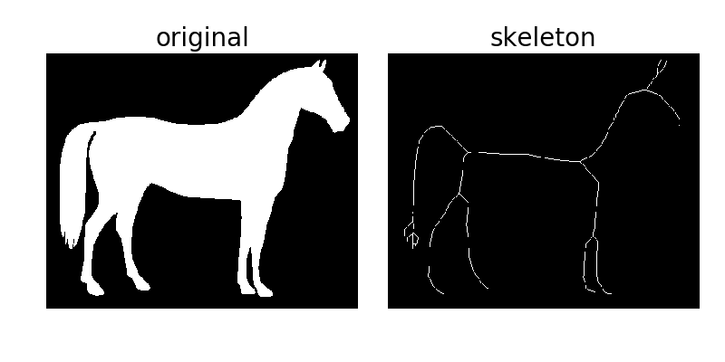
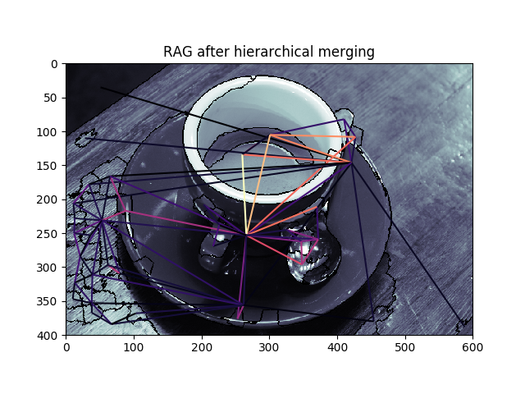
scikit-image.org — go to “gallery”

Slide 3
Notable developments
0.14 released 5/2018
186 PRs, 67 committers, 23 reviewers (core ~ 5 active)

Slide 4
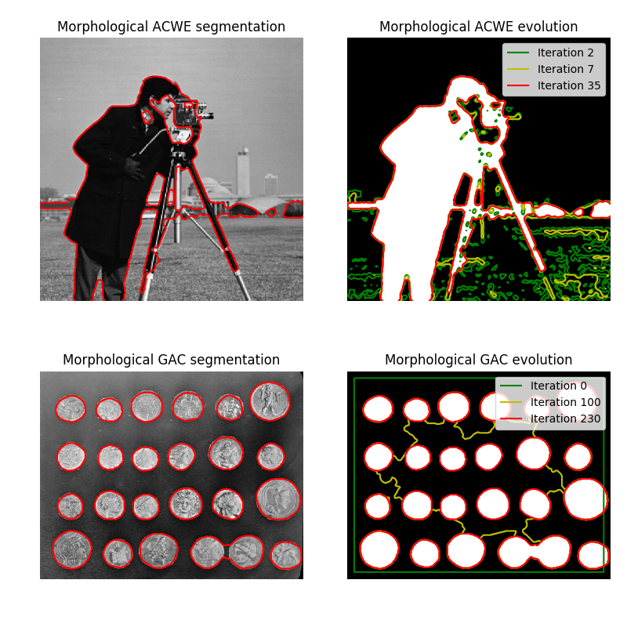
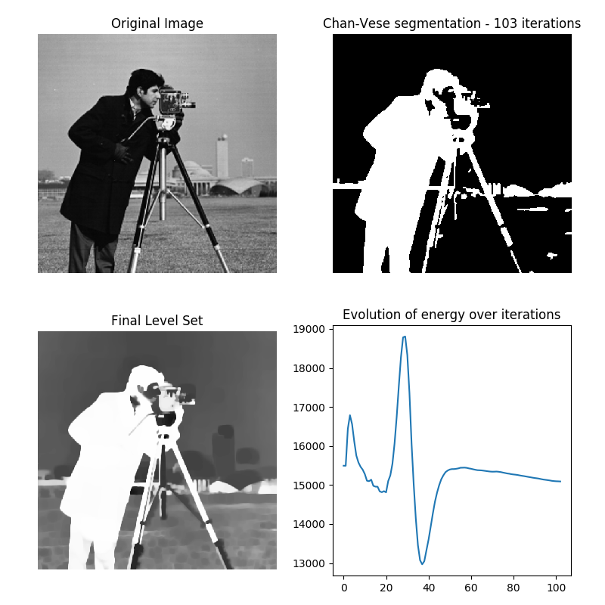
Chan-Vese segmentation
Morphological snakes

Slide 5
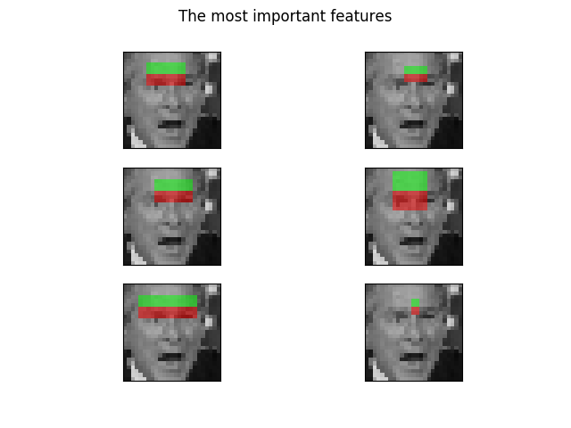
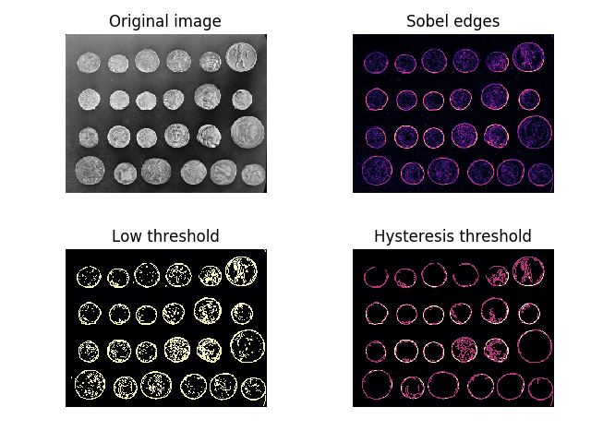
Haar-like features
Hysteresis thresholding
More at http://scikit-image.org/ (click “gallery”)

Slide 6
Notable developments
0.14 is a LTS release, Python 2 support
master, >=0.15 is Python 3 only

Slide 7
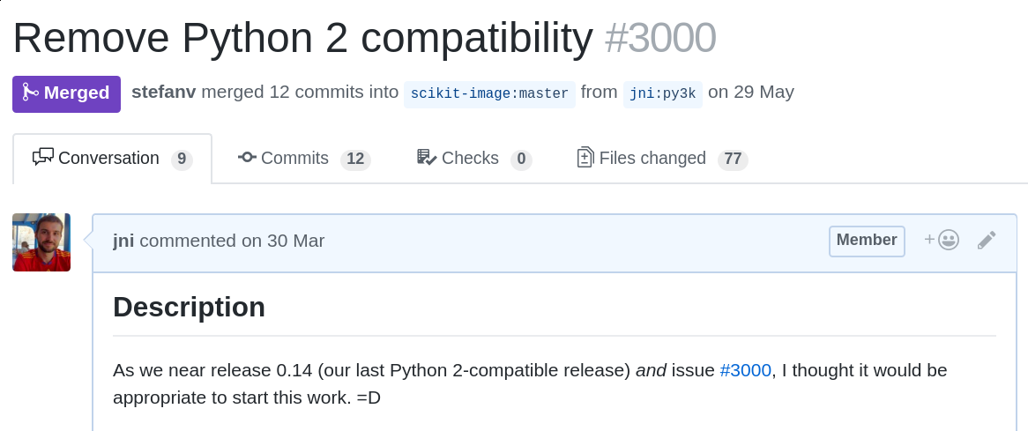
Notable developments
master, >=0.15 is Python 3 only

Slide 8
Technical Roadmap
Continuing improvement of N-d support
Standardized indexing throughout (array axes vs geometrical xy)
Handling metadata
Speed & scaling enhancements (investigations into numba, dask, & other tools continue)
Set up a roadmap: https://ilovesymposia.com/2018/07/13/the-road-to-scikit-image-1-0/
Next release slated for December

Slide 9
Community Roadmap
Monthly developer meetings (goal, among others, to make decisions that are difficult to make on GitHub)
Various community centered website improvements:
Usage survey & exhibition
Core contributor profiles
Clearer definition of mission / values
Cross-language usage examples, real-world pipelines
Expand core team
Improve path from first contribution to core
Sustained developer time & funding
Outreach

