Slide 1

NATHAN GOLDBAUM,
ON BEHALF OF THE YT PROJECT
SCIPY TOOLS PLENARY

Slide 2
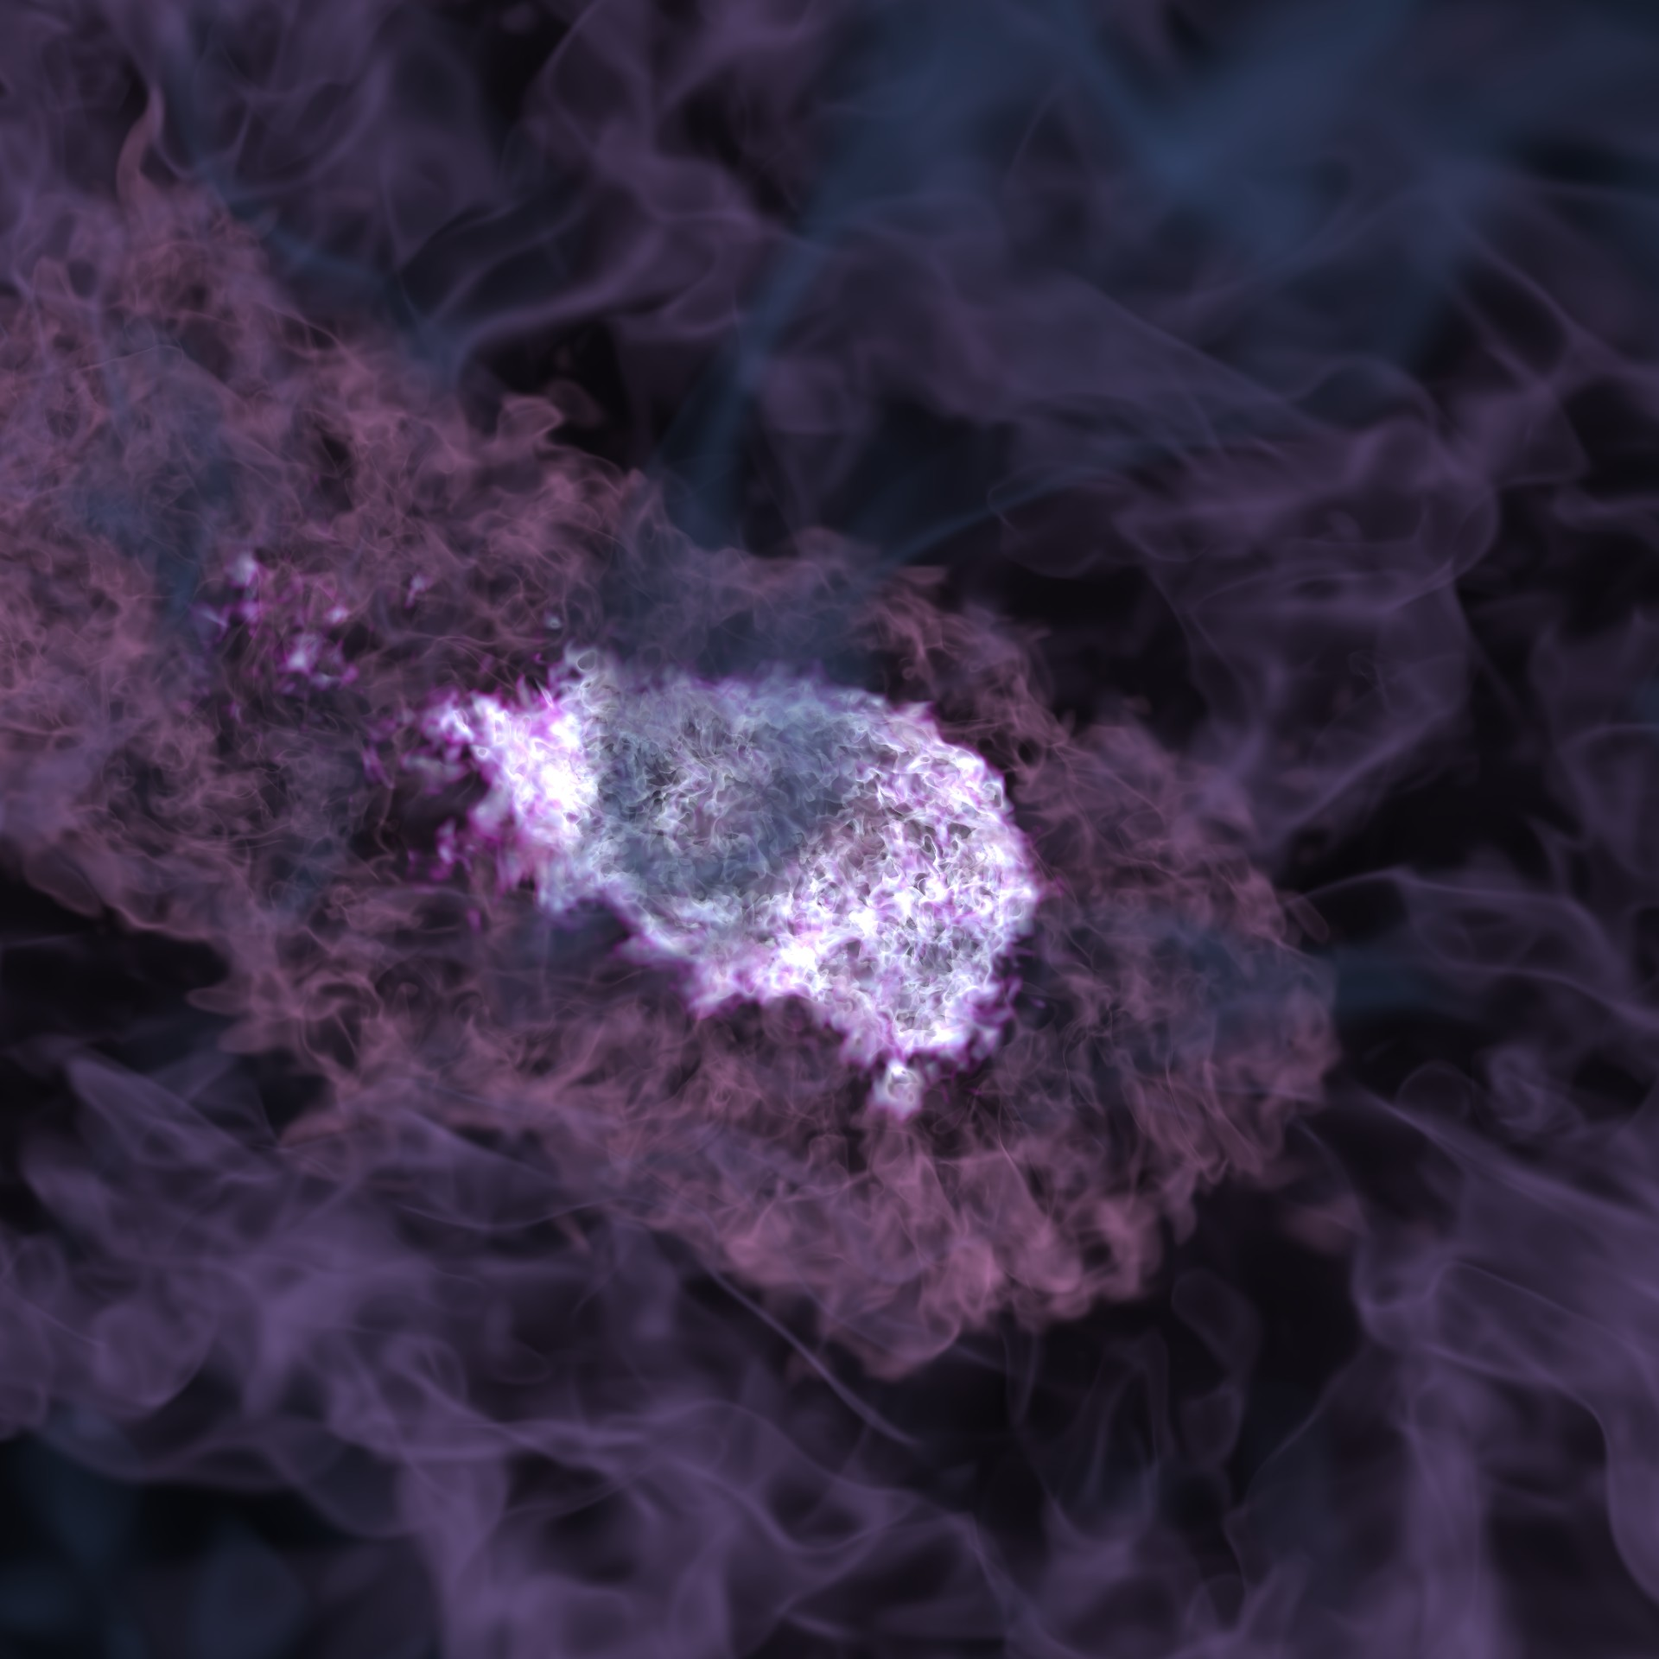

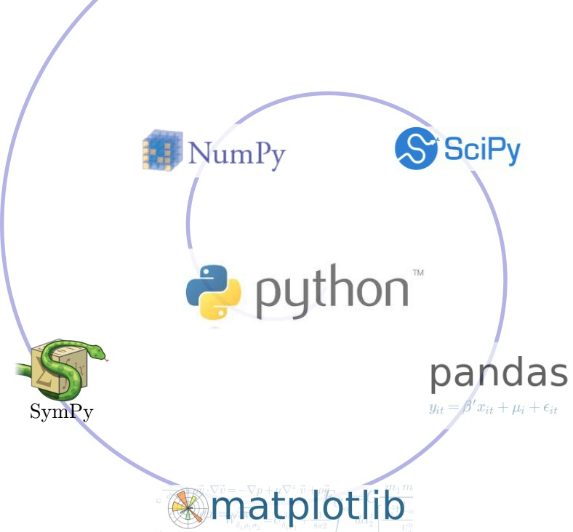

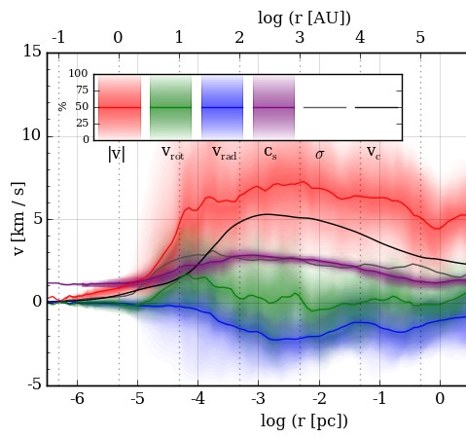
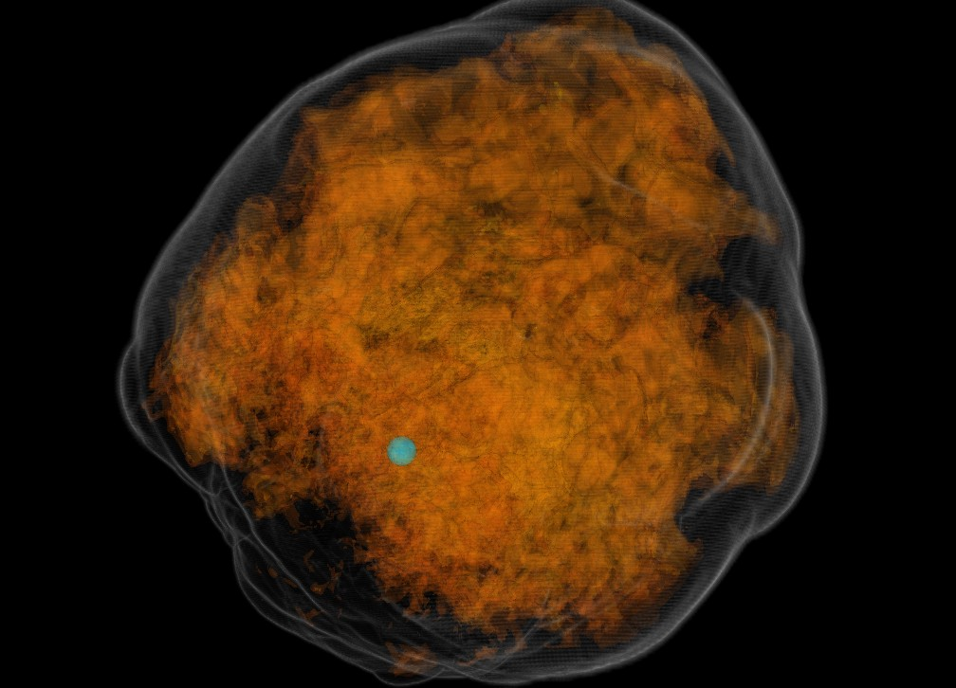

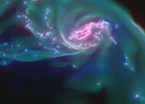

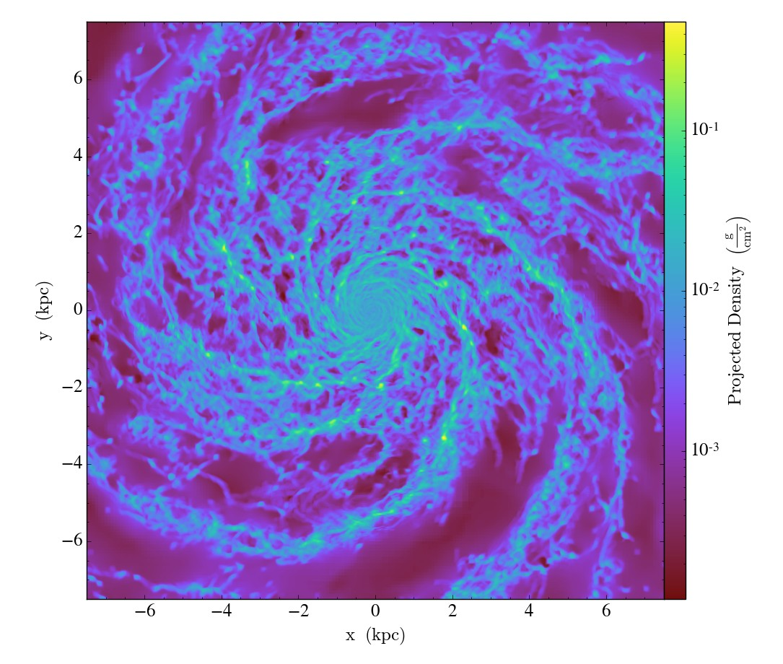

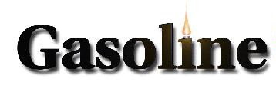

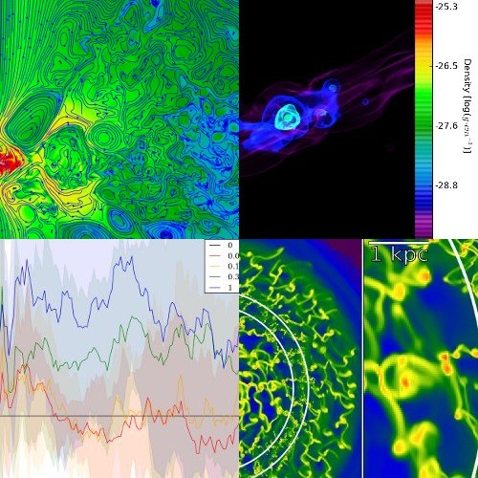


http://yt-project.org
FLASH
Ingest Data
Analysis/ Visualization
Ramses
Gadget
https://github.com/yt-project/yt

Slide 3
A COMMUNITY OF PRACTICE
Tom Abel | Bili Dong | Allyson Julian | Yuan Li | John Regan | Antoine Strugarek
Gabriel Altay | Donald E Willcox | Anni Jarvenpaa | Alex Lindsay | Mark Richardson | Elizabeth Tasker
Kenza Arraki | Nicholas Earl | Christian Karch | Yingchao Lu | Sherwood Richers | Robert Thompson
Kirk Barrow | Hilary Egan | Max Katz | Yinghe Lu | Thomas Robitaille | Ben Thompson
Ricarda Beckmann | Daniel Fenn | BW Keller | Chris Malone | Anna Rosen | Benjamin Thompson
Christoph Behrens | John Forbes | Ashley Kelly | John McCann | Chuck Rozhon | Joseph Tomlinson
Elliott Biondo | Enrico Garaldi | Chang-Goo Kim | Jonah Miller | Douglas Rudd | Stephanie Tonnesen
Alex Bogert | Sam Geen | Ji-hoon Kim | Joshua Moloney | Rafael Ruggiero | Matthew Turk
Josh Borrow | Austin Gilbert | Steffen Klemer | Chris Moody | Hsi-Yu Schive | Miguel de Val-Borro
Robert Bradshaw | Adam Ginsburg | Fabian Koller | Christopher Moody | Anthony Scopatz | Kausik Venkat
Andre-Patrick Bubel | Nick Gnedin | Claire Kopenhafer | Stuart Mumford | Noel Scudder | Casey W. Stark
Corentin Cadiou | Nathan Goldbaum | Kacper Kowalik | Madicken Munk | Patrick Shriwise | Rick Wagner
Pengfei Chen | William Gray | Matthew Krafczyk | Andrew Myers | Devin Silvia | Mike Warren
Yi-Hao Chen | Philipp Grete | Mark Krumholz | Jill Naiman | Abhishek Singh | Charlie Watson
Salvatore Cielo | Max Gronke | Michael Kuhlen | Desika Narayanan | Sam Skillman | Andrew Wetzel
David Collins | Markus Haider | Avik Laha | Kaylea Nelson | Stephen Skory | John Wise
Marianne Corvellec | Eric Hallman | Meagan Lang | Brian O'Shea | Joseph Smidt | Michael Zingale
Jared Coughlin | David Hannasch | Erwin Lau | J.S. Oishi | Aaron Smith | John ZuHone
Brian Crosby | Stephanie Ho | Eve Lee | JC Passy | Britton Smith
Weiguang Cui | Cameron Hummels | Doris Lee | Hugo Pfister | Geoffrey So
Andrew Cunningham | Suoqing Ji | Sam Leitner | David Perez-Suarez | Josh Soref
123 CONTRIBUTORS AS OF JUNE 2018
“Scaling a code in the human dimension”: https://arxiv.org/abs/1301.7064

Slide 4
A COMMUNITY OF PRACTICE
Tom Abel | Bili Dong | Allyson Julian | Yuan Li | John Regan | Antoine Strugarek
Gabriel Altay | Donald E Willcox | Anni Jarvenpaa | Alex Lindsay | Mark Richardson | Elizabeth Tasker
Kenza Arraki | Nicholas Earl | Christian Karch | Yingchao Lu | Sherwood Richers | Robert Thompson
Kirk Barrow | Hilary Egan | Max Katz | Yinghe Lu | Thomas Robitaille | Ben Thompson
Ricarda Beckmann | Daniel Fenn | BW Keller | Chris Malone | Anna Rosen | Benjamin Thompson
Christoph Behrens | John Forbes | Ashley Kelly | John McCann | Chuck Rozhon | Joseph Tomlinson
Elliott Biondo | Enrico Garaldi | Chang-Goo Kim | Jonah Miller | Douglas Rudd | Stephanie Tonnesen
Alex Bogert | Sam Geen | Ji-hoon Kim | Joshua Moloney | Rafael Ruggiero | Matthew Turk
Josh Borrow | Austin Gilbert | Steffen Klemer | Chris Moody | Hsi-Yu Schive | Miguel de Val-Borro
Robert Bradshaw | Adam Ginsburg | Fabian Koller | Christopher Moody | Anthony Scopatz | Kausik Venkat
Andre-Patrick Bubel | Nick Gnedin | Claire Kopenhafer | Stuart Mumford | Noel Scudder | Casey W. Stark
Corentin Cadiou | Nathan Goldbaum | Kacper Kowalik | Madicken Munk | Patrick Shriwise | Rick Wagner
Pengfei Chen | William Gray | Matthew Krafczyk | Andrew Myers | Devin Silvia | Mike Warren
Yi-Hao Chen | Philipp Grete | Mark Krumholz | Jill Naiman | Abhishek Singh | Charlie Watson
Salvatore Cielo | Max Gronke | Michael Kuhlen | Desika Narayanan | Sam Skillman | Andrew Wetzel
David Collins | Markus Haider | Avik Laha | Kaylea Nelson | Stephen Skory | John Wise
Marianne Corvellec | Eric Hallman | Meagan Lang | Brian O'Shea | Joseph Smidt | Michael Zingale
Jared Coughlin | David Hannasch | Erwin Lau | J.S. Oishi | Aaron Smith | John ZuHone
Brian Crosby | Stephanie Ho | Eve Lee | JC Passy | Britton Smith
Weiguang Cui | Cameron Hummels | Doris Lee | Hugo Pfister | Geoffrey So
Andrew Cunningham | Suoqing Ji | Sam Leitner | David Perez-Suarez | Josh Soref
123 CONTRIBUTORS AS OF JUNE 2018
“Scaling a code in the human dimension”: https://arxiv.org/abs/1301.7064

Slide 5
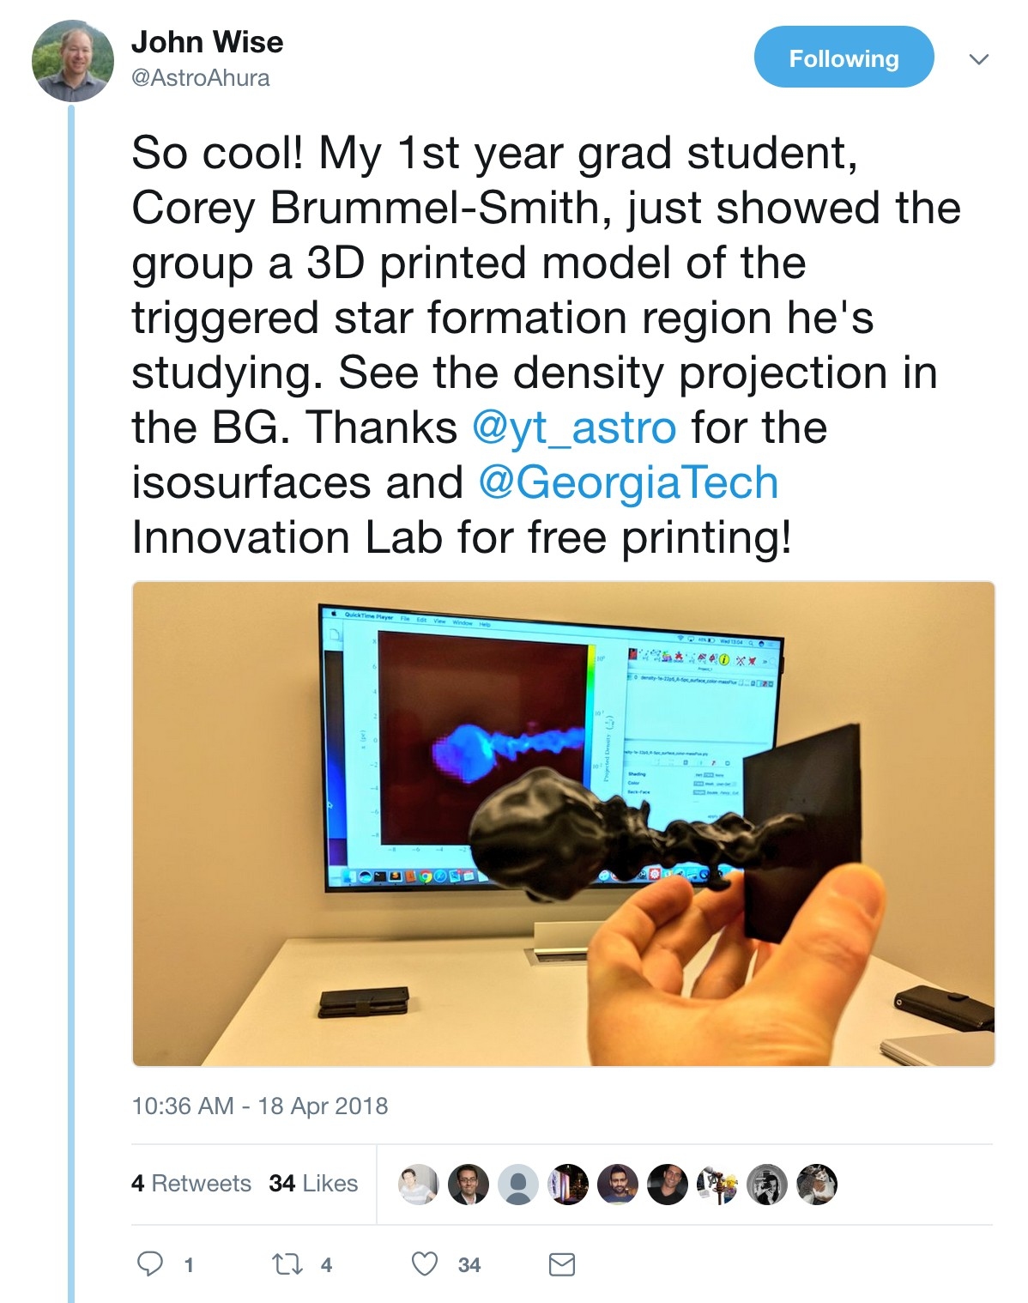
NEW IN YT 3.5, DUE OUT SOON (TM)
▸ A whole bunch of minor improvements and bugfixes, >200 merged pull requests
▸ Substantial improvements to the RAMSES frontend (credit: Corentin Cadiou, Ricarda Beckmann, Huge Pfister, others)
▸ Last version to support Python2.7

Slide 6
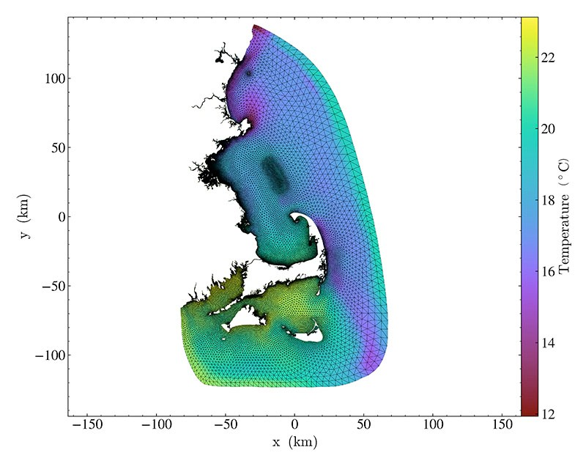
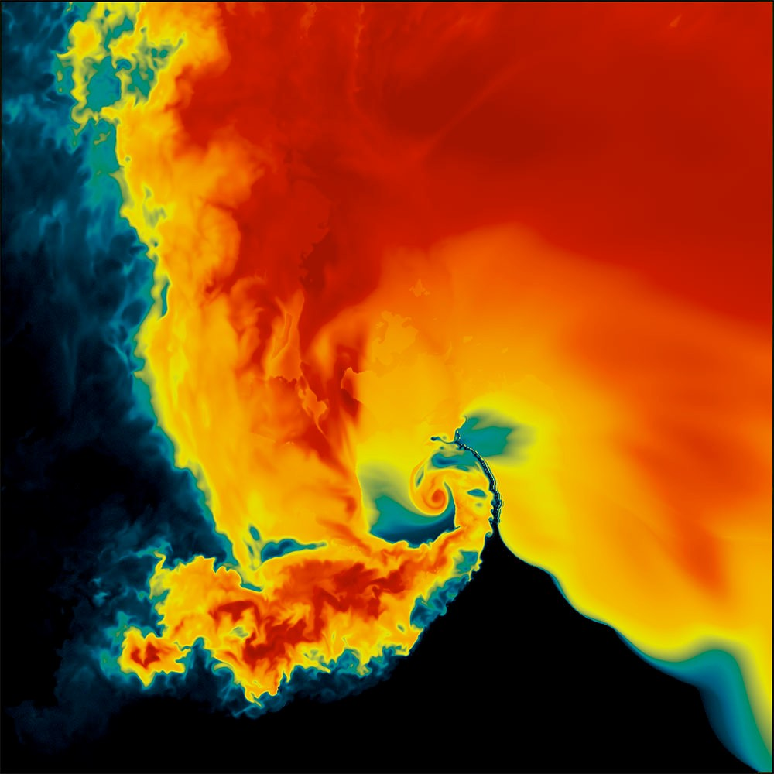
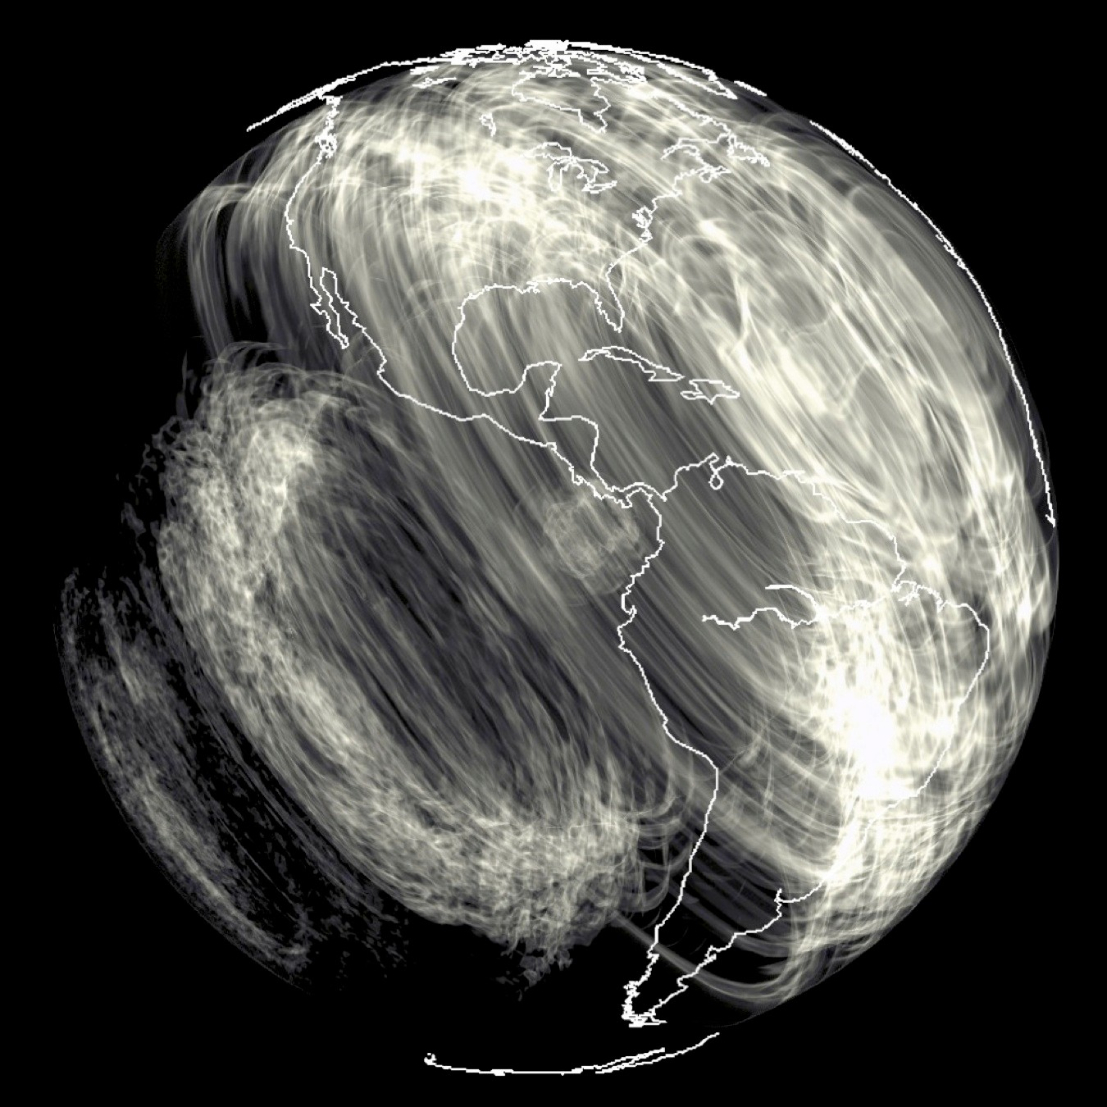
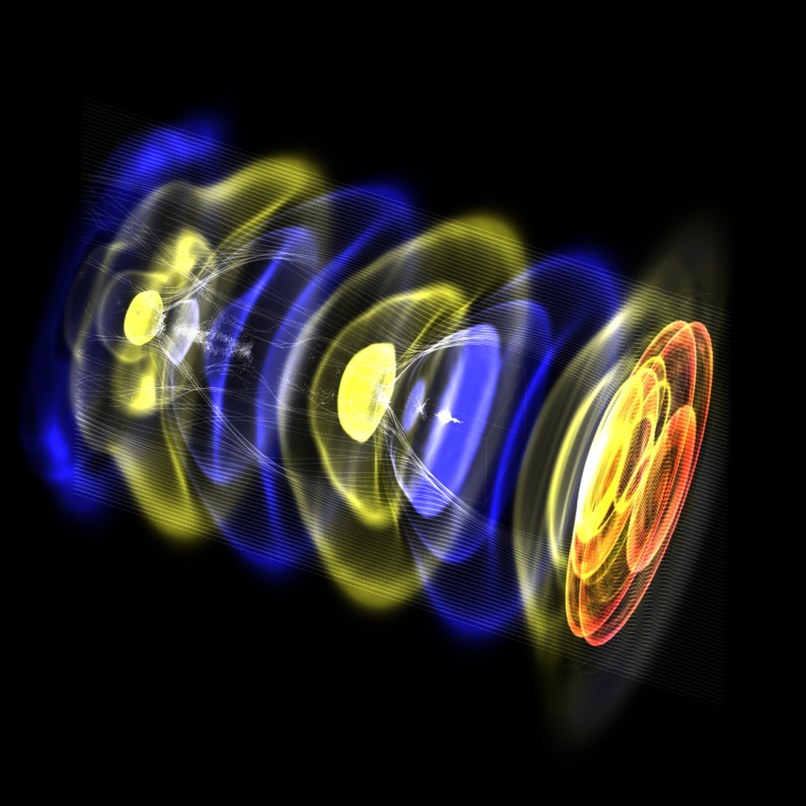
YT 4.0: YT BEYOND
ASTROPHYSICS
See our grant on FigShare for details:
NSF SI2-SSI OAC-1663914
(goo.gl/6w25zy)
FVCOM Ocean Forecast Model of the North Atlantic Coast (NOAA, UMass Dartmouth)
Weather Radar Prediction from Tornadogenesis Simulation
Leigh Orf (University of Wisconsin),
Planned Release: Summer 2019
We have an open postdoc at NCSA to work on this!
WARPX Laser Wakefield Acceleration Simulation Maxence Thévenet & the WarpX team (LBL)
Volume Rendering of Whole-Earth Seismology Simulation
Ben Holtzman (Columbia University)

Slide 7

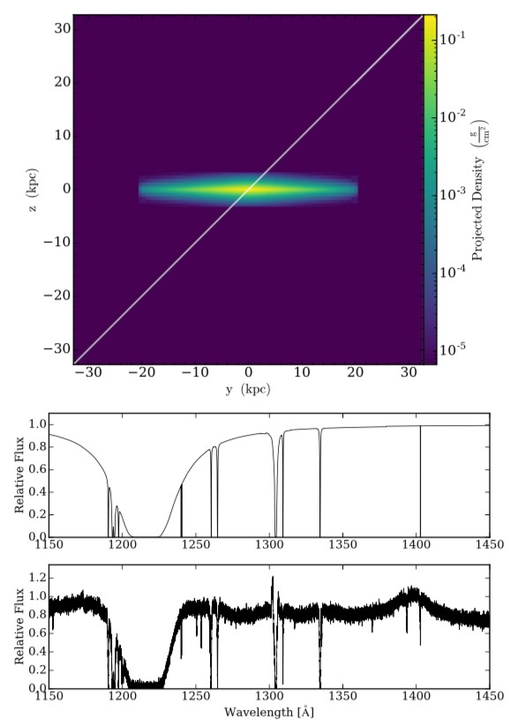


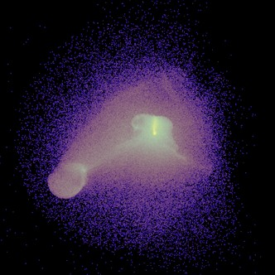
YT EXTENSION ECOSYSTEM
•
•
Trident (trident-project.org) Maintainer: Cameron Hummels
Generate synthetic absorption spectra from simulation data loadable by yt.
ytini (www.ytini.com) Maintainer: Jill Naiman
Interface between yt and the Houdini commercial volume rendering and special effects suite.
ytree (ytree.readthedocs.io/en/latest/) Maintainer: Britton Smith
Load and process halo merger trees in yt
PyXSIM (hea-www.cfa.harvar.edu/~jzuhone/ pyxsim)
Maintainer: John ZuHone
Generate synthetic x-ray observations for data loadable by yt.
Synthetic Spectrum Generation with Trident (Cameron Hummels, Britton Smith and Devin Silvia, ApJ 847 59H 2017)

