Slide 1


Slide 2
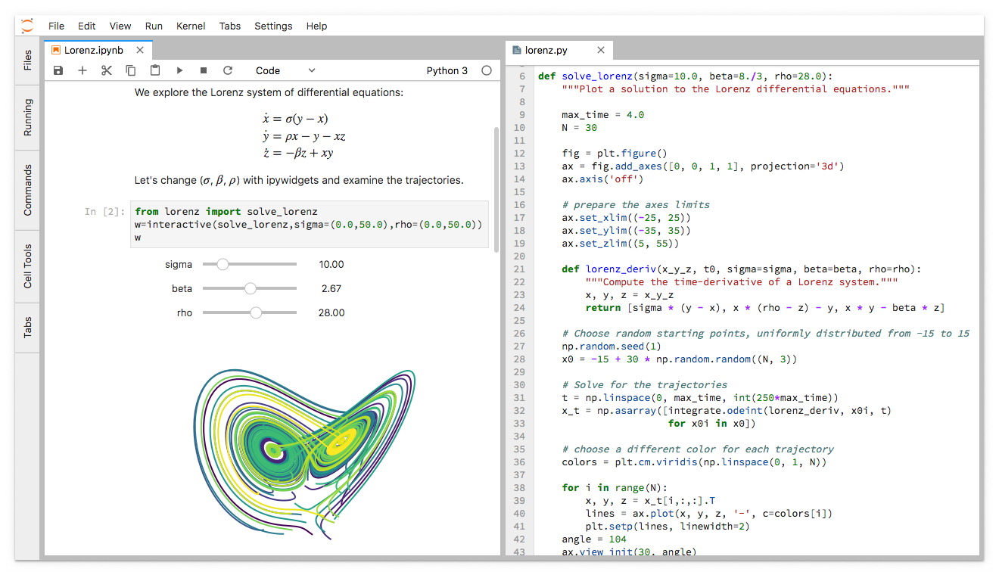
JupyterLab: Ready for users

Slide 3

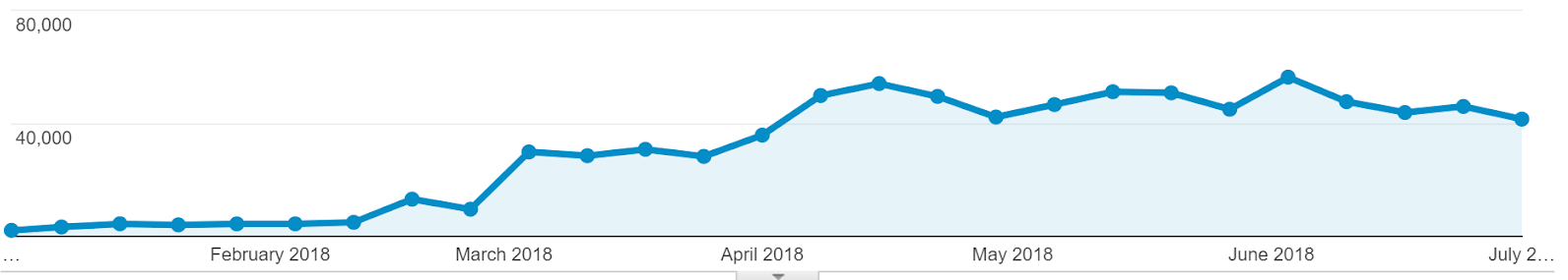


Sessions per week

Slide 4
JupyterCon 2018
August 21-24, New York
"Open Studio" Community Sprint Day: Aug 25
Jupyter Community Workshops
Announcement on blog.jupyter.org
First round proposals due Aug 1

Slide 5

ACM 2017 Software System Award

