Slide 1

Numba: What’s New?
Siu Kwan Lam
Anaconda

Slide 2
General Improvements
Now supporting Python 3.7
Note: Numba is planning to follow the NumPy schedule for Python 2 deprecation (applause)
Most NumPy functions are working
Recently added take, convolve, correlate, most of np.random, percentile, unique...
Some optional arguments not working yet, especially when they change the return data type
Support for list comprehensions, closures, and “array comprehensions” (optimized list comp inside np.array()), namedtuples, nested lists
Working to make error messages less cryptic (a perpetual task)
Promoting __cuda_array_interface__ for consuming other GPU data buffers in Numba
We post binary wheels and conda packages for releases now
Binaries do not require LLVM installation or use your system LLVM libraries

Slide 3
Performance Improvements
Automatic SIMD vectorization of loops:
@jit(nopython=True, fastmath=True)
Much improved in LLVM 6, works with SSE, AVX, AVX, AVX-512 (Skylake, Xeon Phi)
Even better with SVML (see below)
ParallelAccelerator (contributed by Intel):
@jit(nopython=True, parallel=True)
Automatic multithreading / loop fusion / optimization of NumPy array expressions.
numba.prange(): Parallel loops!
@stencil: like ufuncs, but for windowed functions
SVML support (contributed by Intel):
SIMD vectorization of loops with common math function calls (sin, cos, exp, etc..)
Combining all the above can be 10x over regular nopython mode in some cases:
https://numba.pydata.org/numba-doc/dev/user/performance-tips.html

Slide 4
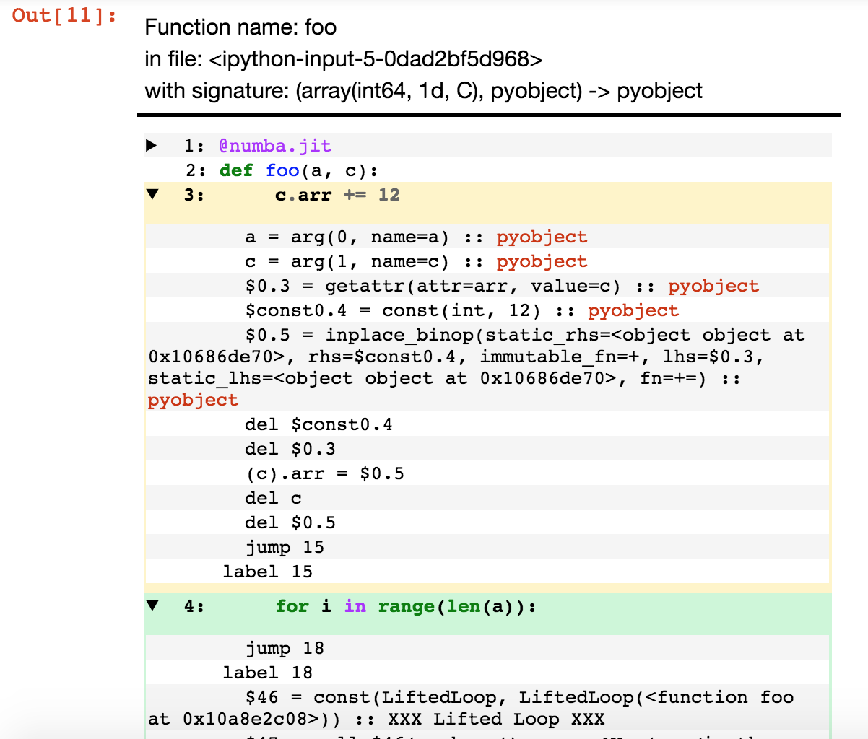
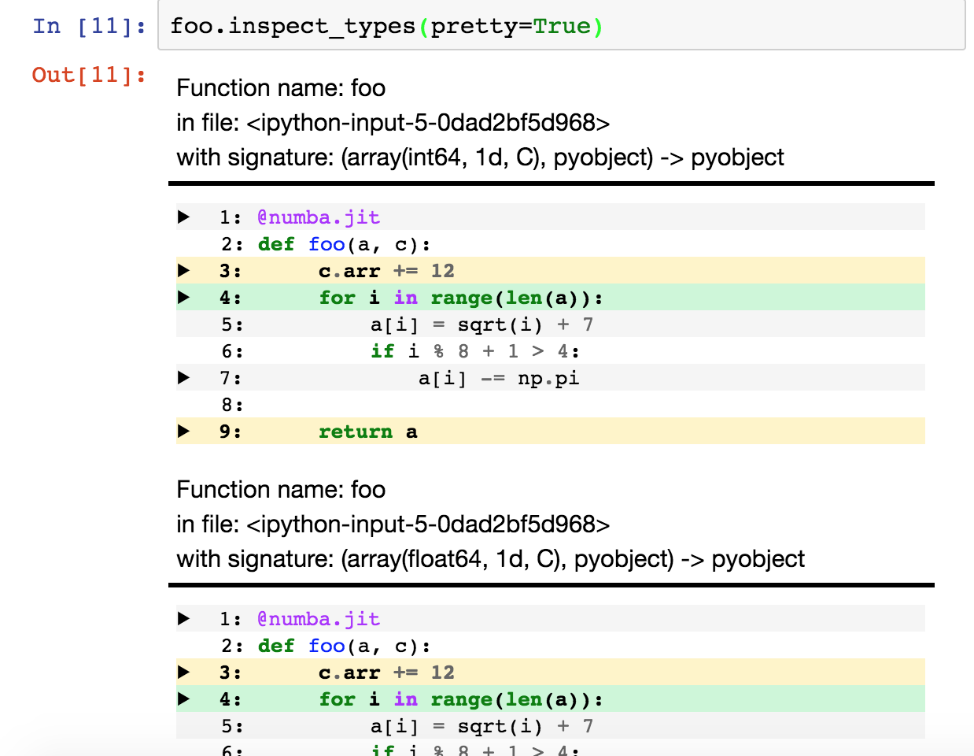
HTML Annotation in the Notebook
Contributed by Matthias Bussonnier

Slide 5
Numba Features Coming Very Soon
Numba Features Coming Less Soon
New hardware:
ARMv7 and ARMv8 (nearly there, need a Numpy fix)
PPC64LE (POWER8/9) - Fixes contributed by Olexa Bilaniuk, pending LLVM bug fix release
AMD GPU (ROCm drivers on Linux)
Put a Python mode block inside a nopython mode function
Diagnostic modes to show you what ParallelAccelerator is doing
Nopython mode dictionaries
Rewritten @vectorize/@guvectorize to remove long-standing discrepancies between behavior of @jit functions and (g)ufuncs

Slide 6
Have Questions?
Numba developers will be at the SciPy sprints
Bring code, questions, or ideas, and we can help
Ask us about all the neat CUDA GPU stuff that didn’t fit on these slides
Thanks!

