Slide 1
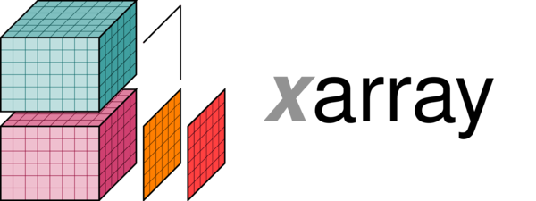
what’s new and what’s next
at SciPy 2018
By Stephan Hoyer (@shoyer)

Slide 2
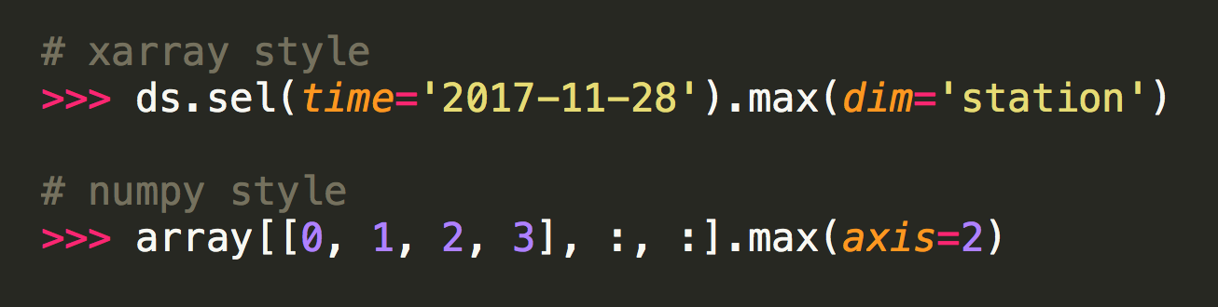
What’s xarray?
Labeled N-D arrays and datasets for Python
“NumPy with labels” or “N-dimensional pandas”

Slide 3
What’s new: xarray.apply_ufunc
Handles all the boilerplate involved in wrapping a NumPy function.
Example usage:
def spearman_correlation(x, y, dim): return xarray.apply_ufunc( spearman_correlation_gufunc, x, y, input_core_dims=[[dim], [dim]], dask='parallelized', output_dtypes=[float])
Function that supports NumPy style broadcasting
Core dimensions over which the computation takes place
Automatic parallelization with dask!

Slide 4
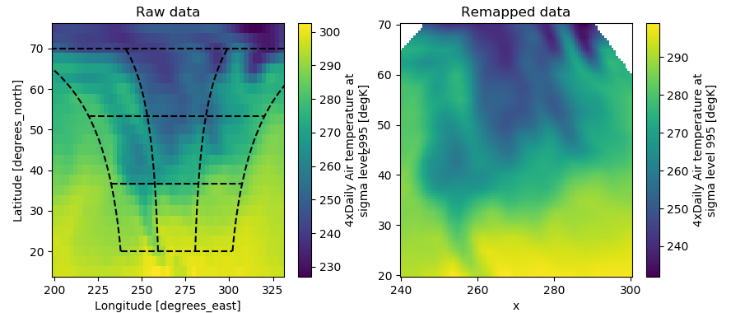

What’s new: multi-dimensional vectorized indexing and interpolation
lat = xr.DataArray(z, dims=['z'], coords={'z': z}) lon = xr.DataArray((x[:, np.newaxis]-270)/np.cos(z*np.pi/180)+270, dims=['x', 'z'], coords={'x': x, 'z': z}) dsi = ds.interp(lon=lon, lat=lat)
By Keisuke Fujii

Slide 5
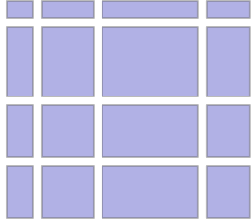


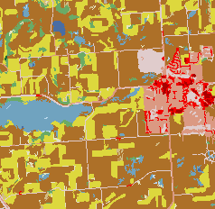
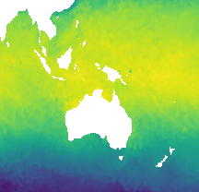
What’s next: extensible “duck arrays” in xarray
Currently we “hard code” support for NumPy, Dask and pandas.
Solution: use NumPy as a higher level array API, e.g., NEP-18: __array_function__ protocol
(with Matthew Rocklin, Marten van Kerkwijk, Hameer Abbasi, Eric Wieser)
Distributed
Sparse
Physical Units
Categorical
Missing data

