Slide 1
Improving Predictive Modeling in Pure Solvents and Hydrogel Systems
Andrew Lefors, Joshua Yuan

Slide 2
Objective
Context and Significance:
Current biomedical innovations are increasingly researching Microneedle technology using Hydrogels for painless and sustained delivery of medications. In order to design these devices, the diffusion rate of the compound must be known in that system to ensure proper therapeutic levels of the compound are delivered to the target tissue(s). To improve upon the tools to predict diffusion rates would increase the rate at which these technologies can be designed and tested, potentially improving lives.
Primary Goal:
Predict diffusion coefficients of chemical compounds based on their functional group contributions in pure solvent utilizing a Feed-forward Deep Neural Network to improve upon the SVM and Ensemble Tree models developed.
Secondary Goal:
Predict diffusion coefficients of chemical compounds based on their functional group contributions and the percent polymer volume fraction in a hydrogel solution using the same method.
To create
Expected Outcomes
Develop a predictive model for diffusion in pure solvent capable of generalizing to unknowns.
Desired Outcomes:
Develop model capable of generalizing to various hydrogel systems
Notes:
josh

Slide 3
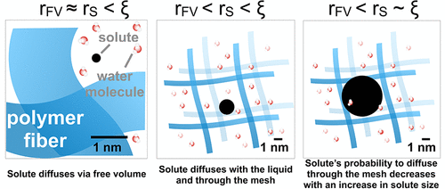
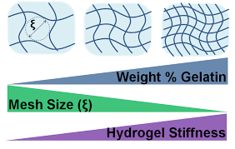
Problem Statement
Current Data Set Limitations
Existing models and datasets focus on diffusion in pure water environments.
Hydrogel have a network-like structure with various pore sizes depending various factors, posing difficulties in accurate diffusion modeling.
Limitations of Conventional Models
Reliance on mathematical models based upon Hydrodynamics, Free Volume, and Obstruction Theory.
Approach:
Develop a Feed Forward Deep Neural Network (FFDNN) to overcome limitations of current models to include:
(Pure and Composite) Hydrogels
Notes:
Jared

Slide 4
Collection and Engineering of Data
Initial Data Set
Acquired from research by Zhou et al., Dataset includes:
4823 chemical compounds.
Diffusivity measurements in pure water (H2O)(label).
Functional group contribution counts for each compound (Features).
Provides the foundational data upon which we would train our DNN
Hydrogel-Specific Data
Necessary to enable the DNN to generalize well to complex hydrogel mesh systems.
Additional data was derived from research conducted by Axpe et. al.
In order to combine the datasets, functional group data for FITC-Dextran of various sizes were obtained and added, while each compound in the original dataset was given a value of 0 for the percent polymer volume fraction.
Notes:
josh

Slide 5
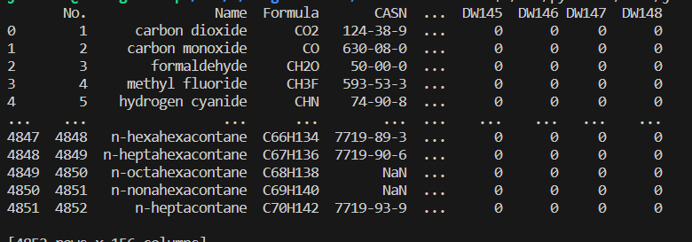
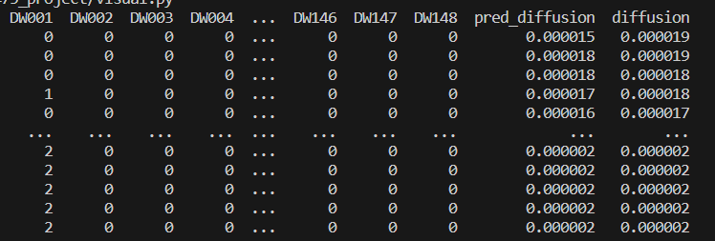
Data Wrangling
Raw Data
Clean Data
Notes:
To ensure the dnn would learn efficiently, we cleaned the raw dataset, removing columns, and performed dimensional analysis to ensure the units of measurement were equivalent. jared

Slide 6
Model
Initially trained on our DNN on the pure solvent dataset with functional group presence
Treat functional groups as features
Dataset was split 60/20/20 fo DV3 and 80/10/10 for DV4, randomly for training/validation/testing.
Hyperparameter Tuning:
Used keras_tuner.RandomSearch, to acquired the best model architecture.
Best Model Retrieval and Training:
The best model was re-trained.
To prevent overfitting, early stopping was utilized with a patience of 250 over 1000 epochs for training and validation
Model Evaluation: The trained model was evaluated on the MSE( mean squared error) and MAE(mean absolute error) to evaluate performance.
Notes:
jared

Slide 7
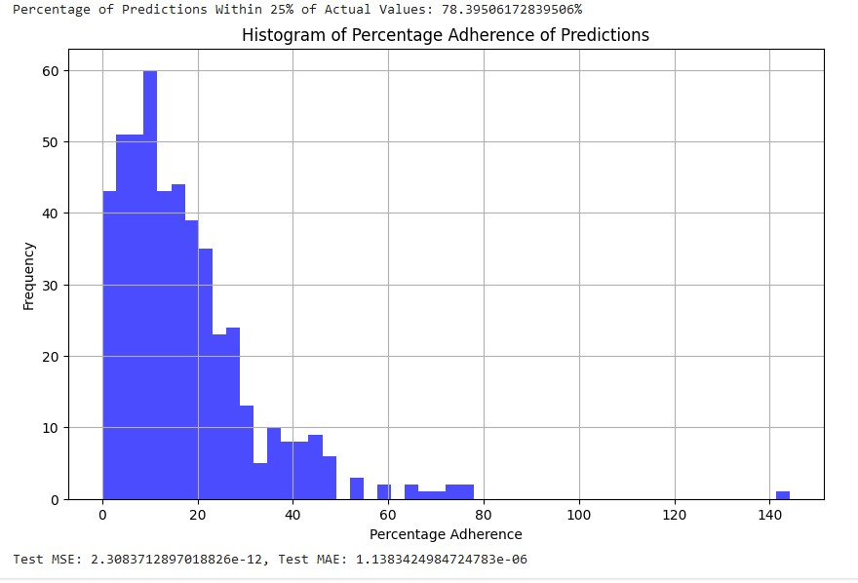
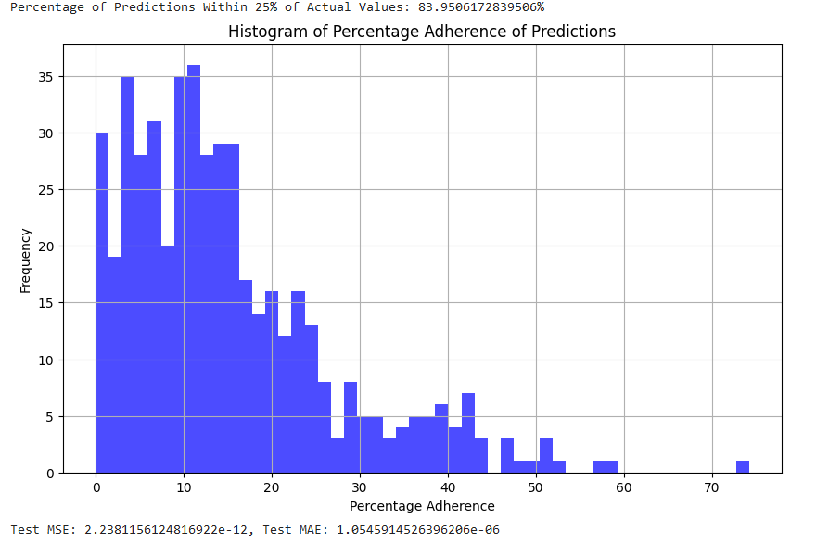
DV3
DV4

Slide 8
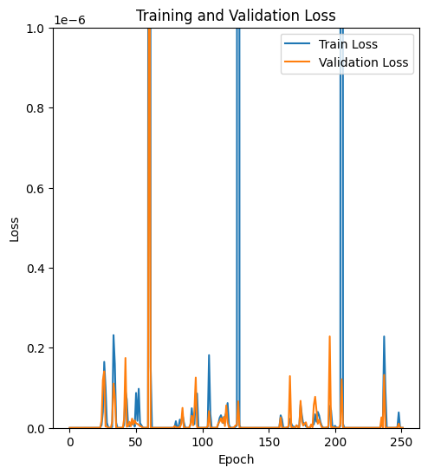
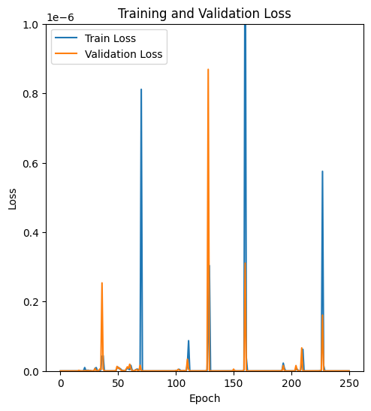
Notes:
MSE( mean squared error) and MAE(mean absolute error) to evaluate performance of our model - josh

Slide 9
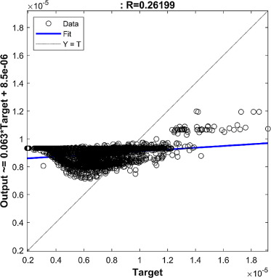
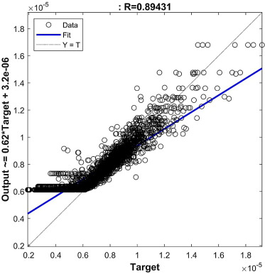
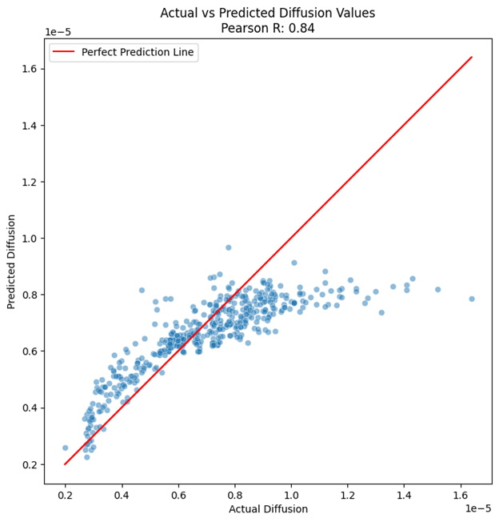
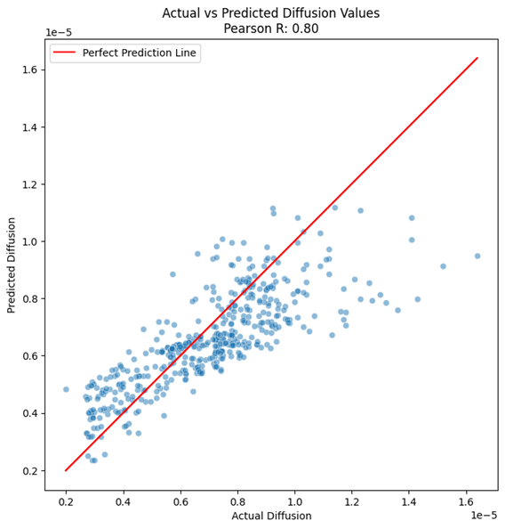
Results Findings
The first DNN that we trained had the ability to fit well to the actual measured diffusion rate
More feature engineering is necessary to achieve a model that will generalize well to a complex hydrogel mesh system.
We will join the larger dataset that highlights the presence of chemical compounds groups, with our smaller dataset that highlights the diffusion rate of solutes in hydrogel environments, to feature engineer a dataset representative of diffusion in non pure solvents.
We will then retrain DNN with joined dataset
Analysis: the closer the data points are to the line of best fit, the more accurate the model is.
SVM Model
Fine Tree Model
DV4
DV3
Our DNN Models
Notes:
Each data point represents the predicted value on the x axis, and the actual value on the y. The assumption here is if the numbers are the same, they will be on the line of best fit, therefore describing our model to be accurate. jared

Slide 10
Future Work
Additional work is being done to collect more diffusion rate data in from hydrogels and add them to the larger pure-solvent dataset to leverage the existing models.
The datasets will be engineered to contain functional group contributions to match the existing pure solvent data set
The pure solvent dataset has been augmented to include a percent polymer volume fraction feature to make it compaitble with future datasets.
Currently awaiting the corresponding author to provide the list of functional groups rather than DW identifiers.

