Slide 1
Week 8: Procedural Abstraction Writing and Using functions
Reading:
Text book p. 101-113, 193-207, 341-346
I will provide minimal additional notes
Concepts for Today’s Class:
defining functions
using a function
calling a function, returning from a function, help
pass-by-value versus pass-by-reference
scope & sub-functions
Lab: writing a function
Assignment: Part 2 due Wed. Nov 7th, 4pm.

Slide 2
Function Definition Line
function y = poly3(x)
function keyword
output arguments
input arguments
function name
Can have more than one input argument and/or output argument, e.g.
function [volsum, gvadep]=getvol(mlong,mlatg,deg2km,mthick,mask)
Matching the order of multiple input/output arguments is critical when calling the function from the main script
Notes:
2
Discussion on board:
We’ve already seen lots of functions in MATLAB: e.g. round, ceil, floor, sin, sind, asind, mean, median, sum, plot, eps, pi
Ones that take input arguments or not, ones that return output arguments or not, and ones that have “side-effects” e.g. plot
NOTE: filename should be poly3.m

Slide 3
H1 Lines and Help
function y = poly3(x)
%
% Evaluates a cubic polynomial y = a*x + b*x^2 + c*x^3
% where a=1, b=-1, c=2
%
% Input: x
% Output: y = a*x + b*x^2 + c*x^3
%
a = 1;
etc
The H1 Lines are the comment block immediately after function definition line, before first line of the code. They should explain what the function does, the input and output arguments and any checks that are performed. They appear in the command window when you type e.g., >> help poly3
Notes:
3

Slide 4
Function Body
function y = poly3(x)
%
% Evaluates a cubic polynomial y = a*x + b*x^2 + c*x^3
% where a=1, b=-1, c=2
%
% Input: x
% Output: y = a*x + b*x^2 + c*x^3
%
a = 1;
b = -1;
c = 2;
y = a*x + b*x^2 + c*x^3;⁣
end
a, b, c, x, y are local variables
Notes:
4

Slide 5
Worksheet 1 Exercise 1

Slide 6
Function Call from Main Script
t=12;
a = poly3(t)
Example 2: our example from earlier for the following function
function [volsum, gvadep]=getvol(mlong,mlatg,deg2km,mthick,mask)
Function call from main script could look like:
[vol1, dep1]=getvol(lon,lat,d2km,mthick,mask)
Note that the variables in the main script can have either the same (mthick, mask) OR different (e.g., vol1, dep1, lon, lat,d2km) names from inside the function. This brings us to the topic of how arguments are passed from the script to a function….
Notes:
6
Discuss formal and actual parameters

Slide 7
Worksheet 1 Exercise 2

Slide 8
Returning from a Function
A function returns control to the main script when the first of the following occur:
The end of the code is reached
The word “return” is reached
The word “error” is reached
Notes:
8

Slide 9
Worksheet 1 Exercise 3

Slide 10
Subfunctions
Subfunctions are a method to further simplify your code
They are limited in scope i.e. can only be called by the parent function (main function) that contains them
function fancyprint(Str)
%
% Print the string Str with * at the beginning and end of
% the string.
%
WrappedStr = wrapstr(Str);
disp(WrappedStr);
function Newstr = wrapstr(Str)
Newstr(1) = '*';
Newstr(2:length(Str)+1) = Str;
Newstr(end+1) = '*';
Notes:
10

Slide 11
Worksheet 1 Exercises 4, 5 and 6

Slide 12
Logical Indexing: Prep for worksheet 2 on Thurs
Recall: mentioned during
- week 03
- when logical operators covered
- when “find” covered
Review:
x=10*rand(1000,1);
% pick out only values > 5
y2=x(x>5);
% could also have used “find”, but logical indexing is much faster
ix=find(x>5);
y2=x(ix);

Slide 13
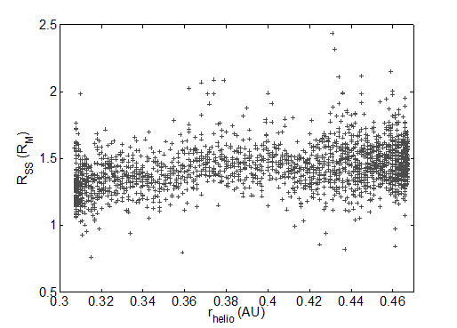
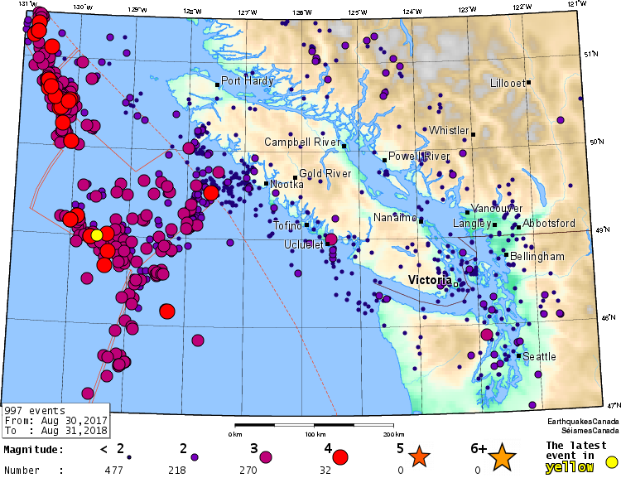
Added pictures to generate media folder bug

