Slide 1

United Launch Alliance Atlas V 411 with NASA OSIRIS-REx mission lifts off from Cape Canaveral, Sept 2016
Concepts for Today’s Class:
steps in problem solving
MATLAB syntax: underlying structure
syntax versus semantics
Reading:
See course web site for details, we’ll cover material in:
pgs 6-40 (in class)
pgs 3-6, 75-80, 89-101 (labs)
pgs 557-564 (general reference, will show up in classes)
Lab:
bring text
Labs due at 4pm on Fridays
TA hours, EOS-Main 203 – make sure to note which weeks these carefully!
Friday (wks 3,4,5,6,8,9,10,11): 9:30 am – 10:30 am
Monday (wks 7,10 only): 11:00 am – noon.
Notes:
TIME: 2MINS
TA hours can be either Th or M

Slide 2
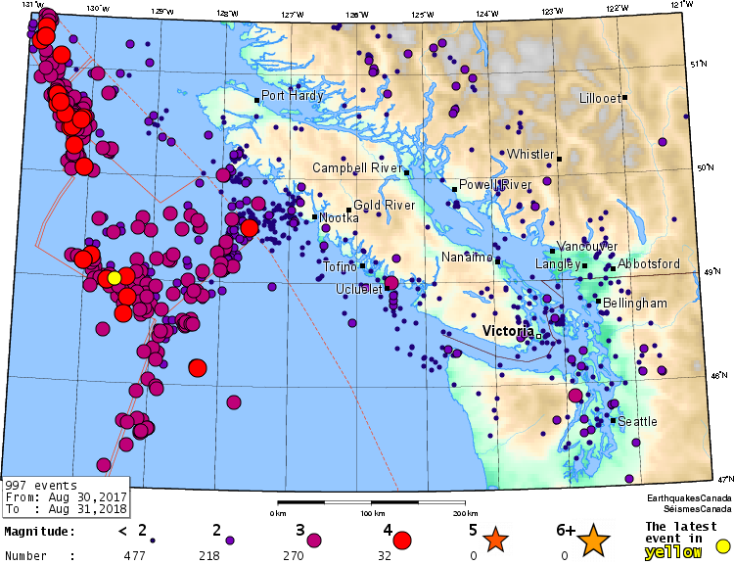
Good Problem Solving Techniques
Work in pairs and write down the steps in algorithm design (problem solving using MATLAB) mentioned in the text book (or if you didn’t get that far in the reading just write down what you think are reasonable steps)
Notes:
TIME 5 MINS (3 to write, 2 for followup)
Note any recent quake that is big here….

Slide 3
Good Problem Solving Techniques
We will adopt the 5-step program (NOTE: this is more complete than the approach in the text book on page 76)
State the problem clearly
Describe your input and output info / data
Write down the problem-solving procedure IN WORDS
- pay special attention to the logic
- if possible work the problem “by hand” for a simple set of data
Develop a MATLAB code to do (3)
Test your code with a variety of data or different cases
Example: What was the largest earthquake in the Vancouver / Vancouver Island region in the past year?
Notes:
TIME 3 MINS
Get answers back from students before this slide……(2 mins), go over quickly 1 min

Slide 4
http://www.iris.edu/hq/audience/public/earthquakes
http://earthquake.usgs.gov/regional/neic/
http://earthquakescanada.nrcan.gc.ca/index-eng.php
Goal: find the largest earthquake in the Pacific Northwest during 08/30/2017– 08/31/2018. I have only printed out eqs w/ magnitudes larger than 4.0
Write down input and output in words
Give numeric value for the actual output
3. Write down the procedure you used to get your answer
Notes:
TIME 10 MINS including followup, 4 for parts 1 and 2 on this slide, 6 for part 3.
HINT: you need to think about what your brain actually does when it finds the largest # in a list
Given a list of earthquakes, with magnitude, and depth for each earthquake write down the procedure to:
find largest magnitude earthquake in your list?
find mean magnitude?
find largest magnitude earthquake with a depth greater than 100km?

Slide 5
Finding the Largest Earthquake
My procedure or algorithm:
read magnitude on first line, and remember
read magnitude on second line
compare with first, and
remember only the largest of the 2
read magnitude on the next line
compare with largest, and
remember the largest of these two
repeat steps 5-7, until reach end of list
tell you my largest magnitude
Notes:
TIME: 5 MINS
Break this discussion down into how you would get biggest of 2 quakes, biggest of 3 quakes….

Slide 6
Finding the Largest Earthquake
My procedure or algorithm:
read mag1
read mag2
Is mag2 > mag1 ?
YES: biggest = mag2
NO: biggest = mag1
read next_mag
Is next_mag > biggest ?
YES: biggest = next_mag
NO: don’t need to update biggest
write out biggest
how do we turn this into matlab code?

Slide 7
MATLAB: Programming elements (overview)
The structure of MATLAB
Lexical Elements
- building blocks
Human Language
words, symbols, punctuation
Programming language
names, operators, special characters
Syntax
- set of rules to combine lexical elements into legitimate constructs
Programming language
how to build expressions, statements,
functions & programs
Human Language
how to build sentences & paragraphs
Notes:
TIME: 2 MINS
Both lexical elements and syntax vary from one language to another.
MATLAB is somewhat similar to the programming language FORTAN since it was originally written in FORTRAN
FORTRAN was designed for use by scientists and engineers: MATLAB has capitalized on this and advanced some aspects further.

Slide 8
Lexical Elements (Building Blocks)
Names
Variable names:
Reserved words:
Function names:
store data: e.g., our user-defined variable: mag1
have a special meaning, cannot be redefined; e.g. for
sequences of code; e.g. sin
2. Operators
Logical:
Arithmetic:
Relational:
e.g., && text p. 20
e.g., +, -, *, / text p. 12-13
e.g., >, >=, <, <= text p. 19
Special characters: keyboard characters with special meaning in MATLAB.
e.g., ; {} ()
Notes:
TIME: 2 MINS
Operators “do things” to variables / numbers
logical - and, or, not (&, |, ~)
mathematical operators - arithmetic such as +,-,/,* or relational such as >= etc
Special characters are like “punctuation marks” in a human language - we’ll see the “;” in the lab this week. GRAMMAR

Slide 9
Lexical Elements (Building Blocks)
Names: variable names, reserved words, function names
2. Operators: logical, arithmetic, relational
Special characters: keyboard characters with special meaning in MATLAB.
mag1 =4.9;
mag2 =5.3;
if (mag1 > mag2)
max_mag = mag1;
else
max_mag = mag2;
end
Worksheet Part D
Notes:
4 MINS: 3 MINS for part D of worksheet, 1 MIN to discuss
Operators “do things” to variables / numbers
logical - and, or, not (&, |, ~)
mathematical operators - arithmetic such as +,-,/,* or relational such as >= etc
Special characters are like “punctuation marks” in a human language - we’ll see the “;” in the lab this week.
NOTE: “==“ is a relational operator.
“=“ is sometimes listed as arithmetic operator and sometimes as a special character. More important than definition is what it DOES.

Slide 10
Lexical Elements (Building Blocks)
How are variables assigned in MATLAB?
>> mag1 = 4.9
What does this do?
Creates a space in memory
Gives the space the name “mag1”. We call mag1 a VARIABLE
Stores the value 4.9 in that space (variable)
Echoes back this information
The prompt reappears
>> mag1 = 3.7 overwrites “4.9” with “3.7”
Note
“=“ does not mean = in the mathematical sense. Instead, it means “assign the number on the RHS to the variable on the LHS”
We can do math on the RHS, mixing numbers and variables
Notes:
Don’t need to write down the stuff in the box

Slide 11
Syntax
Lexical elements are combined using the set of rules known as “syntax”
I cdnuolt blveiee that I cluod aulacity uesdnatnrd what I was rdgnieg.
Important difference between human and programming languages is tolerance to syntax errors versus tolerance to spelling/grammar errors
Notes:
Details of the rules vary from one language to another
Again don’t copy what’s in the box.

Slide 12
Examples of Syntax Errors
Usually / often your code will not run if you make a syntax error:
>> x=10; defined my variable x and assigned it a value of 10
>> y=cos(x trying to compute cos(x) and assign it to variable y
??? y=cos(x Correct: y = cos(x)
|
Error: Expression or statement is incorrect--possibly unbalanced (, {, or [.
>> y=2x trying to compute “2 times x” and assign it to “y”
??? y=2x Correct: y = 2*x (spaces around = don’t matter)
|
Error: Unexpected MATLAB expression.
Notes:
Details of the rules vary from one language to another
Again don’t copy what’s in the box.

Slide 13
Syntax versus Semantics
When a program doesn’t work this can happen because:
SYNTAX is incorrect - e.g.,
>> distance = speed *
- multiplication (*) needs numbers or variables on both sides of *
b) SEMANTICS are incorrect
>> distance = speed / time
- may or may not run but will certainly give you the wrong answer!!
The program you wrote is not the program you meant to write!
can reduce both types of errors using
good problem solving techniques
Notes:
The problem is that the program you wrote is not the program you wanted to write. The meaning of the program (its semantics) is wrong. Identifying semantic errors can be tricky because it requires you to work backward by looking at the output of the program and trying to figure out what it is doing.

Slide 14
Example of Semantics Error
Here’s a code snippet for finding the largest of 2 earthquakes.
What is wrong?
mag1 =4.9;
mag2 =5.3;
if (mag1 < mag2)
max_mag = mag1;
else
max_mag = mag2;
end
Notes:
14
The problem is that the program you wrote is not the program you wanted to write. The meaning of the program (its semantics) is wrong. Identifying semantic errors can be tricky because it requires you to work backward by looking at the output of the program and trying to figure out what it is doing.

Slide 15
Wrap Up
Steps in problem solving
1. state problem clearly
2. define the input/output
3. write down algorithm by hand: ie., think the problem through
4. code in MATLAB
5. test, test, test…
Underlying structure of MATLAB syntax
- building blocks: names, operators, special characters
Syntax versus semantics
- syntax errors are about bugs in step 4 above
- semantics errors usually result from skipping step 3
Notes:
15

Slide 16
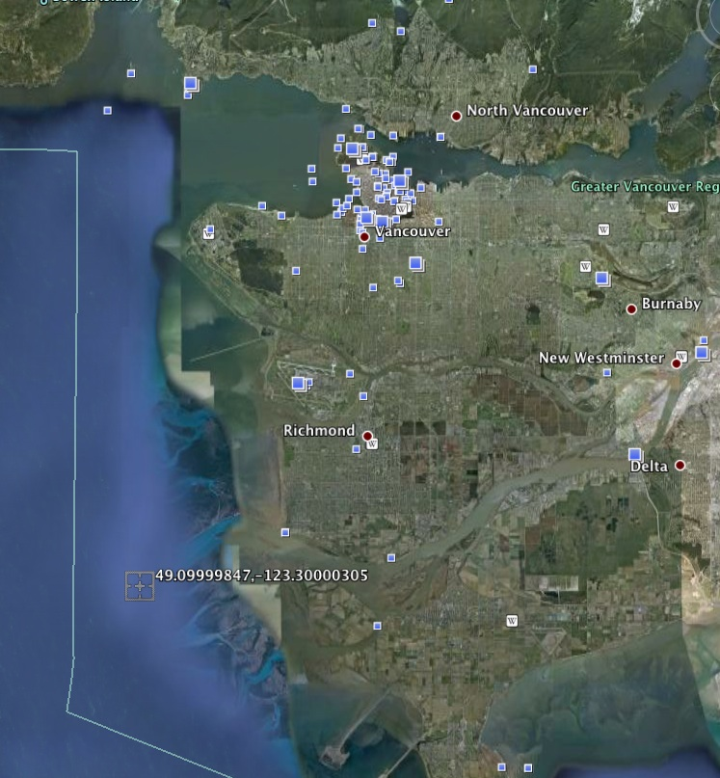
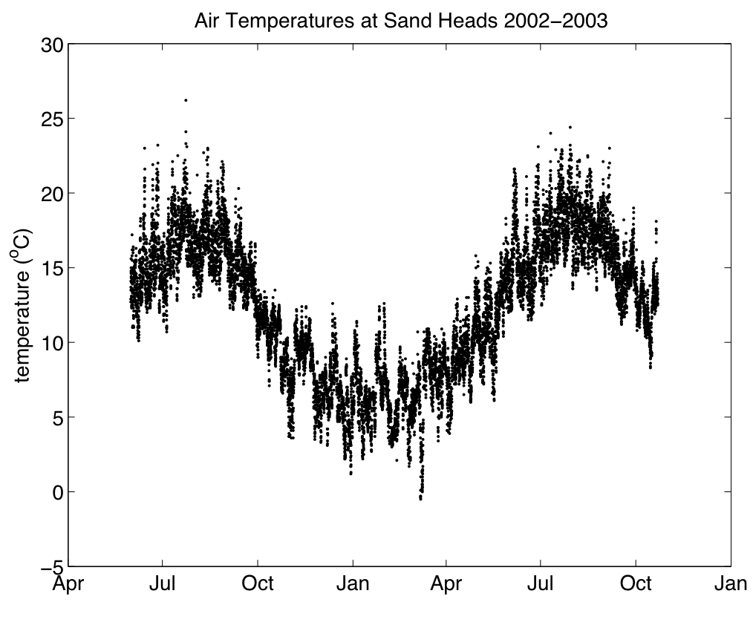
Lab Overview
become familiar with MATLAB environment
load, plot and save data
try some simple operations
write MATLAB scripts
a) pair programming
b) need either an account, or your own version of MATLAB
c) turn in requested file on Canvas (not graded but will use later in term)
Notes:
16
Have MATLAB running

