Slide 1
Week 2: Steps In Problem Solving & Some MATLAB Basics
Concepts:
review variable assignment, structural elements of MATLAB
identify 6 types of action involved in algorithm
preview of arrays (link to lab 1)
use built-in functions (link to lab 1)
Reading for next week:
For Tues: pg. 35-40 (review), 40-60, 266-267
there will be a quiz on the material on pages 35-60.
For lab: pg. 443-456
For Thurs: pg. 60-69
TA hours, EOS-Main 203 – make sure to note these carefully!
Thurs (wks 3,4,5,6,8,9,10,11): 9:30am – 10:30am
Mon (wks 7,10 only): 11:00am – noon
Lab due on Canvas by 4pm Friday

Slide 2
Types of Action in Algorithm
use example from last time, maximum earthquake magnitude
1. read mag1
2. read mag2
3. Is mag2 > mag1 ?
3a. YES: biggest = mag2
3b. NO: biggest = mag1
4. read mag3
5. Is mag3 > biggest ?
5a. YES: biggest = mag3
5b. NO: don’t need to update biggest
Loop over 4-5b until reach end of list
write out biggest
1. read mag1
2. read mag2
3. Is mag2 > mag1 ?
3a. YES: biggest = mag2
3b. NO: biggest = mag1
4. read mag3
5. Is mag3 > biggest ?
5a. YES: biggest = mag3
5b. NO: don’t need to update biggest
Loop over 4-5b until reach end of list
write out biggest
Types of Actions
Input
Operation
Selection
Repetition
Output
Stop
Notes:
2
Add the links to the weeks that will cover each topic

Slide 3
Question
Case Sensitivity: what happens when…..
>> if = 2;
??? if = 2;
|
Error: The expression to the left of the equals sign is not a valid target for an assignment.
What went wrong? I tried to use ``if’’ as a variable name, BUT
“if” is a reserved word so I cannot redefine it.
>> IF = 2;
Because MATLAB is case sensitive I AM allowed to do this.
However, it is very bad programming practice

Slide 4
Review from Lab (1) Variable Assignment
Worksheet A: What is output (describe in words) of this code snippet?
Worksheet B: Identify variables etc
% radius of Earth in km
radius = 6371;
area = 4*pi*radius*radius;
% radius of Moon in km
radius = 1739;
area = 4*pi*radius*radius
``pi’’ in MATLAB returns the value of pi
pi = 4*atan(1) and imag(log(-1))
Worksheet C & D:
Notes:
Have students do worksheet qn A - quick feedback and discussion: calculates area of earth but doesn’t print to screen b/c of ;
Calculates and prints value of area of moon to screen
Have them fill in B on worksheet and discuss.
Review in discussion: variable assignment
Calculations
Pi = 4*atan(1) and imag(log(-1))
Review another way to do radius*radius (radius^2)
What happens when I type clc?

Slide 5
Review from Lab (2) Arrays in MATLAB (see next week)
Recall: In lab 1 you loaded a file lab1.mat that contained 2 variables:
>> load lab1
>> whos
Name Size Bytes Class Attributes
temperature 12213x1 97704 double
time 12213x1 97704 double
Temperature 12213 measurements
this is an array, dimensions 12213 by 1
A big advantage of MATLAB is the ease of dealing with vectors and matrices
Analogy: think of a table / EXCEL file
each VALUE in the table is defined by its POSITION (row #, col #)
conversely each POSITION in the table (row #, col #) has associated with it a VALUE
Notes:
5
Draw a sketch on the board of a table

Slide 6
Arrays in MATLAB
Let’s look at e.g.,10 entries in a list of eq magnitudes:
>> clear
>> mags = [4.2; 4.1; 4.1; 4.1; 4.3; 4.2; 4.4; 4.1; 4.0; 4.7]; SEE NEXT WEEK
>> whos
Name Size Bytes Class Attributes
mags 10x1 80 double
>> mags
mags =
4.2000
4.1000
4.1000
4.1000
4.3000
4.2000
4.4000
4.1000
4.0000
4.7000
Worksheet E
Notes:
6
I have made a variable called mags with 10 rows and 1 col - see whos and my echo back to screen
WORKSHEET NOW

Slide 7
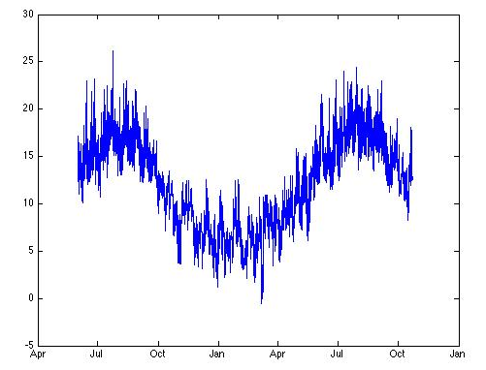
Arrays and Plotting
load lab1;
figure(1)
plot(time,temperature)
datetick('x',3)
# of points in time and temperature MUST be the same
What has happened to make the plot?
time
temperature
Just like plotting by hand the plot command has made a figure that consists of pairs of points
temp(1), temperature(1)
time(2), temperature(2)
time(12213), temperature(12213)
time(1)
temperature(1)
time(2)
temperature(2)
time(12213)
temperature(12213)
Notes:
7
For the plot command to work the lengths of temp and time MUST be equal
Talk about datetick…datestr…datevec….datenum….

Slide 8
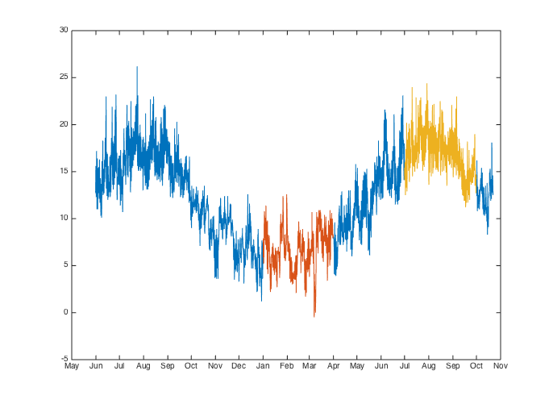
Arrays and Plotting
What does this do?
>> plot(time,temperature,time(5149:7308),temperature(5149:7308),....
time(9493:11700),temperature(9493:11700)
Notes:
8
Talk them through this command.
First MATLAB recognizes that this is like 3 commands
plot(time, temp)
plot(time(5149:7308),temperature(5149:7308))
plot(time(9493:11700),temperature(9493:11700)
Note that red and tan curves are plotted on top of blue one
We’ll learn how to set colors, symbols etc.

Slide 9
Defining new arrays
>> plot(time,temperature,time(5149:7308),temperature(5149:7308),....
time(9493:11700),temperature(9493:11700)
This is error prone if there are many commands involving the winter or summer parts of the time and temperature arrays. So we defined new arrays
wtime = time(5149:7308);
wtemp = temperature(5149:7308);
stime = time(9493:11700);
stemp = temperature(9493:11700);
Programming Style Hint:
Use variable names that are easy to understand and try to keep them short
e.g. wtemp vs. winter_temperature
See text p. 28-29 for Programming style guidelines & common pitfalls
Notes:
9
Talk them through this command.
First MATLAB recognizes that this is like 3 commands
plot(time, temp)
plot(time(5149:7308),temperature(5149:7308))
plot(time(9493:11700),temperature(9493:11700)

Slide 10
Using Built-In Functions
Worksheet F:
y3 = max(mags(3:8))
Steps:
select a subset of mag that includes the 3rd thru 8th values
calculate the maximum of these using the built-in function “max”
assign the output to a variable called y3
no semi-colon so echo the value of y3 to the screen
General Syntax:
Advantage of MATLAB:
many built-in functions
y = max (x)
output
input or
argument
function name
Notes:
10
Make some mistakes like max(mags(3:12))

Slide 11
Why Arrays and Built-In Functions are Slick: Finding the Largest Earthquake
my algorithm that we could code up explicitly (i.e. write code that looks pretty much like this set of instructions):
0. load data file with magnitudes
1. read mag1
2. read mag2
3. Is mag2 > mag1 ?
3a. YES: biggest = mag2
3b. NO: biggest = mag1
4. read mag3
5. Is mag3 > biggest ?
5a. YES: biggest = mag3
5b. NO: don’t need to update biggest
Loop over 4-5b until reach end of list
write out biggest
BUT we’ve learned we can load arrays and use them as the input to built-in functions in MATLAB:
So this can be coded in 2 lines!
% load array of earthquake magnitudes
load mags;
% find biggest and echo to screen
biggest = max(mags)
Notes:
11

