Slide 1
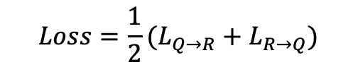
(a) Shared spectral encoder
ỹ
Projection
u
Shared latent space
Pair metadata
Proxy (c)
Theory view
Spectrum Transformer
+ L2 norm
Theory y
$$Loss=\frac{1}{2}(L_{Q→R}+L_{R→Q})$$
128 → 64
Canonical identity
x
u
Positive-pair mask
Experiment
Shared weights
64-D unit vectors
Source label
Theory refs
Spectrum Transformer
Projection
v
QME14S / fg26
96 spectra
+ L2 norm
● queries ■ theory refs
(b) Multi-positive alignment
(c) Proxy augmentation
Identity matching
Theory
Fixed proxy
Random views
U
Same identity
Different identity
V
U → V / V → U
(d) Hard negatives
(e) Coverage masking
Exclude positives
Spectrum + mask
Patch coverage weights
Sample one
Valid-bin norm
Top-16 errors
Real query
Embedding
Training ranks
Patch masking
Weighted pooling
unmeasured
Notes:
Author-finalization draft. Figure text is deliberately limited to module labels. The corresponding manuscript contains the panel caption and method details; its artwork slot remains a placeholder until the author finalizes the figure. Blue circles represent query embeddings, orange squares theoretical references; curves and matrices are schematic.

