Slide 1
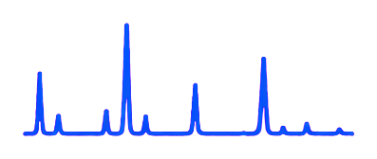


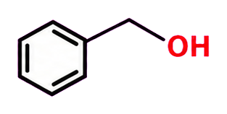


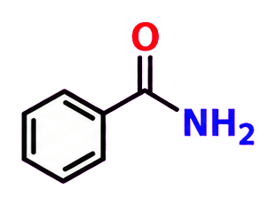


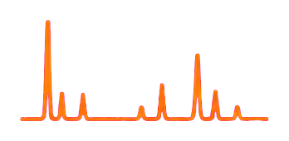
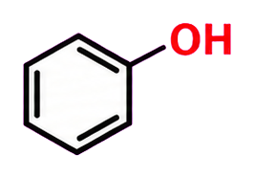
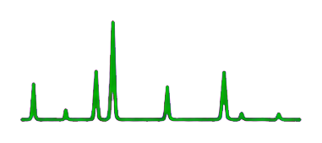

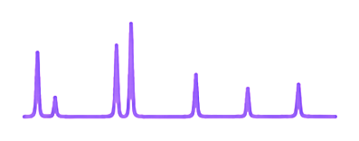


Raman
spectrum q
Top-10 C
Evidence (P, C, E)
Structure
ĉ
Retrieve
LLM select
⋯
⋯
(a) Contrastive Retrieval
(c) Guided Candidate Selection
Top-10 SMILES C
Theoretical spectra
(linked)
Raman spectrum q
Encoder
1
Evidence packet (P, C, E)
P: observed peaks
C: ordered SMILES
(from retrieval)
E: source-linked modes
q
Cosine
ranking
2
m₁
612
Ref. A
L2-normalized, 64-D
1
3
m₂
1003
Ref. B
3
Theoretical reference spectra rj
Cached embeddings
2
⋮
m₃
1602
Ref. C
1
⋮
⋯
10
⋯
⋯
zj
10
L2-normalized, 64-D
Offline training:
Paired spectra + surrogate views · multi-positive contrastive loss · hard negatives
Reasoning within one LLM call
LLM output
SELECTED_INDEX: i
CONFIDENCE: c
EXPLANATION
(b) Spectral Evidence
Assign
bands
Compare
candidates
Select
one
Query peaks P
ν (cm⁻¹)
I
prominence
width
Spectral evidence E
Spectroscopist
LLM
612
1.00
0.82
18
Peak–mode
interval matcher
mode ID
matched peaks
source
1003
0.64
0.57
22
m₁
612
Ref. A
1602
0.91
0.76
16
m₂
1003
Ref. B
Schematic candidates with matched peaks (using retrieval order as prior)
⋯
m₃
1602
Ref. C
⋯
1
2
3
10
Raman mode records K
interval (cm⁻¹)
activity
source
600–650
A₁
Ref. A
Optional: SMARTS scope;
compact evidence ≤ 8 modes
⋯
1000–1030
E
Ref. B
1580–1620
A₁
Ref. C
; confidence is self-reported
⋯

