Slide 1

ONE-STOP ONLINE DISCOUNT PLATFORM FOR STUDENT SUPPORT
PROJECT INDEX: PRJ 109
Presented By: Muiruri Andrew Maingi

Slide 2

Introduction
Mwafunzi is a one-stop online discount platform that serves the students of the University of Nairobi by providing goods at discounts.
Anyone who stays and works within or near the university can access the application, visit the main office at Mahatma Gandhi Wing for any enquiries or visit the bazaar located nearby where electronic goods on sale could be displayed.
Main objective:
To implement a one-stop online discount platform for students
Specific objectives:
To provide a safe platform for buying and selling of goods
To provide a faster option for exchange of goods and currency
To provide goods to students at a discounted price

Slide 3
Brief Overview of an Online Shopping Platform
In the past, buying and selling of goods and services necessarily involved the interaction of two parties(people), the buyer and the seller.
Nowadays, improvement in technology has enabled us to realize software-based platforms for buying and selling of goods to access them more easily and ensure secure transactions by monitoring for fraud.

Slide 4
The Purpose of this Platform
The reduced prices of goods will help students to save on shopping costs and use the total amount saved in other aspects of life where finances are required.
Also, this platform could help reduce wastage, as goods that are not needed by one user could be sold to another user through the platform.

Slide 5
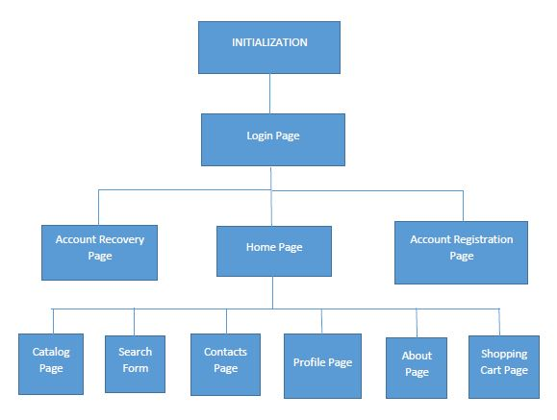
Tools used for Design and Implementation
Mwafunzi was designed using block diagrams and AFP(Algorithm-Flowchart-Pseudocode) method.
It was implemented using Flask micro-framework, HTML and CSS.
VS Code was used to input and run all code.

Slide 6
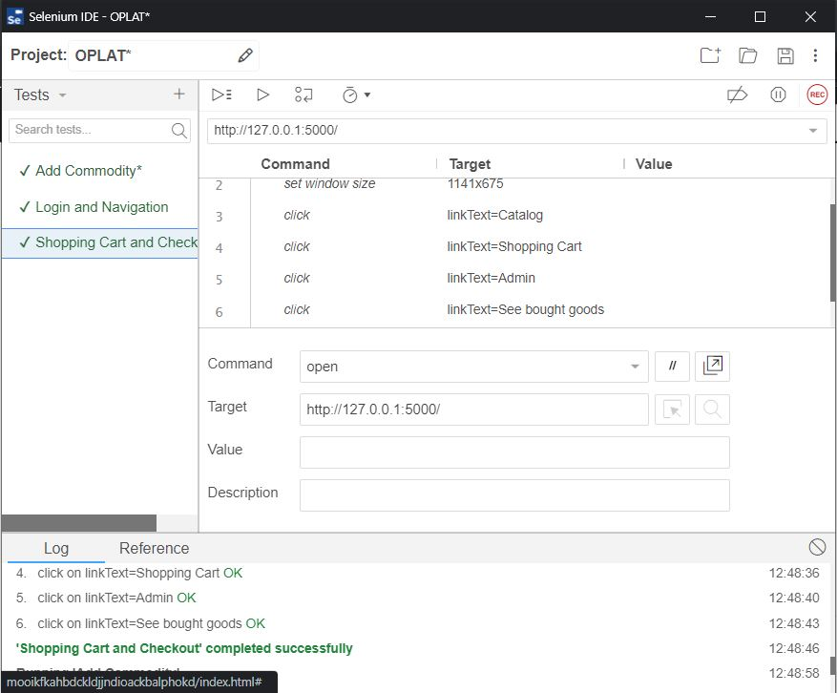
Testing
Selenium IDE was used to check the platform for broken links and pages that did not work as expected.
The application was also tested manually to check if only admins could access certain pages.

Slide 7
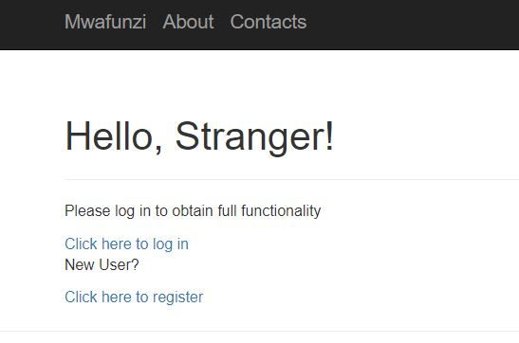
Login and Registration
When a user accesses the app for the first time, the application welcomes the user as a stranger and displays two options: The user can either log in using his/her credentials or register as a new user.
When logging in, the credentials required are the user’s email address and password. The platform flashes a warning if incorrect credentials are used.

Slide 8
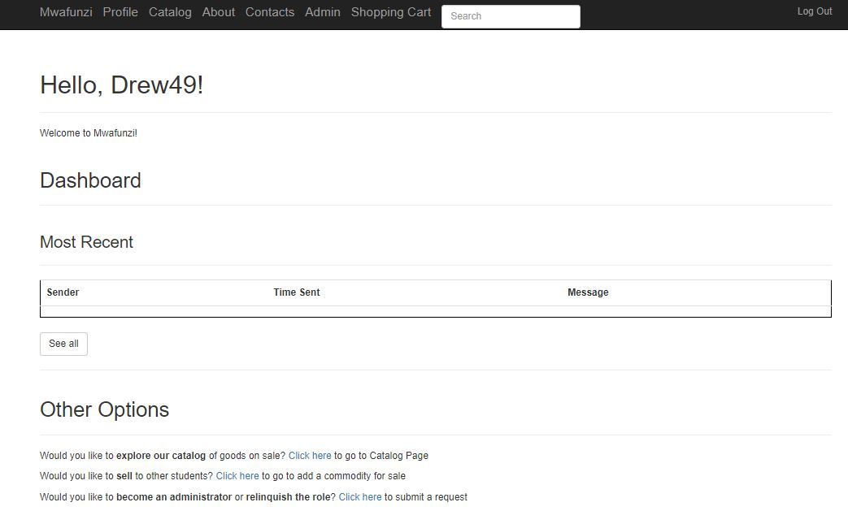
Home Page and Navigation Bar
The home page has three sections:
1. The greeting section, with the user’s username
2. The dashboard section
3. The Other Options Section
The navigation bar has tabs that redirect the user to other important pages of the platform, for example, the profile page, catalog page and shopping cart page.

Slide 9
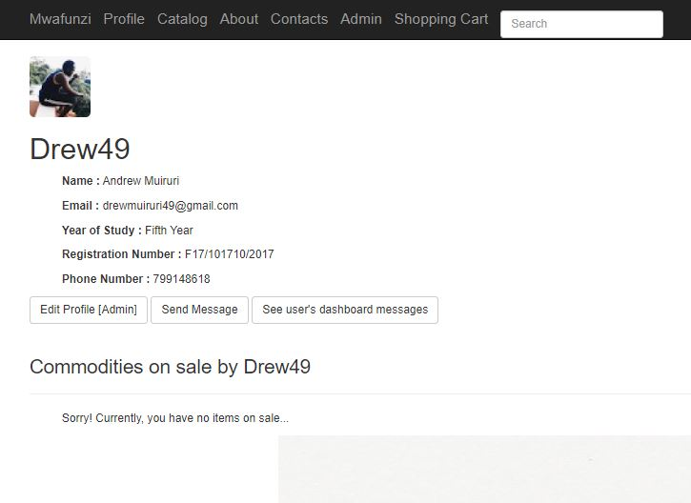
Profile Page
This page has two sections:
1. The user information section
2. The user commodity section
The user information section contains the public details of the user, while the user commodity section contains information about the goods on sale by the user.

Slide 10
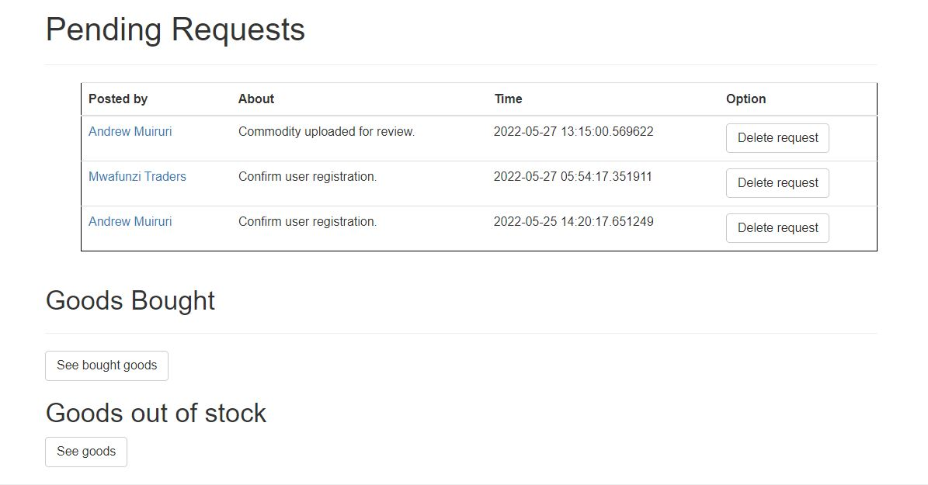
Admin Page
Only users who are admins can access this page. This page has three sections:
1. Pending Requests section
2. Goods Sold section
3. Goods Out of Stock section
In the Pending Requests section, admins can follow up on requests by going into the user’s profile page to either edit the user’s role or inspect the user’s commodity post.

Slide 11
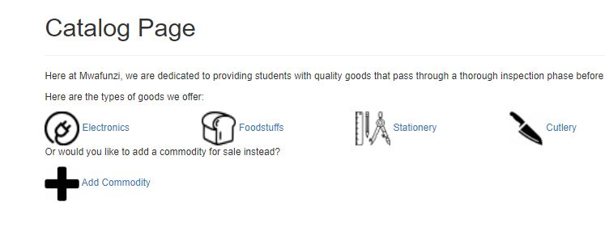
Catalog Page
The catalog page is the page that contains the categories of goods on sale by the users. These four categories of commodities are:
1. Electronics
2. Stationery
3. Cutlery
4. Foodstuffs
There is also a “Add commodity” link for users who would like to add goods for sale

Slide 12
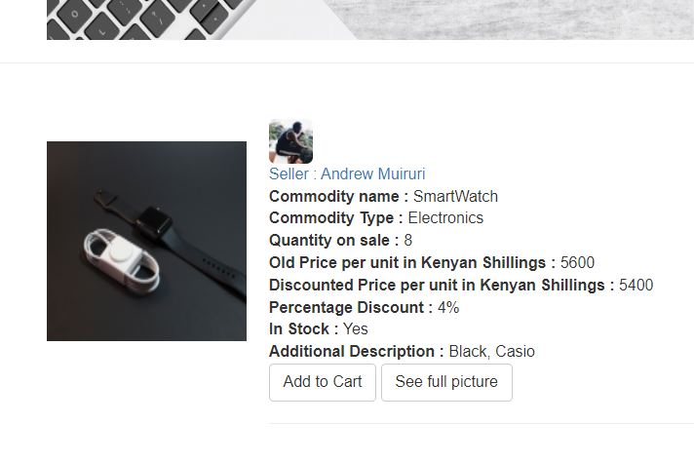
Category pages
Upon clicking on any category of goods in the Catalog page, the user is presented with a list of commodities on sale, if any. Otherwise, a message is displayed that tells the user that no such category of commodity is on sale.
Each commodity is displayed as a post with its picture and other crucial details that help a buyer to make decisions. These details include the commodity’s name, discounted price, percentage discount and expiry date.

Slide 13
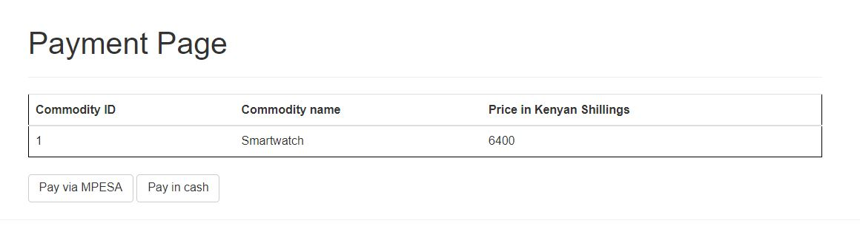
Shopping Cart and Checkout
Upon adding a commodity to the shopping cart, the commodity’s name, price and quantity are displayed to the user in this page in a table.
Two options for payment are available:
1. Pay with cash
2. Pay via MPESA
Once a cash payment method is selected and the order confirmed, the user is asked to come and collect the goods from the main office.

Slide 14
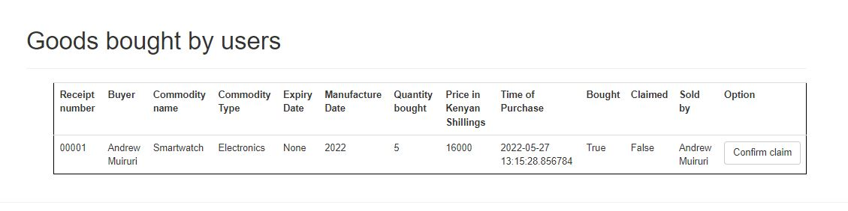
Claim of goods and user details confirmation
Once the user comes to collect goods from the main office in Mahatma Gandhi Wing, the user will be required to present his/her school ID so that an admin can confirm the user’s details were registered correctly on the platform.
If the user’s details are correct, the user is asked for the receipt number of the transaction so as to claim the bought goods.
The admin then confirms the claim of goods on the platform.

Slide 15
Analysis and Conclusion
Mwafunzi, the one-stop online discount platform, was implemented using Python, Flask, CSS and HTML. This is a platform that enables students to buy and sell new and used commodities to and from each other to minimize wastage and encourage reusability
To buy a commodity, the user needs to add the commodity to the shopping cart and choose a preferred method of payment: either via MPESA or cash. Once the purchase is confirmed, the user needs to claim his/her goods from the main office, where an administrator will confirm the details of the user in the platform and the dispatch of goods.

Slide 16

The End

