Slide 1
Final Exam Scheduler
4005-735-01 Parallel Computing I
G2. Team Kyz
Kevin Cheek, Yandong Wang, Ziyan Zhou
http://tinyurl.com/ritkyz
Notes:
Kevin: Introduce team members

Slide 2
Agenda
Problem Description
Solutions
Approaches
Brute-Force
Sequential/Parallel Design, Performance Metrics, Investigation
Simulated Annealing (SA)
Paper Summary, Sequential/Parallel Design, Performance Metrics
Genetic Algorithm (GA)
Paper Summary, Sequential/Parallel Design, Performance Metrics
Future Work
Q&A

Slide 3
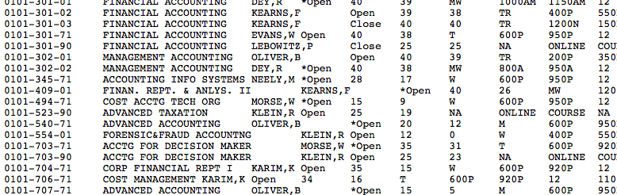
Final Exam Scheduling Problem
Sections
Slots
MTWRF 8:00-10:00 10:15-12:15p 12:30p-14:30p 14:45p-16:45p
Students
Notes:
Kevin
Describe data structure and assumptions
Slots do not include room numbers
Mention that its an NP problem

Slide 4
Solutions
Three different experimental approaches
Brute-force
Simulated Annealing (SA)
Genetic Algorithm (GA)

Slide 5
Ranking Criteria
Variant of Exams distributed across exam slots
Each student has a vote:
Exam Conflict: POSITIVE_INFINITY
Three or more exam per day: 5.0
Consecutive Exams: 2.0
Friday Exams: 0.5

Slide 6
Examples
Schedule for Student 68997-3266 John Doe 1
 | MON | TUE | WED | THU | FRI
8:00am | N/A | N/A | N/A | 4003-233-70 | 4003-233-45
10:15am | N/A | N/A | N/A | 4003-420-02 | N/A
12:30pm | N/A | N/A | 4003-232-01 | N/A | 4003-713-70
2:45pm | N/A | N/A | 4003-334-40 | N/A | N/A
Schedule for Student 54331-5905 John Doe 2
 | MON | TUE | WED | THU | FRI
8:00am | 4003-231-01 | N/A | N/A | 4003-334-02 | N/A
10:15am | N/A | 4003-232-55 | N/A | N/A | N/A
12:30pm | N/A | N/A | 4003-233-03 | N/A | N/A
2:45pm | N/A | N/A | N/A | 4003-410-01 | N/A

Slide 7
Package common
Objects
Section
Student
Schedule
Utilities
Resources
Provide data loading, global access to resources
Random.generateSchedule()
Randomly generate a schedule
Ranker.rank(Schedule)
Rank the given schedule
GenerateData Program

Slide 8
Test Data
N | Courses | Students | Student Load
5 | 5 | 2,00 | 4
10 | 10 | 4,00 | 4
20 | 20 | 8,00 | 4
50 | 50 | 2,000 | 4
100 | 100 | 4,000 | 4
200 | 200 | 8,000 | 4

Slide 9
Brute-Force Approach

Slide 10
Brute-Force: Sequential
Give out one schedule
Students vote this schedule
Compare to current optimal schedule
Notes:
In this program, I tried to use brutal force to find the optimal schedule for final exam, which is the most popular one among the students. So, the most straightforward way is to give out all the potential schedules, and then let students to vote, which has the best rank. Now, this is the flow chart of sequential program, which is very easy, giving out one schedule, and let all students vote, and compare to the current optimal schedule, if it has a lower rank, then swap the optimal schedule and current schedule. While, the speed of this problem is incredible slow, because of the 20 to n probable schedules, which n is the number of courses, this is huge exponential problem, if I want to iterate all the schedules, it will cost several years. So I hope to iterate as much as schedules in an assigned time to find an optimal one. And in this sequential program, I can iterate about 7000 schedules in 10 seconds. And get a best rank about 400.

Slide 11
Brute-Force: First Cluster Parallel Design
Master:
Schedule []
Schedule Generator
All the information of courses
ObjectBuf< Schedule > buf = ObjectBuf.sliceBuffer(Schedule[], Range);
vote
Processor.1
Processor.0
Master
vote
Worker:
Schedule[]
Optimal Schedule
All the information of students
Processor.2
Worker
vote
Processor.3
Communication Method:
world.receive(pro, buf);
world.send(pro,tag, buf);
- CommRequest request;
world.receive(0, tag, buf, request);
vote
Processor.3
Notes:
Now I want to iterate more schedules in 10 seconds, and then, I begin to design the first cluster parallel program based on this sequential program. In my first design, I hope I can have a schedule factory, and then no other processors need to know how to create schedules, and don’t need to save the courses information. and the only thing they need to do is just let students to vote. And then with the increase of processors, there have more schedule be created and get a size up. So in the processor 0, I have two threads, one is master thread, which save all the schedules it created, and doing the job of distributing schedules to other processors. In master, I use one schedule array to save created schedules, the size of the array depend on the size of communicator. And there has generator of schedules, and only in the processor 0, there has the information of courses. I use ObjectBuf.sliceBuffer to slice the array into several pieces, then distribute each pieces to other processors.
In the workers side, there also has a schedule array, which is used to save all the schedules sent from master. There also has a schedule object to save the optimal schedule, all workers know all the students’ information.
At the beginning, every worker has no schedule to vote, then master create an array of schedule and slice them into pieces and distribute these pieces to each worker, and then master refill the schedule array, meanwhile, every worker begin to vote the schedules, and find the temporary optimal schedule, once worker finish its own schedule piece, it send message to master to require more schedules. And the same time, in every worker, they also detect the end message send from master. Once processor 0 get a schedule requirement from the worker, the master thread will be invoked, and give a pieces of array to the worker, and refill the schedule array. If there is no more schedules to create or the running time has beyond the time limit, the master will inform all worker to end their processes.
And in the program, I use block send and block receive method to conduct the communication. And use unblock receive to detect the end message.

Slide 12
Brute-Force: First Design Expected Sizeup
0
1
2
3
4
5
Notes:
So, this model sounds good or at least reasonable, and I hope this design can achieve an nice size up. So this is my expected size up. With the increase of processors, more schedule pieces would be created in master, and can be voted in workers.

Slide 13
Brute-Force: Relentless Reality
(1): 10000 msc,
pieces size 50
(2): 10000 msc,
Pieces size 150
(3): 10000 msc
Pieces size 1000
Notes:
But, relentless reality crushes my model. After testing it, you can see, there is almost no size up, and on the contrary, there even has some kind of size down.
I tried to increase the piece size to reduce the frequency to send the data. But you can see, the situation is still very bad.
And then I think why the situation can be so bad. The reason is that the schedule is a big data structure, transporting it among the communicator will cost horrible time, and if do that , master and every worker have to put more time on the send and receiving data, then there would be only a little portion of time used on the vote and calculate schedules. There is no doubt this model has to been redesigned.

Slide 14
Brute-Force: Redesign
PP
PP
PP
Processor.1
Processor.2
Processor.3
Give out one schedule
Give out one schedule
Give out one schedule
Students vote this schedule
Students vote this schedule
Students vote this schedule
Compare to current optimal schedule
Compare to current optimal schedule
Compare to current optimal schedule
Master
Notes:
Now I begin to redesign, I know that transporting schedules array in the cluster will cost too much time, I have to delete this phase and make sure there is schedule transporting between the communicator. So, I tried to make every worker in cluster to calculate their own schedules. Then the job of master is just to tell every worker which range piece of schedule every worker should create. And in this design, the processor 0 still has two threads, one of which is master and the other one is worker. In master thread, it knows the lower bound and upper bound of schedules that can be created, at first, there is no range to calculate in worker side, then the master distribute some range object to worker to make them know which piece they can create, and then master begin to block waiting for the finish message from the worker, once master get the message from the worker that it has finish its piece, the master will give a new range to the worker, if there is no more range can be calculated by worker, the master will inform the worker to end the process. In workers side, they use unblock receive to detect the end message, and use block receive to get the range object. Meanwhile if the running time beyond the time limit, it will inform the master and over the program, then master record how many workers has beyond the time limit, If the number of workers whose running time is beyond the time limit is equal to the size of communicator size. The master process will be over.

Slide 15
Brute-Force: Second Design Result
(1): 10000 msc
(2): 20000 msc
(3): 30000 msc
Notes:
Now, what about this design, I hope it would not be so bad, these are the charts of size up and efficiency of the redesign. This time, we can see, size up and efficiency has been much better. Analyze the success of this design. There is no much communication between master and worker, the only thing that need to balance the load is just to send a range to the worker.

Slide 16
Simulated Annealing (SA)

Slide 17
Paper #1: Stochastic Search Algorithms for Exam Scheduling
By Mansour and Timany, published in International Journal of Computational Intelligence Research in 2007
Exam scheduling as a modified weighted graph coloring problem
Objective Functions
Simulated Annealing Algorithm (SA)
Results Reference

Slide 18
SA: Sequential
Initial configuration = random;
Initial temperature T(0) = 0.93; //high initial acceptance
Freezing temperature Tf = 2^-30; //uphill moves impossible
while(T(i) > Tf and not converged) {
repeat (# of slots) * (# of exams) times
generate_function();
save_best_so_far(); //smallest OF1
T(i) = phi * T(i); //phi = 0.95
}
function generate_function() {
perturb(); //randomly change one exam's slot to another slot
if (ΔOF1 <= 0)
accept();
else if (ramdon() < e^(-ΔOF1/T(i)))
accept(); //accept with a probability
}

Slide 19
SA: Result Comparison
Problem Size:
Exams: 336
Students 2456
Enrolments: 9550
Slots: 20
Notations:
SE: Simultaneous Exam (conflict)
CE: Consecutive Exams
ME: Multiple Exam (3 or more on the same day)
 | SE | CE | ME | Rank
Our | 0 | 24 | 351 | 2594.66
Their | 3 | 336 | 572 | N/A

Slide 20
SA: Parallel

Slide 21
SA: Reduction
final ObjectItemBuf<Schedule> buf = ObjectItemBuf.buffer(sa.getBest());
Comm.world().allReduce(0, buf, new ObjectOp<Schedule>() {
@Override
public Schedule op(final Schedule x, final Schedule y) {
if(x.getRank() < y.getRank())
return x;
return y;
}
});
sa.setBest(buf.item);

Slide 22
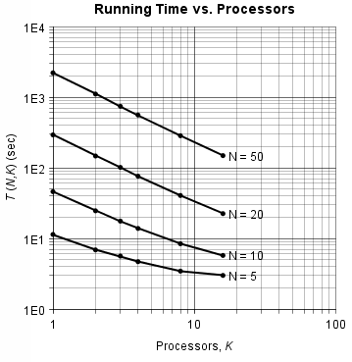
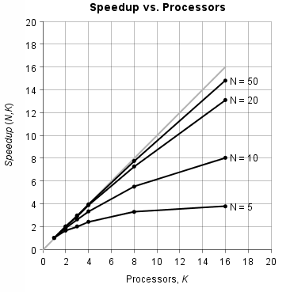
SA: Performance Metrics

Slide 23
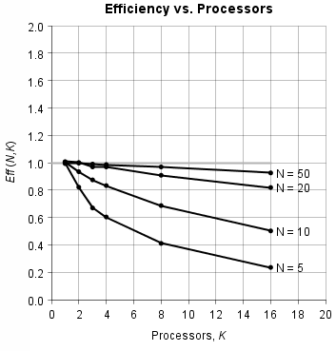
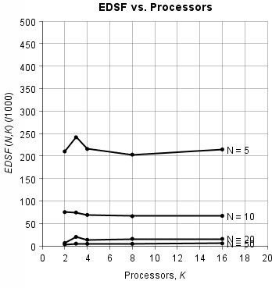
SA: Performance Metrics

Slide 24
SA: Investigation
Bottlenecks
Barrier makes it hard to load balance
Communication overhead
Better efficiency as N becomes larger
# of temperature fixed
Amount of communication fixed
Perturb and ranking takes significantly longer, O(N²)
Limitation
When N=100, sequential program takes more than an hour to run on a cluster node, K=16 takes 613,783 ms
When N=200, K=16, it takes 2530,561 ms to finish

Slide 25
Genetic Algorithm

Slide 26
GA: Genetic Algorithm
Randomly generate initial population size POP;
Evaluate fitness of individuals;
repeat {
rank individuals and allocate reproduction trials;
for i=1 to POP step 2 {
randomly select two parents from list;
apply crossover and mutation;
}
apply hill-climbing to offspring //hybridization
evaluate fitness of offspring;
save_best_so_far();
} until converge
Notes:
based on the idea of natural revolution DNA: individuals are encoded as A-element array of records that corresponds to a candidate exam schedule.
Fitness function: 1/OF1
Crossover (0.75): randomly choose two parents, randomly choose k and l, swap k to l create two children
Mutation (0.01): randomly selected genes: change exam slot Hybridization: select every gene and randomly reassign, accept better OF1
Elitism: replace the least-fit individual with the best-so-far individual if the latter is better than the current-fittest
Convergence: best-so-far candidate solution does not change its OF1 value for 20 generations
Now, let me hand over to Kevin, who will be talking about the second paper we analyzed.

Slide 27
GA: Papers
Used 3 Papers:
Genetic Algorithm Taxonomy by Mariusz Nowostawski and Riccardo Poli
Stochastic Search Algorithms for Exam Scheduling by Nashat Massour and Mazen Timany
Parallel Genetic Algorithms for the Hybrid Flow shop Scheduling Problem by K. Belkadi, M. Gourgand, and M. Benyettou
Notes:
Genetic Algorithm (10 Min)
a. Paper finding
- Paper Covered different types of algorithsm
- Helped for choosing type of algorithm to implement

Slide 28
GA: Paper Findings
Findings
Cross-over rate
Mutation rate
Number of mutations
Selection of individuals for reproduction
Replacement strategies
Convergence Detection
Population size
Migration Topologies
Notes:
- Helped for choosing parameters
- Cross-over Rate
-How many individuals will go into pool of mating inviduals
-Mutation rate
-How many of the offspring will mutate
-Number of mutations
-Replacement strategies
-Fixed population size
-Replace individuals
-Convergence detection
-Initial population size
-Migration topologies
-Grid (pass to all neighbors)
- Pass to the side

Slide 29
GA: Sequential and Parallel Design
Report

Slide 30
GA: Result Comparison
Problem Size:
Exams: 336
Students 2456
Enrolments: 9550
Slots: 20
Notations:
SE: Simultaneous Exam (conflict)
CE: Consecutive Exams
ME: Multiple Exam (3 or more on the same day)
 | SE | CE | ME | Rank
Our GA | 0 | 19 | 275 | 2283.26
Their GA | 4 | 308 | 537 | N/A
Our SA | 0 | 24 | 351 | 2594.66
Their SA | 3 | 336 | 572 | N/A

Slide 31
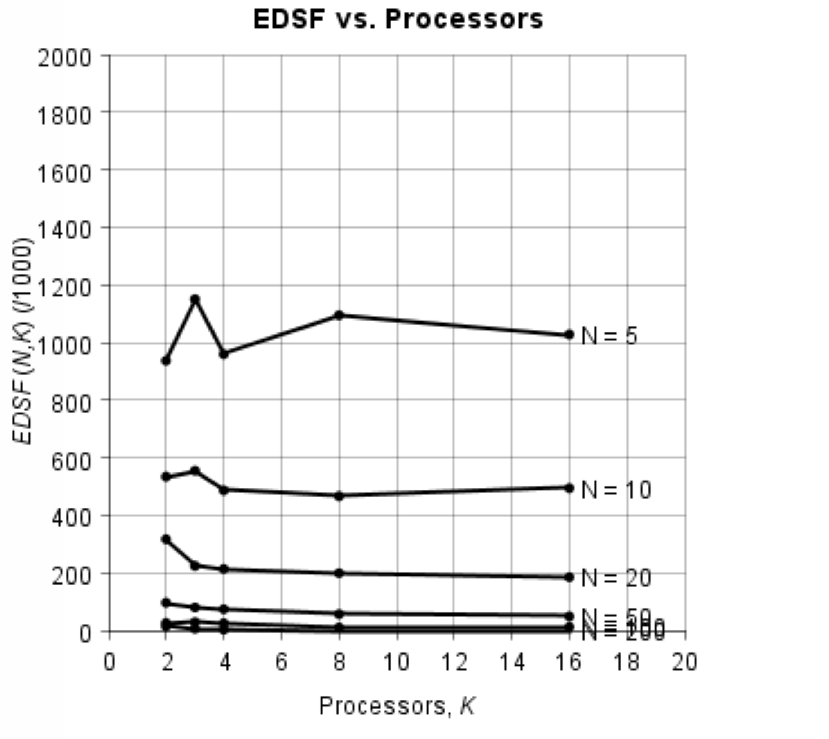
GA: Performance
Notes:
Migration issues
- Can't perform real benchmarks

Slide 32
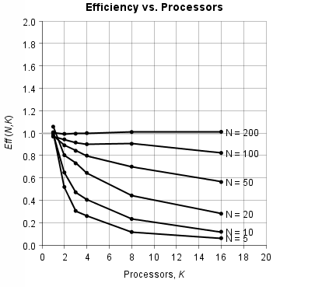
GA: Performance
Notes:
Migration issues
- Can't perform real benchmarks

Slide 33
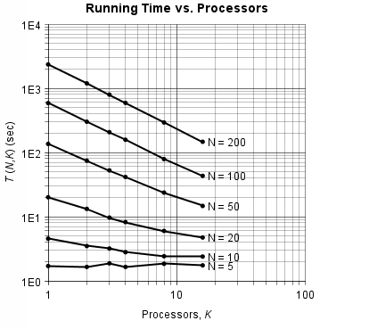
GA: Performance

Slide 34
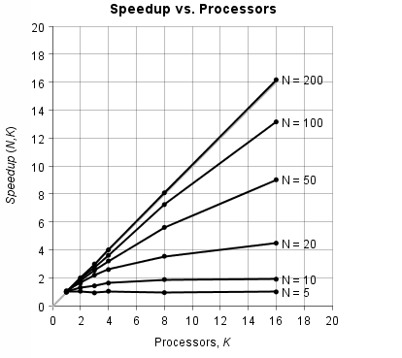
GA: Performance

Slide 35
GA: Investigation
Investigation Results and Problems:
It works!
Convergence Problems
Parameter Issues
Notes:
d. Investigation
- Ton of problems with premature convergence
- Parameters have a huge effect

Slide 36
Future Work
Increased Problem Complexity
RIT: 2500 courses, 16,000 students
More parameter for Ranker
Minimize the schedule structure
Use only 32-bit integers instead of Section ID String
Focus on Genetic Algorithm (GA)
True Migration
Better Convergence Detection
Solution Detection
Load Balancing with Convergence

Slide 37
Thank You for Listening
G2. Team Kyz
Kevin Cheek
Yandong Wang
Ziyan Zhou
Visit us at: http://tinyurl.com/ritkyz

