Slide 1
OPEN HASHING
Andrew Magdy ID:224929

Slide 2
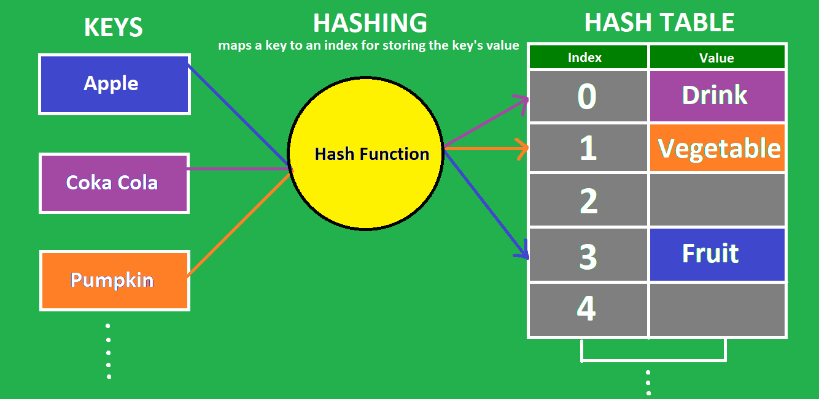
What is Hashing ?

Slide 3
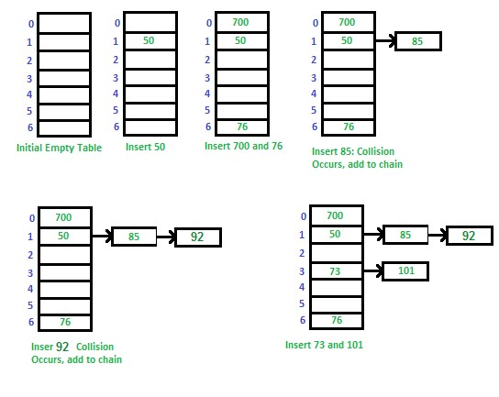
Dealing with collisions

Slide 4
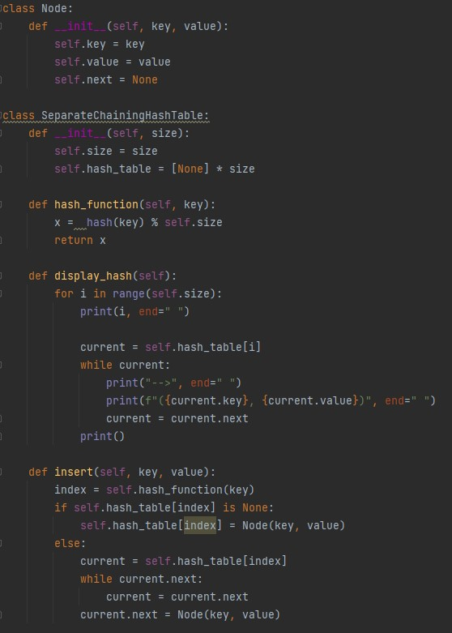
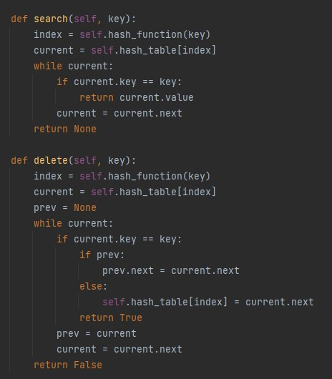

Slide 5
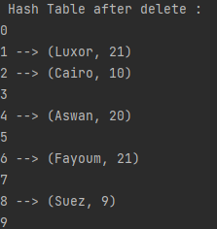
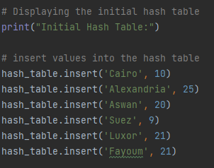
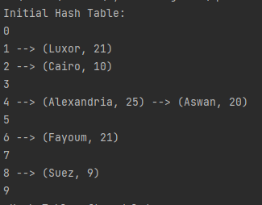



Example output:
Delete
Insert
Search

Slide 6
Space and times Trade offs

Slide 7
Analysis:
Best case
Average case
0(1 + a)
0(1 + a)
Worst case
0(n)

Slide 8
Thank You For Listening

