Slide 1
UAV landing gear assistance
Simulation proof of concept and Arduino bench prototype
UAV01 · Sensor Systems for UAVs
Aristotle University of Thessaloniki
Andreas Manitsas · Maria Vrana
Notes:
Present two separate implementations of the same course idea. The simulation explores the broader concept. The Arduino implementation tests a smaller subset with physical sensors and virtual commands. Sources: LandingGearSystem/README.md; firmware/LandingGearController/LandingGearController.ino; tools/IMU.py. Hardware checks reflect the demonstrated bench setup, not aircraft validation. Sources: https://github.com/AndrewManitsas/LandingGearController; src/sensing_domain/src/sensor_processor.cpp; src/intelligence_domain/include/intelligence_domain/model_rules.hpp; src/control_domain/src/flight_supervisor.cpp; src/control_domain/src/landing_gear_controller.cpp.

Slide 2
Project goal and implemented scope
Assess landing conditions before accepting a deployment request.
Simulation explores terrain classification and flight behaviour.
The Uno demo exercises real sensing and a manual landing sequence.
2
separate prototypes
1
Uno with IMU and one ToF
0
powered servos in the bench demo
Notes:
Explain that READY means the configured bench conditions passed. It is not a general terrain-safety classification. No physical actuator output is enabled. Sources: LandingGearSystem/README.md; firmware/LandingGearController/LandingGearController.ino; tools/IMU.py. Hardware checks reflect the demonstrated bench setup, not aircraft validation.

Slide 3
Simulation architecture
1
SENSING
2
INTELLIGENCE
3
CONTROL
Sensing node
Classifier node
Control nodes
3× ToF, sonar, IMU
Filtering and features
Decision tree in C++
Verdict + abort flag
Pitch PID and gear
Flight supervisor
ROS 2 Jazzy and Gazebo Harmonic on a PC. Pico / Pi / Uno describe the original board plan.
Notes:
The ROS nodes run on the simulation host. The original physical targets were Pico 2 W for sensing, Pi Zero W for intelligence and Uno for control. The current hardware repo puts acquisition and rule-based decisions on the Uno. Simulation sensing extracts seven features: mean ToF, spatial variance, acoustic-optical difference and its variance, slope, gyro norm and tilt error. sensor_processor.cpp computes delta_d as sonar minus central optical altitude; some prose documentation uses the opposite sign. Avoid claiming that this signature has been measured on real foliage. Sources: https://github.com/AndrewManitsas/LandingGearController; src/sensing_domain/src/sensor_processor.cpp; src/intelligence_domain/include/intelligence_domain/model_rules.hpp; src/control_domain/src/flight_supervisor.cpp; src/control_domain/src/landing_gear_controller.cpp.

Slide 4
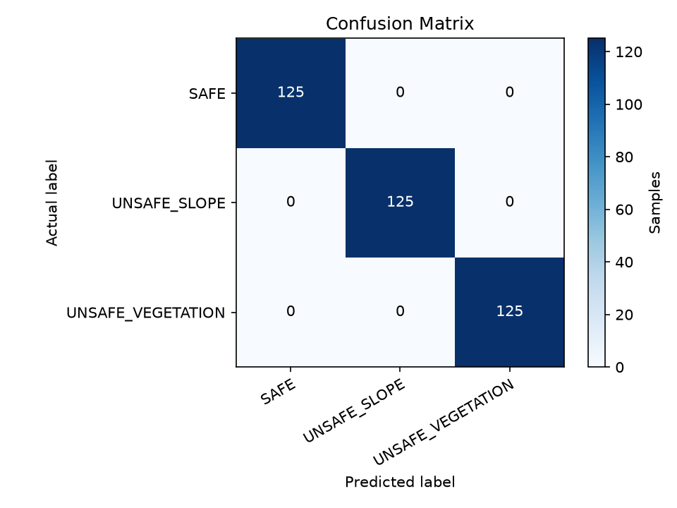
Simulation classifier and results
tilt error ≤ 0.138 rad (7.9°)?
yes
no
SAFE
spatial var ≤ 0.00078 m²?
yes
no
UNSAFE
slope
UNSAFE
vegetation
Reported test split: 375 / 375 correct
Correlated samples and testbed labels. The tree uses 2 of 7 features. Real terrain performance remains untested.
1,500 synthetic samples, CART, depth limit 4, 75/25 split
Notes:
The supplied confusion matrix reports 125 correct samples in each class, 375 total. This is an existing simulation result, not a new evaluation in this presentation update. Dataset contains 1,500 rows; training uses random_state 42, a stratified 75/25 split and max_depth 4. The generated tree tests tilt error and spatial variance only. Correlated samples and labels assigned by world make this score optimistic. Host inference timing does not measure a microcontroller. Sources: https://github.com/AndrewManitsas/LandingGearController; src/sensing_domain/src/sensor_processor.cpp; src/intelligence_domain/include/intelligence_domain/model_rules.hpp; src/control_domain/src/flight_supervisor.cpp; src/control_domain/src/landing_gear_controller.cpp. Additional sources: scripts/train_classifier.py; data/dataset.csv; docs/testing_and_validation.md; supplied slide graphic.

Slide 5
Connected hardware prototype
1
Arduino Uno
Simulation sensor geometry
Sensing and control on one board
2
MPU6500 IMU
Acceleration and gyro, pitch and roll
3
One VL53L0X
Target range, validity and freshness
4
Virtual stabilizer
Pitch response, 65 to 115 degrees
5
Virtual landing gear
The bench demo uses one ToF
0 / 90 degrees, both SG90s disconnected
Notes:
Left: retain the supplied diagram as simulation geometry, three sensors at radius 0.06 m. Right: actual connected hardware is Uno plus MPU6500 plus one VL53L0X. Both sensor modules use the existing 3.3 V wiring. Both SG90s remain disconnected because suitable actuator power is unavailable. ESP32, sonar and magnetometer are unused. Sources: LandingGearSystem/README.md; firmware/LandingGearController/LandingGearController.ino; tools/IMU.py. Hardware checks reflect the demonstrated bench setup, not aircraft validation.

Slide 6
Attitude estimation on the Uno
Complementary filter
Virtual pitch correction
θ = α(θ + ω·Δt) + (1 − α)·θ_acc
command = 90° − pitch
100 Hz with measured elapsed time
Time constant 0.50 s, α = τ / (τ + Δt)
Acceleration in g, gyro in deg/s
Deadband: ±1 degree
Command limits: 65 to 115 degrees
Demonstrates response to hand tilt
IMU
Filter
Correction
Virtual angle
Notes:
The hardware filter uses time constant 0.50 s and actual dt, unlike the simulation filter fixed alpha of 0.9. The Uno computes a proportional virtual angle, not the simulated PID controller. Show +10 degree pitch producing approximately 80 degrees stabilizer command. Invalid numeric IMU data neutralizes the stabilizer but retains a deployed gear command. Sources: LandingGearSystem/README.md; firmware/LandingGearController/LandingGearController.ino; tools/IMU.py. Hardware checks reflect the demonstrated bench setup, not aircraft validation.

Slide 7
One-ToF readiness rules
Valid measurements
Stability window
Qualification
Distance: 100 to 500 mm
Pitch and roll: within ±10°
Range age: at most 250 ms
10 completed ToF readings
Distance spread: at most 20 mm
Each reading within range
All checks pass for 1 second
UNKNOWN while collecting
UNSAFE when a rule fails
READY permits a manual D request. One beam does not establish terrain slope or material.
Notes:
Ten distinct ranges build the window, then all checks must hold for another second. Sensor faults or range age over 250 ms reset the window. Failed tilt/range/stability restarts qualification. UNKNOWN includes missing or invalid data and qualification; UNSAFE denotes a failed measured rule. These are provisional bench settings. Sources: LandingGearSystem/README.md; firmware/LandingGearController/LandingGearController.ino; tools/IMU.py. Hardware checks reflect the demonstrated bench setup, not aircraft validation.

Slide 8
Latched gear sequence on the Uno
STOWED
READY
DEPLOYED
D deploys while READY. Gear stays deployed after readiness loss. S or reset stows the gear.
100 Hz
2 Hz
20 Hz
Python
nominal sensor sampling
readable status reports
optional raw IMU frames
desktop reports and D / S controls
Notes:
STOWED to READY represents permission, not actuator movement. D transitions to DEPLOYED only while qualified; early D is rejected. Once deployed, readiness can be lost without retraction. S or reset stows the virtual gear. Contrast explicitly with the simulation: the supervisor requests deployment below 0.5 m when abort is clear; unsafe conditions cause go-around, and the gear controller forces stow on abort. The two policies differ intentionally and neither establishes flight safety. Sources: LandingGearSystem/README.md; firmware/LandingGearController/LandingGearController.ino; tools/IMU.py. Hardware checks reflect the demonstrated bench setup, not aircraft validation. Sources: https://github.com/AndrewManitsas/LandingGearController; src/sensing_domain/src/sensor_processor.cpp; src/intelligence_domain/include/intelligence_domain/model_rules.hpp; src/control_domain/src/flight_supervisor.cpp; src/control_domain/src/landing_gear_controller.cpp.

Slide 9
Demonstration and current limits
Current limits
Live demonstration
One ToF: range and stability only
Servo power and mechanical rig still needed
Simulation results do not validate real flight
1
Simulation: Alpha / Beta / Gamma
terrain verdict and deployment
2
Uno: level and steady target
wait for READY, send D
3
Move target or tilt the IMU
warning, gear held, S retracts
Notes:
Demo order: first show the broader Gazebo scenarios, then the real sensors. For the hardware aim at a steady card 200-300 mm away with IMU level. Wait for qualification, send D, move the target away or tilt, show warning and retained DEPLOYED, then S. Tilt separately to show virtual stabilizer response. Use Python Reports mode or Serial Monitor at 115200; only one can own the port. Keep IMU level during startup calibration. Future work needs compatible sensor power and I2C, rigid three-sensor geometry, servo power and calibrated mechanics before closed-loop hardware tests. Sources: LandingGearSystem/README.md; firmware/LandingGearController/LandingGearController.ino; tools/IMU.py. Hardware checks reflect the demonstrated bench setup, not aircraft validation. Sources: https://github.com/AndrewManitsas/LandingGearController; src/sensing_domain/src/sensor_processor.cpp; src/intelligence_domain/include/intelligence_domain/model_rules.hpp; src/control_domain/src/flight_supervisor.cpp; src/control_domain/src/landing_gear_controller.cpp.

