Slide 1
00_helloWorld

Slide 2


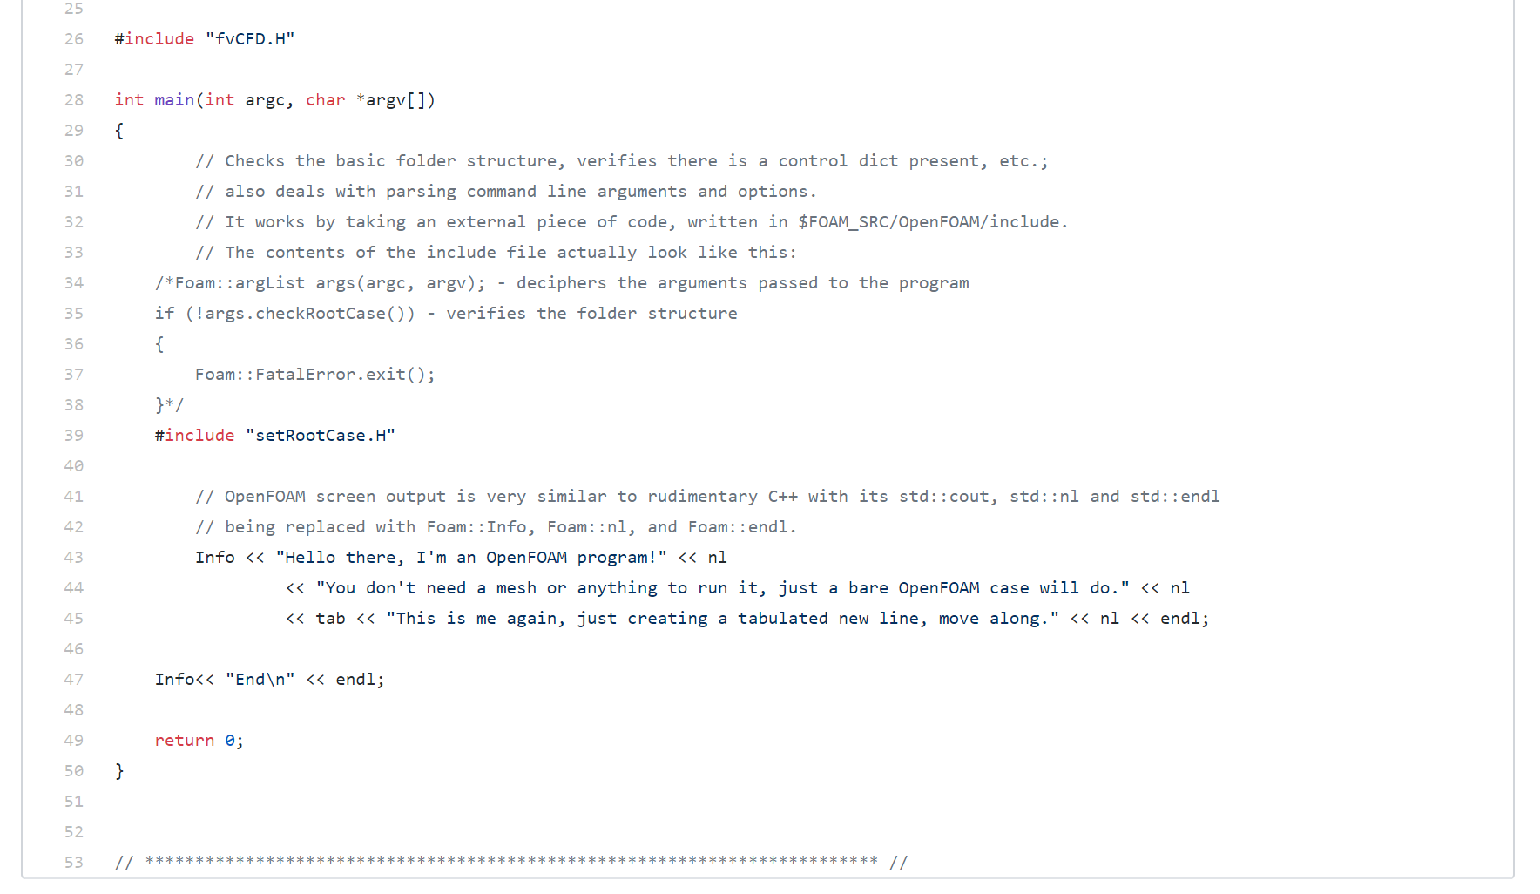

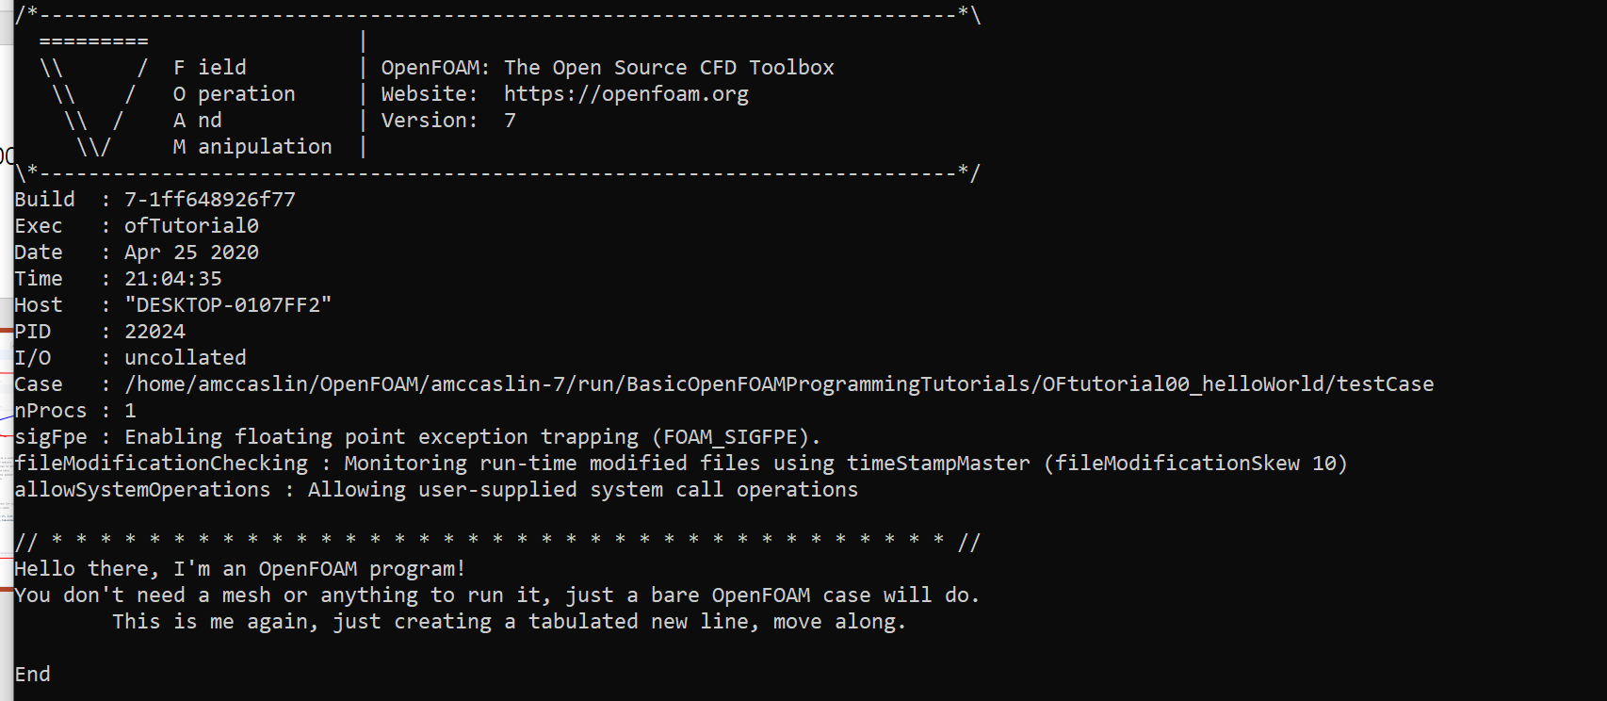
Dependent on both of these. Main is not dependent
.C File name
Calling name
Dependent

Slide 3
01_inputOutput

Slide 4

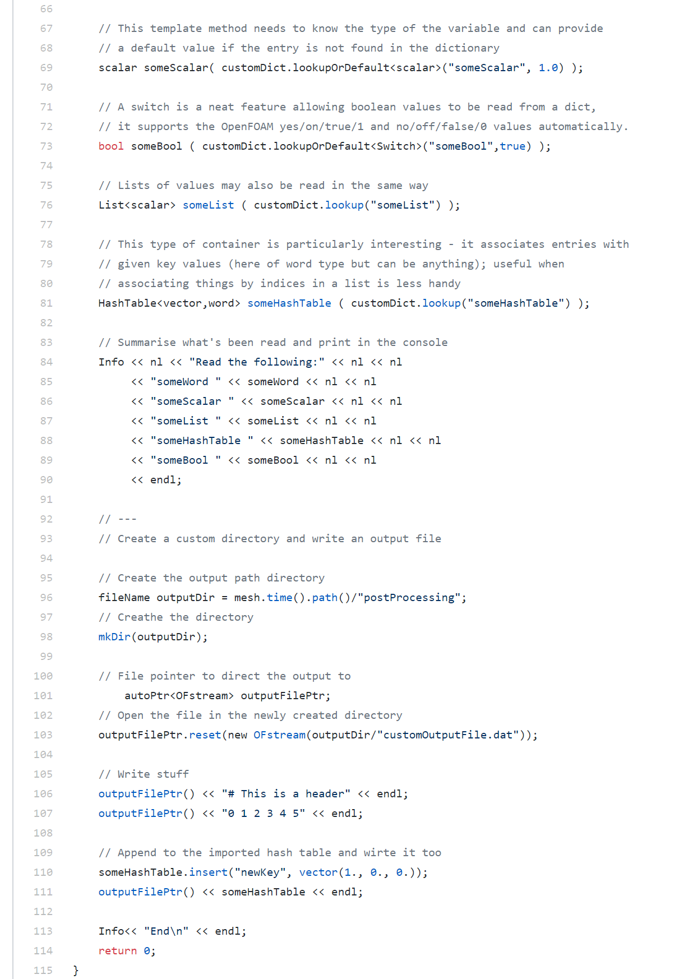
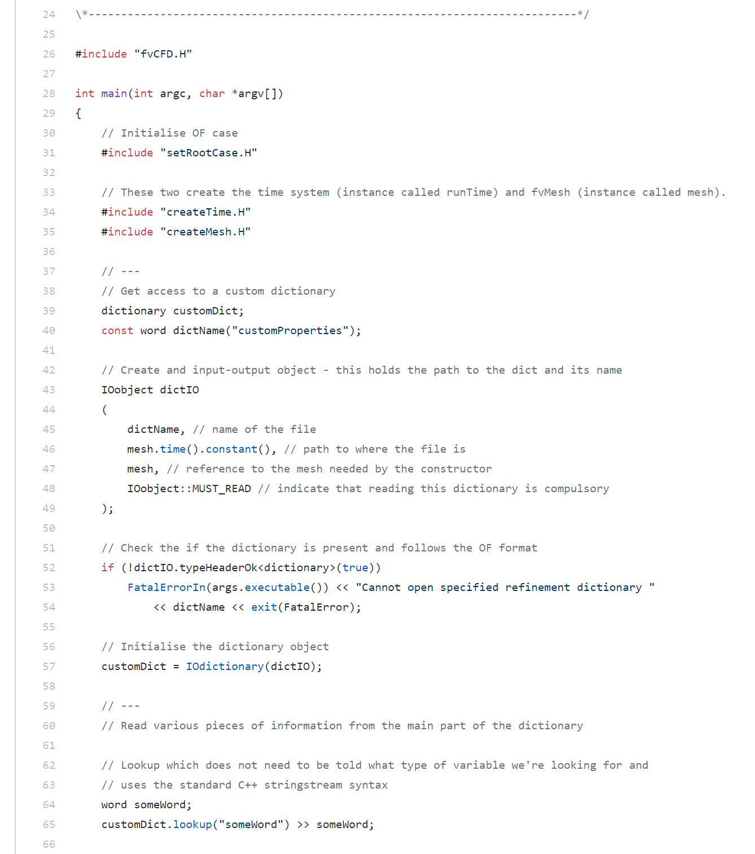
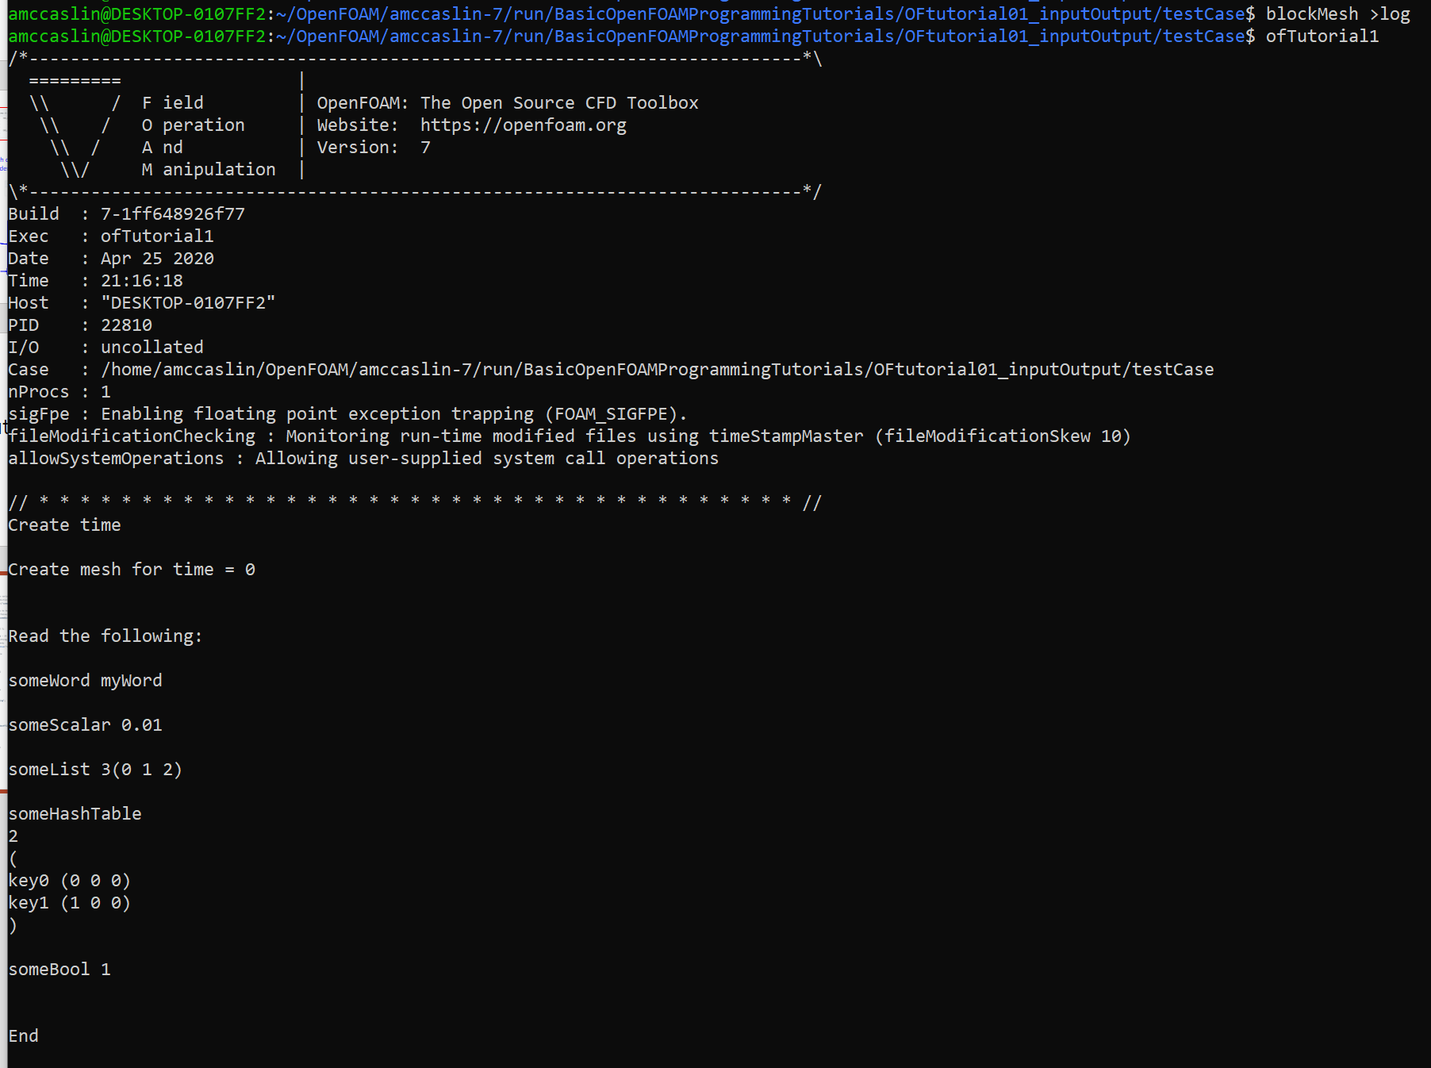
I am not sure what the point of looking up random things in customDict. I don’t even know what’s in customDict

