Slide 1
Non-Profit Foundation
Analytics of Donor Contributions 2015-19
Prepared by Andrew McNall, Ph.D.
v. 2 updated January 29, 2020
Note: Non-Profit name withheld for donor privacy

Slide 2
Analytics Context
Focus on repeatable, annual gifts
Data excluded:
    Realized estate gifts
    Disbursements from endowment at Community Foundation
    Other large disbursements not renewable as annual support
Event was not held in 2019
Reviewing comparative data by calendar year
    Smooths out dips from reversing dates of events
    Just finished calendar 2019

Slide 3
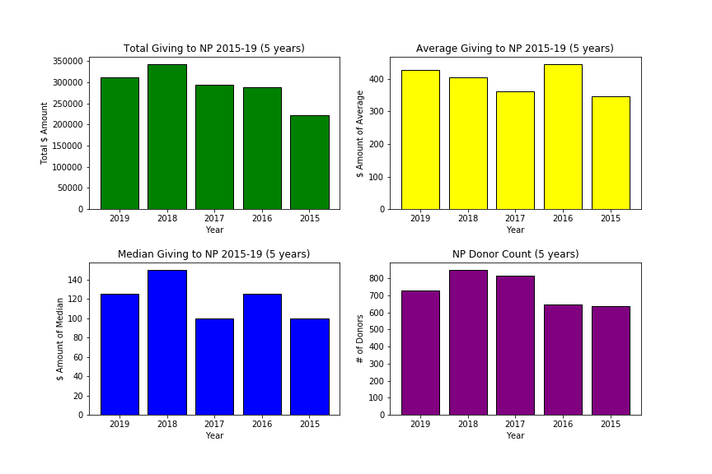
Non-Profit Total Giving Statistics 2015-19

Slide 4
Data for
Non-Profit Total Giving Statistics 2015-19
 | Total $ | Avg Gvg | Median Gvg | # of Donors
2019 | $310,848 | $427.58 | $125 | 727
2018 | $343,056 | $403.60 | $150 | 850
2017 | $293,962 | $361.58 | $100 | 813
2016 | $287,685 | $445.33 | $125 | 646
2015 | $221,579 | $346.76 | $100 | 639

Slide 5
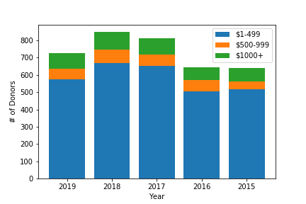
Non-Profit Donor Counts by Giving Levels 2015-19

Slide 6
Data for
NP Donor Counts by Giving Levels 2015-19
 | Giving $1-499 | Gvg $500-999 | Giving $1000+
2019 | 573 | 65 | 89
2018 | 669 | 80 | 101
2017 | 654 | 65 | 94
2016 | 505 | 64 | 77
2015 | 517 | 46 | 76

Slide 7
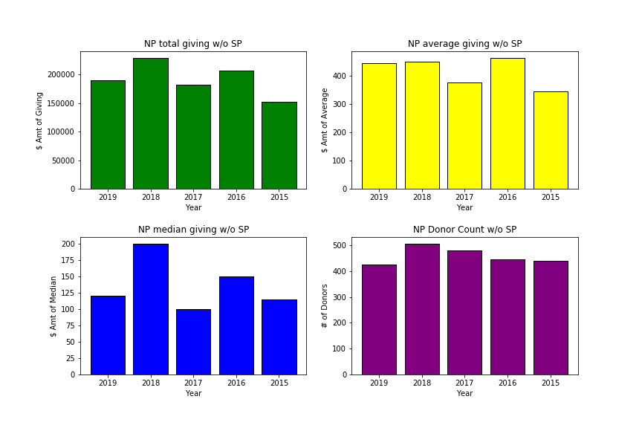
NP Giving Stats (excluding SP data) 2015-19

Slide 8
Data for NP Giving Stats
(excluding special program) 2015-19
 | Total $ | Avg Gvg | Median Gvg | # of Donors
2019 | $189,295 | $444.35 | $120 | 426
2018 | $228,604 | $450.90 | $200 | 507
2017 | $181,573 | $377.49 | $100 | 481
2016 | $206,530 | $463.07 | $150 | 446
2015 | $162,126 | $344.96 | $115 | 441

Slide 9
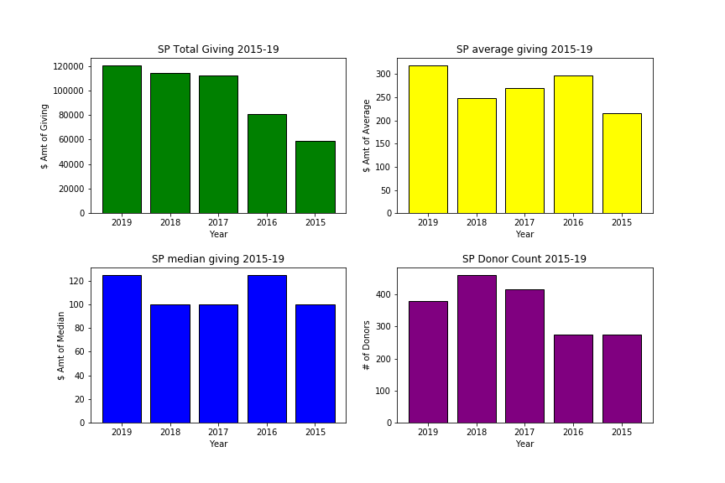
Special Program Giving Stats 2015-19

Slide 10
Data for
Special Program Giving Stats 2015-19
 | Total $ | Avg Gvg | Median Gvg | # of Donors
2019 | $120,553 | $318.92 | $125 | 378
2018 | $114,452 | $248.27 | $100 | 461
2017 | $112,389 | $270,82 | $100 | 415
2016 | $81,155 | $296.19 | $125 | 274
2015 | $58,953 | $215.16 | $100 | 274

Slide 11
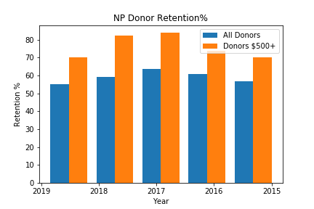
Non-Profit Donor Retention 2015-2019
 | Ret All | Ret $500+
2019 | 55.1% | 70.2%
2018 | 59.0% | 82.4%
2017 | 63.5% | 84.0%
2016 | 60.9% | 73.8%
2015 | 56.86% | 70.2%
Note: Retention for donors of $500 is for a gift of any size in the next year, the same standard for All Donors retention on the chart. Retention for Donors $500+ at the same gift level or above the next year is similar to retention for All Donors.

Slide 12
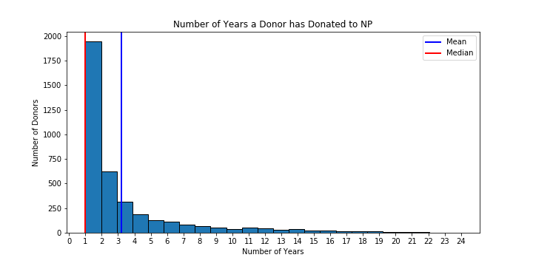
Number of Years as a Donor
(all donors of record giving in any year)

Slide 13
Data for
Number of Years as a Donor
Years | # of Donors | Years | # of Donors | Years | # of Donors
1 | 1945 | 11 | 49 | 21 | 8
2 | 624 | 12 | 42 | 22 | 6
3 | 313 | 13 | 33 | 23 | 2
4 | 190 | 14 | 35 | 24 | 1
5 | 128 | 15 | 21
6 | 113 | 16 | 23 | 3+ yrs | 1261
7 | 84 | 17 | 18 | 5+ yrs | 758
8 | 66 | 18 | 17
9 | 51 | 19 | 15
10 | 39 | 20 | 7

Slide 14
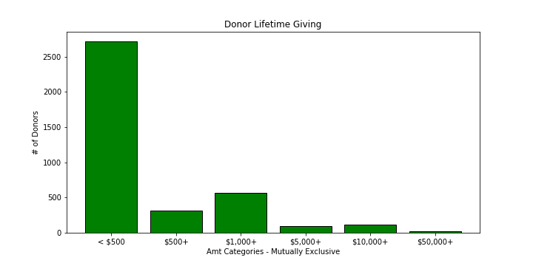
Aggregate Donations to Non-Profit - Lifetime

Slide 15
Data for
Aggregate Donations to Non-Profit - Lifetime
Amt | # of Donors
< $500 | 2717
$500+ | 313
$1,000+ | 569
$5,000+ | 93
$10,000+ | 116
$50,000+ | 24

Slide 16
Conclusions
Gift revenue is very sensitive to event performance
Total giving is trending upward
    Trend is stronger with Special Program
    2019 giving was almost the same as 2018 despite one less event
2018 & 2017 retention for $500+ was fantastic, but the low overall retention should be addressed.
There is a core group of 250 recent donors that could be explored for major gift potential.

